Slide 1

ExactSpace
Data Science Internship Assignment
By Asif Sahadh

Slide 2

DATA PREPARATION
It was evident that the missing values corresponded to machine shutdown, denoted by "I/O Timeout". For certain analyses, these values were filled using forward filling. For other analyses that involve looking into these shutdown points itself, they were set to 0.
Further, outliers were handled by capping the extremes to Q1 and Q3.
TASK ONE : MACHINE DATA ANALYSIS (TIMESERIES)

Slide 3
ANALYSIS STRATEGY
For machine state clustering, K-Means clustering was used, where K was set to 3. These eventually corresponded to 3 machine states: inactive, moderately active / transition period and active.
For anomaly detection, Isolation Forest was used and for forecasting, ARIMA and using the Persistence Baseline was used. The model gave a pretty low RMSE & MAE values of 8.25 and 6.57 respectively for ARIMA while using Persistence Baseline, this was higher with RMSE 14.16 & MAE 11.58.
This can suggest that simply using persistence baseline, even for short forecasts may not be reliable.
TASK ONE : MACHINE DATA ANALYSIS (TIMESERIES)

Slide 4
INSIGHTS
Normal operations are dominated by Cluster 0 (active machine state) with stable high temperatures, while Clusters 1 (inactive state) and 2 (transition state) capture volatile or transitional states that correlate with shutdowns. Short shutdowns often occur during these unstable periods, and longer ones usually follow high variability in Cluster 2.
Forecast residuals, particularly in Cyclone Inlet Gas Temp, consistently precede shutdowns, making them a strong early warning indicator.
TASK ONE : MACHINE DATA ANALYSIS (TIMESERIES)

Slide 5
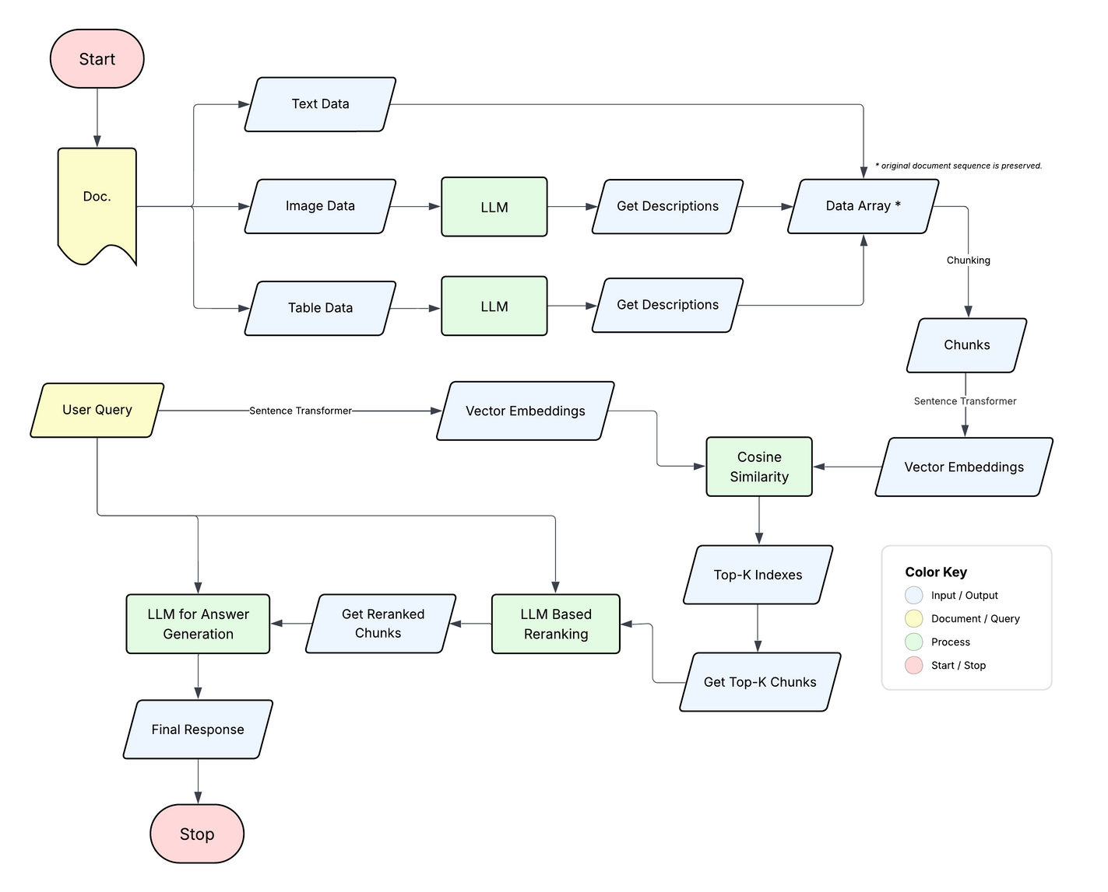
SYSTEM ARCHITECTURE
TASK TWO : RAG + LLM SYSTEM DESIGN

Slide 6
EXPLANATION
First, from the input document, three modalities are extracted: text, image & table data. For the image and table data, an LLM is used to analyze and generate descriptions of what each image shows and what each table contains. This way, visual and structured information is converted to text. All of these descriptions, along with the original text data, are then gathered into a data array, where the original order of information from the document is intact. Next, this data array is broken down into chunks using overlap strategy. These chunks are converted to vector embeddings using a Sentence Transformer model all-mpnet-base-v2 and stored in FAISS.
The user query is also transformed into the same vector space for cosine similarity matching with the chunk embeddings to get the most relevant document chunk IDs. These top-K indexes of the most similar chunks are used to retrieve the corresponding top-K chunks. Further, these chunks undergo an LLM based reranking to prioritize the most important information. Finally, an LLM for answer generation takes these relevant and re-ranked chunks and generated a comprehensive and accurate final response to the original user query.
TASK TWO : RAG + LLM SYSTEM DESIGN

Slide 7
RAG CHALLENGES & GUARDRAILS
The retrieval strategy works by converting chunks into vector embeddings using a sentence transformer, which captures contextual relationships rather than just relying on keywords. The user query is also embedded using the same model, and cosine similarity is used to pull out the top-k relevant chunks. These chunks are then reranked before being passed into the final LLM for answer generation.
To keep the system grounded, guardrails are built in. The prompts explicitly mention that the LLM must not make up answers or hallucinate. If it does not know the answer, it should simply say so. For the final response, the LLM is also instructed to provide the page number reference, which is included in the metadata during the pipeline, ensuring that every answer can be traced back to the original document.
TASK TWO : RAG + LLM SYSTEM DESIGN

Slide 8
continuation...
From a scaling perspective, both efficiency and accuracy have held up well in testing. Moving from a small 4-page document to a much larger 196-page one, the answers remained consistent and reliable. On GPU-based PCs, this setup can run locally, meaning user scaling is not an issue. The most cost-effective approach is to push most of the functions to run on edge, using heavily quantized open-source models if needed, while cloud-based options can be explored when higher accuracy is required.
TASK TWO : RAG + LLM SYSTEM DESIGN

Slide 9
THANK YOU

