Slide 1
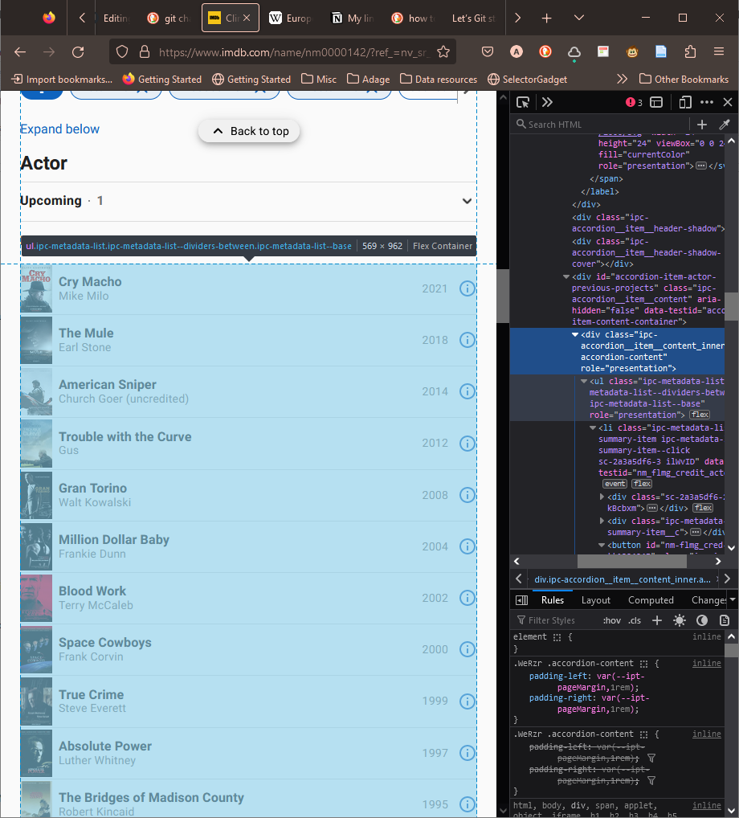
1
3
2
4

Slide 2
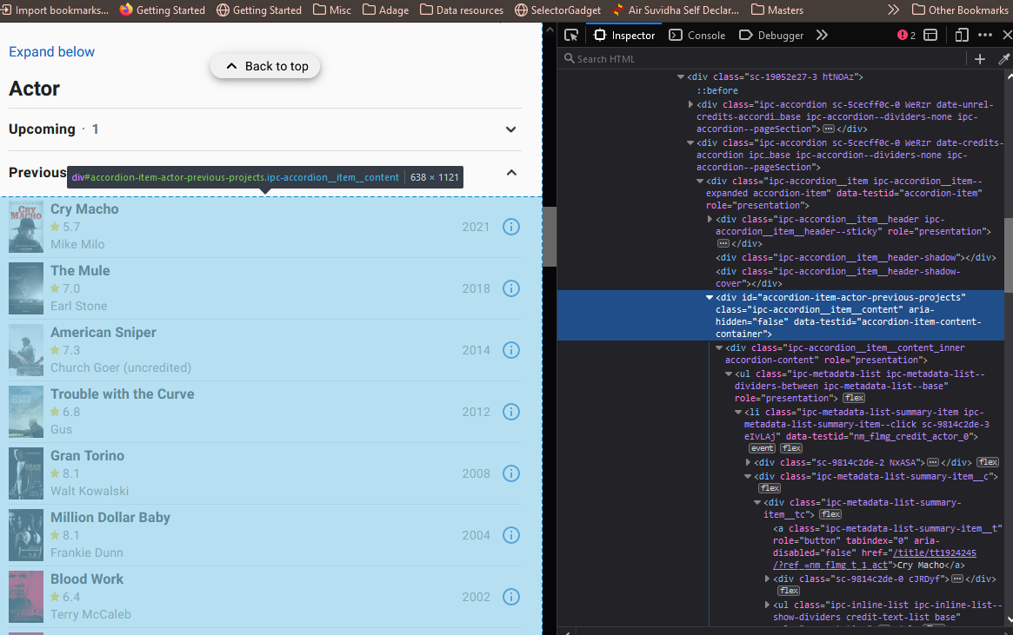
1
3
2
4

Slide 3
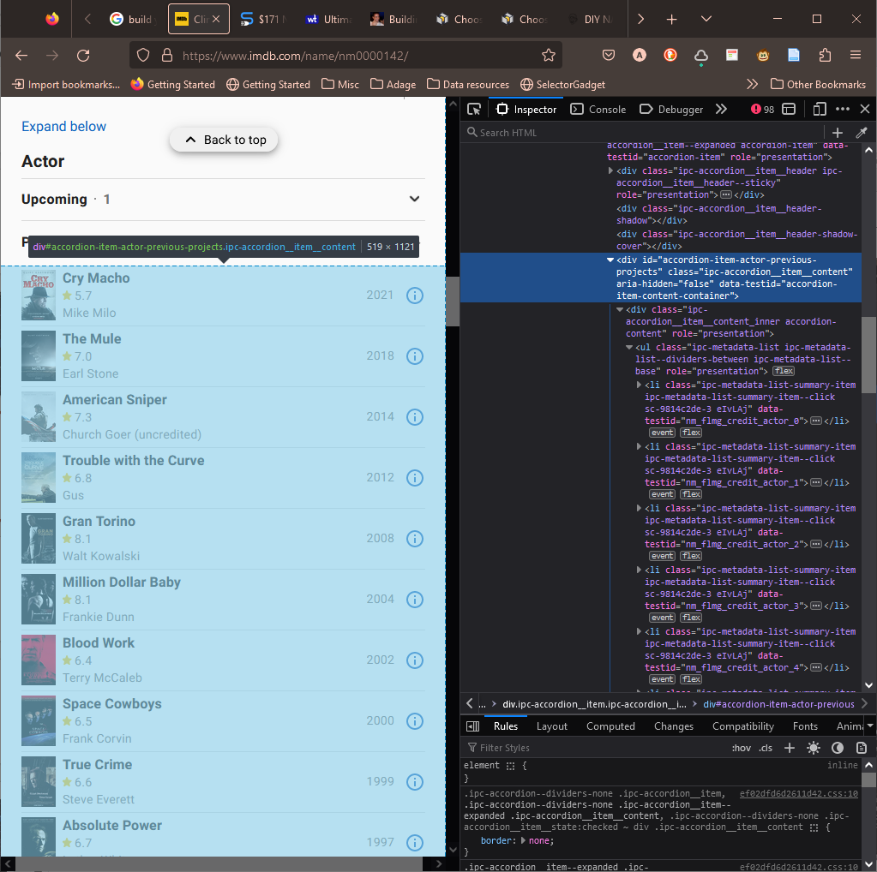
1
3
2
4

Slide 4
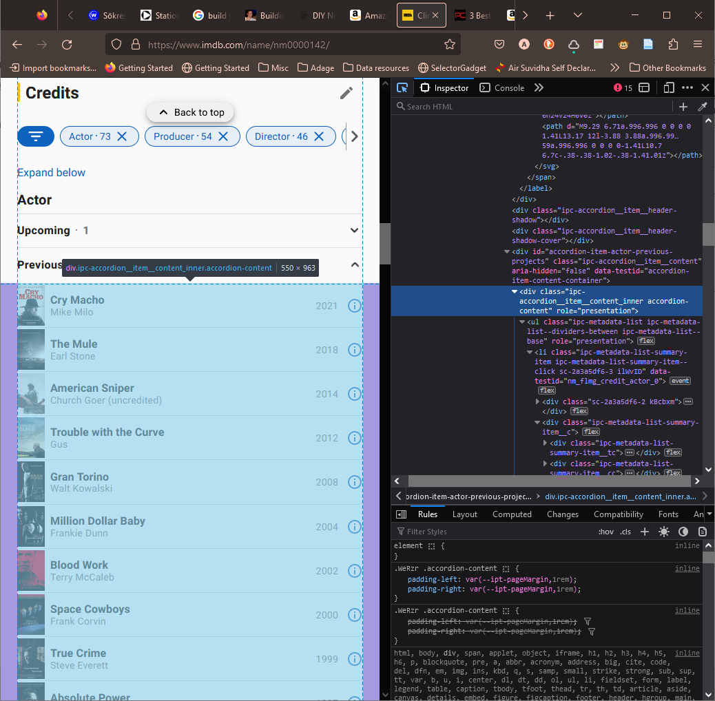
ipc-accordion__item__content
'Scope One', 'Libre Baskerville', 'Roboto Slab', Georgia, 'Times New Roman', Times, serif;
'Scope One', 'Libre Baskerville', 'Roboto Slab', Georgia, 'Times New Roman', Times, serif;

Slide 5
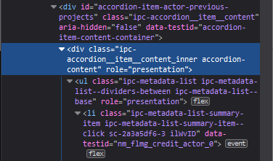
2427

Slide 6
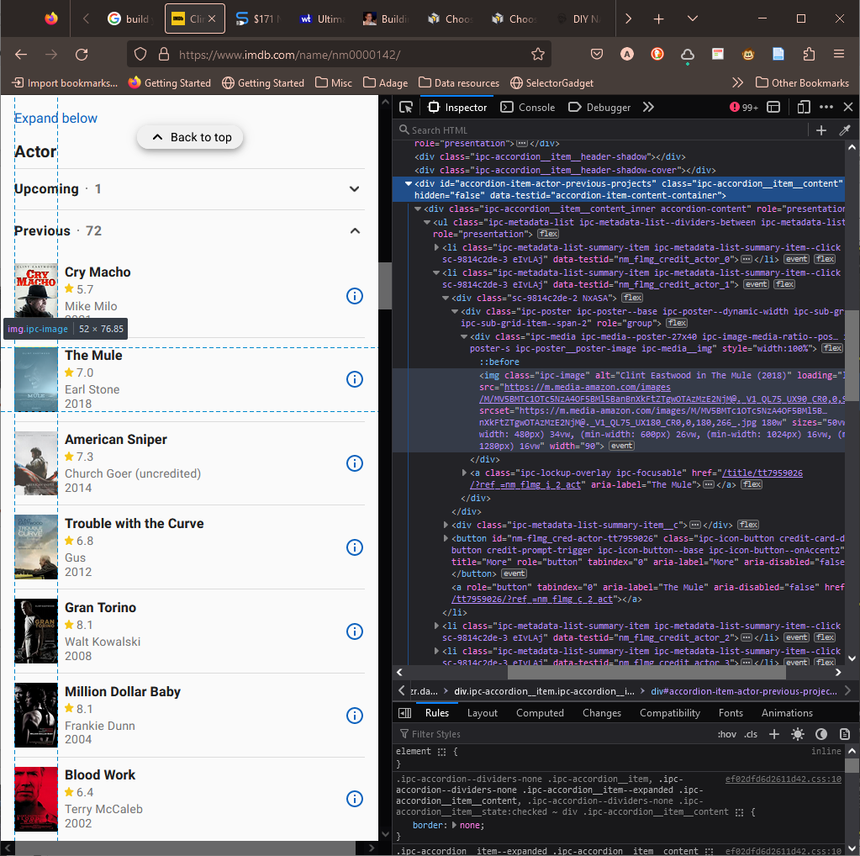
1
2

Slide 7
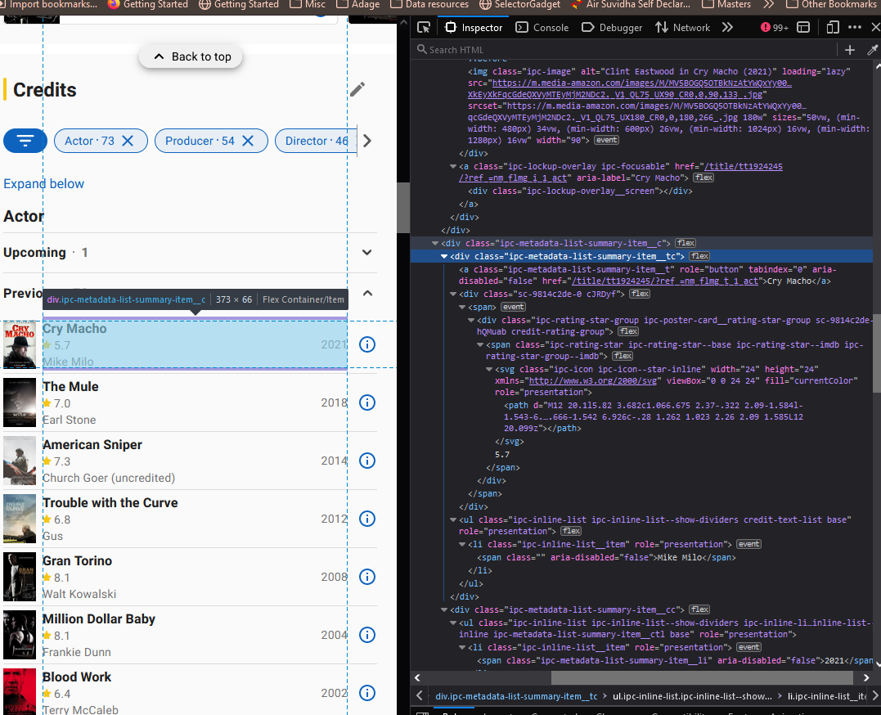
1
2
3

Slide 8






⟹

Slide 9

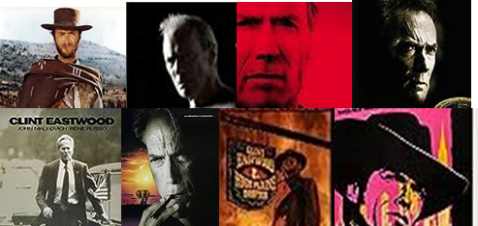
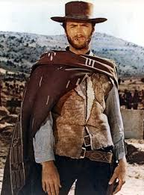

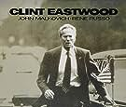
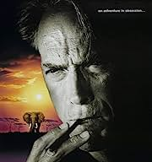



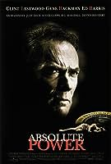

⟹

Slide 10






