Slide 1
Presented By Monim Hossain ID:2013-2-60-050
Supervised By
,
Department of Computer Science & Engineering
East West University, Dhaka

Slide 2


“E-commerce Engine with GUI based customized product platform”
2

Slide 3
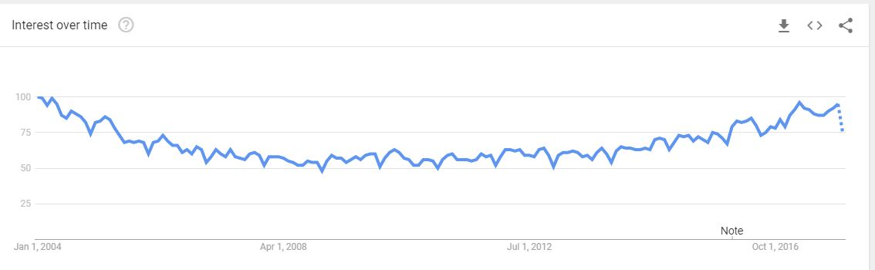
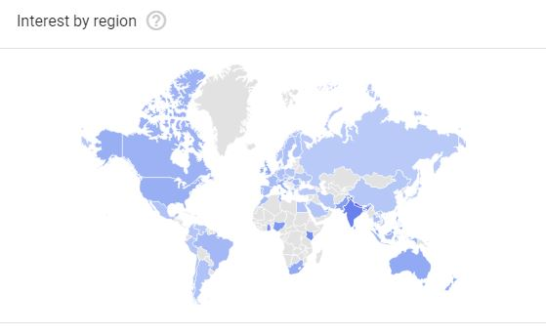
Why do we choose a new e-commerce Platform?
3

Slide 4

Problem
Solution
Decentralize
Centralization
Mobile Phone
SITE - A
All data will be exactly copied from those website and dispaly in our website.
SITE - B
SITE - N
4

Slide 5
Problem
Solution
ONE-WAY
TWO-WAY
SITE - A
SITE - A
My
Website’s
Data
TO
My
Website
SITE - B
SITE - B
SITE - N
SITE - N
5

Slide 6


Problem
Solution
Inflexibility
Flexible
Design your own product here..
I am bored with comparing…What next???

Slide 7
Motivation
1. Widen Circumference.
2. Enhance the flexibility.
3. Adding a new dimension in e-commerce business using affiliate marketing .
4. Integrate data from others.
5. Purchase product by making online payment.
6

Slide 8
Methodology
Comparison: Can compare the other e-commerce sites based on price by web crawler and update the prices by cron job.
Customize Product: Can create own design and use template over the product and also can order them without registration.
Online Payment: It can confirm the payment through online.
Two way marketing: Through extension of a browser it can show the similar product to the other website to our website and other website as well.

Slide 9
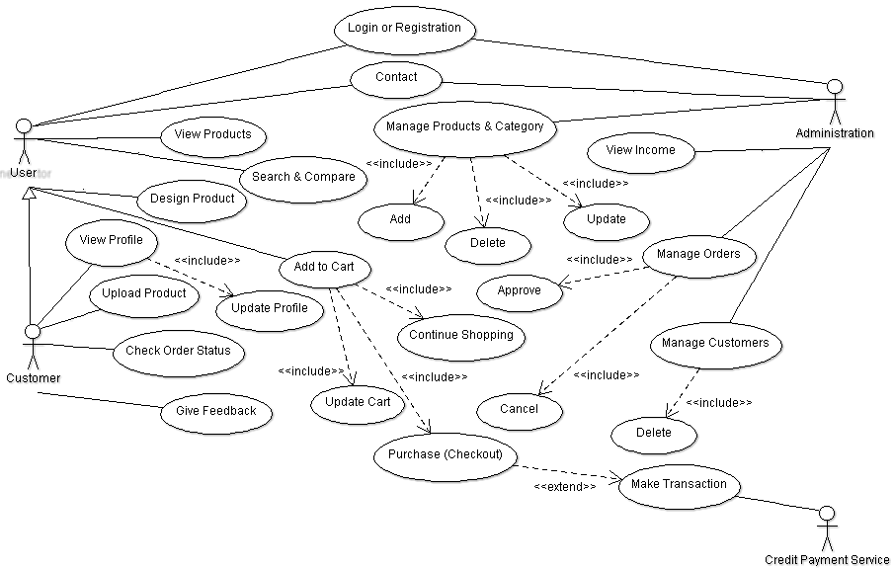
Use Case Diagram
Browse and compare

Slide 10
Advantages
Compare the product prices in a single web application.
Lessen the time of consumer/user.
It is work as a platform of designing own product.
Transection is lot easier and safer.

Slide 11
Limitation
Only workable for two websites.
Customizing Design isn’t highly dynamic.
Justifying product is tough in e-commerce websites.
Product order approval is not automatic.

Slide 12
Conclusions
We focused on new feature like comparison, extension, and custom product design for make our e-commerce more unique.
This feature can help the normal user/consumer more than the existing e-commerce website.
It can be a great platform for us to be new entrepreneur.

Slide 13
Future Scope
Show the result of more e-commerce website.
Create API for the extension.
Providing good quality services and products.
More feature will be added into the custom design.

Slide 14
Reference
Google Trends. (2017). Google Trends. [online] Available at: https://trends.google.com/trends/explore?q=%2Fm%2F02m96 [Accessed 5 Dec. 2017].

Slide 15


