Slide 1
Product Definition
STAY ON TIME
Team : CubeX
Presenter : Mr. Asif Shaikh

Slide 2
Contents
Team Introduction
Product Definition
Why this app?
Features
Time Table
Appointment
Map
Target Audience
Questions??
Thank You!

Slide 3

Captain : Asif Shiekh

Slide 4

Vice Captain : Vishakha Gupta

Slide 5
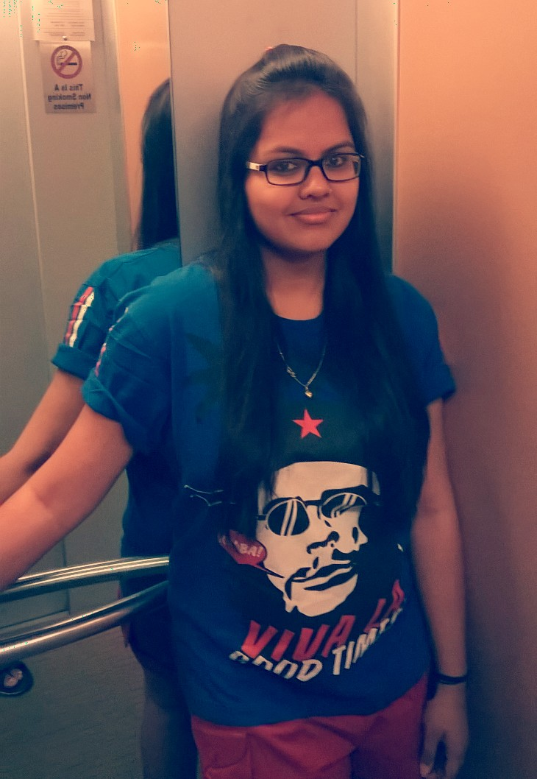
Ayushi Agrawal

Slide 6
Farah Naaz

Slide 7
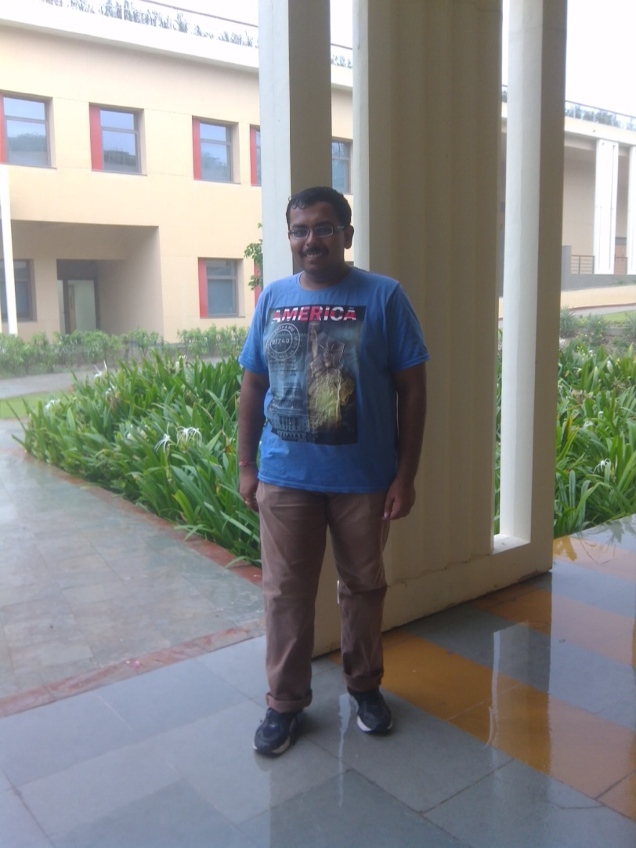
Kunal Mehta

Slide 8

Pallavi Panchal

Slide 9
Product Definition
This app will provide a facility to maintain the daily schedule , book an appointment with professors and view static maps.

Slide 10

Why this Product????

Slide 11

Oh no , I forgot the time of class/meeting.

Slide 12
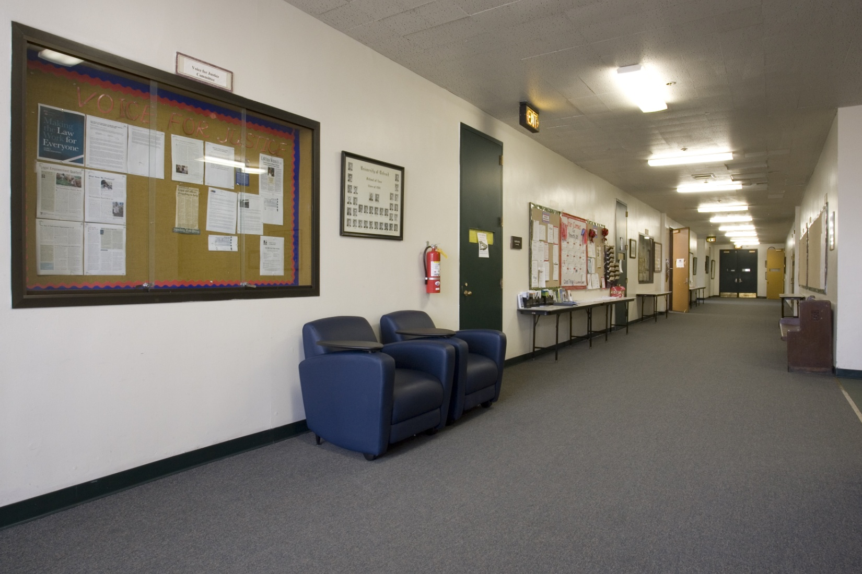
Which room was that?? Oopssss :P

Slide 13

Hello, where do we have to report ??

Slide 14

Oh god ! I have to write a mail for appointment

Slide 15

Where to go?

Slide 16
Here is the solution!!!
Features of this app….

Slide 17
1. Maintaining Schedule
Enter the schedule
Update the schedule
Notifications for class/meeting
Showing all relevant details
Like time, room no. , agenda etc.

Slide 18
2. Make an Appointment
Book appointment just with single click instead of writing a mail
Professor can accept or reject the appointment as per his/her convenience
Student will get notified if appointment gets confirmed

Slide 19
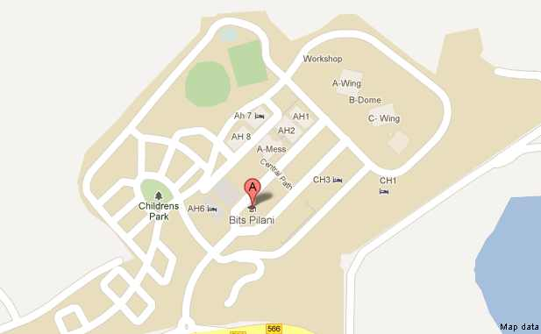
Bits Maps
A static map of BITS Pilani campus will also be available

Slide 20
Target Audience
Students
Professors
Staff members

Slide 21

Any Questions???

Slide 22


