Slide 1


SQA Presentation : N-li8
By team- cubeX
Presented by-Vishakha Gupta
Date -24/12/2015

Slide 2
Test Plan
Test Coverage
Functional Testing
Unit Testing
Test Methods
Automated Testing (Firebug)
Manual Testing
Test Responsibilities
Organize and distribute responsibilities
Track deliverables

Slide 3
Functional Testing
WEBSITE
Super Admin
Authentication (login / logout)
Add, update & delete users / admins
Add, update & delete groups
Add, update & delete notices
Add, update & delete registrations
Assign & remove permissions
Edit & delete users & admins
Logout
Admin
Authentication (login / logout)
Add, update & delete notices
Add, update & delete registrations

Slide 4
Functional Testing
Android APP
User
Authentication (login/logout)
Registration
View notices
View departments
Event registration
Subscribe

Slide 5
Non-Functional Testing
Availability
The website should be operable .
Integrity
Confidentiality
Authentication
Authorization
Usability
It’s easy to use.
Correctness
the degree to which a program operates according to specification

Slide 6
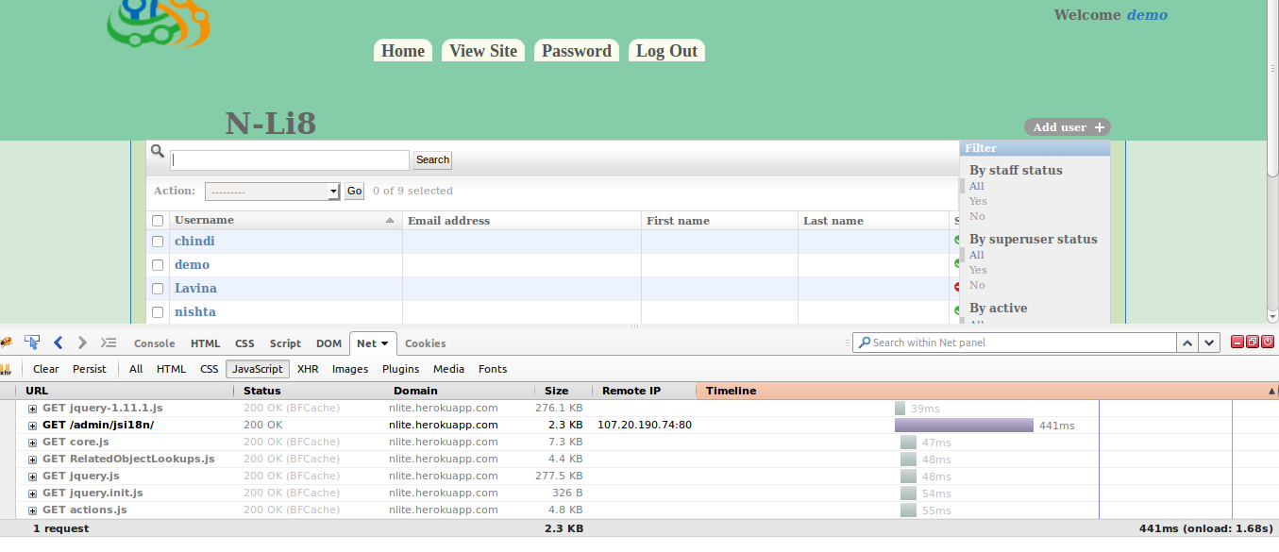
Automated testing
Performance Measure

Slide 7
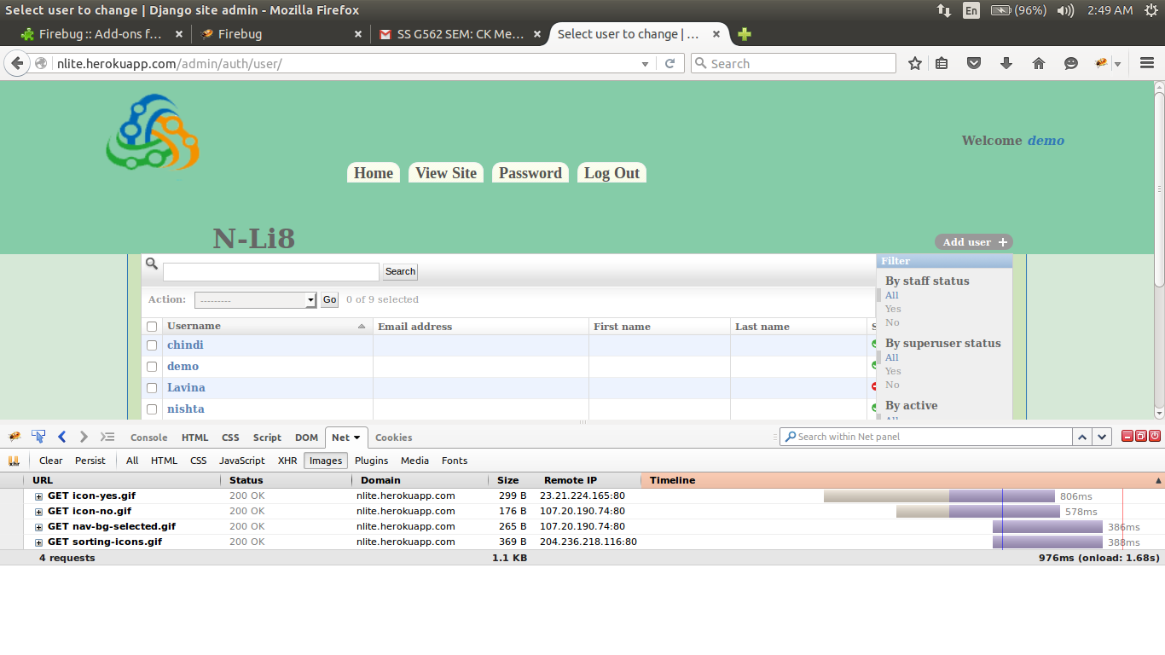
Automated testing
Performance Testing

Slide 8
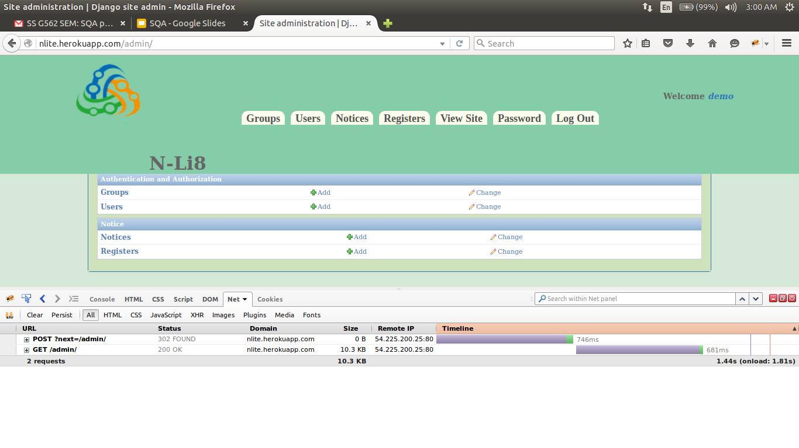
Automated testing
Security Testing

Slide 9
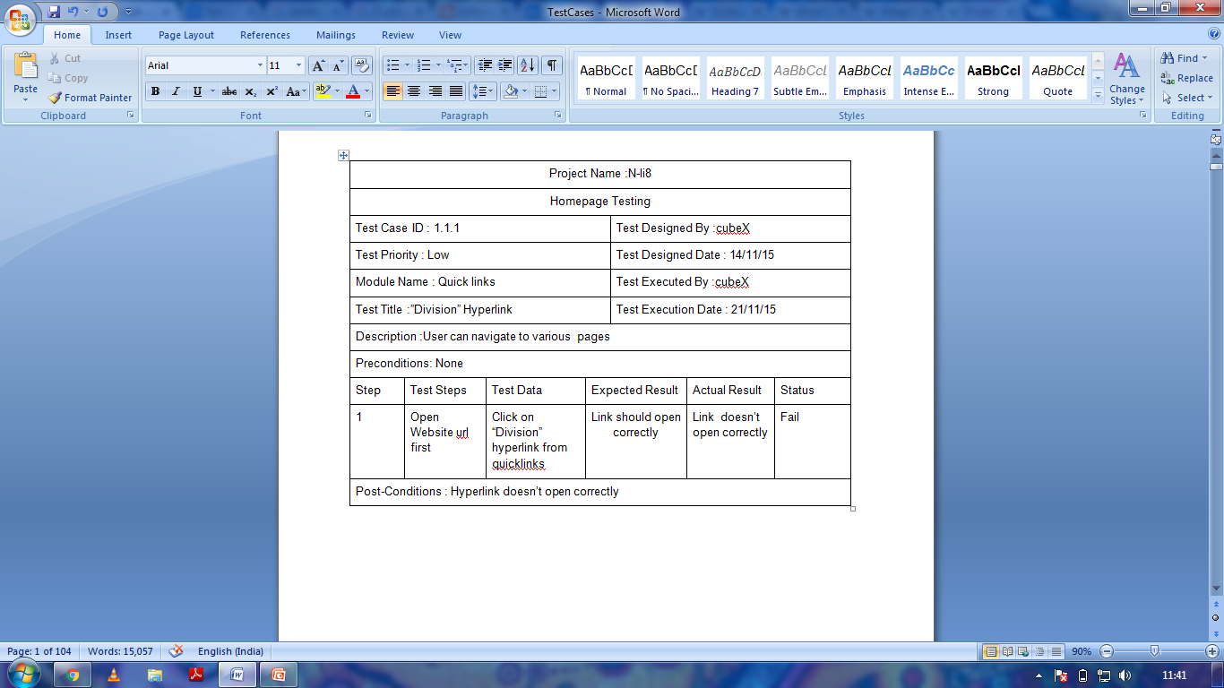
Manual Testing

Slide 10
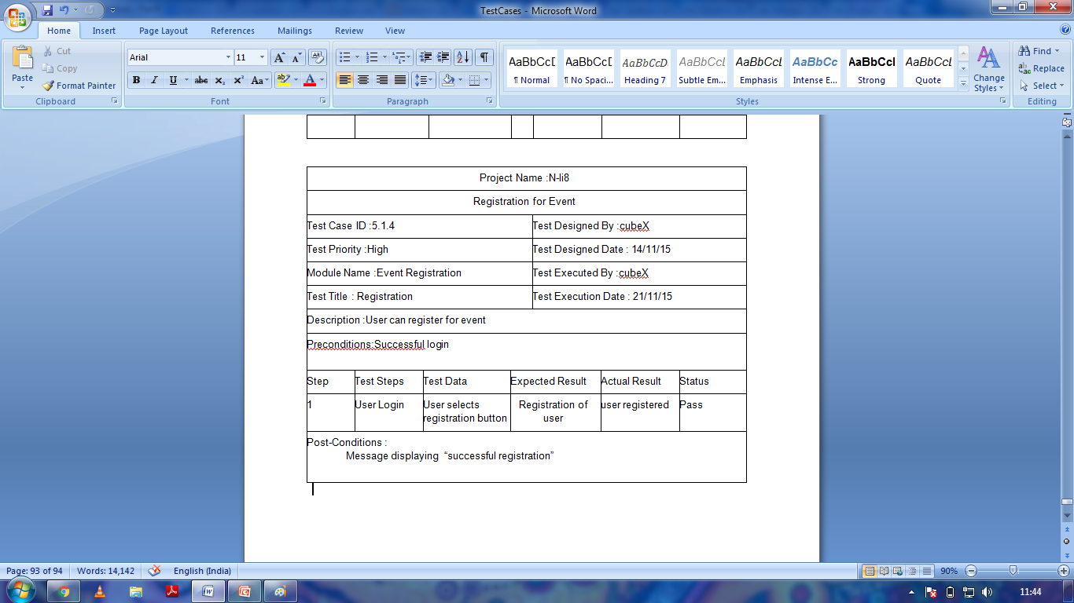
Manual Testing

Slide 11
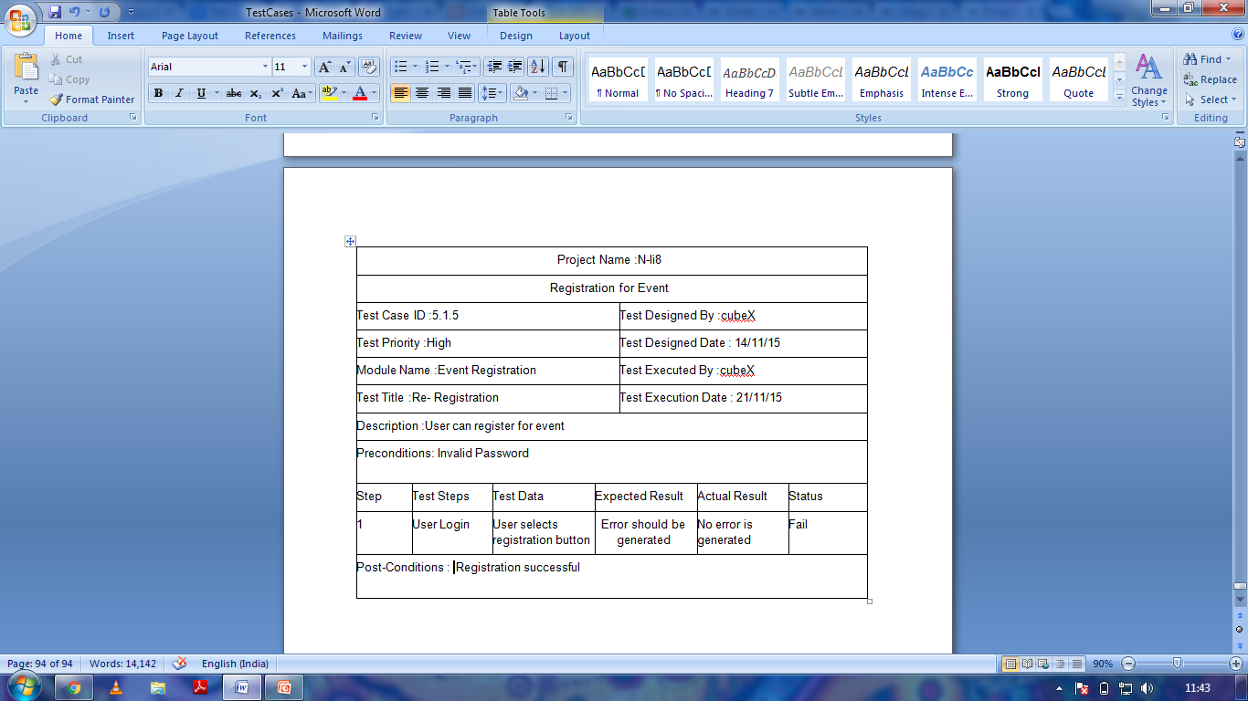
Manual Testing

Slide 12
Defect List
Website :
”Division” Hyperlink doesn’t open correctly
”Club” Hyperlink doesn’t open correctly
”ARCD” Hyperlink doesn’t open correctly
”Contacts” Hyperlink doesn’t open correctly
”@N-Daarp” Hyperlink doesn’t open correctly
Problem in admin login, after registration
App:
User is registered but locally
Re-registration is successful instead of giving error message

Slide 13
Thank You !
Queries???

