Slide 1

noteIt
By Team - CubeX
Presented by-
Farha naaz

Slide 2
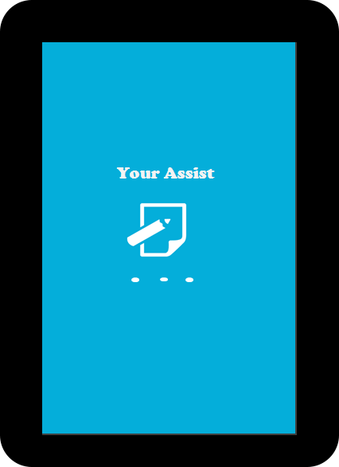
Splash screen

Slide 3
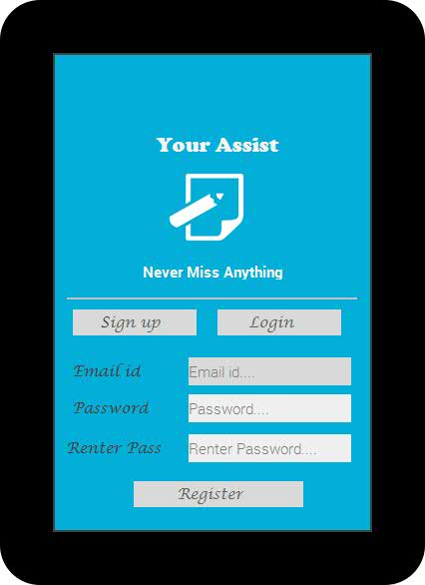
Sign up Screen
User can sign up after downloading app

Slide 4
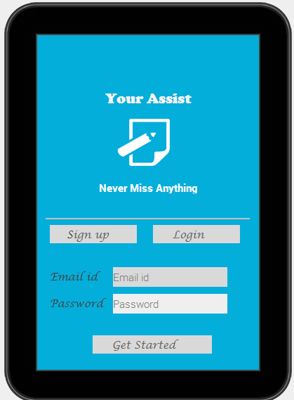
Login Screen
Login through already registered account and backup previous notes

Slide 5
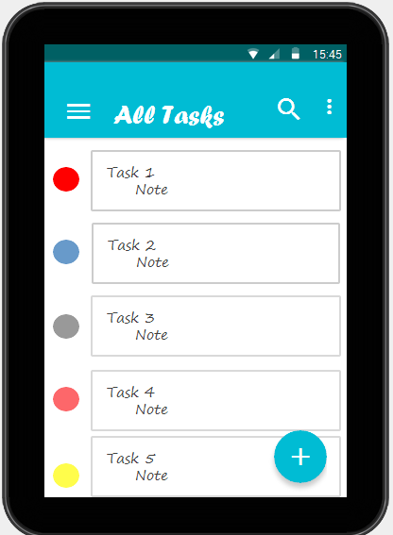
Home Screen
Action bar contains
Navigation drawer
Search
Menu Bar
Click to open navigation drawer
Menu bar has options –sort by(title,deadline,recently updated), view as , add to home screen and settings
Click on floating button to add new task

Slide 6
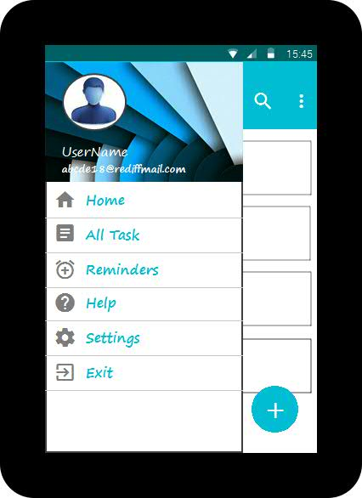
Navigation Drawer
view tasks having reminder
view all tasks
see help content
Edit Account info, Reset application,Syn settings
To exit from app

Slide 7
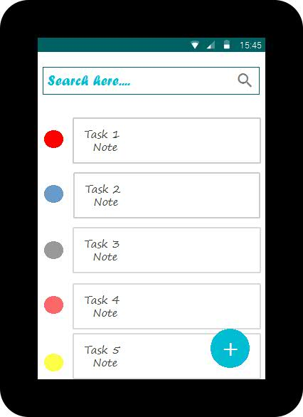
Search Screen
Type here to search

Slide 8
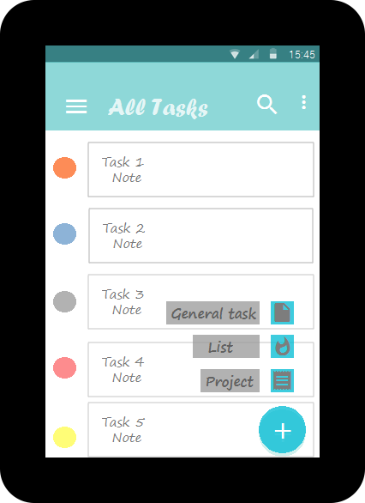
New Task
3 types of task a user can create
General task
List
Project

Slide 9
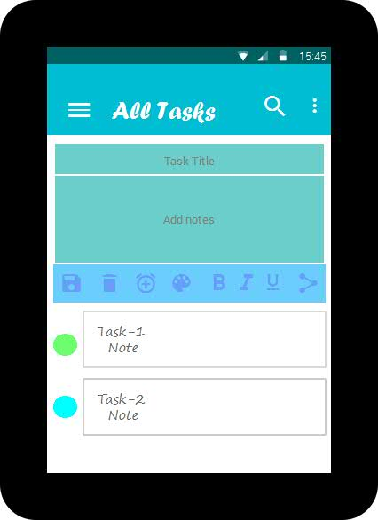
General task creation
Change color
Save
Share with friends
Cancel
Set reminder
Older tasks are shown here

Slide 10
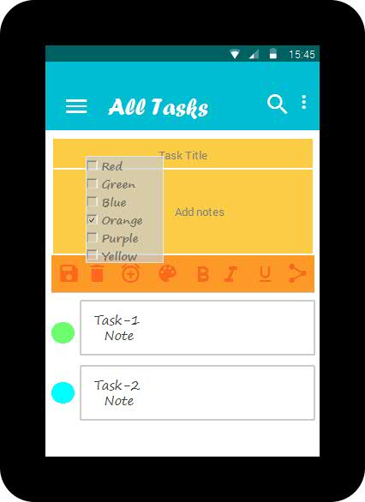
Color selection screen
Save
User can choose color of his choice for task

Slide 11
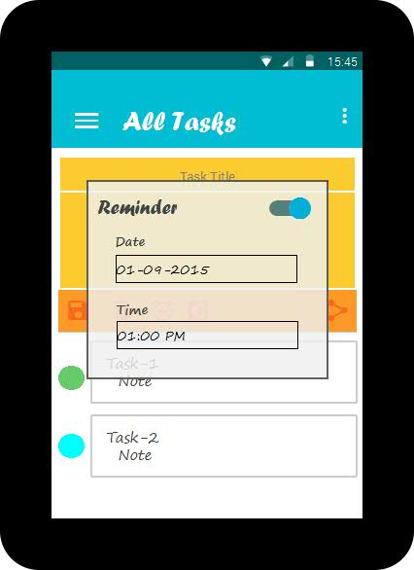
Reminder option
Reminders can be set for the tasks user want

Slide 12
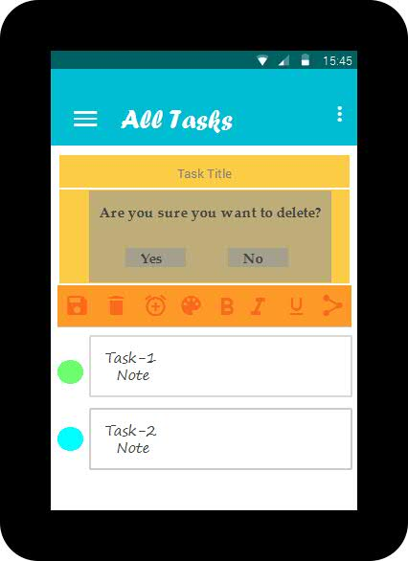
Delete option
Confirmation for deletion

Slide 13
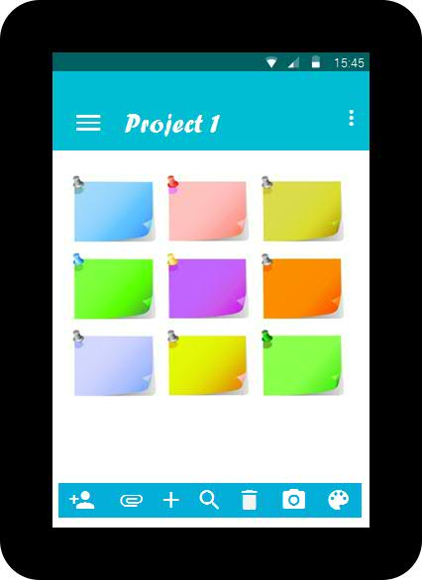
Project task
Confirmation for deletion
Picture note
Attach any file
Set color
Add note

Slide 14
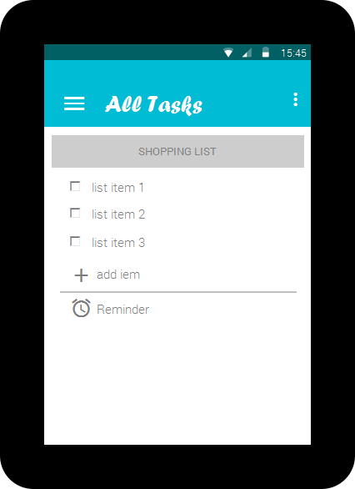
List
User can add list of items and
Can also set reminders

Slide 15
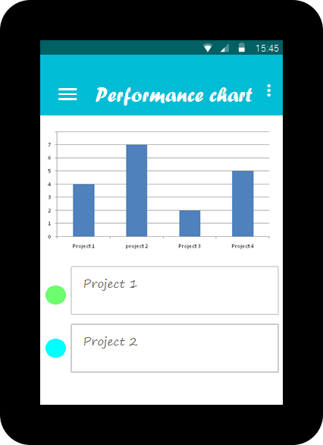
Performance Chart
Progress on projects according to deadlines

Slide 16
Thank You !☺

Slide 17
Any Queries???

