Slide 1
BSE1207: Introduction to web development
Dr. Johnson Mwebaze
jmwebaze@cit.ac.ug
0701735800

Slide 2
Course Organization
The course is structured in
lectures
exercises (in class)
programming assignments (take home)
Strong emphasis on programming assignments
Read the paper: how NOT to go about a programming assignment
http://www.di.uniovi.es/~cernuda/noprog_ENG.html
Assignment submissions to be done online

Slide 3
Materials for this course
Main Course Text Book
Internet & World Wide Web How to Program, 5/e
Most of what you need during practice hours is on the web or in the slides,
Examination (not open book) focuses on subjects treated during the lecturers and the things you encounter during the practical work.

Slide 4
Materials for this course
Registration to this class is mandatory on MUELE and onto the mailing list
Please register by June 30th, 2022
Slides on the MUELE course website

Slide 5
About your assignments Documentation
Documentation accounts for 30%, code for 70% of your grade.
Write in English!
Documentation must contain:
Your name(s), student number(s), and MUELE Username
On which platform you tested your programs
How to use your programs
Which program does what, which parameters are needed, screenshots
A description of your program's design
Answers to questions
Documentation must not contain:
Rephrased version of the assignment
Your code in words

Slide 6
About your assignments Documentation
Present the design of your implementation
Even better: a list of possible designs and why you chose one rather than the others
Which problems you encountered while doing the assignment, and how you solved them
In general: everything which shows that you thought about the problems involved in realizing the assignment
If a program does not fully work as required, please mention it in the documentation.

Slide 7
Assignment deadlines
Each assignment is given a deadline
Avoid last minute submisions

Slide 8
Rules
We will systematically check your assignments for plagiarism
There are automated tools to do that
I Do not think that changing variable/function names will be enough to fool them!
If we find plagiarism cases, anyone involved gets a ZERO in that assignment. No discussion.

Slide 9
Content
HTML
CCS
JavaScript

Slide 10
Chapter 1 Introduction to the Internet and www

Slide 11
Define?
Internet
Web
www?

Slide 12
A Brief Intro to the Internet
What the Internet is:
Informally, a huge collection of computers connected in a network
A world-wide network of computer networks
Actually, a network of networks, not computers

Slide 13
WWW (World Wide Web)
Web
The Web is a collection of software and protocols that has been installed on most computers on the Internet
Global information space which people can read and write via computers connected to the Internet.
World Wide Web is combination of four ideas :
Hypertext
Resource identifiers
Client-server architecture
Markup language

Slide 14
WWW (World Wide Web)
Hypertext,
ability to move from one part of a document to another or from one document to another through internal connections among these documents (called "hyperlinks");
Resource identifiers
ability to locate a particular resource (computer, document, image, video, or other resource) on the network using a unique identifier;
Markup language (e.g., html)
embedded text with code, to indicate to a computer how to print or display the text, e.g. as in <make this bold>italics < make this bold > or bold type or font.

Slide 15
World Wide Web
AIM: is to Send and retrieve multimedia documents including text, images, graphs, sounds, and video
Web Browser
Client program for viewing Hypertext document
HTML (Hyper Text Markup Language)
A set of pre-defined tags
HTTP (Hyper Text Transfer Protocol)
protocol for sending/receiving HTML documents

Slide 16
Web Servers
Web servers are programs that provide documents to requesting browsers
Apache
the most commonly used web servers
takes 59% over 110 million web hosts as of March 2007
Microsoft‟s Internet Information Server (IIS)
runs under Windows OS
takes 31%

Slide 17
url format
<scheme>://<server-domain-name>/<pathmane>
<scheme> which protocol to use
https: in general
file: which tells the client document is in a local machine
ftp: file transfer protocol
<server-domain-name> identifies the server system
i.e. www.doc.gold.ac.uk
<pathname> tells the server where to find the file
http://doc.gold.ac.uk/~username/index.html

Slide 18
HTML
Hypertext Markup Language (HTML)
The language used to create or build a Web page
Markup language
A language that uses tags to annotate the information in a document
Tags
The syntactic element in a markup language that indicates how information should be displayed

Slide 19
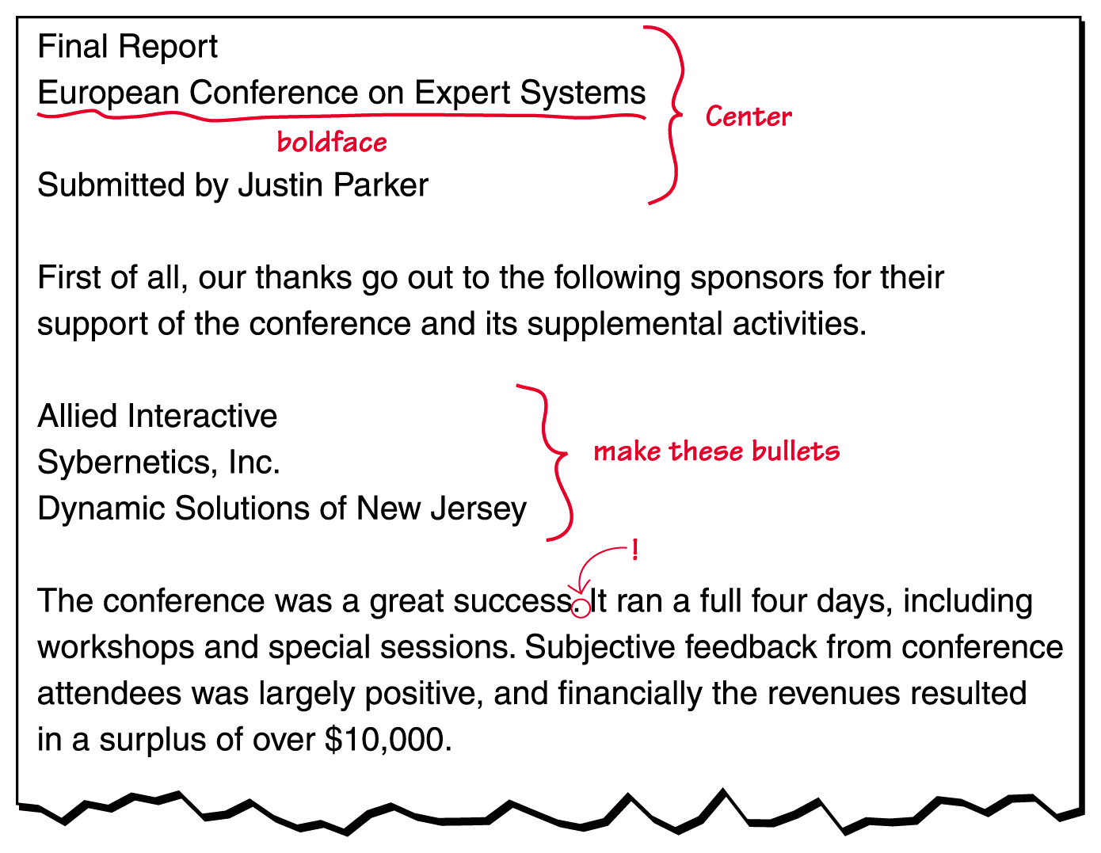
HTML
Figure 16.2 A marked-up document

Slide 20
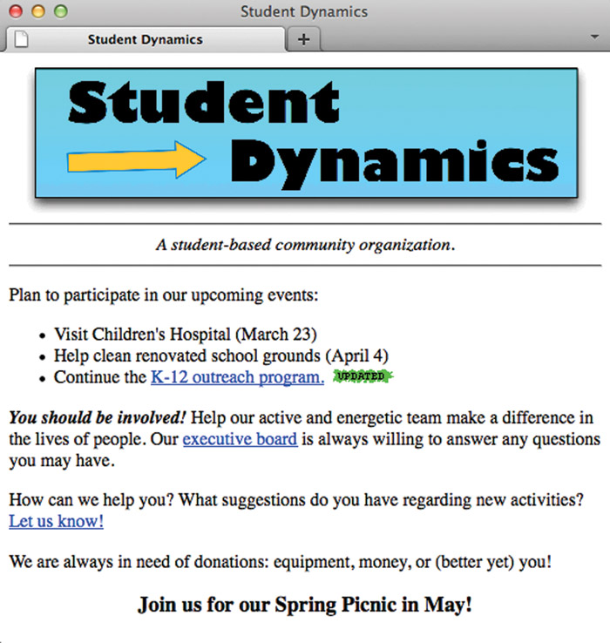

Slide 21
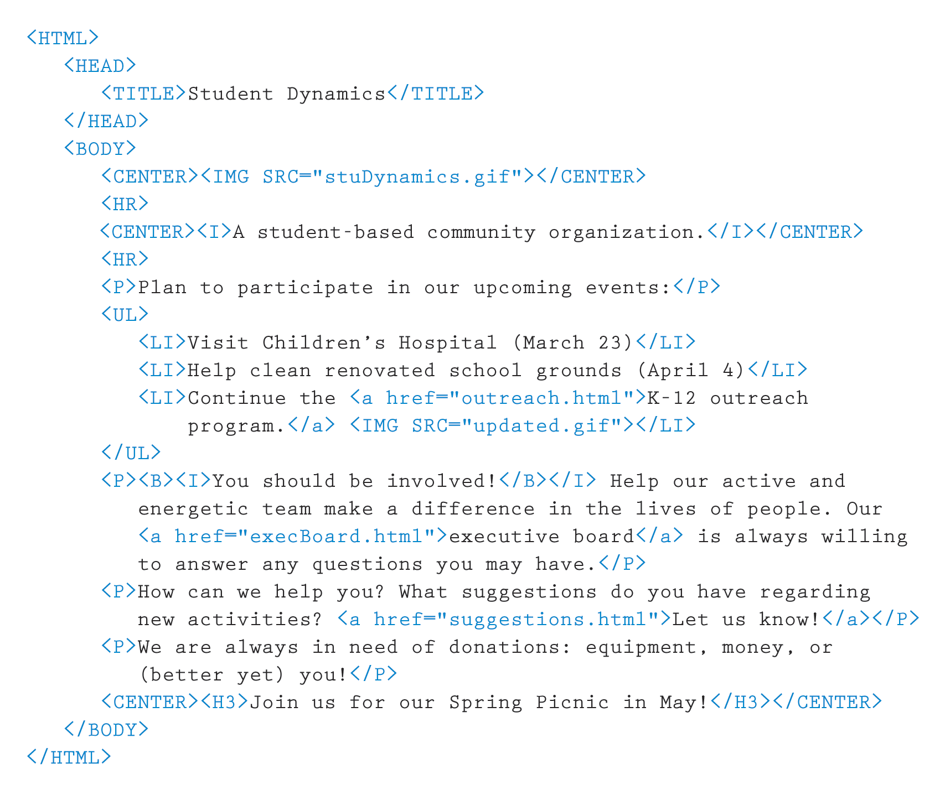
HTML

Slide 22
