Slide 1

Group2: ChangeDistiller
Sprint4 Review

Slide 2
Methods and Solution
Reuse from Sprint #2
Core Code of REST API
Dockerfile structure
Java Executer for calling the ChangeDistiller Library
Step #1: Gets list of all commits, determines changed files between commits and clones two commits in separate folders
Step #2: Uses list of changed files and executes the Change Distiller on them. Writes output file with distilled changes
Docker Container
REST API
Git Executer
Change Distiller

Slide 3
Division of work
Project Manager: Felix
Scrum Master: Fouzia
Developer
Asier
Developer
Fouzia
Developer
Felix
Developer
Daniel
REST
Java Executer Step #1
Java Executer
Step #2
Dockerfile

Slide 4
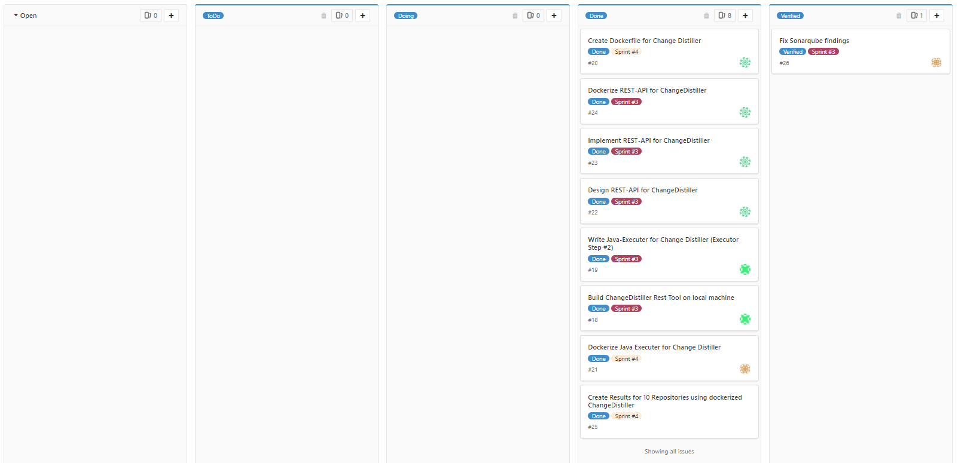
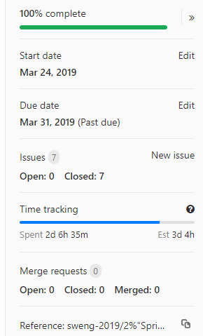
Project Board
User Stories, Time Estimation vs. Actual Time, Comparison to 1st Sprint

Slide 5
Problems
One Group Member dropped the course → her tasks had to be reassigned
Getting Gradle build to run took more time than expected
Maven dependencies
Open Issues
None known

Slide 6
Demo

Slide 7
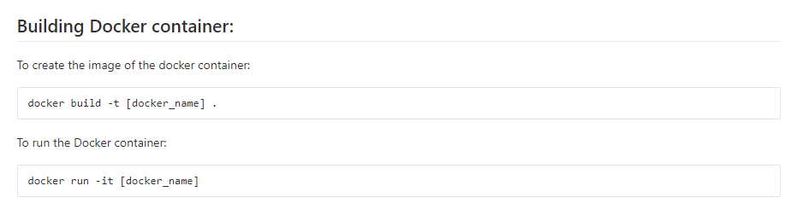
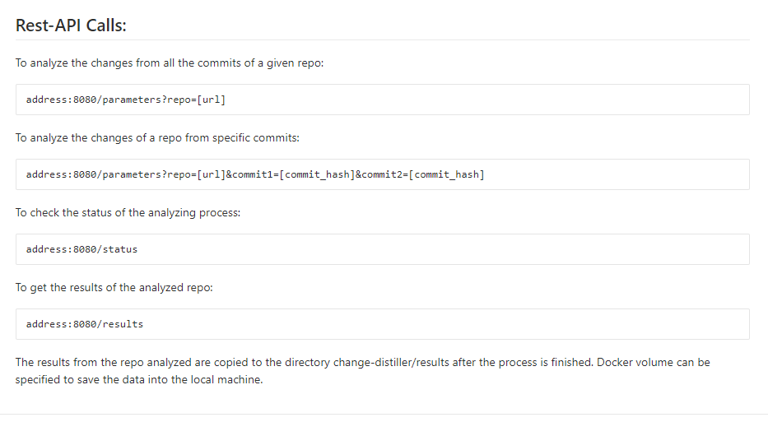
Usage
REST API:

Slide 8
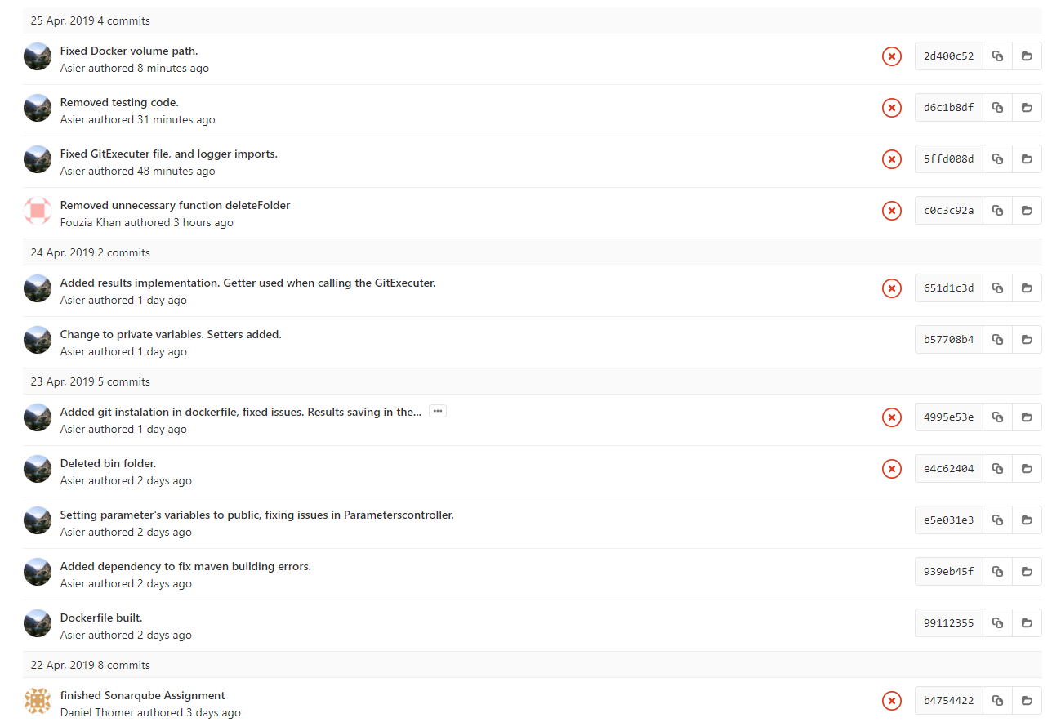
Commits

Slide 9
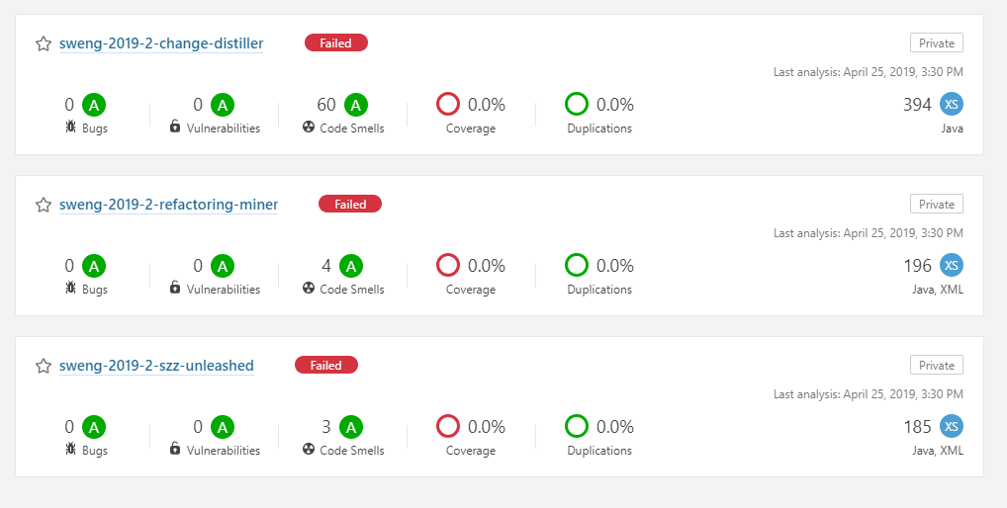
Sonarqube

Slide 10
Retrospective
What went good:
Group Management
Overcame issues from Sprint 1&2
Separation of Work:
Initial Meeting separating all the tasks
This Time: Very good estimation of effort
Java skills improved fast over time
What did not go so good:
Sprint #2:
Documentation
Tool usage

