Slide 1

Group2: SZZ Unleashed

Slide 2
Methods and Solution
Reuse from Sprint #1
Core Code of REST API
SH script to execute SZZ inside of Docker, called by REST API
Dockerfile structure
Dockerfile adapted from SZZ Github
Docker Container
REST API
SH Script
SZZ Unleashed

Slide 3
Division of work
Project Manager: Daniel
Scrum Master: Asier
Developer
Felix & Daniel
Developer
Daniel & Felix
Developer
Fouzia & Daniel
REST
SH Script
Dockerfile

Slide 4
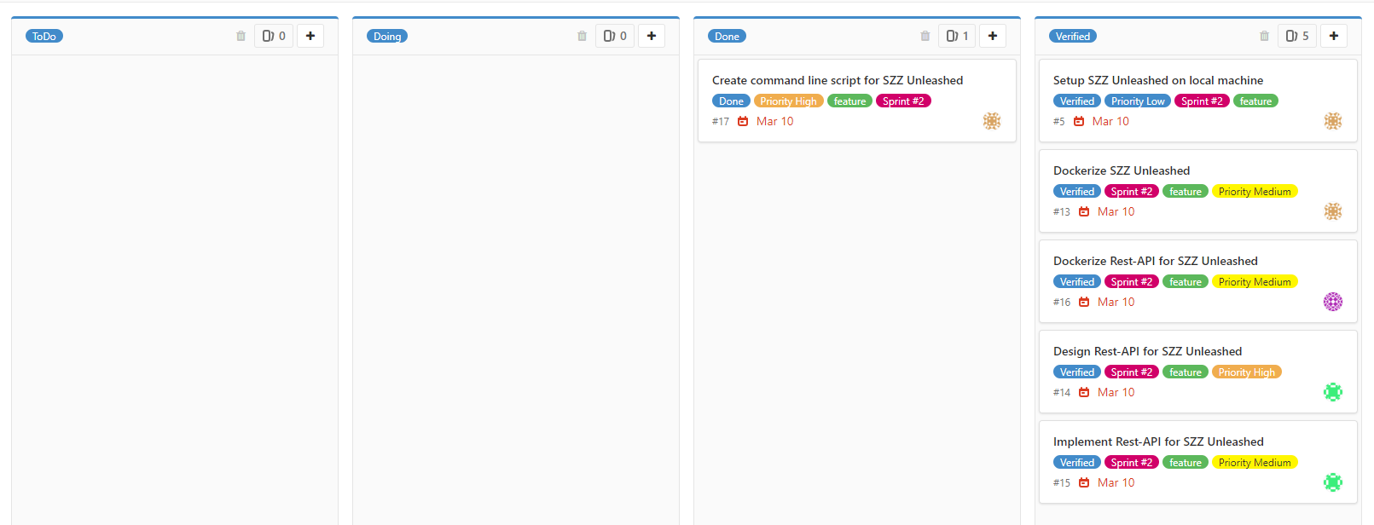
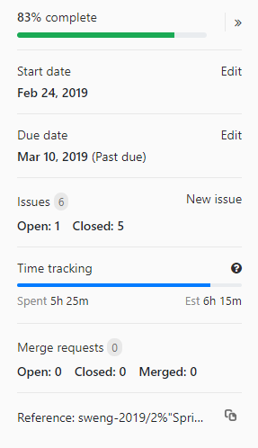
Project Board
User Stories, Time Estimation vs. Actual Time, Comparison to 1st Sprint

Slide 5
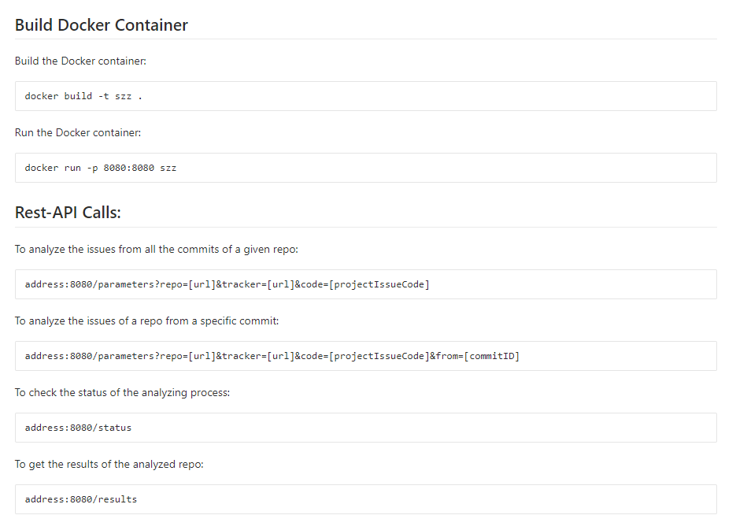
Usage
REST API, Docker:

Slide 6
Problems
LineEndings in SH file were not converted in Git
Empty Results even when executing the Github Demo with given Example (Jenkins)
SZZUnleashed parameters were not clear
Unclear what each parameter has to be set, to produce desired result
What is the desired result?
→ Unable to create Result
Open Issues
SZZUnleashed does run successfully but result file is empty JSON String

Slide 7
Demo

Slide 8
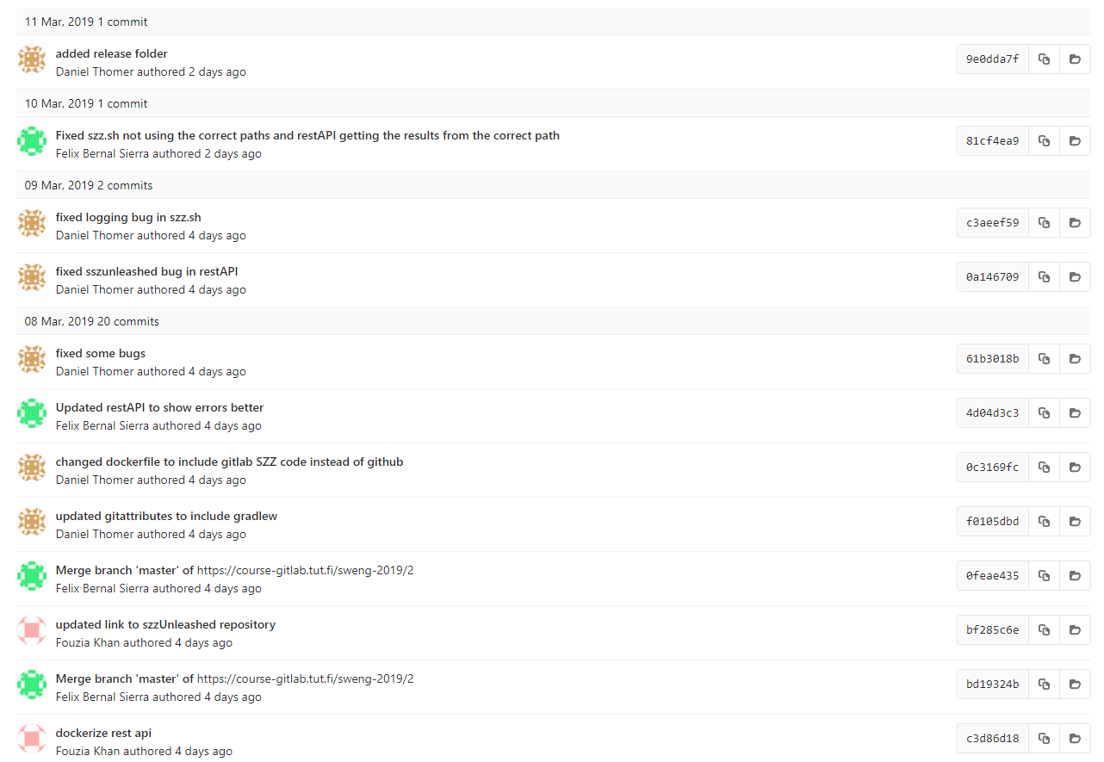
Commits

