Slide 1


Thrifty Cook
GROUP 2:
Rebecca Jewers
Anna Lewandowska
Susanna Parolo
Joanna Bek
Code First Girls
Mobile Development +masters Course
Final Project

Slide 2
Thrifty Cook – What, Why?
1. What did we choose to build?
- grocery list generator based on the recipes
2. Why did we decide to build this?
- facilitate meal prep, reduce waste, simplify shopping
3. What core technologies did we decide to use?
- deciding API was the key, so was enabling users to generate shopping list based on recipe (and save that recipe to favourites, thanks to Redux and Async Store)

Slide 3
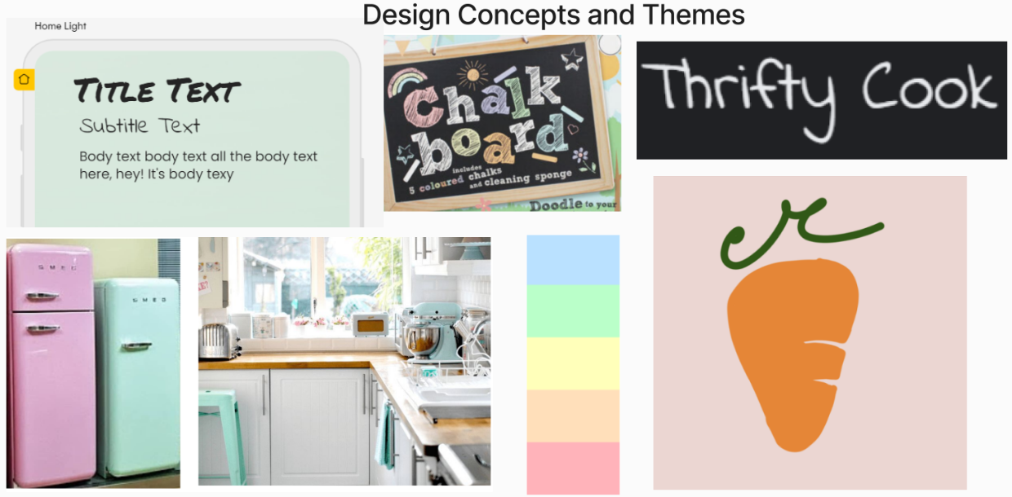
Thrifty Cook – Design Ideas
Inspiration: pantone kitchen and chalkboard menu

Slide 4
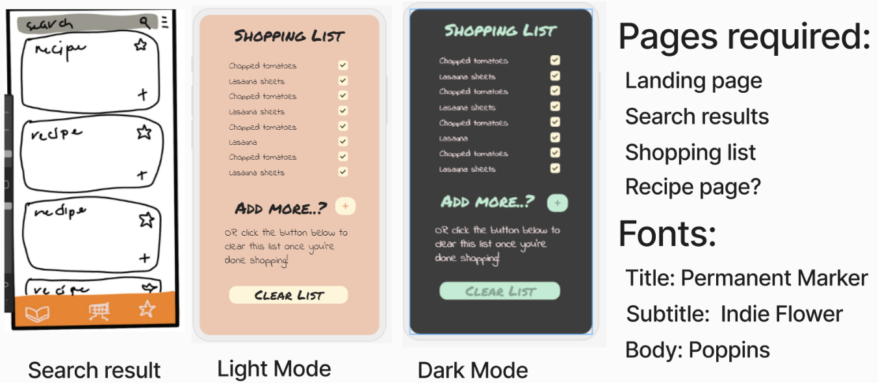
Thrifty Cook – Design Ideas
Pre-wireframe – core concepts visualisation

Slide 5
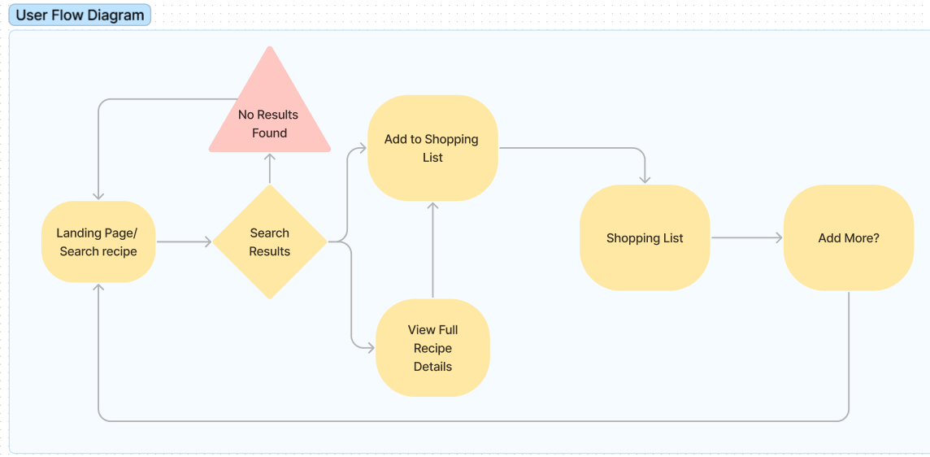
Thrifty Cook – User Flow Diagram
User journey through the app

Slide 6
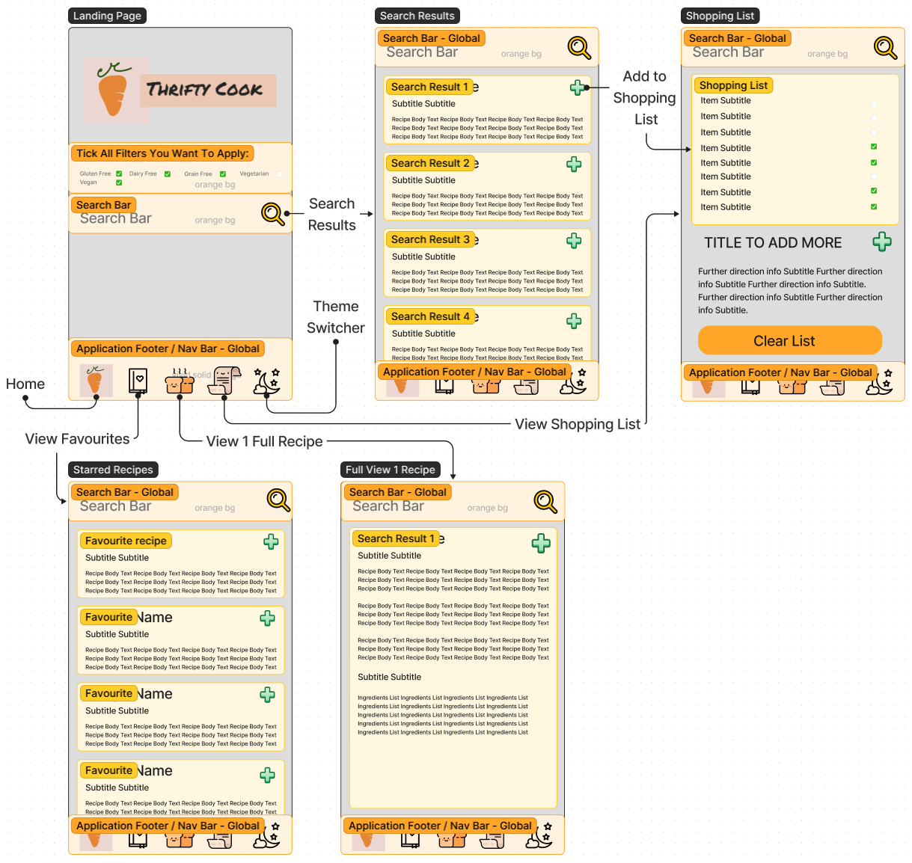
Thrifty Cook – Wireframing

Slide 7
Thrifty Cook – App Video

Slide 8
Thrifty Cook – Implementation
1. How did we divide & structure our work?
- Trello „kanban” board
2. How did we report & check-up progress?
- Slack; daily communication
- Google Meet; as needed, min. bi-weekly

Slide 9
Thrifty Cook – Challenges
1. Light & Dark Mode Switcher
- React’s move from component to function
- x-teen tutorials tried, none worked
- problems with „react-appearance” module
2. React Native’s hardcoded properties vs. styling
- hidden and inflexible in-built properties
3. Time Constraint
- not enough time to explore all the ideas
4. External libraries overriding each other
- for example Jest & react native testing library overriding existing dependencies

Slide 10
Thrifty Cook – What’s next?
Some ideas for future development:
- light&dark theme switcher
- filter for search (choosing recipes by specific diet requirements)
- adding images to the recipe cards
better ingredients management
expanding home page (for example using „get random recipes” API endpoint)

