Slide 1
Testing
A.ASIK RAJA M.sc.,

Slide 2
In Waterfall,
Analysis
Design
Implementation
Integration and Testing
Deployment
Maintenance

Slide 3
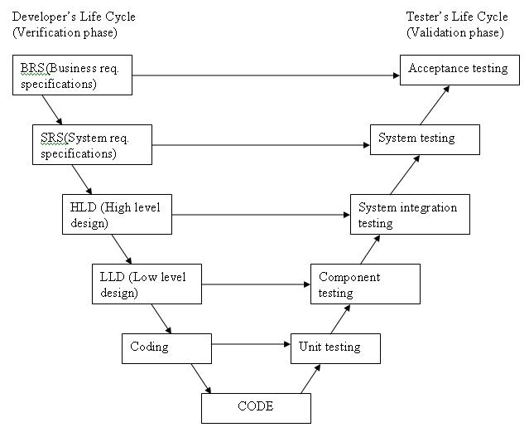
V-Model
It is an SDLC model where execution of processes happens in a sequential manner in a V-shape
Also known as Verification and validation method

Slide 4
In Agile,
Every iteration has its own testing phase. It allows implementing regression testing every time new functions or logic are released.
Agile Testing is not sequential but continuous.

Slide 5
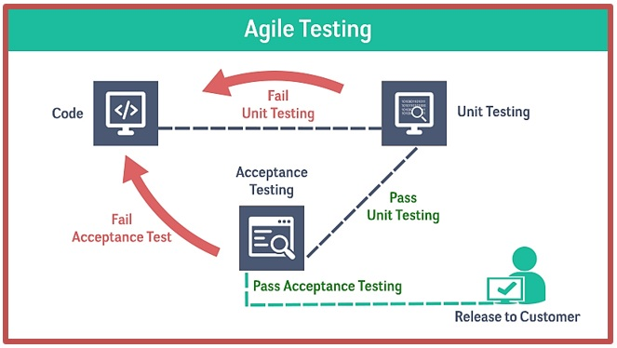
Agile Testing
Testing as part of development process, rather than considering it as a different phase
It is actively gets done throughout the programming phase

Slide 6
Continuous Testing(CT)?
Process of executing automated tests as part of the software delivery pipeline.

Slide 7
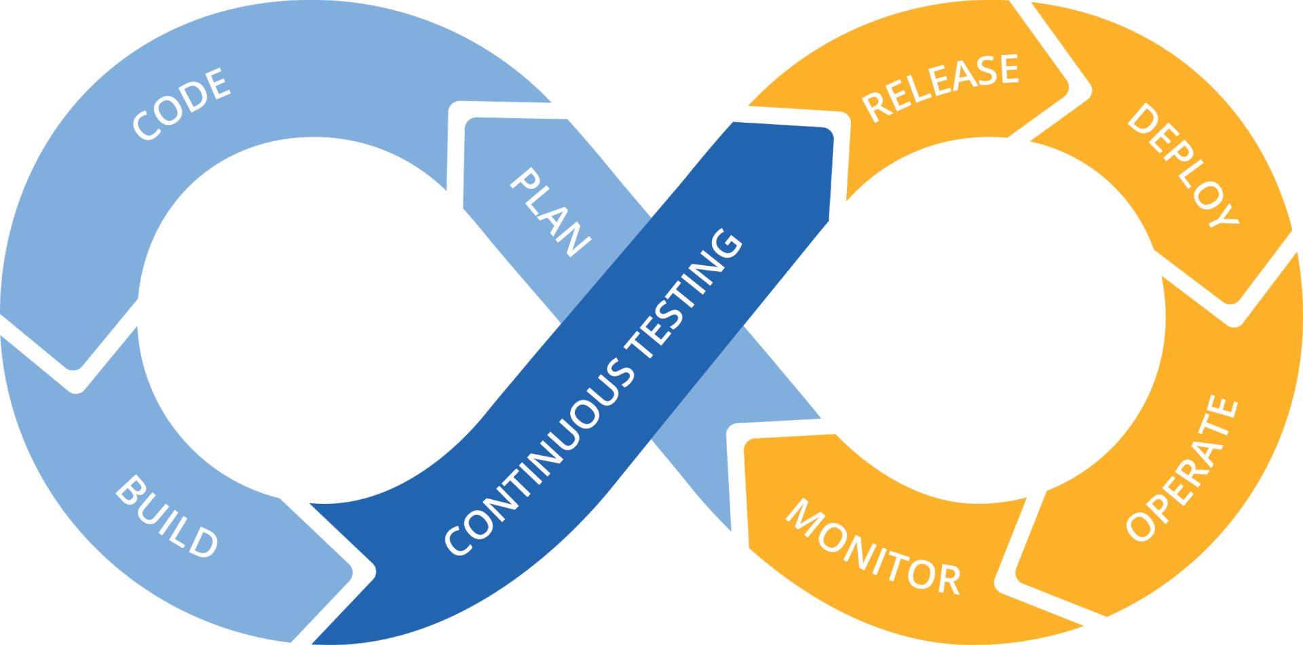
The Flow

