Slide 1
TortoiseSVN
Tutorial
Topic: version control
By: Dung Nguyen
Date: May 26th, 2008
Duration: 1h30’

Slide 2
Contents
Concepts of version control & SVN
Common functions in TortoiseSVN
3. Best practices
4. Q&A
5. Test
Notes:
TortoiseSVN

Slide 3
1. Concepts of version control & SVN
  What is version control?
  Versioning models
  What is SVN?
  SVN clients and plug-ins

Slide 4
1.1. What is version control?
The management of changes to information (physical: files).
Allow concentrating and sharing files over the network.
Support authority and security.
Cooperate member’s changes.
Manage files with version, allow recovering of desired version.
Allow checking the modification.
Support CM process.

Slide 5
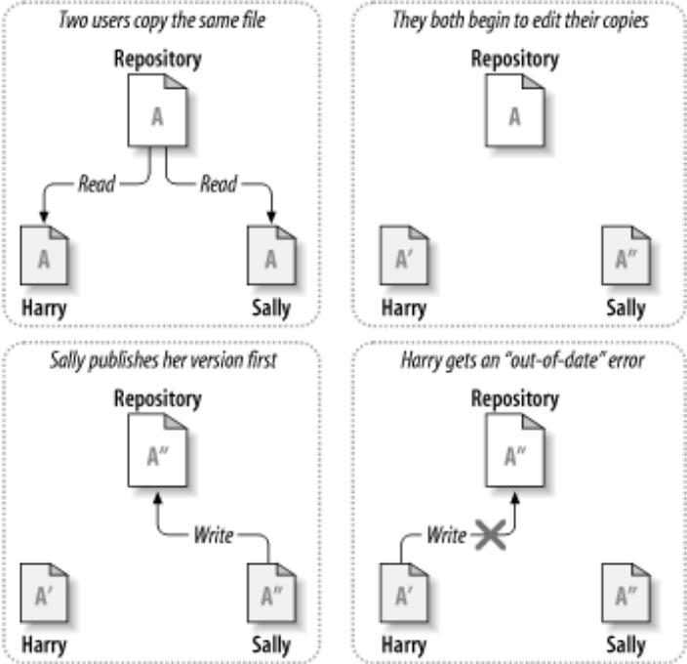
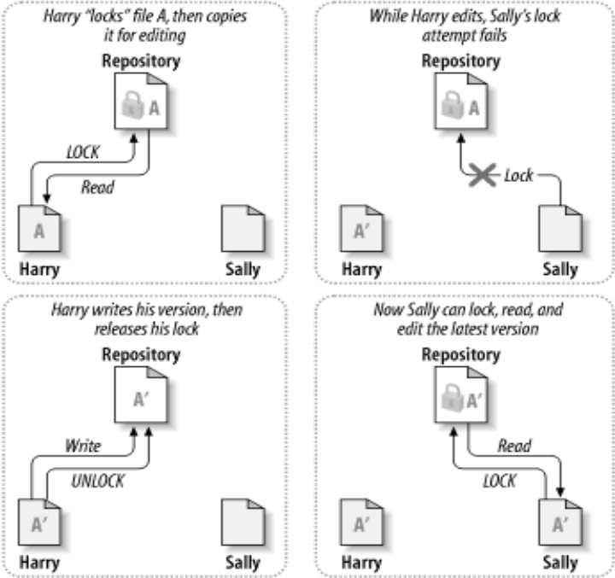
1.2. Versioning models (1/2)
File-sharing without control: one’s data may be accidentally overwritten by others.
Lock-Modify-Unlock solution: weak point is not allow many persons to work on the same file at the same time.

Slide 6
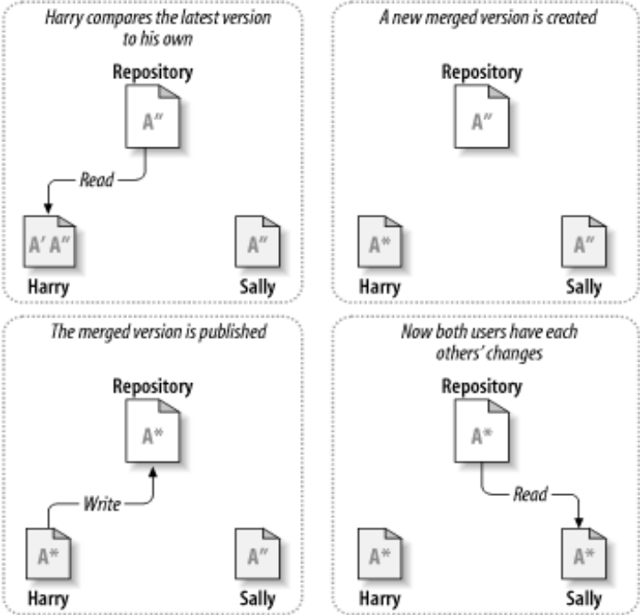
1.2. Versioning models (2/2)
Copy-Modify-Merge solution (SVN recommended): allow many persons to work on the same file at the same time, but must apply file merging before submitting.

Slide 7
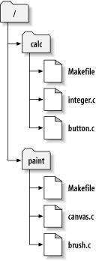
1.3. What is SVN? (1/2)
Subversion (abbreviated SVN) is a free open-source version control system.
Managed folders/files are placed into a repository. A repository is much like an ordinary file server.
Subversion allows you to recover old versions of your data, or examine the history of how your data changed.
checkout
Working copy
SVN
Repository

Slide 8
1.3. What is SVN? (2/2)
Why use SVN (versus Visual Source Safe-VSS)
  Sufficient features
  Free
  Support Windows, UNIX, Linux
  Large community: many clients/shells (TortoiseSVN, Syncro, SmartSVN…), many plugins (VS .NET, Eclipse, XCode IDE…)
  Plain file formats: allow to recover data when repository broken
  Good performance (on-debate)

Slide 9
1.4 SVN Clients and Plugins
SVN Client for Windows:
http://tortoisesvn.tigris.org
SVN Plugin for Eclipse:
http://subclipse.tigris.org/
SVN Plugin for Visual Studio .NET:
http://ankhsvn.tigris.org/
Company
server
SVN
Repository
Checkout / Commit
TortoiseSVN
TortoiseSVN
TortoiseSVN
Working
copy
Working
copy
Working
copy
Member 1
desktop
Member 2
desktop
Member n
desktop

Slide 10
2. Common functions in TortoiseSVN
  1. Setup TortoiseSVN, grant access right
  2. Browse repository
  3. Add file/folder to repository
  4. Check out a working copy
  5. Lock/Release repository files
  6. Commit to repository
  7. Check modification
  8. Update working copy
  9. Revision log dialog
  10. View differences
  11. Clean up
  12. Status of version controlled files/folders
Notes:
TortoiseSVN

Slide 11
2. Common functions in TortoiseSVN (cont.)
Create rep
Merge
Browse
Add file
Checkout
Commit
Update
Export
Lock

Slide 12
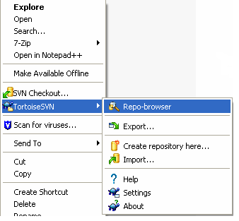
2.1. Setup TortoiseSVN, grant access right (1/2)
Find the latest TortoiseSVN at: http://tortoisesvn.tigris.org/download.html
Download and install the package: TortoiseSVN-xxx.msi
After installing, TortoiseSVN is integrated into Windows Explorer:
- Open Windows Explorer
- Right click, popup menu opened
- Select TortoiseSVN
  Note: for stand-alone PC, TortoiseSVN can be used as a source control system, it’s not necessary to setup a SVN server.

Slide 13
2.1. Setup TortoiseSVN, grant access right (2/2)
Working model: client (TortoiseSVN) – server (SVN)
Role: Admin or PM to grant access right to members.
How to:
Locate file \\[SVN server]\[Project folder]\authz-svn.cfg
Add members as follows:
[groups]
  svn_owner = PYRAMID\xnguyenvan
  svn_read = PYRAMID\ytranvan
  [/]
  @svn_owner = rw
  @svn_read = r
Company
server
SVN
Repository
Checkout / Commit
Working
copy
Working
copy
Working
copy
Admin or PM provides the URL to members
http://winserver:8000/svn/[ProjectName]
Member 1
desktop
Member 2
desktop
Member n
desktop
TortoiseSVN
folder

Slide 14
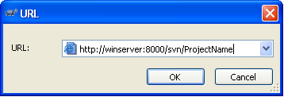
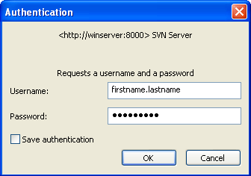
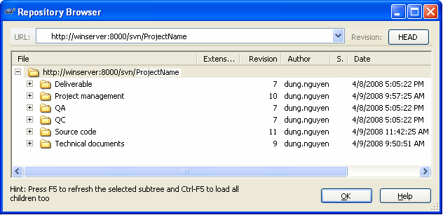
2.2. Browse repository
In Windows Explorer, right click>TortoiseSVN>Repo-browser
Put the repository URL into the dialog box
Login with given username and password
The Repo-browser opened

Slide 15
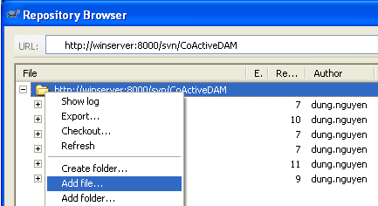
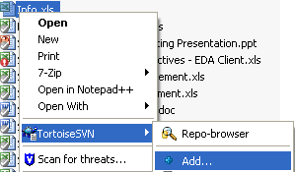
2.3. Add file/folder to repository
  A. Without (local) working copy folder
  In Repo-browser, right click>Add folder…
  Select source file/folder to be added
  => New files/folders will be added under current
  selected folder.
  B. With (local) working copy folder (recommended)
  Copy new file/folder to the working copy folder
  In Windows Explorer, select new file/folder,
  right click>TortoiseSVN>Add…
  TortoiseSVN>Commit…
  => New file/folder has a check mark.

Slide 16
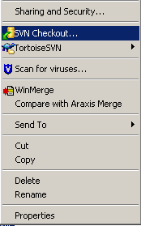
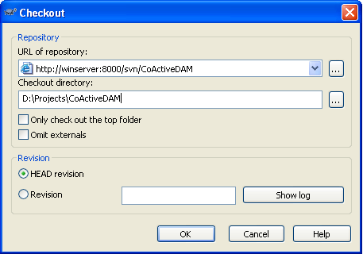
2.4. Check out a working copy
  SVN: Checkout (head rev.) = VSS: Get latest version
  In Windows Explorer, select working folder, right click>SVN Checkout… OR
  In Repo-browser, select the folder to check out, right click>Checkout…
Desired revision

Slide 17
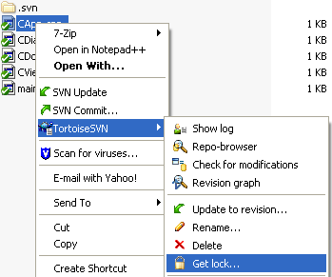
2.5. Lock/Release repository files (1/2)
  SVN: Checkout + Lock = VSS: Check-out
This is to avoid the conflict when another user updates the repository while you are working on your working copy.
How to:
In the working copy, select file to lock,
right-click>TortoiseSVN>Get lock…
=> Locked file has a lock-icon mark.
Other users will not be able to commit until you release the locked files.

Slide 18
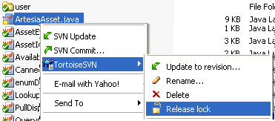
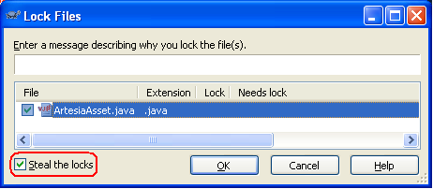
2.5. Lock/Release repository files (2/2)
This is to release the locked files for others to commit.
How to:
Select locked file>TortoiseSVN>
Release lock
Steal the locks:
- Select locked file>TortoiseSVN>
Get lock…
- Check Steal the locks
This way will steal other’s lock and replace by your lock. Not recommended. It’d be better to ask the author to release his lock.

Slide 19
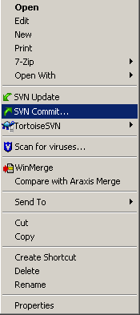
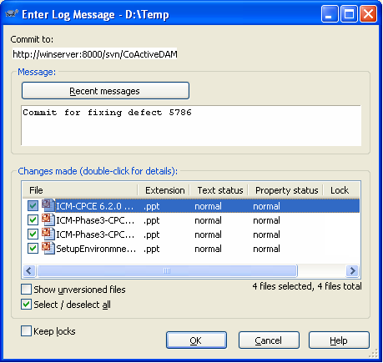
2.6. Commit to repository
  SVN: Commit = VSS: Check-in
This is to send the changes you made on working copy to the repository.
How to:
On the working copy, right click>SVN Commit…
Before committing, you should make sure that your working copy is up-to-date.
Should give comments

Slide 20
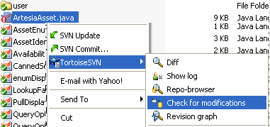

2.7. Check modification
This is to know the modification status of selected file in comparison with that file on the repository.
How to:
- On working copy, select modified file
- right click>TortoiseSVN>Check for modifications
The Working Copy dialog shows the status of the selected files in comparison with that file on the repository.

Slide 21
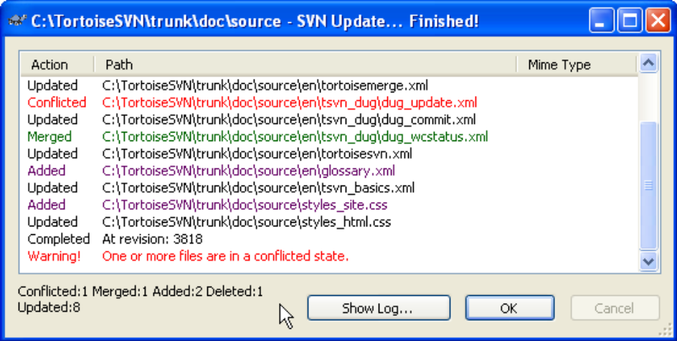
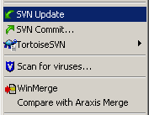
2.8. Update working copy (1/2)
  SVN: Update = VSS: Get latest version
This is to update your working copy with new changes on the repository.
Periodically, you should ensure that changes done by others get incorporated in your working copy.
How to:
On the working copy, select folder to be updated, right click>SVN Update…

Slide 22
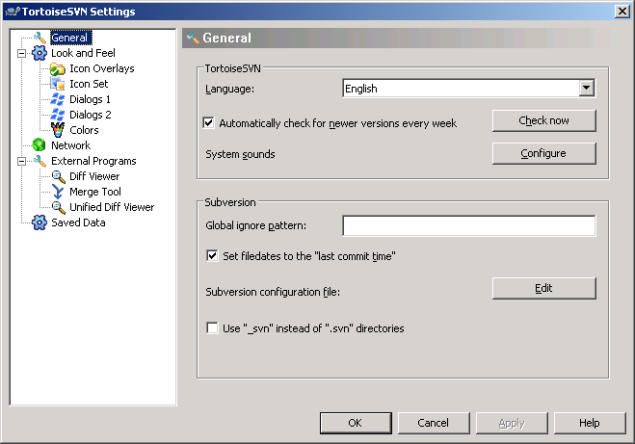
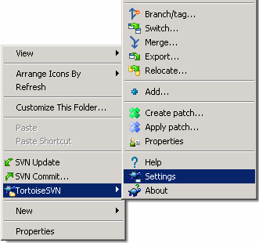
2.8. Update working copy (2/2)
To make date time of local files match with date time of files at SVN.
How to:
TortoireSVN>Settings to open TortoiseSVN Settings dialog.
Turn on option [Set filedates to “last commit time”].

Slide 23
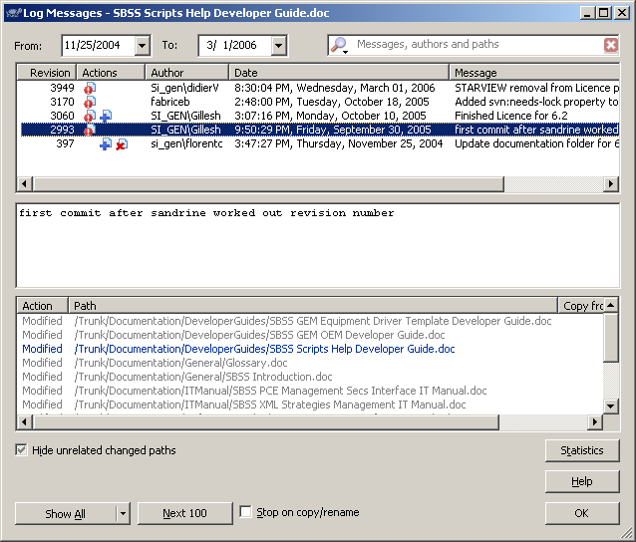
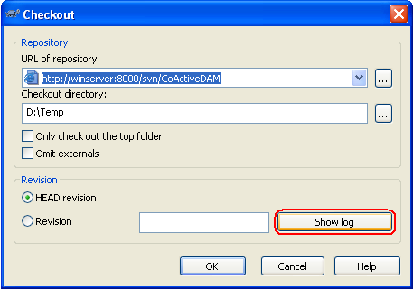
2.9. Show Revision log message
For every change you make and commit, should provide a log message describes the meaning of your change.
The Log Messages dialog retrieves all those log messages and allows you to select the desired revision.
Revision number is applied for the
whole repository.

Slide 24
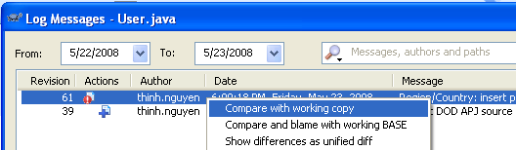
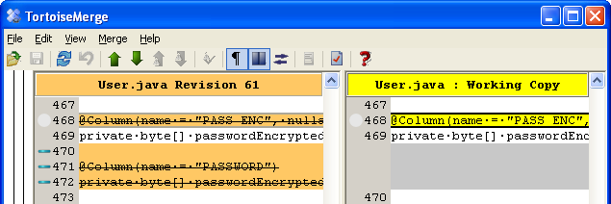
2.10. View differences
Compare working copy with a given SVN revision.
How to:
On working copy, select file to compare
Right click>Show log => Log messages dialog opened
Select the revison to compare, right click>Compare with local copy

Slide 25

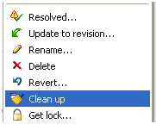
2.11. Clean up
If a Subversion command cannot complete successfully, perhaps due to server or network problems, your working copy can be left in an inconsistent state.
It is a good idea to do “clean up” at the top level of the working copy.

Slide 26







2.12. Status of version controlled files/folders
Green checkmark: normal status, under control
Red exclamation: file has been modified since last update and needs to be committed.
Yellow exclamation: a conflict occurs during an update.
Grey checkmark: this file needs to be locked first before editing.
Locked lock: file is locked. Need to unlock for other to commit.
Red deletion: missing file or file to be deleted under version control.
Blue plus: File to be added to version control.

Slide 27
3. Best practices
Best practices for the correct-usage
Avoid conflict over multi-user repository
Enforce control and cooperation among team

Slide 28
3. Best practices (1/5)
Give comments for the commit
  Professional working style.
  Give the meaning for the update you made.
  Help to find the desired revision quickly.
Update latest version before committing
  To assure your update is made on the latest version of the repository.
  Right-click>SVN Update

Slide 29
3. Best practices (2/5)
Self-manage the merging, do not let TortoiseSVN to merge files
  In case there is conflict between your working copy and the repository, you should merge file by yourself.
  Steps:
    Perform Update => TortoiseSVN creates 3 files: your original file, the latest file from repository and the SVN merged file.
    Don’t use the merged file.
    Manually compare and merge your original file with latest file.
    Overwrite your result onto the SVN merged file.
    Commit your merged file to the repository.

Slide 30
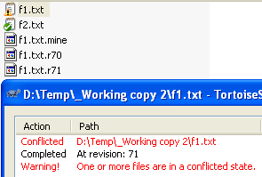
3. Best practices (3/5)
User 1
f1.txt.
r71
f1.txt.
r70
Commit?
Merge
f1.txt
f1.txt.
mine
User 2

Slide 31
3. Best practices (4/5)
Checkout-Lock-Edit-Commit-Unlock
(VSS: single checkout)
  Apply the auto need-lock property.
  How to use?
    Before editing one file, perform Get lock => file is ready to update, also the repository file is locked so the other cannot commit their changes.
    Commit your file after editing
    Release lock => the other can edit and commit their changes.
    Do not use Windows Explorer to set file attributes.

Slide 32
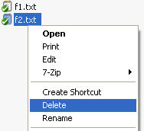
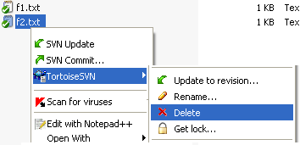
3. Best practices (5/5)
Use TortoiseSVN commands (right click, drag and drop)
don not use the Windows Explorer commands.
  This to keep the consistency between your working copy to the repository. The actions have effect on both your working copy and repository.

Slide 33
4. Q&A (1/3)
How to obtain a “clean” working copy (original sources only) and exclude .svn folders.
  Select working copy>right-click>TortoiseSVN>Export
  Provide the destination folder for the “clean” working copy
How to leave (ignore) the files/folders not in source control
  Select files/folders in working copy not in source control
  Right-click>TortoiseSVN>Add to ignore list
How to add “free” files/folders (in working copy) into source control
  Select fils/folders>right-click>TortoiseSVN>Add
  Commit the working copy

Slide 34
4. Q&A (2/3)
How to break/steal lock
  This is to break the locking on file by override the locking author.
  Check for modifications>select locked files>break lock, OR
  Right click>TortoiseSVN>Get lock, check the Steal option, OK.
  Recommend: should not use this function unless you have agreement of the PM.
Cannot login because of wrong SSL cache: clear cache
  First login to a wrong/forbidden link failed => wrong SSL is cached
  Later login (to correct link) also failed because the TortoiseSVN use the wrong cached SSL.
  Solution: right click>TortoiseSVN>Settings>Saved data>Authentication Data>Clear

Slide 35
4. Q&A (3/3)
How to check out an SVN directory (recursively) to local existing folder? (Similar to get latest version in VSS & overwrite all local)
  Should checkout to an empty working copy.
  Existing working copy may cause file conflict or leave files not under source control.
How to get specific version of code from SVN?
  Select file/folder in the working copy
  TortoiseSVN>Update to revision…
  Select the option Revision, input desired revision
  You can Show log to know the log message.

Slide 36
5. Test

Slide 37
Thank You
For Your Comment and Update.

