Slide 1
Software Testing and Quality Assurance
Testing Web Applications

Slide 2
Reading Assignment
Louise Tamres, “Introducing Software Testing,” First edition, Addison Wesley, 2002.
  Chapter 7: Testing Web Applications

Slide 3
Objectives
Learn what to test in web applications.
Learn how to test in a web application.

Slide 4

Topics Covered
Functional and usability issues: functional testing, usability testing, navigation testing, form testing, and page content testing.
Configuration and compatibility testing
Reliability and availability testing
Performance testing: scalability testing, load testing, and stress testing.
Security testing
End-to-end transaction testing
Database testing
Post implementation testing

Slide 5
Introduction
Web-based applications present new challenges, both for developers and testers. These challenges include:
  Short releases cycles
  Constantly changing technology
  Possible huge number of users during initial website launch
  Inability to control the user’s running environment
  24-hour availability of the website
Any difficulty in response time, accuracy, or ease of use will make the user to click on a competitor's site.

Slide 6
Topology of a Web Site
Internet
I
S
P
F
i
r
e
w
a
l
l
Browser
Database
Server
Web
Server
Browser
Browser
Application
Server

Slide 7
The Need for Web Testing
Is the site content meaningful?
Is this application easy to use?
How about browser compatibilities?
How reliable is our technology?
Do the Servers have enough power?
How many visitors are we expecting?
Are the machines fast enough?
How much activity can the site handle?

Slide 8
Functional and Usability Issues
The first tests for a website should focus on the site’s intended behavior by assessing the following issues:
  Functionality
  Usability
  Navigation
  Forms
  Page content

Slide 9
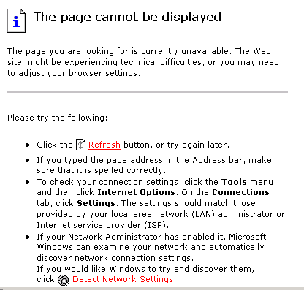
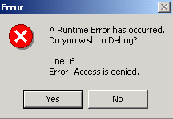

Why is Functionality Testing Important?
Missing image

Slide 10
Functional and Usability Issues: Functional Testing
Functional testing involves making sure features that most affect user interactions work properly. These include:
  Forms
  Searches
  Popup windows
  Shopping carts
  Online payments
Functional testing evaluates the content of dynamically generated pages and verifies many behind the scene (connections to database)

Slide 11
Functional and Usability Issues: Usability Testing
Usability testing assesses the website’s user friendliness and suitability by gathering information about how users interact with the site.
The key to usability testing is to study what a user actually does.
Usability testing steps:
  Identify the website’s purpose
  Identify the intended users
  Define tests and conduct the usability testing
  Analyze the acquired information

Slide 12
Functional and Usability Issues: Navigation Testing
Good navigation is an essential part of a website, especially those that are complex and provide a lot of information.
Most users expect the following:
  Easy and quick access to the information they want
  Logical hierarchy of pages
  Confirmation of where they are at any point
  Facility to return to previous states or the homepage
  Consistent look and layout of every page
  Uncluttered pages

Slide 13
Functional and Usability Issues: Forms Testing
Websites that use forms need to be tested to ensure that each field works properly and that the form posts all data as intended by the designers.
Testing forms include the following actions:
  Using the tab key to verify that the form traverses fields in the proper order, both forward and backward
  Testing boundary values
  Checking that forms traps invalid data correctly, especially data and numeric formats
  Verifying that the form updates information correctly

Slide 14
Functional and Usability Issues: Page Content Testing
Each web page must be tested for correct content from the user perspective.
These test fall into two categories:
  Ensuring that each component functions correctly
  Ensuring that the content of each is correct

Slide 15
Configuration and Compatibility Testing
A key challenge in web applications is ensuring that the user sees a web page as the designer intended:
  The user can select different browser software and browsers options.
  Use different network software and online service
  Run concurrent applications
Compatibility testing ensures product functionality and reliability on the supported browsers and platforms that exist on the customer computer.

Slide 16
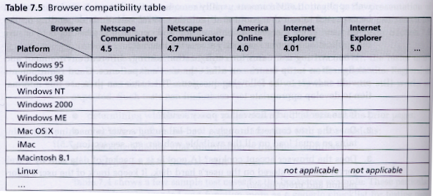
Configuration and Compatibility Testing (Cont.)
Guideline for testing web applications (by listing the platform and browser environments to be tested).

Slide 17
Reliability and Availability
A key requirement of a website is that:
  It is available whenever the user requests it, often 24 hours a day, every day.
  The number of users accessing a website simultaneously may also affect the site’s availability.
To assess availability, the tester must build tests around anticipated usage spikes which can include:
  For store applications: promotional campaigns and sales
  For business cycles: month-end and quarter-end dates
  For banking applications: direct deposit dates
  During maintenance: required downtime for backups, upgrades, and other operations.

Slide 18
Performance
Performance testing evaluates system performance under normal and heavy usage.
Website performance is crucial to the success of any web application.
Performance tests:
  Scalability testing
  Load testing
  Stress testing

Slide 19
Performance: Scalability Testing
Scalability concerns the website’s ability to handle the volumes and types of activities that can occur after launch.
The following types of scenarios affect scalability:
  How closely the test environment matches the production environment
  Millions of users accessing the site during launch
  Activity spikes due to marketing promotions

Slide 20
Performance: Load Testing
The purpose of load testing is to model real world experiences, typically by generating many simulations users accessing the website.
Load testing may need to be repeated at least once.

Slide 21
Performance: Stress Testing
Stress testing consists of subjecting the system to varying and maximum loads to evaluate the resulting performance.
Stress testing can be automated. Tools can report the following type of information:
  Number of requests, transactions and kilobyte/second
  Round trip time (time from the user makes a request to the time that the users receives the result)
  Number of concurrent connections
  Degradation of performance
  Types of visitors to the site and their number
  CPU and memory usage of the application server

Slide 22
Security Testing
Security is a primary concern when communicating and conducting business especially sensitive and business critical transactions over the internet.
Regardless whether the application requires the user to enter a password to access the website, the tester must check for internet threats.

Slide 23
End-to-end Transaction Testing
End-to-end transactions follow the workflow to the customer from beginning of the visit until the customer leaves the site.

Slide 24
Database Testing
Database testing is an essential part of the web testing.
Key issues include:
  Data integrity (no data corruption)
  Data validity (accurate information provided to the customer and accurate information passed back to the database)
  Data manipulation and updates (updating the number of books sold, books available, ...)

Slide 25
Post-Implementation Testing
Post-implementation testing verifies the behavior of the application in the production environment.
It is not feasible to duplicate the test environment to match the production environment.
Post-implementation testing takes place in a “production maintenance window”.

Slide 26
Key Points
Testing web applications present new challenges.
Functional and usability tests focus on the site’s intended behavior:
  Functional testing asserts whether the main features function correctly.
  Usability testing evaluates whether a site is user friendly by observing users as they interact with the site.
  Testing a form ensures that each field works properly.
  Navigation testing ensures that the user can accomplish the desired tasks by verifying access to pages, images, links, and other page components.
  Testing page content ensures that the information provided by the website is correct.

Slide 27
Key Points (Cont.)
Configuration and compatibility testing make sure that the application functions correctly across the various hardware and software environments.
Reliability and availability testing assesses whether the website is accessible whenever the users request it by testing around anticipated peak usage such as marketing promotions and high-activity cycles.

Slide 28
Key Points (Cont.)
Performance testing ensures that the website server responds to browser requests within defined parameters. As part of performance testing:
  Scalability testing assesses the website's ability to meet the load requirements.
  Load testing evaluates how the system functions when processing many simultaneous requests from a multitude of users.
  Stress testing subjects the system to varying loads.
Security testing aims to check for internet threats or protect sensitive information.

Slide 29
Key Points (Cont.)
End-to-end transaction testing tests all parts that make up a particular transaction by following a customer's workflow from entering to leaving the site.
Database testing verifies the integrity, validity and manipulation and updates of the data.
Post-implementation testing verifies an application's behavior in the production environment.

