Slide 1

Manage Engine: Q Engine

Slide 2
What is it?
Tool developed by Manage Engine that allows one to test web applications using a variety of different tests to ensure that the application is running well.

Slide 3
How it works?
Uses a browser interface and an integrated management solution, which allows engineers to maintain, modify, execute and schedule tests, all done via a Test Manager and an automated testing system.
Tests:
  Functionality, Compatibility, Localized Testing, Stress, Load, Web Services, Regression

Slide 4
Testing Manager
The testing manager lets the tool user modify, maintain and execute tests
Some features:
  Can be done via browser interface
  Allows creation of users to provide secure central access
  Automatic notification of test results
  Automatic test scheduling

Slide 5
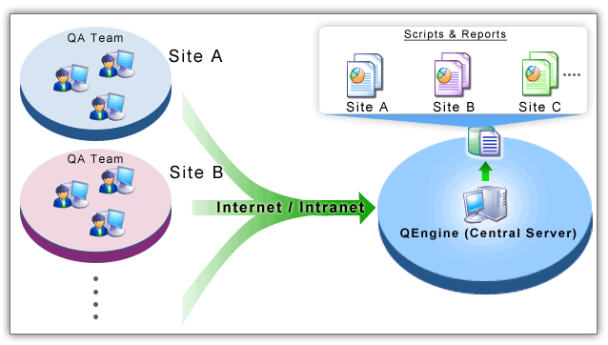
Test Automatons
Let’s scheduled tests execute and run on it’s own
  Saves time, money, effort in manual testing, can be repeated with less overhead
  Needs load and stress testing
Distributed Test Automaton
  Allows changes to be made from different sites to the same server, and respond to each with the test results.

Slide 6
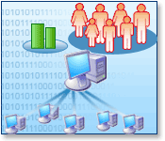
Load Testing
Ensures application can handle load conditions
Tests to make sure that speed is not sacrificed should multiple users access application
Simulates realistic load types with flexible scenarios
Supports Performance and Stress testing

Slide 7
Functional Testing
Tests functionality of application using various features
  Scripting
    Simplified script creation
    Unicode support
    Object repository
  Portability
    Allows scripts to be swapped over operating systems
    Multiple databases
    Test all languages with one script
  Validation and Verification
    Built in library to help for specific requirements
  Reports

Slide 8
Stress Testing
Tests the breaking point of one system by overwhelming resources.
Ensures that fails have a graceful recovery
Features
  Flexible scenario and dynamic data generation
  Real world load simulation
  Distributed stress testing
  Reports

Slide 9
Performance Testing
Tests the performance aspect of the application with respect to load and stress testing
Features:
  Flexible user scenarios
  Real world performance
  Session Handling
  Parameterized Performance Tests
  Browser Simulation
  Bandwidth Simulation
  Etc.

Slide 10
Compatibility Testing
Helps reuse test scripts for different platforms/browsers/languages/servers/databases
Multi-Browser Support
  IE
  Firefox
Multi-Lingual Support
  Java
  .NET
  AJAX
  PHP
Multi-Database Support
  My SQL
  Oracle
  SQL Server
  Any JDBC-compliant database

Slide 11
Regression Testing
Allows tests for unattended test execution and run test suites from command line mode using batch/shell files
Supports all the test and can be set for automatic execution at periodic intervals
Reports and logs generated

Slide 12
Web/Web Service Testing
2 Types
  Functional
    Checks validity of functions and conditions, and whether it is taken care of (SOAP/HTTP Responses for Service)
  Performance
    Checks load of application and stability should multiple users be
3 Steps
  Create scripts
  Run scripts
  Analyze scripts

Slide 13
Advantages/Disadvantages
Advantages
  One tool for diagnostics and various testing cases and tests that need to be completed
  Quicker and easier to use
  Simulates realistic scenarios for test cases
  Compatibility for major languages/browsers/O.S.
  Etc..
Disadvantage
  If language/browser/O.S. not supported, than must rewrite script, thus tool becoming useless
  Tool is not open source
  Must have toolbar installed on machine to access server and test reports

Slide 14

Questions/Comments

Slide 15
Thank You
References:
  http://www.manageengine.com/products/qengine/distributed-test-automation.html
  http://www.manageengine.com/products/qengine/functional-testing.html
  http://www.manageengine.com/products/qengine/performance-testing.html
  http://www.manageengine.com/products/qengine/compatibility-testing.html
  http://www.manageengine.com/products/qengine/stress-testing.html
  http://www.manageengine.com/products/qengine/load-testing.html
  http://www.manageengine.com/products/qengine/index.html
Presenters:
  Shaan Siddiqui
  Dave Jesion

