Slide 1
MEDVISION · TECHNICAL PROJECT REVIEW
MedVision turns image segmentation into a study workflow
Upload, process, visualize, compare, and evaluate segmentation outputs in one place.
ACADEMIC LEARNING AND EXPERIMENTATION SYSTEM

Slide 2
THE PROBLEM
Manual segmentation is slow, inconsistent, and sensitive to image conditions
1
Brightness, contrast, noise, and uneven illumination can change the result.
2
MedVision gives learners one place to upload, process, visualize, compare, and evaluate segmentation outputs.
3
Position the project as an academic learning and experimentation system, not a standalone clinical diagnostic tool.

Slide 3
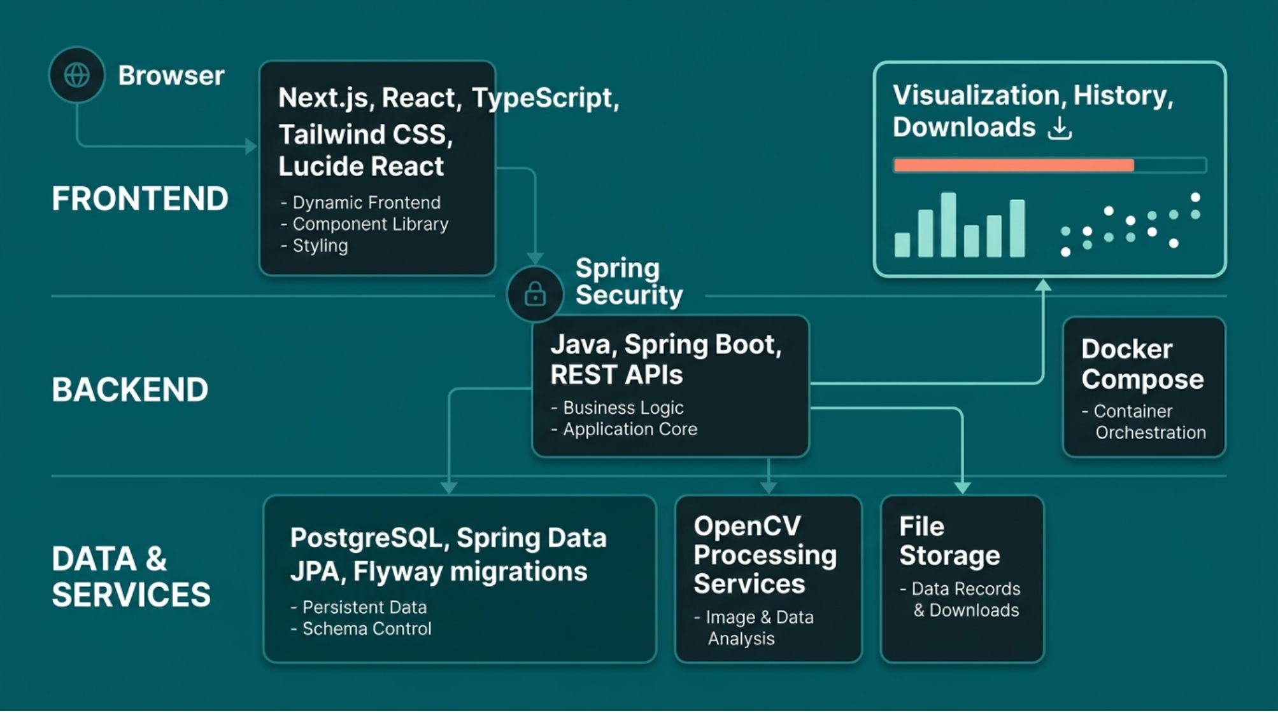
MEDVISION SYSTEM BOUNDARY · BROWSER TO ANALYSIS RESULTS
SYSTEM ARCHITECTURE
MedVision connects a web interface to image-processing services

Slide 4

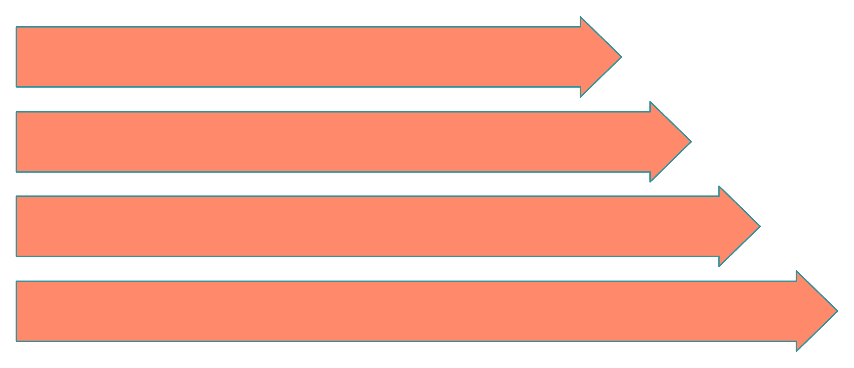
UPLOAD TO COMPARABLE RESULT · ANALYSIS HISTORY PRESERVED
END-TO-END PIPELINE
The segmentation pipeline turns an upload into a comparable result
Authenticate
Validate & Decode
Generate Mask
Store & History

Slide 5
ALGORITHM COMPARISON
Three thresholding methods expose different trade-offs
Otsu
Manual
Adaptive
Automatically selects one global threshold from the intensity distribution.
Global threshold: Yes. Parameter tuning: Low. Uneven illumination: Limited. Main limitation: Histogram dependence.
Gives the user direct control over a chosen threshold.
Threshold selection: User-defined. Global threshold: Yes. Parameter tuning: Required. Uneven illumination: Limited. Main limitation: Manual tuning.
Calculates local thresholds and can handle uneven illumination better, but adds parameter sensitivity.
Threshold selection: Local adaptive. Global threshold: No. Parameter tuning: Required. Uneven illumination: Often better. Main limitation: Noise sensitivity.

Slide 6
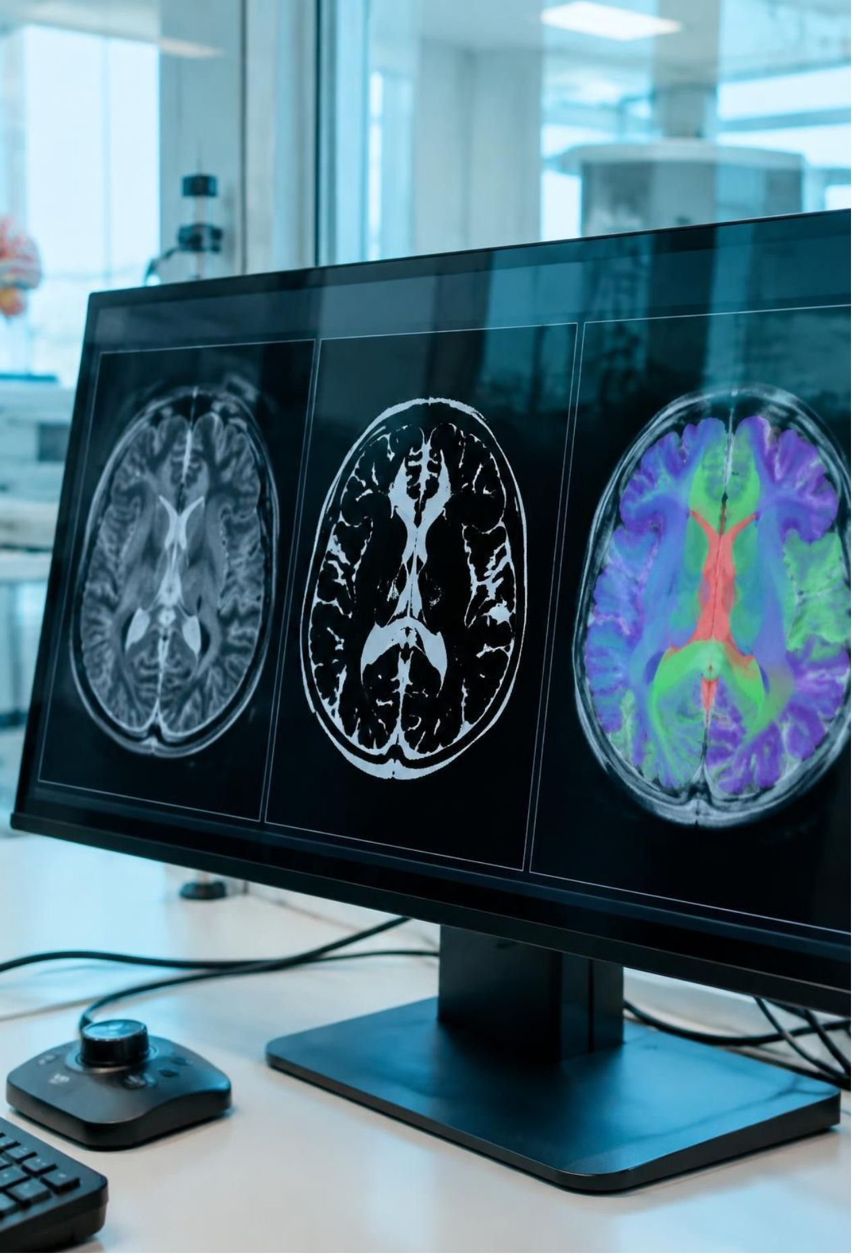
INSPECTION LAYER
Visualization makes algorithm behavior easier to inspect
1
Each analysis can expose the original image, the segmentation mask, and an overlay view.
2
Repeating the workflow with another method makes differences visible instead of theoretical.
3
History, filtering, renaming, and downloads support repeatable classroom or research demonstrations.
ORIGINAL · MASK · OVERLAY

Slide 7


EVALUATION
Dice and IoU turn visual comparison into measurable overlap
Dice
IoU
A emphasizes shared area relative to the two regions.
IoU compares shared area with the full combined region.
A ∩ B
Interpretation
The predicted region and ground-truth region overlap.
A is the predicted region; B is the ground-truth region. Scores range from 0 to 1 in the usual interpretation, with higher values indicating greater overlap.

Slide 8



TRUST BOUNDARIES
Security and validation protect the analysis workflow
Access control
Upload validation
Supported boundary
Session authentication, authorization, CSRF protection, ownership checks, and login attempt limiting.
Checks file type, size, decoding, dimensions, and controlled storage identifiers.
PNG and JPEG. The documented limits include 10 MiB maximum size and 4096-pixel maximum width and height.

Slide 9
BUILD APPROACH
The project was built as an incremental full-stack learning exercise
1
Analyze
2
Implement
Analyze requirements and design the system and database.
Implement backend APIs, storage, and segmentation algorithms.
3
Build
4
Demonstrate
Build the frontend workflow and add authentication and validation.
Test, document, and demonstrate the complete experience.
Testing coverage
Frontend checks
Authentication, uploads, storage, authorization, algorithms, evaluation, database mappings, and API errors.
TypeScript validation, ESLint, and the Next.js production build.

Slide 10
OUTLOOK
MedVision is a foundation for deeper medical image analysis
Current achievement
Current limits
Next steps
A web-based workflow connecting conventional segmentation, visualization, history, downloads, and evaluation.
Threshold methods vary with image characteristics, and no validated clinical performance is claimed.
Add specialized formats, more algorithms, deep-learning segmentation, stronger experiment tracking, and production monitoring.

