Slide 1



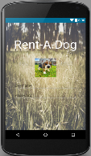
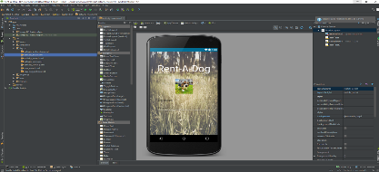

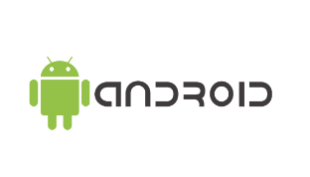
Rent A Dog!
Armando Silva
University of California Santa Cruz
Introduction
As students, employees, siblings, parents, supervisors, and more, we have always been occupied to enjoy in the simple things in life. We don’t have time to own dogs because of the amount of responsibility. However, with Rent-A-Dog, this Android Mobile application, easily allows you to rent out dogs based on your availabilities.
With the use of Android Studio, we are able to create the application, Figure 1, where people can create an account, search up dogs to rent, and rent them out based on the person’s availability.
Figure 1. Using Android Studio for Rent-A-Dog
Thus, not only does this mobile application help benefit mobile developers, the community, but as well, many stray dogs. Rent-A-Dog provides a safe and efficiently environment for users to rent a dog.
Materials and Methods
Android Studio: Graphical User Interface
In order to create the mobile application, I used Android Studio IDE; which consisted programming languages written in Java, XML, and SQLite. Through these programming languages, the mobile application can be developed; however, there are more underlying structures that allows for the development to be fully functional to be further discussed.
Database: Data Storage
One of the structures that must be taken to account when programming Rent-A-Dog is the stored information of not only the dog, but the user as well. In order to do so, I will use Firebase to interact with the back-end of the application. As well, by using Firebase database, it already has an user management system that enables an user authentication by email.
Enabling Global Positioning System
An important aspect of renting out a dog is to search for them based on location of the Android device. Here, Android Studio provides the developer a library that allows for such a feature. Here in the Android Manifest XML file, one may enable Android permission. After that feature has been enabled, there are more functionalities that are programmed in Java that allows for settings on searching a location for the closest dog.
Data Structure: Dynamic Listing
By using a MySQL database, it allows for easy and efficient search up of the dogs depending on the criteria. However, in order to display that, there is Java functionalities that handle the information and displays them on the XML style page.
Results
Beta
The mobile application is currently being development; however the structure has been proposed as the following:
1. create new account
2. accept user’s
3. Once logged in, store account request
or request information
3. Retried the updated
information and send
back.
Figure 3. Structure of Rent-A-Dog
As described from Figure 3, the user is first needed to create an account via email and be approved by the administrator of Rent-A-Dog. Once, the user has had approval of their account, then they are able to log in to the mobile application. As they interact with the Android device, the back-end database is constantly in communication with the front-end written in Java and XML. Some of the interactions between these actions are as follows:
Main activity page that allows user to search a dog by the type of bread, age, and/or location.
Another activity page that allows the user to edit their information.
An activity page for users to add friends, which allows for users to add their friends for communication.
Improvements on the Beta
Although there as been an implemented design to Rent-A-Dog, this is the prototype of what may expand. Some of the improvements that have been suggested are:
establish an online payment system that allows users to pay once the dog has been rented out.
allow SMS messaging, email, and other forms of communication with the mobile application.
Through these recommendations, there is further in depth research about API features and Android functionality that will improve upon a user’s experience with Rent-A-Dog.
Admin Rent-A-Dog
Conclusion
By developing a mobile application that allows users to rent out dogs, we are serving the community and stray dogs together. The application consist of Java, XML, and MySQL database, a database hosted in a cloud by Firebase. Through these functionalities, there will be a form of access to users about dogs that are allowed to be rented.
References
Rent-A-Cat. (n.d.). Retrieved May 23, 2016, from http://rentcats.pythonanywhere.com/
"Android Studio: The Official IDE for Android." Download Android Studio and SDK Tools. Web. 23 May 2016.
Login to legacy console - Firebase. (n.d.). Retrieved May 23, 2016, from https://www.firebase.com/
Objective
The goal is to build and design an Android mobile application in order to obtain a system that allows people to rent out dogs.
Figure 2. Android Mobile Device logo
Thus, the Rent-A-Dog application will be downloadable on the Google play store. Here, users with Android devices, such as one with the logo of Figure 2, can access the application.
Research for this project was influenced by a mobile application course taken at the University of California Santa Cruz, taught by Luca De Alfaro
and a web application, “Rent-A-Cat”, developed by Armando Silva, Ben D’Costa, Alex Janakos, and Evan Morrison

