Slide 1
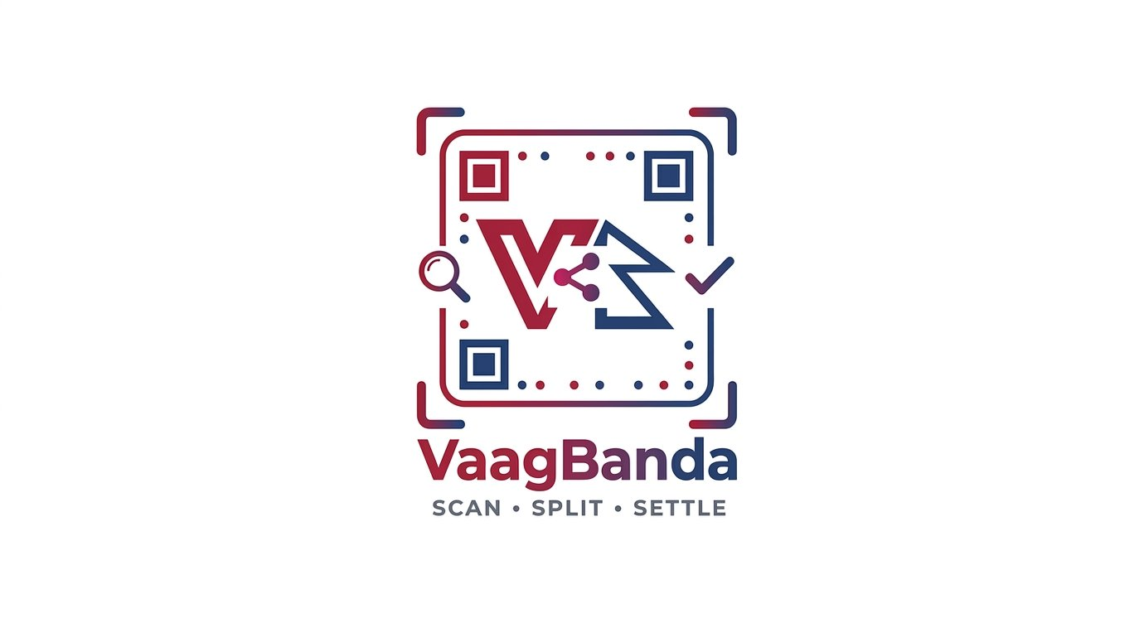
SCAN · SPLIT · SETTLE
Smart Mobile Expense-Splitting Application
Design Document Presentation - Design Phase
TEAM CYBERSQUADNP
Lama Rojan · Project Manager
Lama Nischal · Systems Analyst
Dankoti Jabin · UI/UX Designer
Shrestha Asim · Developer
Dongshin University · Glocal Autonomous Major College · Supervisor: Prof. Ibrahim Musa

Slide 2





THE FAMILIAR SCENE
Why we built VaagBanda
THE PROBLEM
The bill arrives.
Mental Math at the Table
Someone fumbles with a calculator. Tip? Tax? Who had the appetizer?
Then comes the chaos.
Lost Receipts, Lost Trust
Group chats fill up with screenshots. Old debts get forgotten.
Five friends. One receipt. Different orders. One person paid the whole thing — and now everyone owes a different amount.
Awkward Money Conversations
"You still owe me from last week." Nobody wants to be that friend.
It Gets Worse with Groups
Roommates, trips, events — the more people, the bigger the mess.
VaagBanda turns this chaos into one calm screen.

Slide 3





WHAT IS VAAGBANDA?
A mobile app for splitting expenses, without the math.
Inspired by Splitwise. Built independently as an academic project to demonstrate Systems Analysis & Design principles.
FUNCTIONAL REQUIREMENTS
NON-FUNCTIONAL REQUIREMENTS
What the app does
How the app behaves
Authentication
Email/password, biometric, social login
Performance
Fast response on typical smartphones; pagination for large groups
Group Management
Create groups, invite by email, admin roles
Security
HTTPS, bcrypt hashing, JWT tokens, encrypted at rest
Expense Splitting
Equal, exact, percentage, and shares
Usability
Intuitive enough that new users add expenses without help
Balance & Settlements
Real-time balances, debt simplification
Portability
Single codebase runs on both iOS and Android
Notifications
Activity alerts and payment reminders
Reliability
Offline expense entry; auto-sync when connectivity returns
Multi-Currency + OCR
Auto conversion, receipt scanning
Scope Limit
Records expenses only — does NOT process actual money

Slide 4
Functional Requirements
Non-Functional Requirements
Authentication
Biometric login (Face ID / Fingerprint) per device
Secure session management with token expiry
Password reset via verified token flow
Security
HTTPS/TLS for all communication
Passwords stored as cryptographic hashes
AuthDB isolated from SharedExpenseDB
BiometricAuth stores device flag only
Group Management
Create, name, and manage expense-sharing groups
Add or remove members; assign roles within groups
Each user can belong to multiple groups simultaneously
Data Integrity
DECIMAL(12,2) precision for financial amounts
Real-time balance calculation (no stale cache)
Transactional inserts across Expenses + Splits + Notifications
Full audit trail from creation to settlement
Expense Splitting
Log expenses with description, category, and payer
Auto-split by equal share or custom per-member amounts
Optional receipt OCR for automated expense entry
Performance & Scalability
Stateless, horizontally scalable API server
Per-request token validation (no server state)
Modular Pipe-and-Filter for independent scaling
Settlement Tracking
Record payments between members (no money transfer)
Real-time balance updates on each recorded settlement
Push notifications to creditor upon settlement receipt
Reliability
Atomic DB transactions on all writes
Asynchronous, non-blocking push notifications

Slide 5
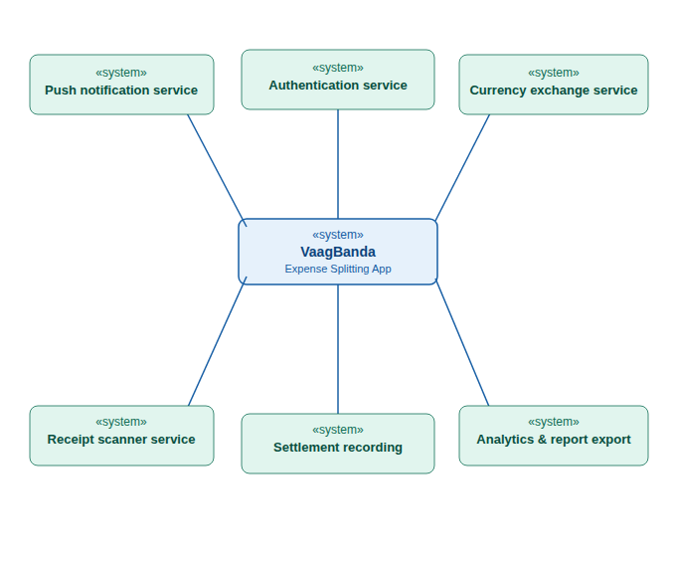
CONTEXT DIAGRAM
Authentication Service for secure user login and identity verification
Push Notification Service for alerts, reminders, and activity updates
Currency Exchange Service for real-time currency conversion
Receipt Scanner Service for extracting expense information from receipts
Settlement Recording Service for tracking completed payments between users
Analytics & Report Export Service for generating spending analysis and reports

Slide 6
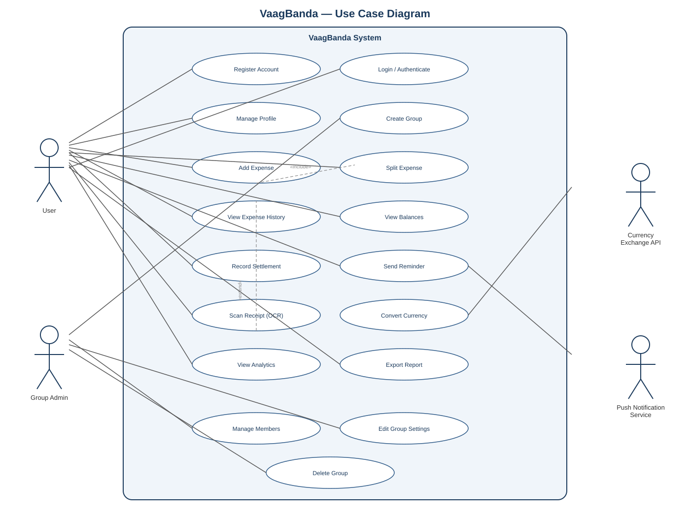
Use Case Diagram
Who does what in the application
▸ Actors
Two human actors: User and Group Admin. Two external systems: Currency Exchange API and Push Notification Service.
▸ Core user actions
Register, login, add expenses, view history, view balances, record settlements, scan receipts via OCR, and export reports.
▸ Admin extras
Group Admin can manage members, edit group settings, and delete the group — in addition to all regular user actions.
▸ Include relationships
Add Expense includes Split Expense — you cannot add an expense without splitting it.
▸ External links
Currency API is called during Convert Currency. Push Notification Service handles all Send Reminder calls.

Slide 7





ARCHITECTURE DESIGN
Three-Tier Client–Server + Pipe-and-Filter
Hybrid pattern: Client–Server separates the tiers; Pipe-and-Filter structures every request inside the server.
PRESENTATION TIER
EXTERNAL
Mobile Client (Rich Client)
Services
React Native + TypeScript app on iOS & Android.
Handles UI, validation, local cache, offline support.
Currency API
Real-time FX rates
APPLICATION TIER
Stateless REST API Server
Node.js + Express. Internal pipe-and-filter pipeline:
Input → Auth → Authorization → Business Logic → Data Access → Output
Push Service
FCM notifications
DATA TIER
No Payments
Two PostgreSQL Databases
By design — records only
AuthDB (credentials, sessions, biometric flags)
SharedExpenseDB (groups, expenses, splits, settlements)

Slide 8
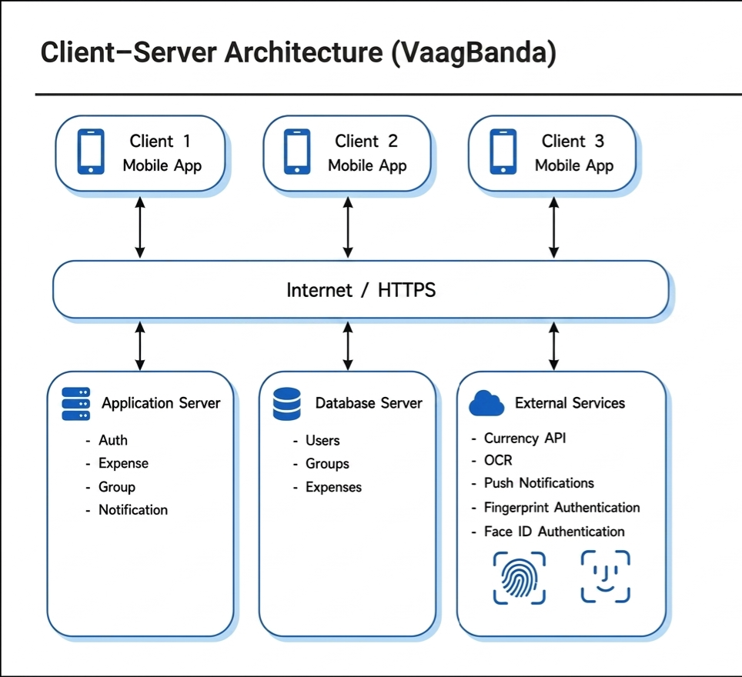
System Architecture
Uses Pipe and Filter architecture for efficient data processing.
Uses Client-Server architecture for communication between users and the server.
1.Client _server Architecture
Name | Client–Server
Description | Clients send requests to the server, and the server processes and returns results.
Example | Mobile app where users add and share expenses.
When used | Used in web and mobile apps with many users.
Advantages | Easy to manage Supports many users Scalable
Disadvantages | Needs internet Server failure affects all Can be slow under heavy load

Slide 9
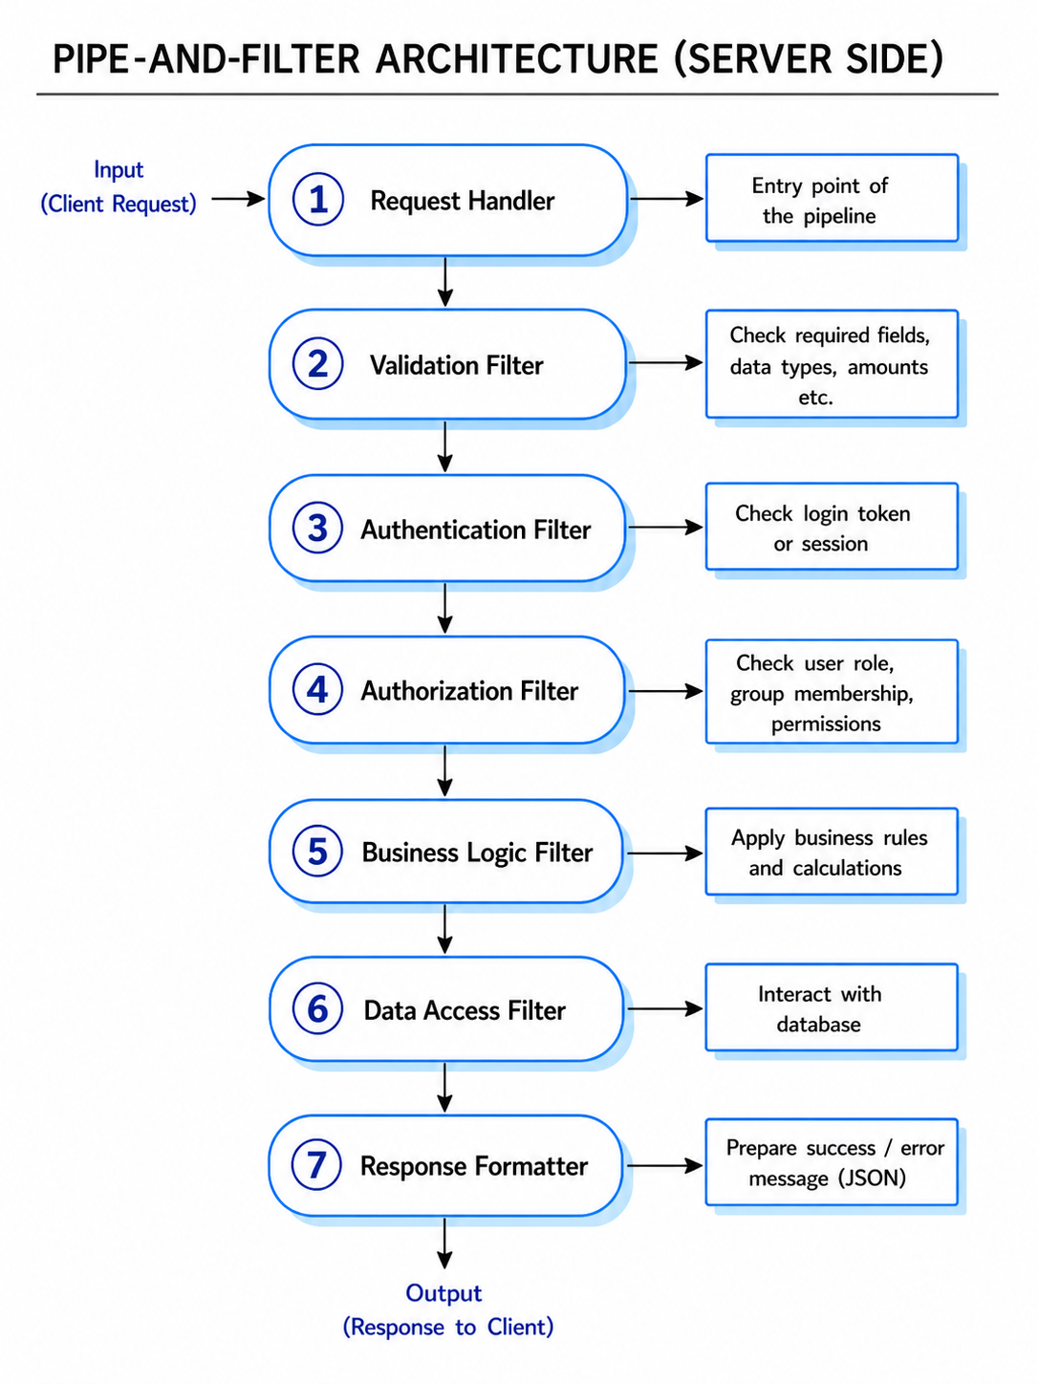
2.PIPE-AND FILTER ARCHITECTURE
Name | Pipe-and-Filter
Description | Data is processed in a sequence of steps (filters), where each filter transforms input and passes it to the next through pipes.
Example | Server request processing: validation → authentication → authorization → business logic → database → response.
When used | Used in data processing systems and backend request pipelines.
Advantages | Simple and modular design
 | Easy to test and maintain
 | Reusable components
Disadvantages | Not suitable for interactive systems
 | Data format must be consistent
 | Can add processing overhead

Slide 10
TECHNOLOGY STACK
Free-tier, open-source — zero budget
Every choice serves a specific SRS or design requirement.
MOBILE
SERVER
DATA
AUTH & EXTRAS
Layer
Layer
Layer
Layer
React Native 0.74+
TypeScript 5.x
React Navigation
expo-sqlite (offline)
expo-secure-store
Node.js 20 LTS
Express.js 4.x
TypeScript 5.x
Prisma ORM 5.x
Zod validation
PostgreSQL 15+
NUMERIC(12,2)
AuthDB + SharedExpenseDB
Render / Neon free tier
Daily backups
JWT + bcrypt
Socket.IO 4.x
FCM push (free)
Frankfurter currency API
Google ML Kit (OCR)
All selections justified in the Physical Design Specification (Section 1.3).

Slide 11
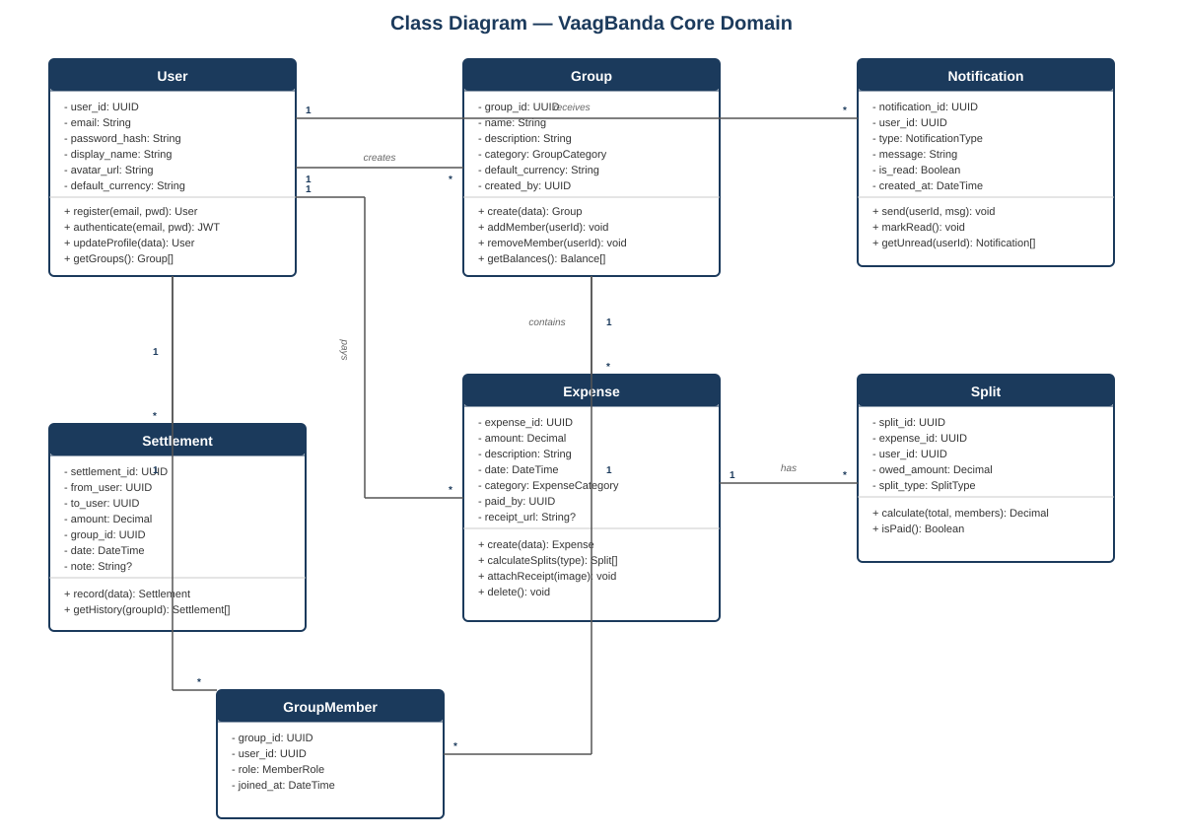
Class Diagram — VaagBanda Core Domain
Seven classes model the entire application
▸ User
Central class. Stores hashed credentials and display info. Methods: register(), login(), updateProfile(). Connects to groups through GroupMember.
▸ Group & GroupMember
Group holds name, defaultCurrency, createdBy. GroupMember is the join table — it also carries the role (admin or member).
▸ Expense
Belongs to a Group. Records amount, paidBy, and categoryId. splitEqually() and attachReceipt() are the key methods.
▸ Split
One row per member per expense. Stores amountOwed. Balance = SUM(Splits) minus SUM(Settlements) — never cached.
▸ Settlement
Records an external payment. validateAgainstBalance() ensures you cannot over-pay.
▸ Notification
In-app notification per user. dispatchPush() triggers FCM for a mobile push.

Slide 12
DATABASE DESIGN
Two Logically Separated Databases
Security Boundary
Auth data is isolated from business data — a security boundary, not a performance trick.
AuthDB
SharedExpenseDB
Authentication & Session Data
Groups, Expenses & Settlements
Users
Groups
userId · email (unique) · password_hash · displayName · createdAt
groupId · name · default_currency · created_by → · createdAt
Sessions
GroupMembers
sessionId · userId → · token · expiresAt
groupMemberId · userId → · groupId → · role · joinedAt
BiometricAuth
Expenses
userId · deviceId · enabled · updatedAt (no raw biometric data)
expenseId · groupId → · paid_by → · amount · description · date
PasswordReset
Splits + Settlements
resetId · userId · reset_token · expiresAt · usedAt
Splits = debt recorded. Settlements = payment made. Two tables for audit trail.

Slide 13



AUTHDB — AUTHENTICATION DATABASE
AuthDB is dedicated solely to user identity and secure access. It handles login flows, session persistence, biometric preferences, and password recovery — completely isolated from business logic.
Separation of auth from app data is a core security best practice, limiting blast radius in case of a breach.

Slide 14




SHAREDEXPENSEDB — CORE EXPENSE SYSTEM
The primary application database. Every user-facing feature — creating groups, logging expenses, splitting bills, recording payments — is backed by this database.
Groups & Members
Groups, GroupMembers
Expenses & Splits
Expenses, Splits
Settlements
Settlements
Notifications & Categories
Notifications, Categories

Slide 15
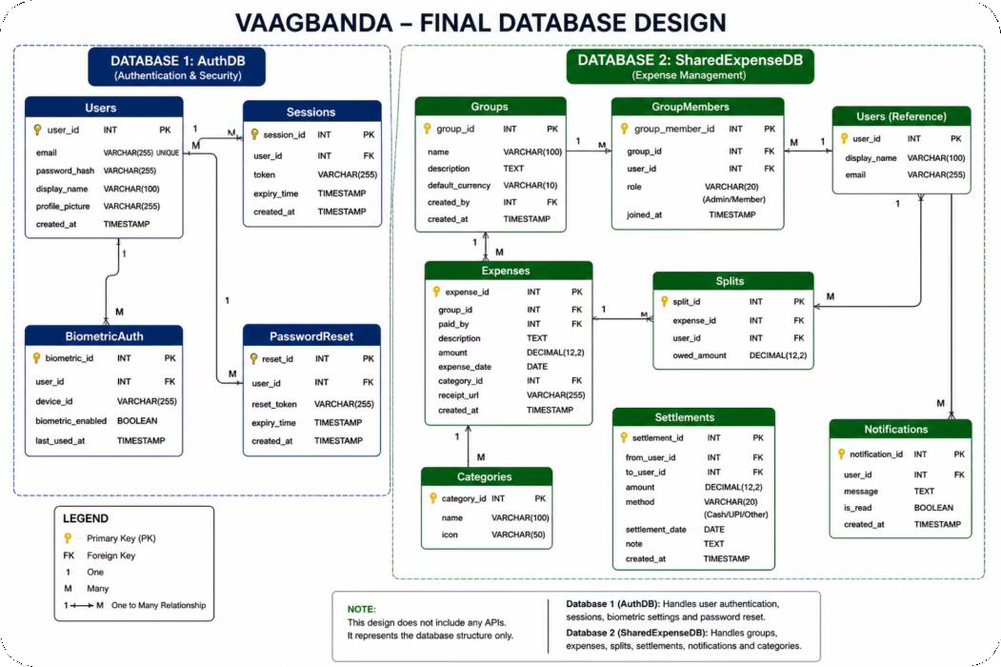

ER DIAGRAM AND : SCHEMA RELATIONSHIPS
Relationship Mopping
Users ↔ Groups via GroupMembers
Groups → Expenses (1:M)
Expenses → Splits (1:M)
Users → Settlements (payer & payee)
Expenses → Categories (lookup)
All foreign keys enforce referential integrity at the database level.

Slide 16
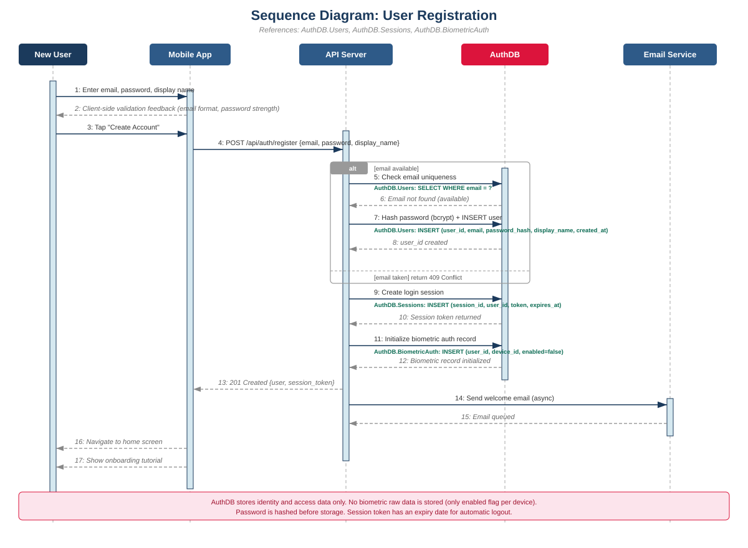

Sequence Diagram — User Registration
Step-by-step: new user signing up

Slide 17
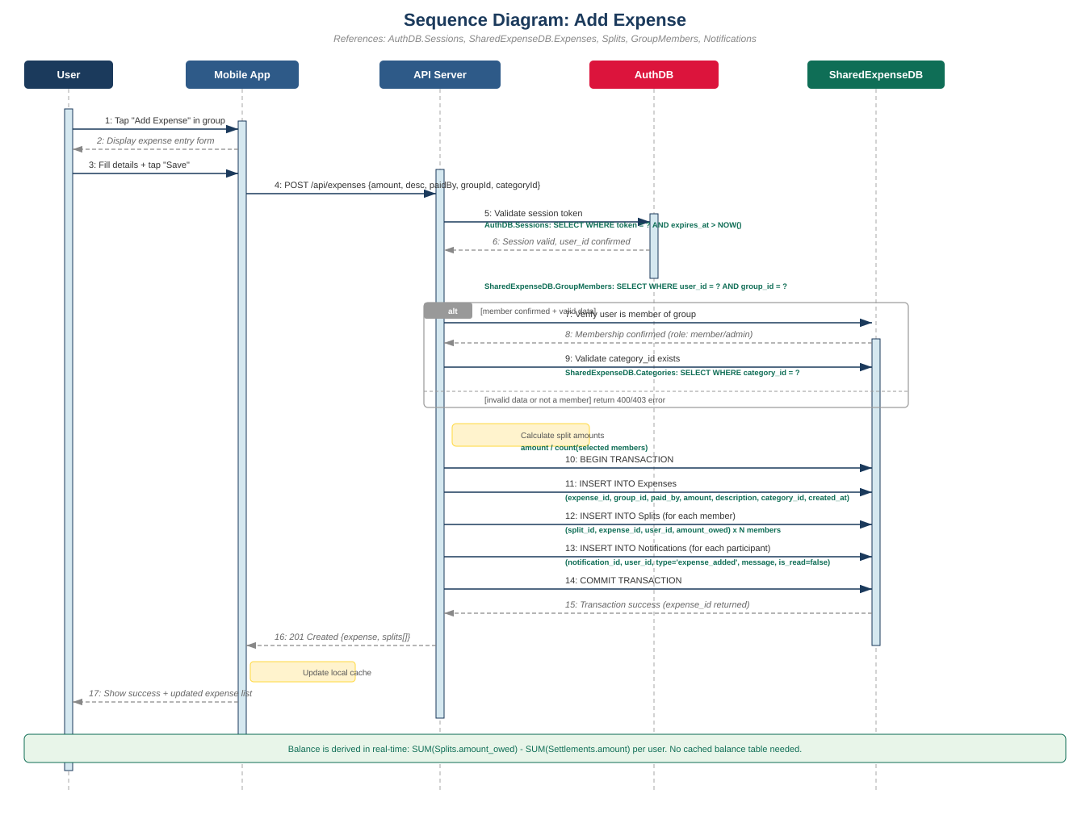
Sequence Diagram — Add Expense
From tapping Add Expense to database commit

Slide 18
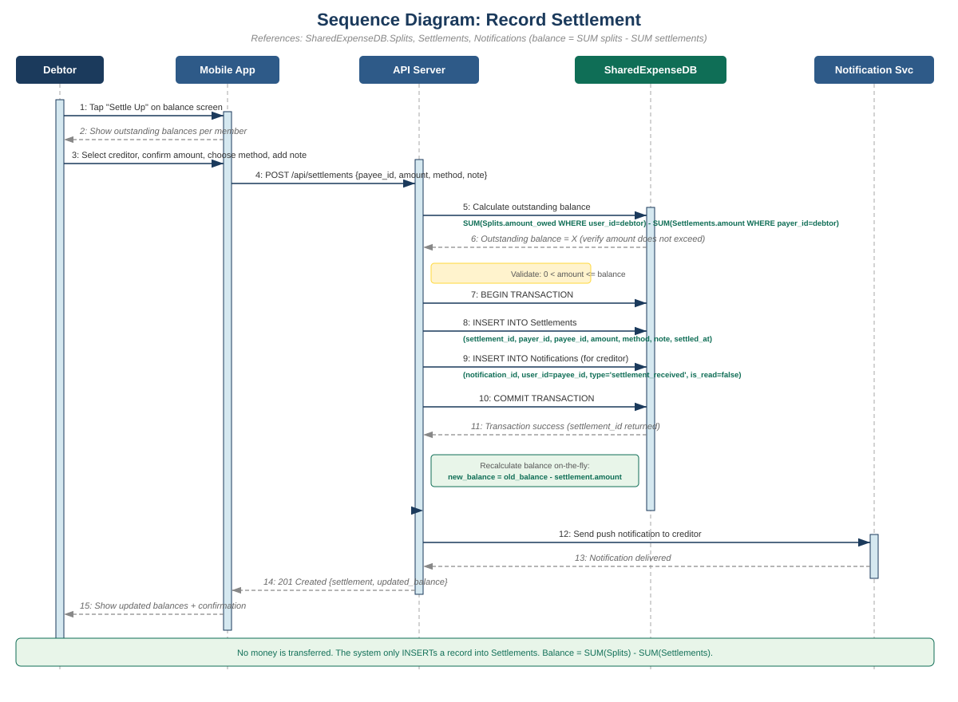
Sequence Diagram — Record Settlement
How a payment between two users is recorded

Slide 19


INTERFACE INVENTORY
Eight core screens — Login flow built, more in progress
01
02
03
04
Splash
Login
Signup
Forgot Pw
Animated logo intro
Email/password + biometric
Name, email, password strength
Reset link request + success
DESIGNED
BUILT
BUILT
BUILT
05
06
07
08
Home
Group Detail
Add Expense
Settle Up
Groups + overall balance
Members + expense list
Split methods + receipt
Record external payment
IN PROGRESS
IN PROGRESS
IN PROGRESS
DESIGNED

Slide 20

INCREMENT PLAN
Three Builds, Each Shippable On Its Own
Following Sommerville's Incremental Model. Each increment is a working app with more features than the last.
01
INCREMENT
02
INCREMENT
03
INCREMENT
Must Have
Should Have
Could Have
Weeks 7–9
Weeks 9–11
Weeks 11–13
User registration & login
Unequal splitting (exact, %, shares)
Receipt OCR (Google ML Kit)
Group creation & invitations
Push notifications (FCM)
Spending pattern analytics
Add expense with equal splitting
Payment reminders
Custom categories & tags
Real-time balance display
Multi-currency support
Export reports (PDF / CSV)
Record external settlements
Group analytics dashboard
Offline mode polish

Slide 21
WHERE WE ARE
Week 11 of 16. Design Document review.
4
7
8
16
Design documents finalized
Domain classes modeled
Screens designed
Weeks total timeline
Interface· Architecture · Database · Physical Design
With attributes, operations, and relationships
Login, Signup, Forgot Pw built in React Native
Three incremental builds + final review
Register → Create Group → Add Expense (equal split) → View Balance → Settle Up. The smallest end-to-end slice that proves the architecture works.

Slide 22
PROJECT TIMELINE
Gantt Chart
Incremental Model with Agile practices. Midterm review at Week 8.
TODAY
PHASE / TASK
W1
W2
W3
W4
W5
W6
W7
W8
W9
W10
W11
W12
W13
W14
W15
W16
PLANNING Project Charter & Scope
ANALYSIS Requirements (SRS)
ANALYSIS Use Cases & Class Diagram
DESIGN Architecture & Database
DESIGN Interface Mockups
MILESTONE MIDTERM REVIEW
★
IMPL. Increment 1 (Auth + Groups)
IMPL. Increment 2 (Expenses + Bal.)
IMPL. Increment 3 (OCR + Analytics)
TESTING Integration & System Tests
DELIVERY Final Presentation
Legend:
Planning/Analysis
Design
Implementation
Milestone

Slide 23
TEAM CYBERSQUADNP
VaagBanda · Smart Mobile Expense-Splitting Application
Dongshin University · Glocal Autonomous Major College · Supervisor: Prof. Ibrahim Musa
SCAN · SPLIT · SETTLE

