Slide 1
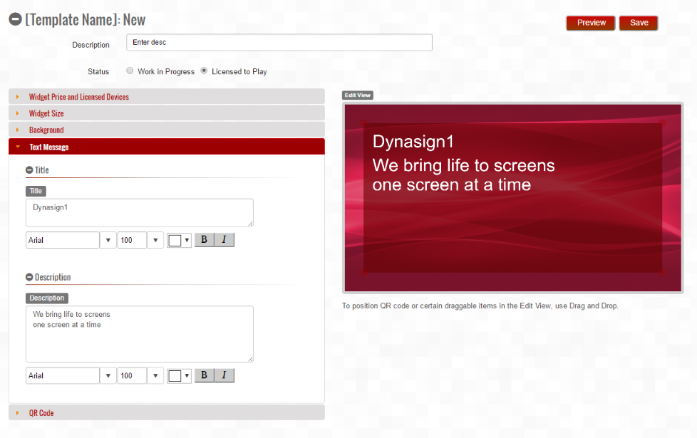
Tabs
Collapsible Groups
Template Fields
Edit View

