Slide 1
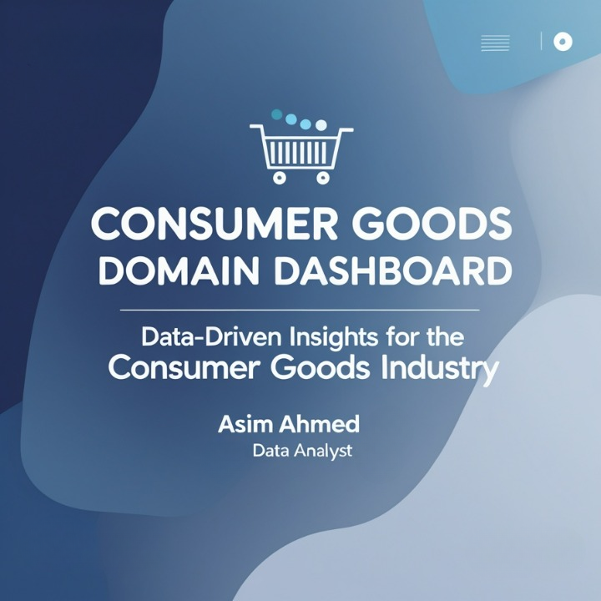



Slide 2
About the project
The goal is to analyze sales, profit, and performance across different products, regions, and customers.
Using historical data, we uncover actionable insights to support data-driven decision-making for AtliQ Consumer Goods.
Tools used include SQL, Power BI, and PowerPoint
Consumer Goods Domain | AtliQ Adhoc SQL Insights | © Asim Ahmed | linkedin.com/in/asimahmedio

Slide 3
Problem Statement & Task
Problem Statement:
AtliQ Hardwares, a leading computer hardware producer in India, has expanded globally.
The management lacks quick, data-informed insights to support smart decision-making.
Task:
Review ad-hoc-requests.pdf (10 business questions).
Write SQL queries to answer each request.
Create a presentation summarizing insights for top management
Consumer Goods Domain | AtliQ Adhoc SQL Insights | © Asim Ahmed | linkedin.com/in/asimahmedio

Slide 4
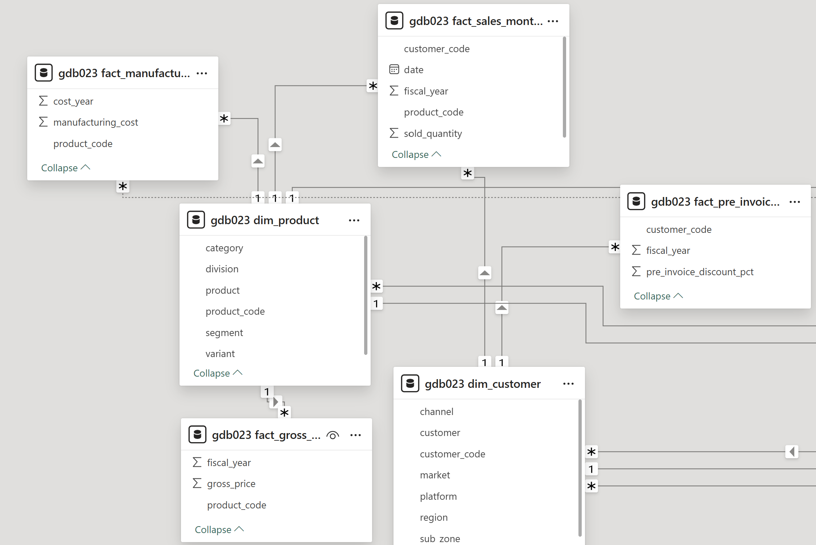
Dataset & Tools
Dataset Overview:
Contains sales, customers, products, markets, and transactions data.
Data is stored in multiple relational tables linked through primary and foreign keys.
Tools Used:
🧩 SQL — to query and analyze data for business questions.
📊 Power BI — to visualize insights and create dashboards.
📄 PowerPoint — for presentation.
Consumer Goods Domain | AtliQ Adhoc SQL Insights | © Asim Ahmed | linkedin.com/in/asimahmedio

Slide 5
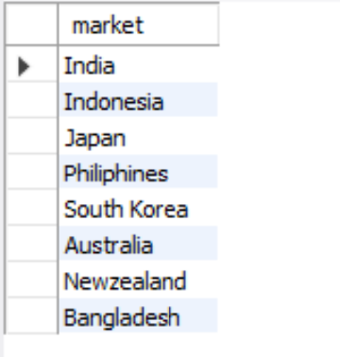
Provide the list of markets in which customer "Atliq Exclusive" operates its business in the APAC region.
🧩 Request 1
📊 Output
Consumer Goods Domain | AtliQ Adhoc SQL Insights | © Asim Ahmed | linkedin.com/in/asimahmedio

Slide 6
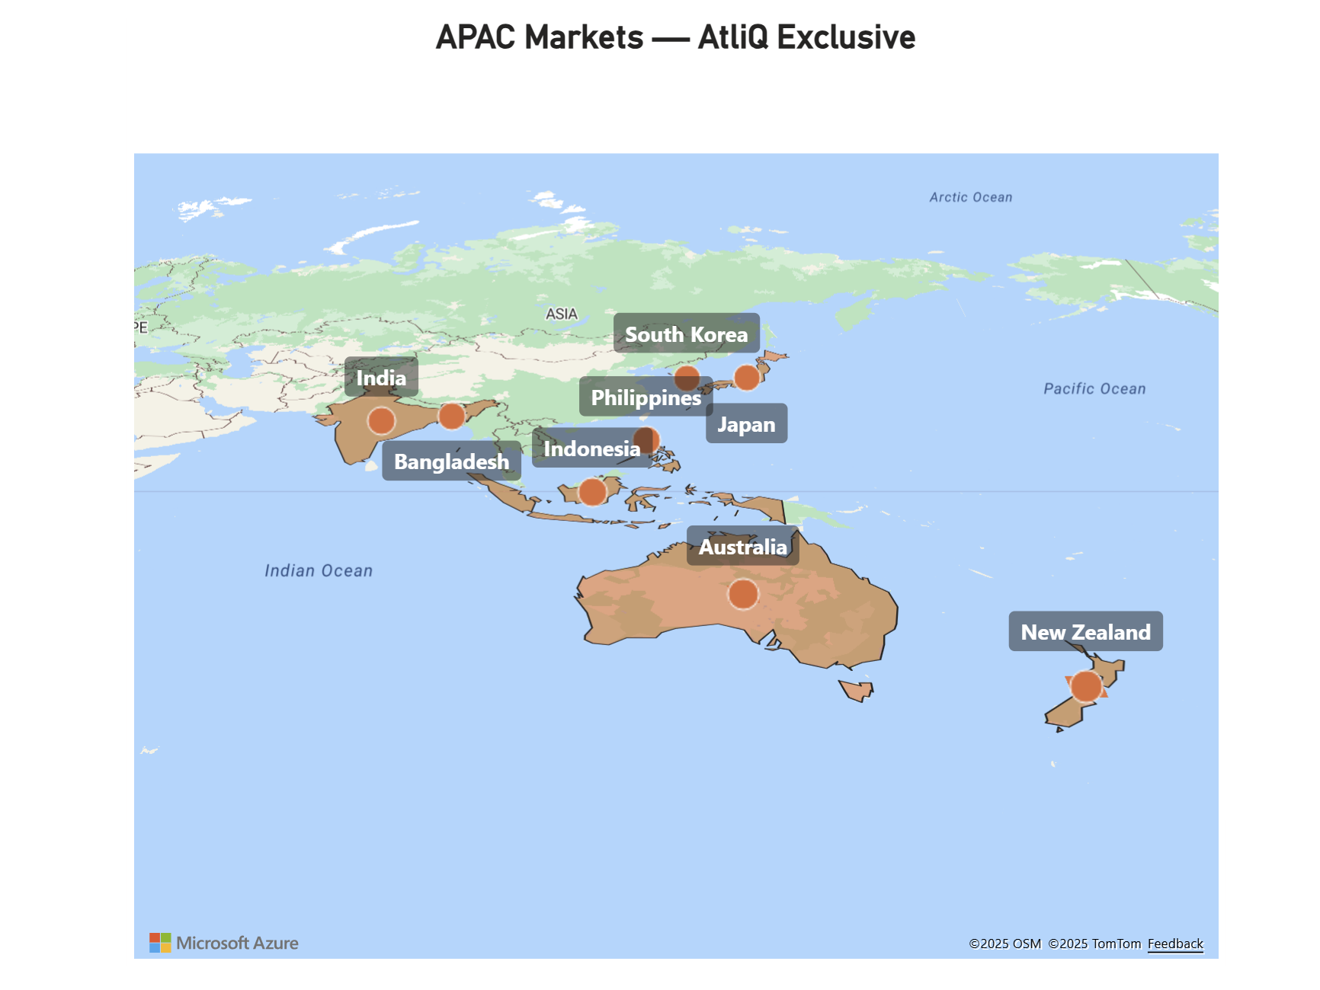
💡 Insights:
AtliQ Exclusive operates across eight APAC markets, covering a balanced mix of mature (Japan, Australia, South Korea) and emerging (India, Indonesia, Philippines, Bangladesh) regions — reflecting strong regional presence with further expansion potential in Southeast Asia.
Consumer Goods Domain | AtliQ Adhoc SQL Insights | © Asim Ahmed | linkedin.com/in/asimahmedio

Slide 7
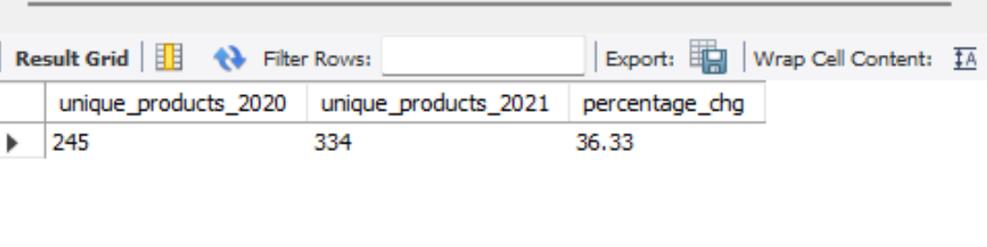
What is the percentage of unique product increase in 2021 vs. 2020? The final output contains these fields:
unique_products_2020
unique_products_2021
percentage_chg
🧩 Request 2
📊 Output
Consumer Goods Domain | AtliQ Adhoc SQL Insights | © Asim Ahmed | linkedin.com/in/asimahmedio

Slide 8
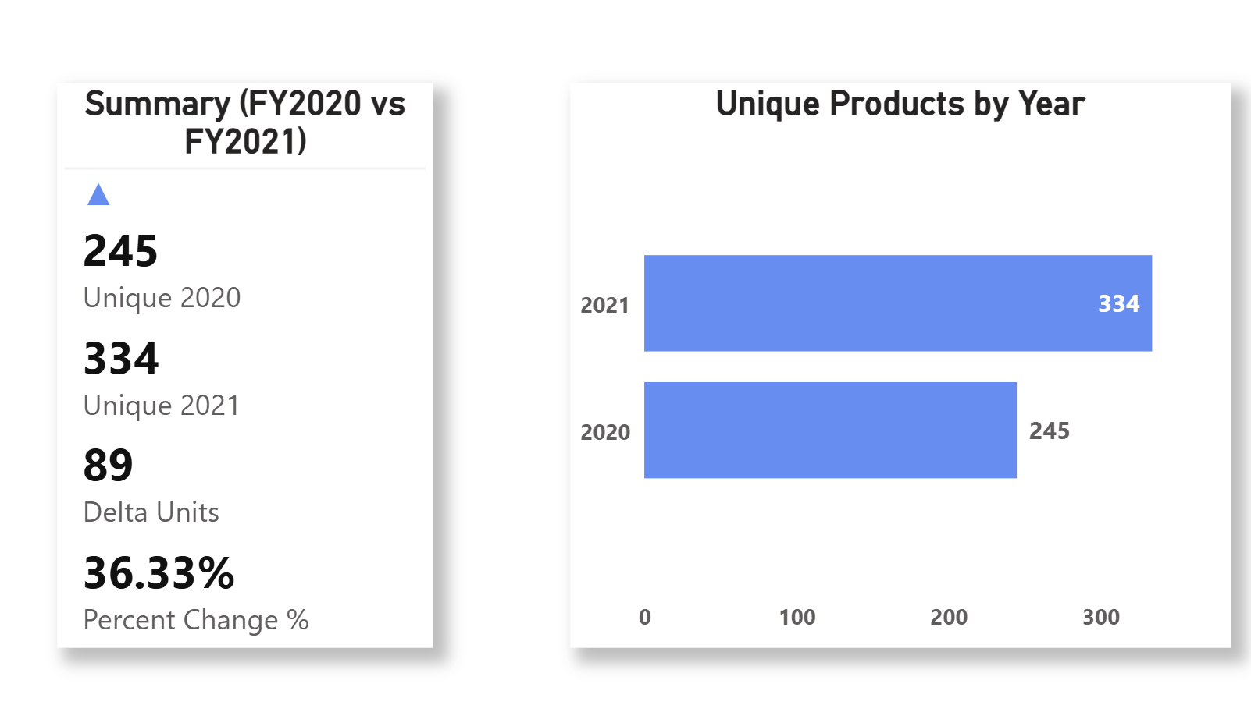
Conversion of Output to Visual
Query Output
Visualization Output
💡 Insights:
AtliQ’s product portfolio expanded from 245 unique SKUs (FY2020) to 334 (FY2021)—an increase of 89 SKUs (+36.33%).
This signals aggressive assortment growth in 2021 and warrants a follow-up on new-SKUvs. complexity (sales, margin, and inventory).
Consumer Goods Domain | AtliQ Adhoc SQL Insights | © Asim Ahmed | linkedin.com/in/asimahmedio

Slide 9
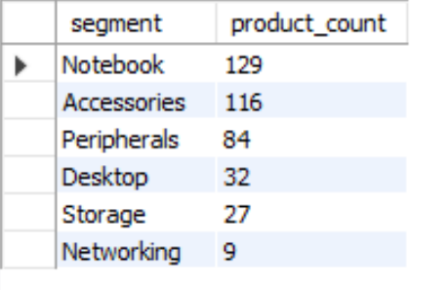
Provide a report with all the unique product counts for each segment and sort them in descending order of product counts. The final output contains
2 fields:
segment
product_count
🧩 Request 3
📊 Output
Consumer Goods Domain | AtliQ Adhoc SQL Insights | © Asim Ahmed | linkedin.com/in/asimahmedio

Slide 10
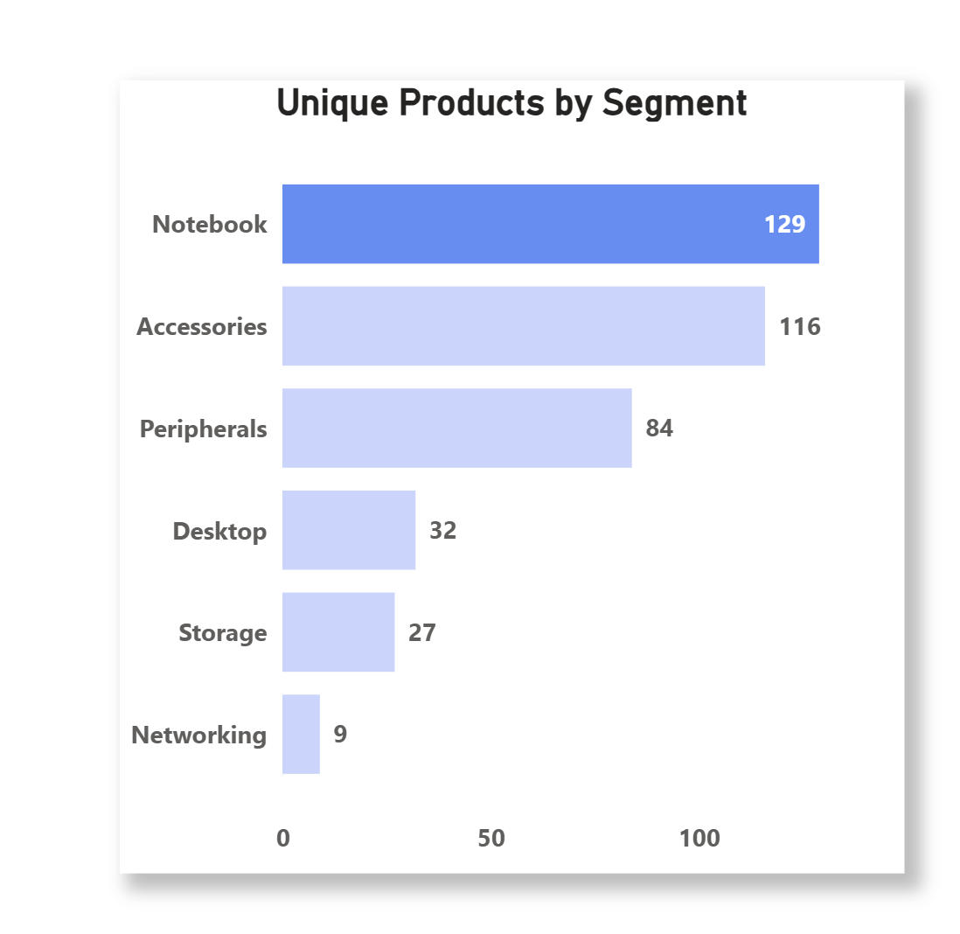
Conversion of Output to Visual
Query Output
Visualization Output
💡 Insights:
SKU breadth is heavily concentrated in Notebook (129), Accessories (116), and Peripherals (84)—these top three account for ~83% of the portfolio (329/397).
The long tail—Desktop (32), Storage (27), Networking (9)—is relatively thin, suggesting either focus areas for growth or candidates for SKU rationalization.
Consumer Goods Domain | AtliQ Adhoc SQL Insights | © Asim Ahmed | linkedin.com/in/asimahmedio

Slide 11
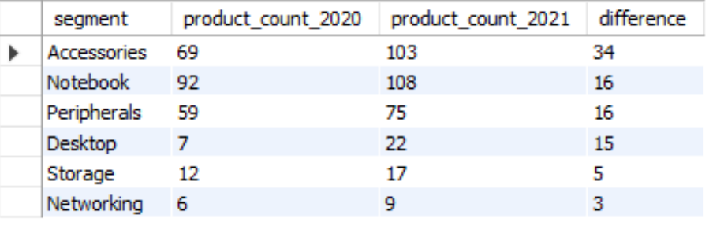
Which segment had the most increase in unique products in 2021 vs 2020? The final output contains these fields,
segment
product_count_2020
product_count_2021
Difference
🧩 Request 4
📊 Output
Consumer Goods Domain | AtliQ Adhoc SQL Insights | © Asim Ahmed | linkedin.com/in/asimahmedio

Slide 12
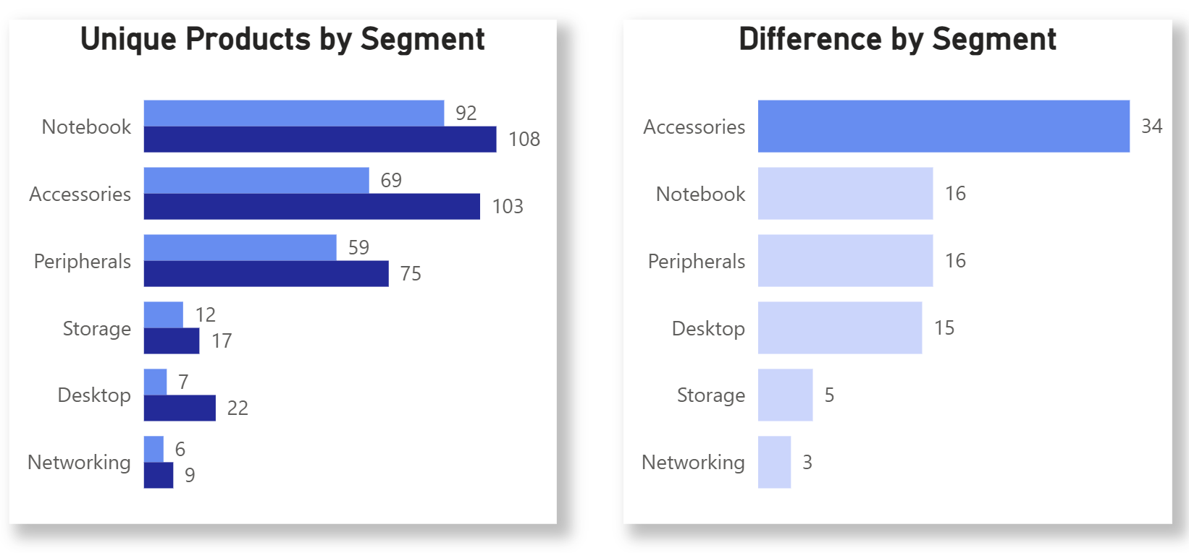
Conversion of Output to Visual
Query Output
Visualization Output
💡 Insights:
Portfolio expanded across all segments from 245 → 334 SKUs (+36.3%).
Biggest driver: Accessories +34 SKUs (69 → 103), contributing ~38% of total growth.
Largest segment remains Notebook: 92 → 108 (+16); steady, not the main growth engine.
Fastest % growth: Desktop +214% (7 → 22) - small base but rapid expansion.
Peripherals +27% (59 → 75); Storage +42% (12 → 17); Networking +50% (6 → 9)- broad-based uplift.
Consumer Goods Domain | AtliQ Adhoc SQL Insights | © Asim Ahmed | linkedin.com/in/asimahmedio

Slide 13
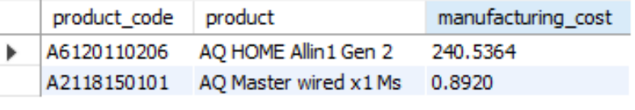
Get the products that have the highest and lowest manufacturing costs. The final output should contain these fields:
product_code
product
manufacturing_cost
🧩 Request 5
📊 Output
Consumer Goods Domain | AtliQ Adhoc SQL Insights | © Asim Ahmed | linkedin.com/in/asimahmedio

Slide 14
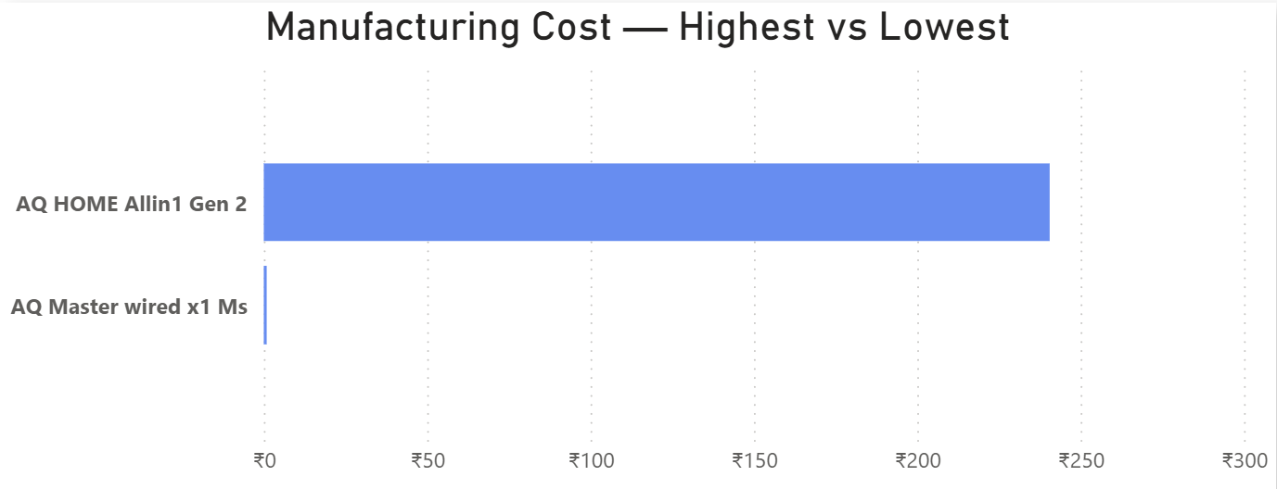
Conversion of Output to Visual
Query Output
Visualization Output
💡 Insights:
There’s a huge cost disparity between products — the AQ HOME Allin1 Gen 2 has the highest manufacturing cost (₹240.54), while the AQ Master Wired x1 Ms has the lowest (₹0.89).
This 270x cost gap highlights a diverse product portfolio, ranging from high-end systems to low-cost peripherals, reflecting AtliQ’s multi-segment market strategy.
Consumer Goods Domain | AtliQ Adhoc SQL Insights | © Asim Ahmed | linkedin.com/in/asimahmedio

Slide 15
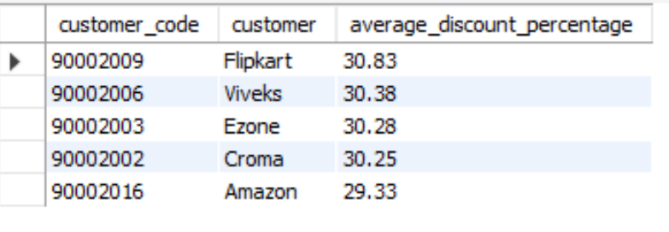
Get Generate a report which contains the top 5 customers who received an average high pre_invoice_discount_pct for the fiscal year 2021 and in the Indian market. The final output contains these fields,
customer_code
customer
average_discount_percentage
🧩 Request 6
📊 Output
Consumer Goods Domain | AtliQ Adhoc SQL Insights | © Asim Ahmed | linkedin.com/in/asimahmedio

Slide 16
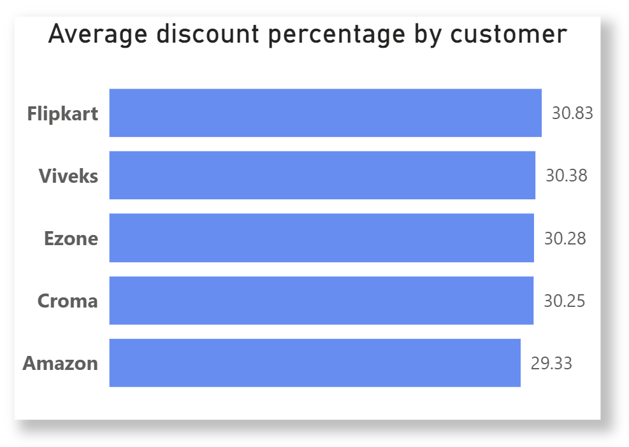
Conversion of Output to Visual
Query Output
Visualization Output
💡 Insights:
The average discount rate across top customers is closely aligned around 30%, indicating consistent pricing policies.
Flipkart receives the highest average discount (30.83%), slightly above others like Viveks (30.38%) and Amazon (29.33%), suggesting competitive incentives offered to major retail partners to maintain sales volume and channel loyalty.
Consumer Goods Domain | AtliQ Adhoc SQL Insights | © Asim Ahmed | linkedin.com/in/asimahmedio

Slide 17
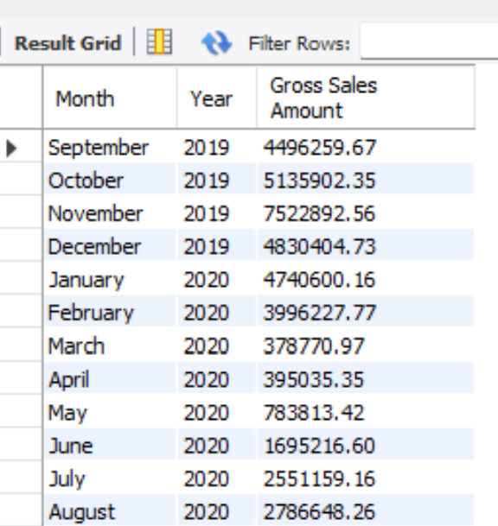
Get the complete report of the Gross sales amount for the customer “Atliq Exclusive” for each month. This analysis helps to get an idea of low and high-performing months and take strategic decisions. The final report contains these columns:
Month
Year
Gross sales Amount
🧩 Request 7
📊 Output
Consumer Goods Domain | AtliQ Adhoc SQL Insights | © Asim Ahmed | linkedin.com/in/asimahmedio

Slide 18
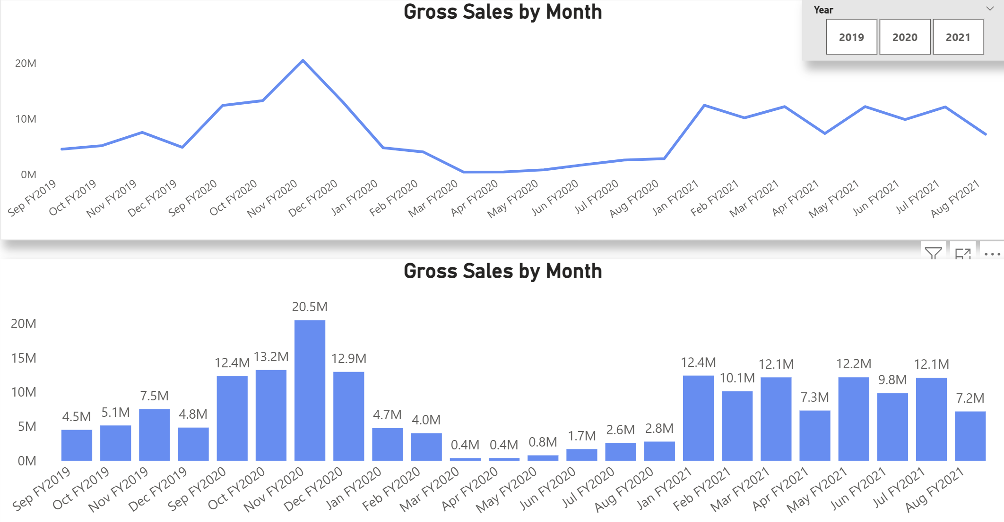
Conversion of Output to Visual
Query Output
Visualization Output
💡 Insights:
Strong seasonality with a holiday spike in Nov–Dec; Nov FY2020 peaked at ~₹20.5M (highest month).
A sharp COVID shock hits Mar–May FY2020 (near-zero in Apr), followed by a gradual recovery.
FY2021 stabilizes around ₹9–12M/month, recovering above FY2019 levels but below the FY2020 holiday peak.
Consumer Goods Domain | AtliQ Adhoc SQL Insights | © Asim Ahmed | linkedin.com/in/asimahmedio

Slide 19
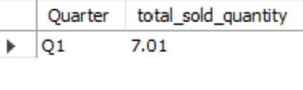
In which quarter of 2020, got the maximum total_sold_quantity? The final output contains these fields sorted by the:
Quarter
Total_sold_quantity
🧩 Request 8
📊 Output
Consumer Goods Domain | AtliQ Adhoc SQL Insights | © Asim Ahmed | linkedin.com/in/asimahmedio

Slide 20
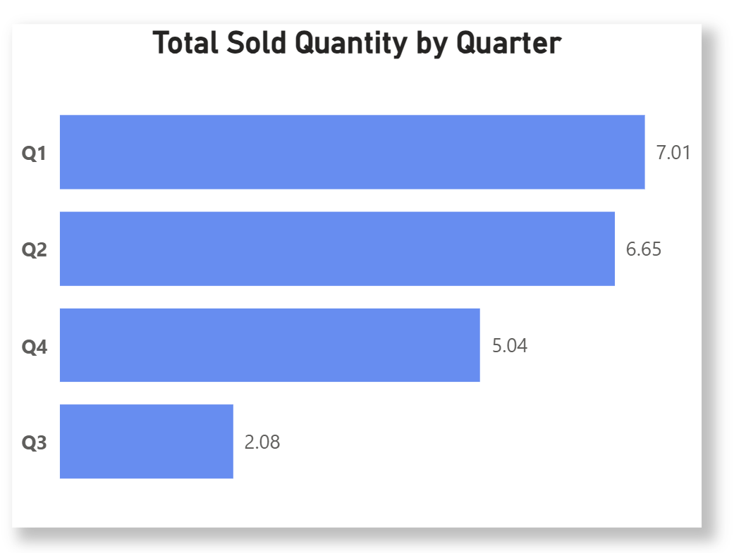
Conversion of Output to Visual
Query Output
Visualization Output
💡 Insights:
Q1 delivered the highest total sold quantity (≈7.01), ahead of Q2 (6.65), Q3 (5.04), and a soft Q4 (2.08)—indicating front-loaded demand with a notable dip in Q3.
Consumer Goods Domain | AtliQ Adhoc SQL Insights | © Asim Ahmed | linkedin.com/in/asimahmedio

Slide 21
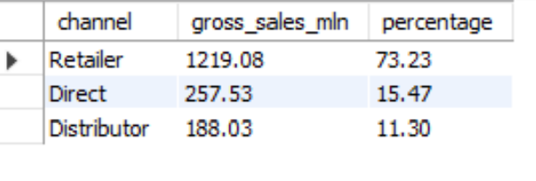
Which channel helped to bring more gross sales in the fiscal year 2021 and the percentage of contribution? The final output contains these fields:
channel
gross_sales_mln
Percentage
🧩 Request 9
📊 Output
Consumer Goods Domain | AtliQ Adhoc SQL Insights | © Asim Ahmed | linkedin.com/in/asimahmedio

Slide 22
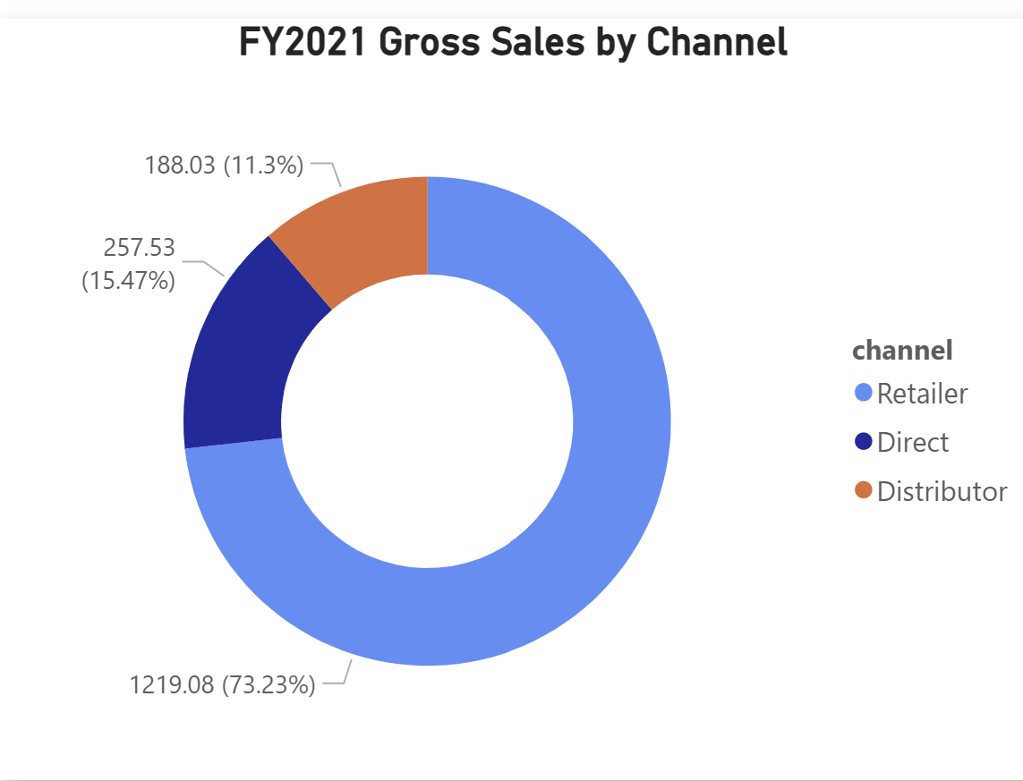
Conversion of Output to Visual
Query Output
Visualization Output
💡 Insights:
In FY2021, Retail channels dominated sales, contributing 73.23% (₹1,219M) of total revenue, while Direct (15.47%) and Distributor (11.3%) channels played smaller roles.
This indicates AtliQ’s strong reliance on retail partners, suggesting opportunities to diversify sales through direct or distributor channels to reduce dependency and enhance margin control.
Consumer Goods Domain | AtliQ Adhoc SQL Insights | © Asim Ahmed | linkedin.com/in/asimahmedio

Slide 23
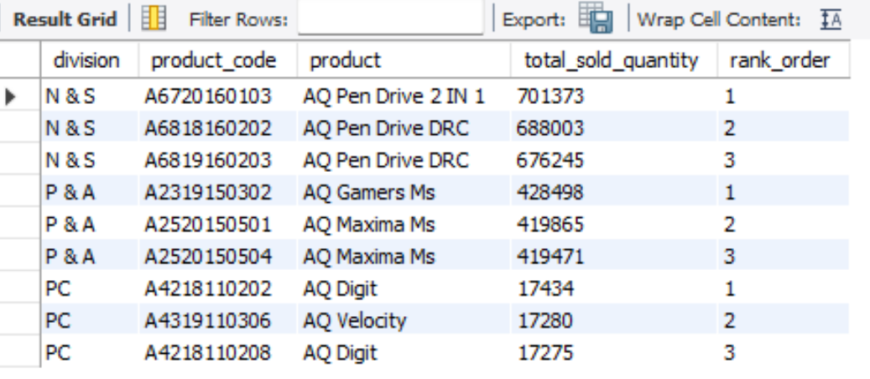
Get the Top 3 products in each division that have a high total_sold_quantity in the fiscal_year 2021? The final output contains these fields:
division
product_code
product
total_sold_quantity
rank_order
🧩 Request 10
📊 Output
Consumer Goods Domain | AtliQ Adhoc SQL Insights | © Asim Ahmed | linkedin.com/in/asimahmedio

Slide 24
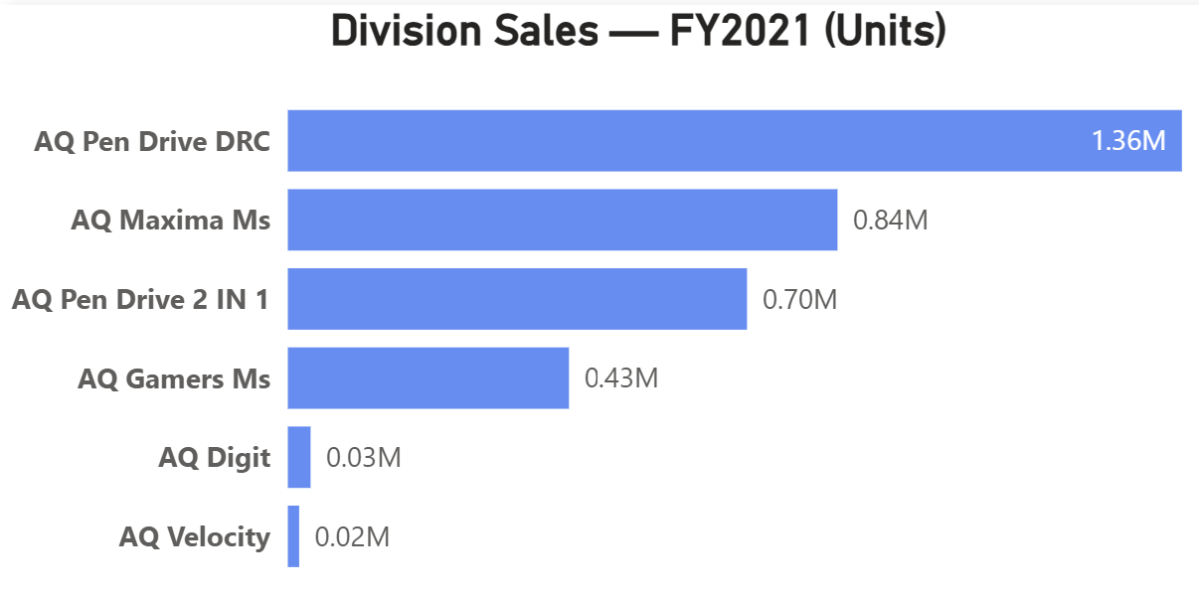
Conversion of Output to Visual
Query Output
Visualization Output
💡 Insights:
Pen Drive DRC is the top-selling SKU (~1.36M units), followed by Maxima Ms (0.84M) and
Pen Drive 2-in-1 (0.70M)—unit sales are heavily concentrated in the N&S / P&A lines.
PC division SKUs (AQ Digit ~0.03M, AQ Velocity ~0.02M) contribute negligible volume, suggesting candidates for SKU rationalization or a rethink of positioning.
The top 4 SKUs deliver the vast majority of FY2021 units (~3.33M) → prioritize supply, promos, and channel space on these winners.
Consumer Goods Domain | AtliQ Adhoc SQL Insights | © Asim Ahmed | linkedin.com/in/asimahmedio

Slide 25

Explore the Full Project
Check out my GitHub repository for detailed insights, SQL scripts, and presentation materials.
🐙 GitHub: github.com/asimahmedhub/AtliQ-Adhoc-SQL-Insights
📊 View Interactive Dashboard: Consumer Goods Project — Power BI Report
💼 Connect with me on LinkedIn: Asim Ahmed (io)

