Slide 1
Optimizing Power Efficiency in SRAM for High-Performance Computing
- Asim Anand (21BEC1519) - Akash Singh (21BEC1542)
- Ayushi Datta (21BEC1471)
Under the guidance of
- Dr. Sridhar C

Slide 2
LITERATURE SURVEY
Static Random Access Memory (SRAM) is one of the core components in the digital world. It is one of the widely used electronic device or electronic circuit.
It plays a critical role in modern high-speed digital systems, especially in cache memory of microprocessors, networking equipment, FPGAs, and embedded systems.
SRAM is a type of random-access memory (RAM) that uses latching circuitry (flip-flop) to store each bit. SRAM is volatile memory i.e. data is lost when power is removed.
It retains data bits in its memory as long as power is being supplied. Unlike dynamic RAM (DRAM), which must be continuously refreshed, SRAM does not have this requirement, resulting in better performance and lower power usage.

Slide 3

POWER CONSUMPTION IN RAM
Power dissipation in SRAM can be categorized into two main types: static and dynamic. Static Power Dissipation Static power consumption occurs even when the SRAM is not performing any operations, i.e., when it is idle but still powered on. The primary sources of static power consumption in SRAM are leakage currents in the transistors. Dynamic Power Dissipation Dynamic power occurs during the active switching of the SRAM, mainly in read and write operations. The switching of capacitances in the bit lines and word lines during these operations causes power dissipation. The formula for dynamic power is:
Pd = Dynamic Power
Ceff = Effective load capacitance
Vdd = Power supply
F = frequency

Slide 4
SRAM IN HIGH SPEED APPLICATIONS
In high-speed applications where SRAM operates at elevated frequencies, power consumption rises significantly due to increased switching activity. This includes faster read and write cycles, higher rates of charging and discharging capacitances, and greater leakage currents. For instance, in processor caches, SRAM runs at the processor's clock speed. Modern CPUs operating in the GHz range frequently access cache memory, which amplifies both dynamic and static power consumption. As clock speed increases, dynamic power scales linearly with frequency and quadratically with supply voltage.
To maintain reliability at higher speeds, SRAM typically uses elevated supply voltages, which further intensify power dissipation and heat generation. As the temperature rises, leakage currents grow exponentially, compounding overall power consumption.

Slide 5
Impact of High power consumption
High power consumption significantly impacts electronic systems, affecting performance, reliability, and sustainability. Addressing power consumption is crucial for system efficiency, component longevity, cost reduction, and environmental impact. Effective power management strategies are essential to ensure reliability and efficiency in modern electronic devices.
These issues can be resolved by exploring the techniques of power reduction such as using Transmission Gates or adding two more transistors to create it 8 Transistor SRAM.

Slide 6
Design of Proposed Methodology
The proposed methodology involves:
Architecture Modification: The design extends the conventional 6T SRAM by adding two transistors to create an 8T SRAM. This additional circuitry aims to reduce power consumption by enabling more efficient control of the memory cell, especially under low-voltage conditions.
Power Reduction Techniques: By integrating gated clocks and sleep transistors, we aim to minimize both dynamic and leakage power. Gated clocks reduce unnecessary switching activity, and sleep transistors help isolate unused memory cells, reducing leakage current during idle periods.

Slide 7
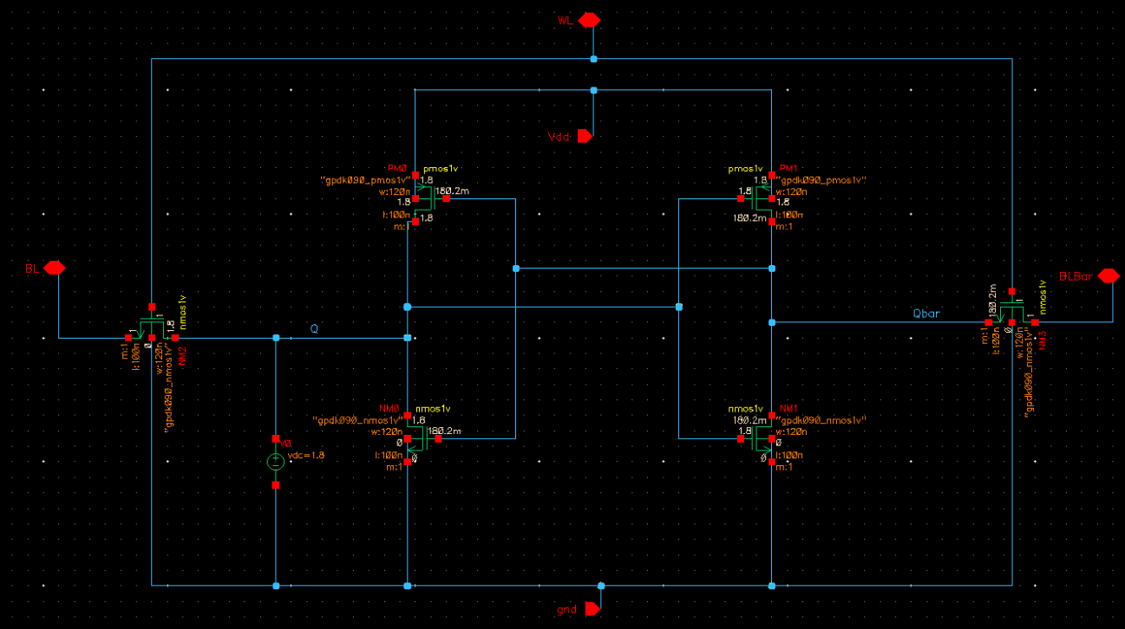
Implementation
6T SRAM

Slide 8
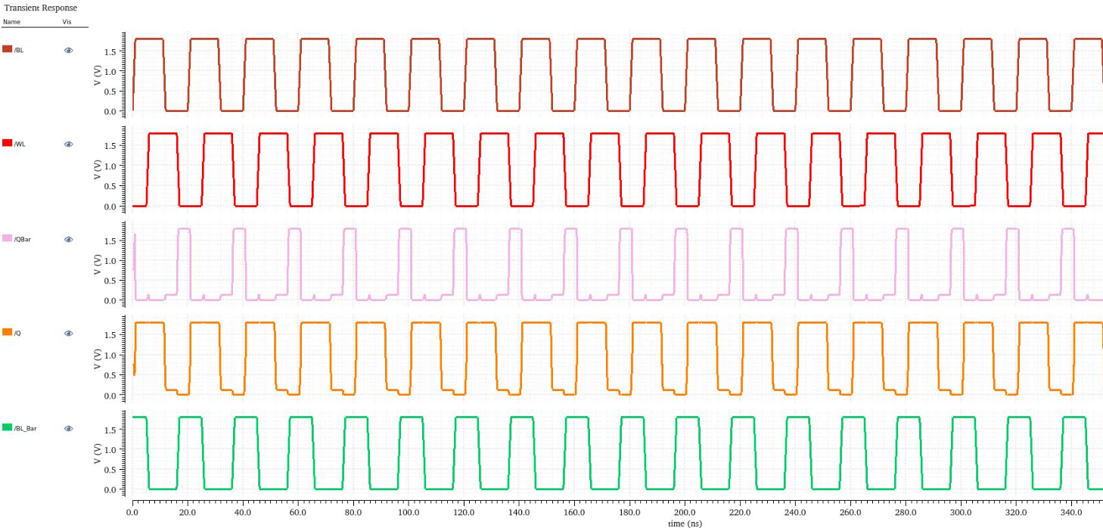

Slide 9
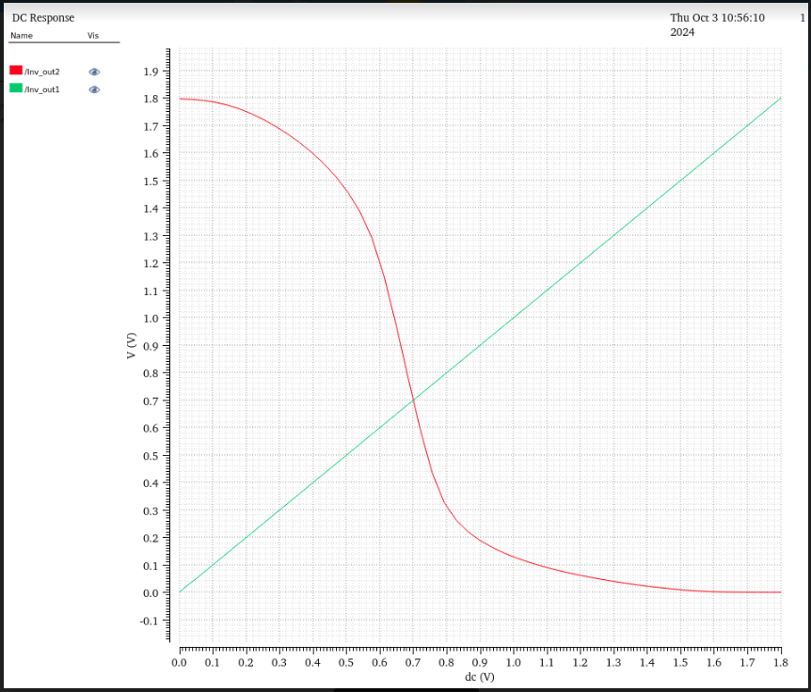
DC Response at Voltage V = 1.8 V

Slide 10
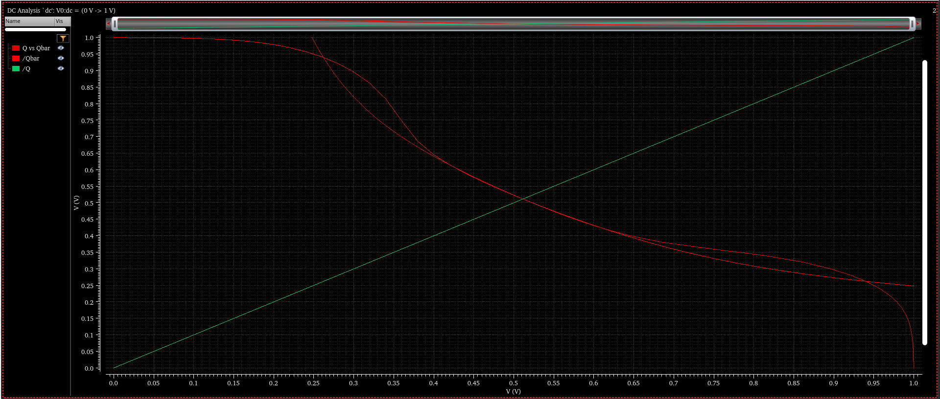

Slide 11
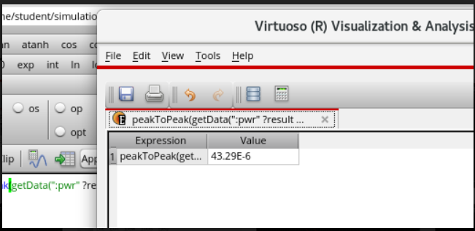
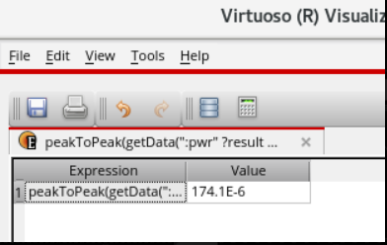
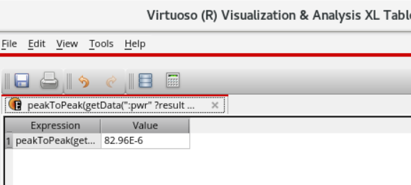
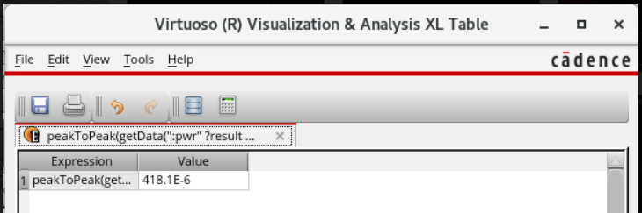
Power

Slide 12
Power
Voltage | Power (uW)
1.8 V | 43. 6
2.0 V | 82.9
2.5 V | 174.1
5 V | 418. 1

Slide 13
Results Obtained
In the analysis of the SRAM, the analysis of the DC response curve indicated that the SRAM is functioning correctly.
The butterfly diagram, a crucial representation in SRAM analysis, illustrated the relationship between stored data states (Q and Qbar). This diagram is significant becuase it helps assess the stability of the SRAM cells.
The study concluded that as the supply voltage increases, the shape of butterfly digram deteriorates, indicating a decrease in SRAM stability. THis instability arises from the decreased SNM caused by higher voltage levels.
Power consumption measurements were taken at different supply voltages as shown in the previous slide.
The analysis shows clear trend, as the voltage increases, the power consumption rises significantly.
These observation supports the assertion that at high speed, the power consumption in the SRAM also escalates

Slide 14
Proposed Methodologies
1. 8T SRAM
8T SRAM is an improvement over the traditional 6T SRAM design, primarily aimed at enhancing stability and reducing power consumption, especially in high-frequency or high-speed applications.
It introduces two additional transistors compared to the 6T configuration, enabling separate read and write paths, which decouples the read operation from the stored data. This decoupling improves stability and reduces power usage during high-speed operations but introduces some disadvantages as well.

Slide 15
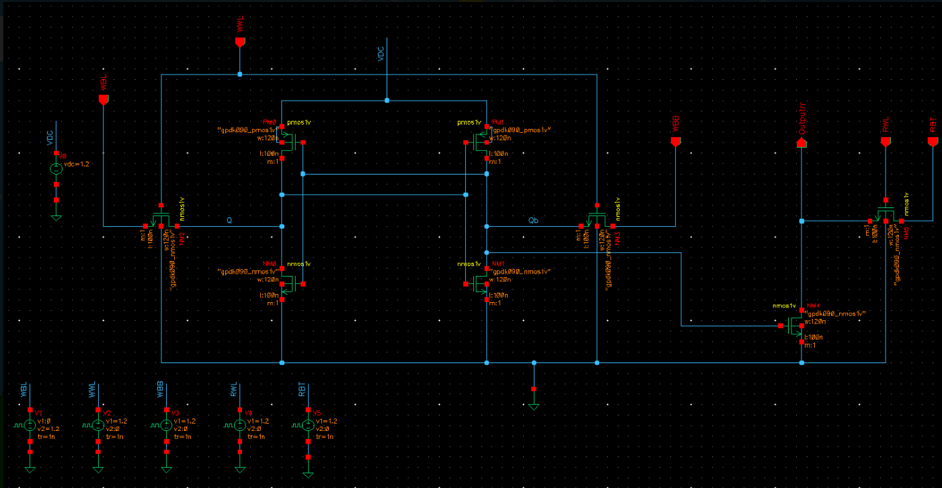
Proposed 8T SRAM

Slide 16
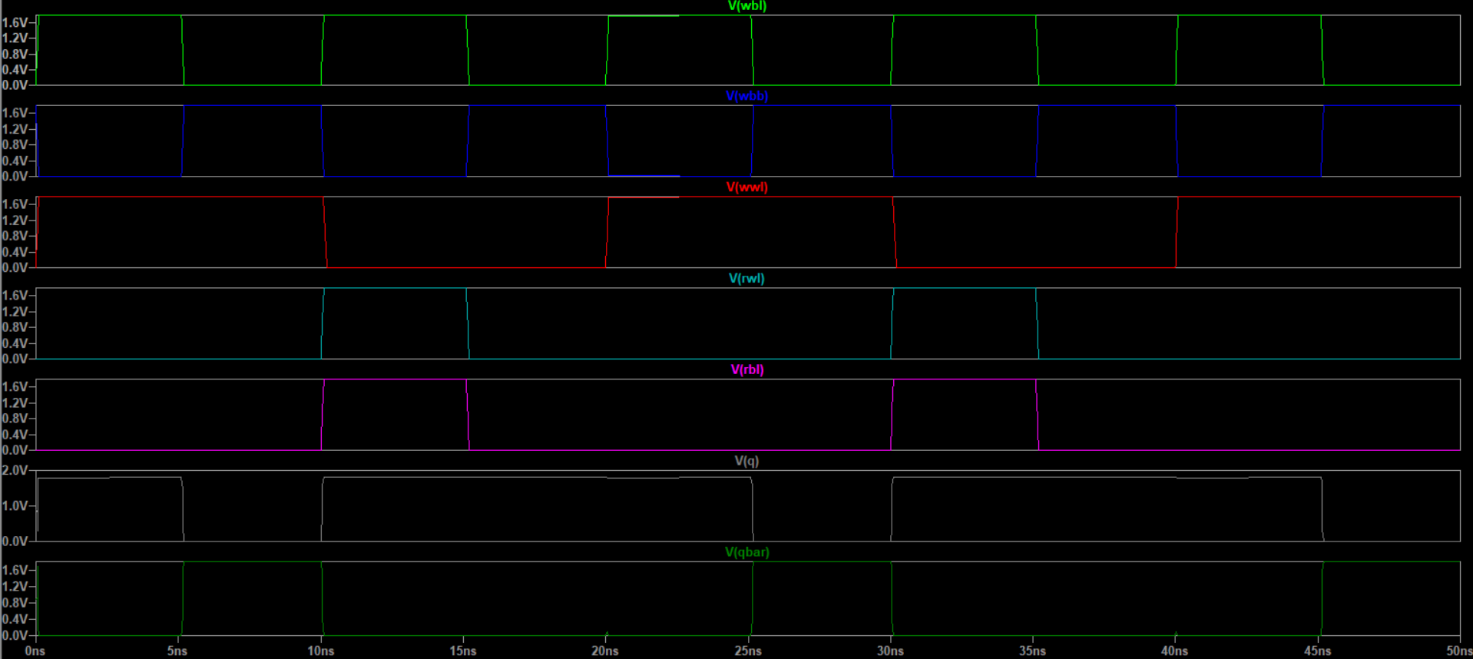
Transient Analysis

Slide 17
Analysis from the Transient Response
1. Write Operation
When V(wwl) is high:
The bit lines (wbl and wbb) are connected to the internal storage nodes (q and qbar).
The values on the bit lines are written into the cell:
If wbl is high and wbb is low, q becomes high, and qbar becomes low (logic 1 written).
If wbl is low and wbb is high, q becomes low, and qbar becomes high (logic 0 written).
2. Read Operation
When V(rwl) is high:
The internal storage nodes (q and qbar) are decoupled from the read bit line (rbl).
A separate read circuitry connected to the storage nodes ensures that the data is reflected on the read bit line (rbl) without disturbing the stored value.
For example:
If q is high (logic 1 stored), rbl will show a high value.
If q is low (logic 0 stored), rbl will show a low value.

Slide 18
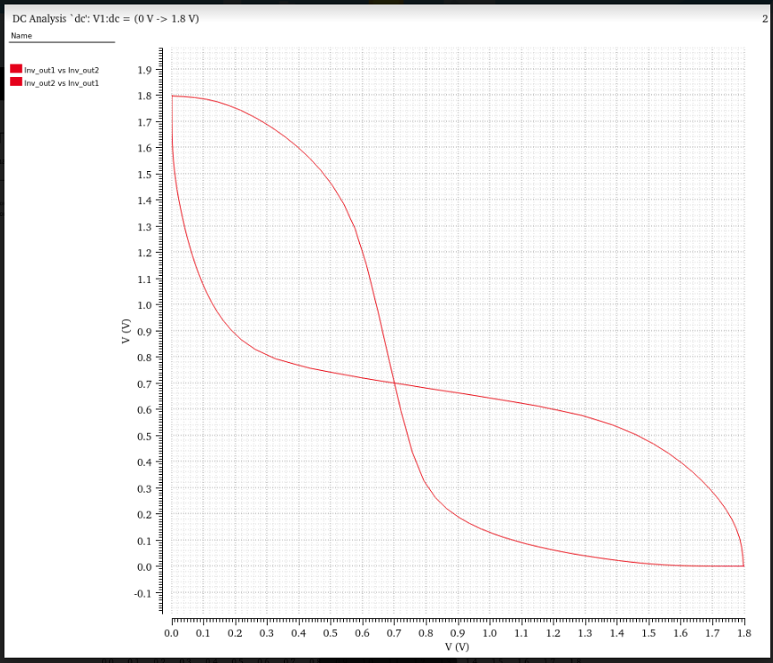

Slide 19
The decoupled architecture of 8T SRAM prevents read disturb issues, making it ideal for high-speed operations.
Smooth and independent transitions in RWL and WWL allow simultaneous high-speed reads and writes without compromising data integrity or stability.
The butterfly diagram appears symmetric, indicating that the SRAM cell has balanced read and write operations.

Slide 20
Feature | 8T SRAM | 6T SRAM
Stability | Improved read stability due to decoupled paths Better noise margins during read. | Susceptible to read disturb Lower noise margins in high-frequency applications
Power Consumption | High dynamic power during high-speed operations Low static power as compared to 6T | lesser dynamic power consumption in high speed applications Higher static power consumption
Speed | Higher Speed due to independent read and write paths | Slower during high frequency operations due to read disturb effects
Disadvantages | Higher area overhead (8 transistors per bit cell) Increased complexity in layout and design Higher static leakage | Lower area footprint Simpler design and fabrication Less leakage but higher dynamic power.

Slide 21
Limitations of 8T SRAM and the use of Transmission
Leakage Currents:
8T SRAM uses additional transistors to separate read and write operations, which introduces more leakage paths, especially in low-power modes.
These leakage currents can increase static power dissipation.
2. Read Signal Degradation:
The read path in 8T SRAM, although separate from the write path, uses pass transistors that suffer from threshold voltage (Vth) drops.
This causes weaker signal levels on the read bit lines, making it less reliable at low supply voltages.
3. Dynamic Power Consumption:
Despite reducing read-disturb issues, the additional transistors increase dynamic power due to higher switching activity during high-speed operations.
To address these limitations, incorporating Transmission Gates (TGs) in 8T SRAM offers several advantages

Slide 22
8T SRAM with Transmission Gate
Enhanced Signal Integrity:
Transmission gates, composed of both PMOS and NMOS transistors in parallel, allow full voltage swings during read and write operations.
This eliminates the issue of threshold voltage drops (Vth) seen with pass transistors, ensuring stronger and more reliable signals.
2. Improved Stability:
By using transmission gates, the read and write operations are further stabilized, reducing the likelihood of noise or voltage fluctuations affecting the stored data.
This directly improves the Static Noise Margin (SNM) of the cell, making it more robust in low-voltage scenarios.

Slide 23
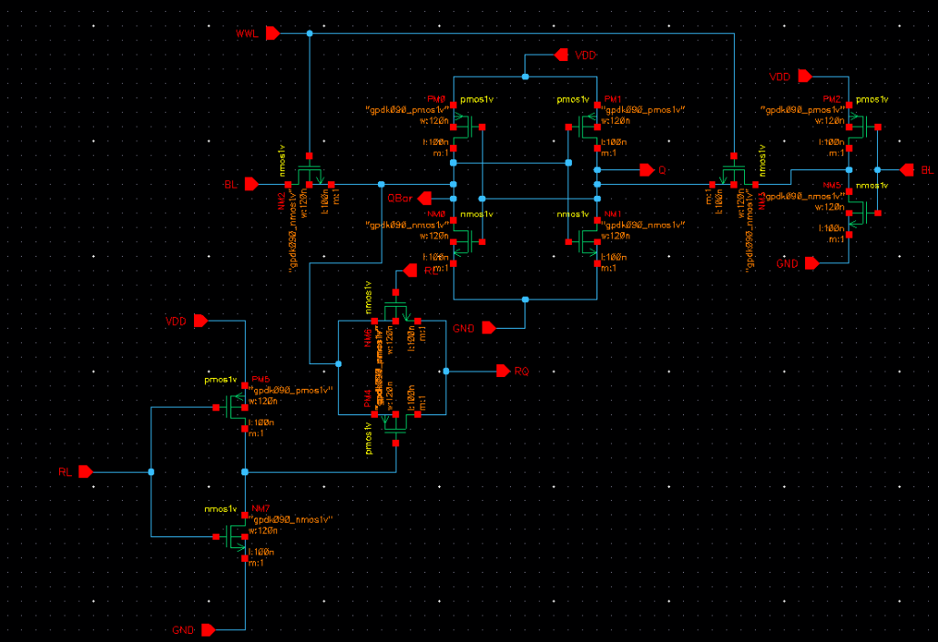
8T SRAM with Transmission Gate

Slide 24
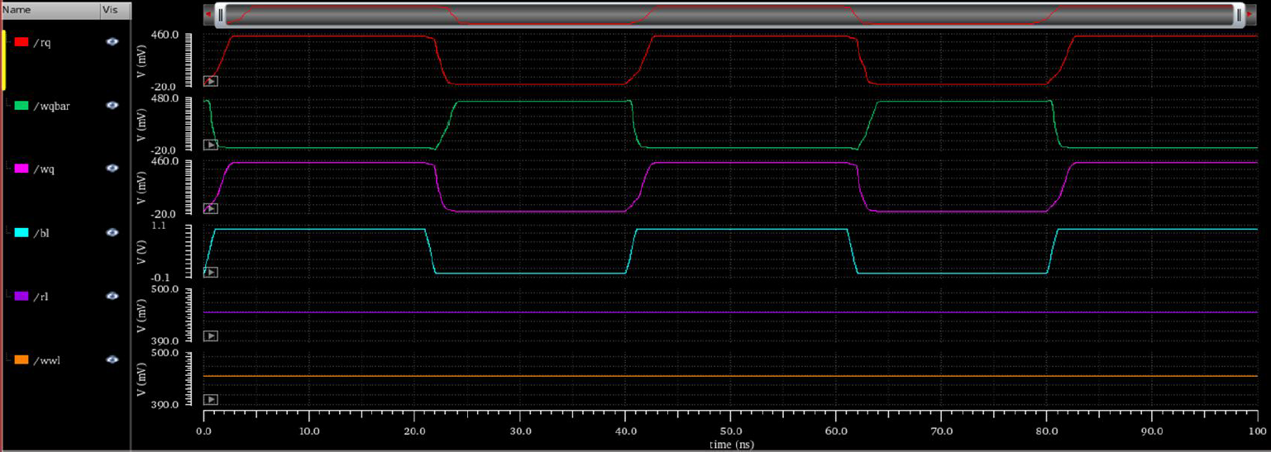

Slide 25
Analysis
1. Write Operation
Signals Involved: wq, wqbar, wwl, bl
Process:
When wwl (orange) is high, the write circuitry is enabled.
Data is provided via bl (bit line), and the complementary data is reflected on wq and wqbar.
Transmission gates ensure full voltage swing during this operation, allowing robust and reliable writing of data to the storage nodes.
2. Read Operation
Signals Involved: rq, rl
Process:
When rl (magenta) is high, the read circuitry is activated.
Data stored in the SRAM cell is passed to rq through the transmission gates.
The decoupled read and write paths ensure the stored data wq and wqbar remains unaffected during the read operation.

Slide 26
Advantages of Introduced Transmission Gates
Elimination of Threshold Voltage (Vth) Drop:
In conventional designs, pass transistors suffer from Vth drops, which degrade the signal strength, especially during read operations.
Transmission gates, composed of parallel PMOS and NMOS transistors, eliminate this issue, ensuring full voltage swing during both read and write operations.
Improved Signal Integrity:
By allowing full voltage swing, transmission gates improve the integrity of the data signals, especially in high-speed and low-voltage scenarios.
Enhanced Read Stability:
Decoupling the read and write paths via transmission gates ensures that the read operation does not disturb the stored data. This is critical in applications requiring high reliability.
Lower Leakage Currents:
Transmission gates offer better control over leakage paths, significantly reducing static power consumption when the SRAM cell is in the hold state.

Slide 27
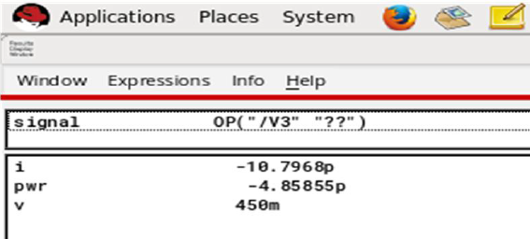
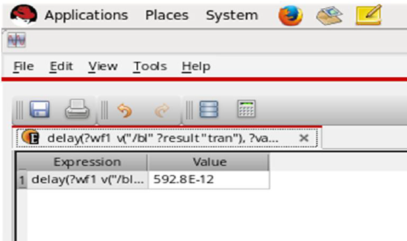
Power

Slide 28
Overall Results
Feature | 6T SRAM | 8T SRAM | 8T SRAM with Tramsmission Gate
Dynamic Power (nW) | 0.864 | 1.08 | 0.95
Static Power (nW) | 60 | 36 | 25
Stability (SNM) | Low | Moderate | High
Read-Write decoupling | No | Yes | Yes
Leakage Reduction | No | Partial | Significant

Slide 29
References
Vatsal Patel , “ Sky130 8-T SRAM Cell for High-Speed Applications” in FOSSEE
Anu Tonk, Meenu Rani Garg, “STUDY OF SRAM AND ITS LOW POWER TECHNIQUES” in IJECET, vol. 6, issue 2
K.Dhanumjaya Dr.MN.Giri Prasad Dr.K.Padmaraju Dr.M.Raja Reddy, “Design of Low Power SRAM in 45 nm CMOS Technology” in IJERA, vol.1 issue 4
M.N. Naga Vyshnavi, S. Mohan Das, “Design of Energy Efficient 8T SRAM cell at 90nm Technology” in IRJET, vol.6, issue 2
Pritesh Gupta, Asst.Prof. Ashish Joshi, Asst.Prof.Ashish Ranjan , “Design of Low Power SRAM using Power Gating and DG-MOS Technology” in IRJET, vol. 9, issue 4
S. H. H. Nemati, N. Eslami and M. H. Moaiyeri, "A Hybrid SRAM/RRAM In-Memory Computing Architecture Based on a Reconfigurable SRAM Sense Amplifier," in IEEE Access, vol. 11

Slide 30
10Sahu, Yogita, Gaurav Kumar Soni, Dr. Himanshu Arora, and Shilpi Mishra. Low Power and High Speed 6T SRAM Cell in Nanoscale CMOS Technologies.
Sah, Rohit Kumar, Inamul Hussain, and Manish Kumar. Performance analysis of a 6T SRAM cell in 180nm CMOS technology. IOSR Journal of VLSI and Signal Processing (IOSR-JVSP) 5.2 (2015): 20-22.
Santhosh, B. G., J. Praveen Sowmya, and R. Raghavengra Rao. Design and implementation of 8T SRAM cell for analysis of DC noise margin during write operation. International Journal of Innovative Research in Electrical, Electronics, Instrumentation and Control Engineering 3 (2015): 94-97.
Dhanumjaya, K., et al. Cell stability analysis of conventional 6T dynamic 8T SRAM cell in 45nm technology. International Journal of VLSI Design & Communication Systems 3.2 (2012): 41.
Kiran, PN Vamsi, and Nikhil Saxena. Design and analysis of different types SRAM cell topologies. 2015 2nd International Conference on Electronics and Communication Systems (ICECS). IEEE, 2015.
Sindwani, Ankush, and Suman Saini. A novel power efficient 8T SRAM cell. 2014 Recent Advances in Engineering and Computational Sciences (RAECS). IEEE, 2014.
Chaudhary, Urvashi, and Rajendra Bahadur Singh. A Low Power CMOS 8T SRAM Cell for High-Speed VLSI Design Using Transmission Gate Mode. School of ICT, Gautam Buddha University.
Aswini, Valluri, Sarada Musala, and Avireni Srinivasulu. Transmission gate-based 8T SRAM cell for biomedical applications. 2021 12th International Symposium on Advanced Topics in Electrical Engineering (ATEE). IEEE, 2021

