Slide 1

INTELLIGENT TRAFFIC
CONTROL SYSTEM
- ASIM ANAND - 21BEC1519
- ROHAN PATIL - 21BEC1505
- AYUSHI DATTA - 21BEC1471

Slide 2

OVERVIEW OF PROJECT
The goal of the Traffic Light controller is to use verilog HDL and a finite state machine to create and simulate an effective system for regulating traffic lights at a four-way intersection. For the least amount of traffic jams, time synchronized green, yellow and red lights are included.
KEY COMPONENTS
FSM Design: Manages the transitions between different traffic light states.
Verilog HDL: A hardware description language used for creating the logic of the controller.
Clock & Timing Logic: Ensures the correct timing of traffic light phases.
Testbench: Simulates the system to verify its correctness in various scenarios using ModelSim.

Slide 3
FEATURES OF TRAFFIC CONTROL
- Efficient Management of traffic flow
- Configurable Timing
- Modular Design
- Vehicle and Pedestrian detection
- Continuous operation
- Low Latency and Fast Response

Slide 4
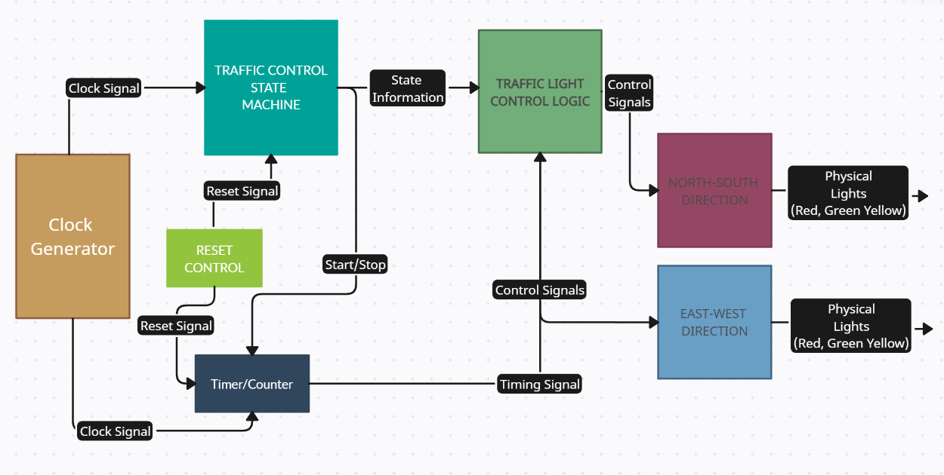
BLOCK DIAGRAM

Slide 5
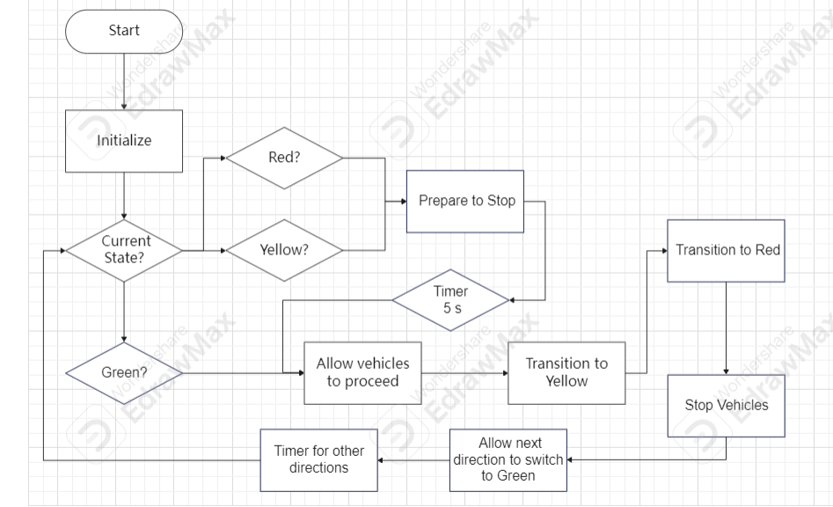

FLOWCHART

Slide 6
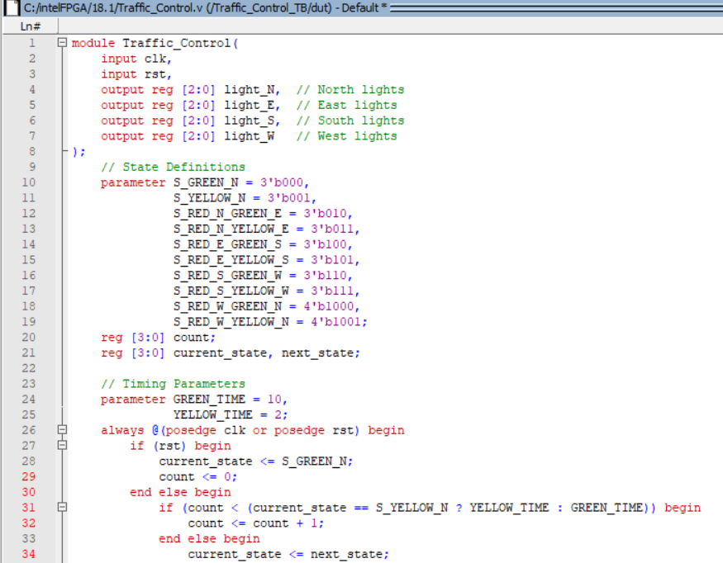


VERILOG CODE
WHAT WE HAVE RIGHT NOW？
19
01
48
Anforderungen angepasst
Und werden an
ATTITUDE
CREATION
TECHNOMAGIC
YOU AND ME
CONTACT

Slide 7
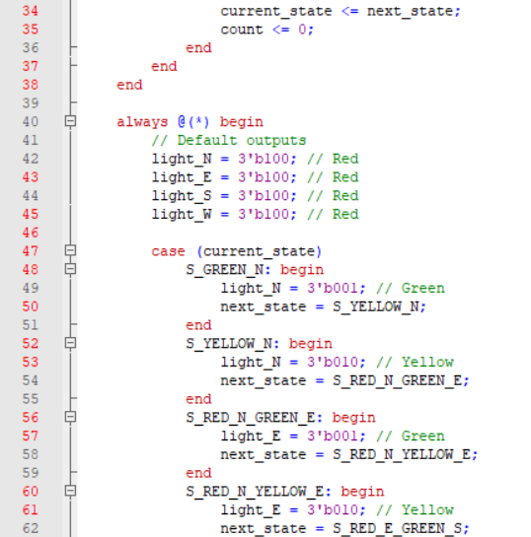
WHAT WE HAVE RIGHT NOW？
19
01
48
Anforderungen angepasst
Und werden an
ATTITUDE
CREATION
TECHNOMAGIC
YOU AND ME
CONTACT

Slide 8
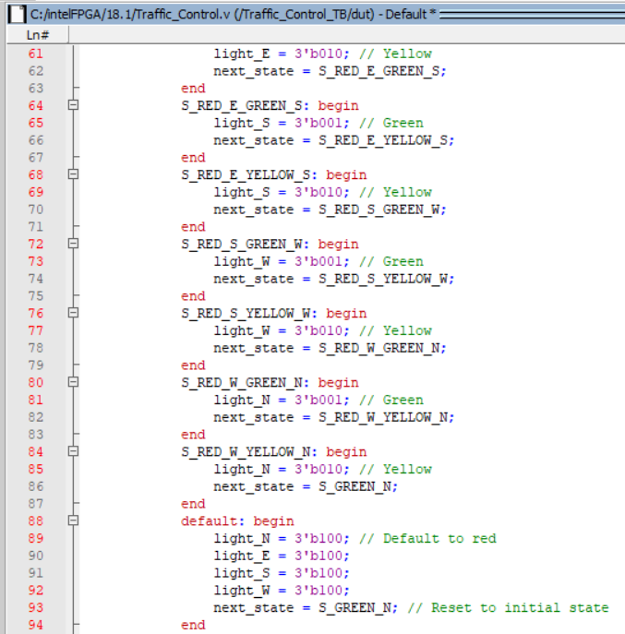
WHAT WE HAVE RIGHT NOW？
19
01
48
Anforderungen angepasst
Und werden an
ATTITUDE
CREATION
TECHNOMAGIC
YOU AND ME
CONTACT

Slide 9
THANK YOU

