Slide 1


Document Management System
Group Members:
Asim Raj Pandey
Kishore Thomas
Priyanka Shahi
Gurjaan Singh
Prabhjit Singh

Slide 2
What is DMS?
Working with ALL documents
Reduces Reliance on paper
better utilization of a company’s Resources.
Automating Workflow

Slide 3
Problems/Challenges:
Document are scattered everywhere
Not enough security measures
Working with existing Hardware
Data Migration is hard and resource draining
Insufficient protection for files

Slide 4
Solution:
Automated Document Processing.
Precise Control Over Who Sees What.
Digital Lock for Your Files.
“One-click, Go” Solution for Managing Files.
Seamless Integration with Existing Hardware
“Control” is in your Hands.

Slide 5
Project Scope
Review other similar Products
Design a DMS for customer needs
Secure, Private and Functional
Future Ready

Slide 6
Differentiating Factors
System is on-premise
More Features without compromise.
Speed and Performance
No reliance on Third-party

Slide 7
End Product/Outcome:
Custom DMS
Comprehensive Evaluation Report
Future-Ready Roadmap

Slide 8
Business Values
Eco-Friendly Solution
Resource Efficiency and Cost Reduction
Increased Productivity
Less Risks

Slide 9
Target Customers:
MHS (Client)
Local Schools
Business

Slide 10
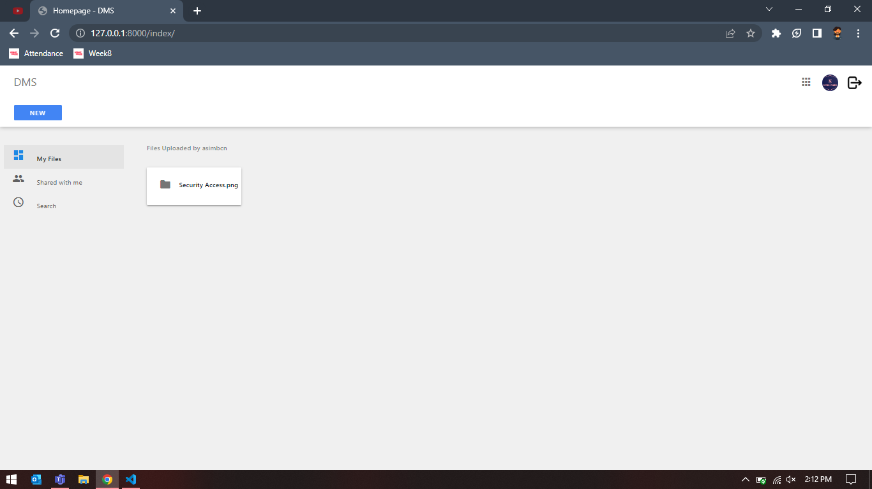
Sample Screenshots(DMS)

Slide 11
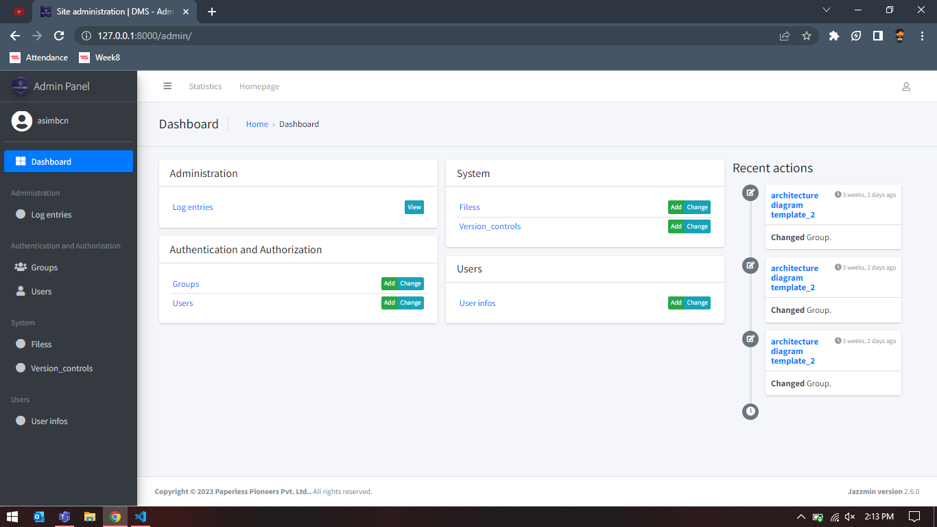
Sample Screenshots(DMS)

Slide 12
Contact Us
Contact Us: asimbcn@gmail.com
Location: 3190 Steels Avenue East, 2pm-8pm, Monday-Friday

Slide 13

Thank You!
Any Questions?

