Slide 1
TITLE: Security Graphical Password Authentication

Slide 2
TEAM DETAILS: Harshit Paneri: Student Asim Ali: Student

Slide 3
INTRODUCTION
The Graphical Password Assistant (GPA) is a technical project designed to enhance password security and user experience by offering a visual alternative to traditional text-based passwords. GPA allows users to create their own graphical passwords by following a series of defined actions.

Slide 4
ABSTRACT
With GPA, users have the freedom to select their desired graphic images as the basis for their passwords. These images are divided into nine sections, and the user is required to choose at least three sections to construct their password. The order in which the sections are selected is also crucial for password validation.

Slide 5
TECHNICAL PROBLEM SOLVED
The objective of GPA is to offer an intuitive and secure method for users to create and remember their passwords. By leveraging visual cues and user-selected images, GPA aims to enhance password memorability while mitigating the risks associated with traditional text-based passwords. The integration of the unique Blur system further strengthens the security aspect, protecting users' passwords from shoulder surfing attacks.

Slide 6
TECH STACK
The implementation of GPA involves a combination of JavaScript and Python code. JavaScript is used to provide interactive elements on the user interface, allowing users to select images and sections. Python is utilized for the back-end logic, including password validation, image processing, and the Blur system.

Slide 7
UNIQUENESS OF THE MODEL
This password system can be used by anyone regardless of their literacy level, language etc.
One of the key features is its unique Blur system, which addresses a common vulnerability of traditional graphical passwords known as shoulder surfing.

Slide 8
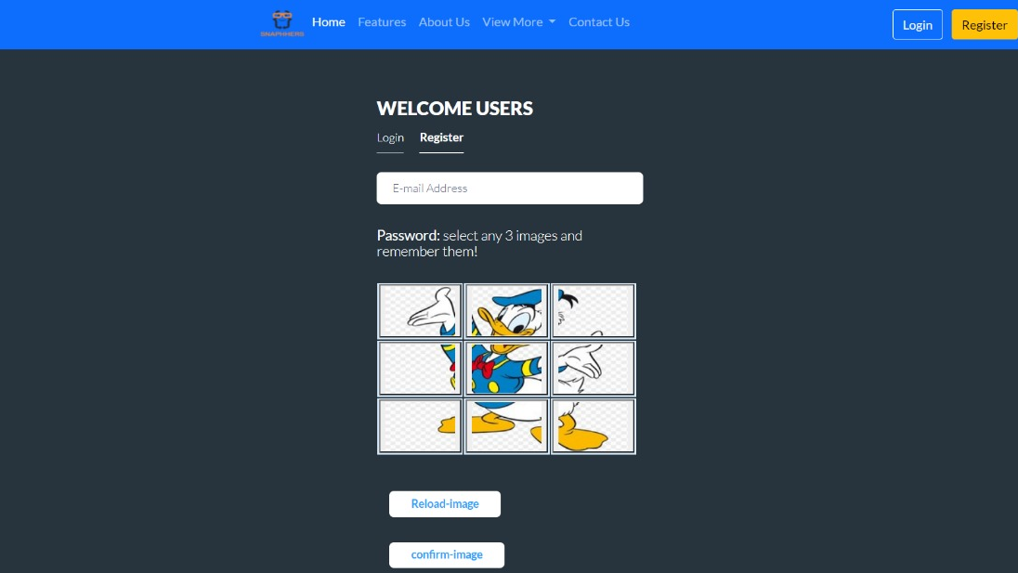
PROTOTYPE

Slide 9
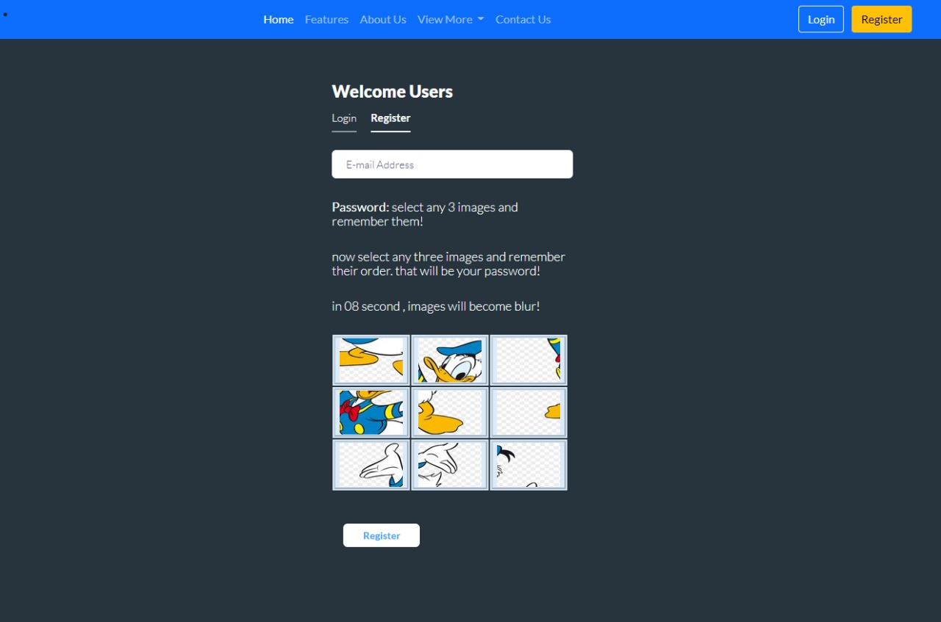
PROTOTYPE

Slide 10
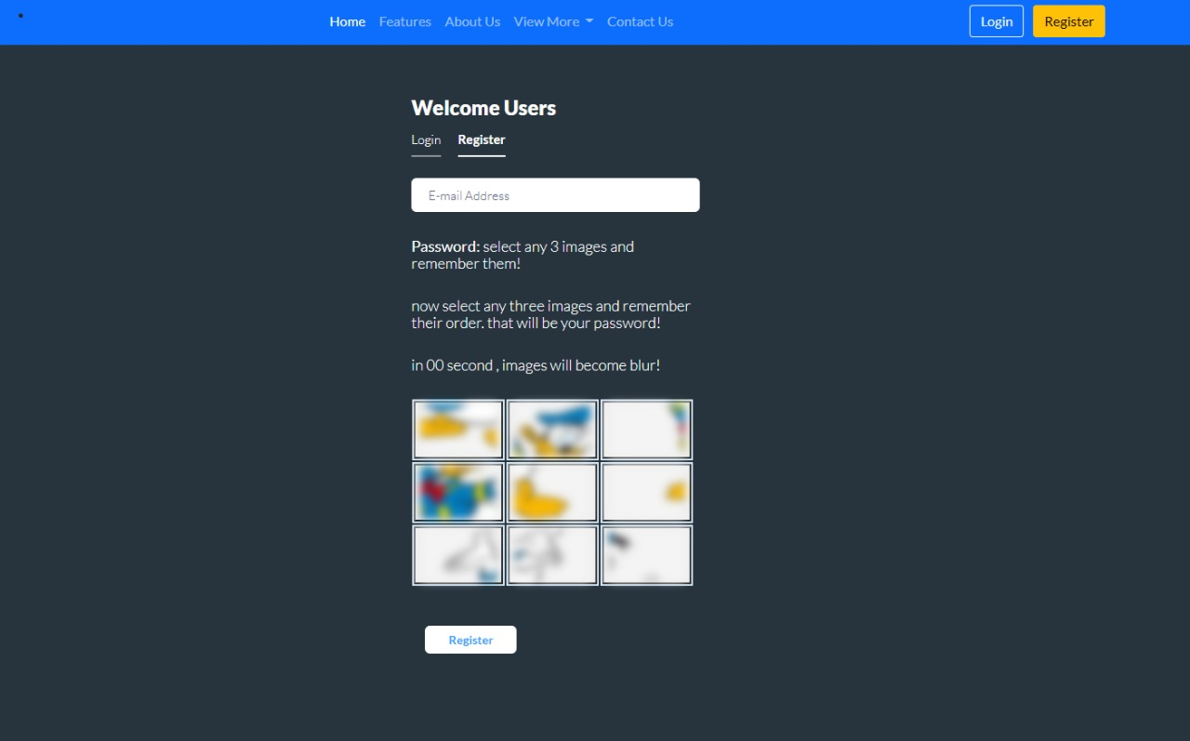
PROTOTYPE

Slide 11
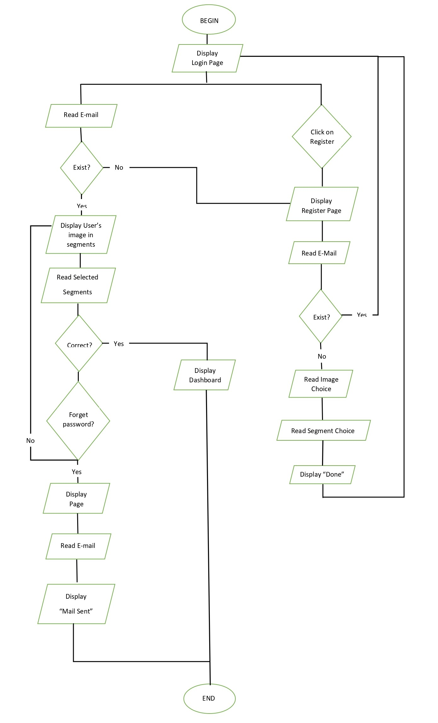
BLOCK DIAGRAMS

Slide 12
CONCLUSION
GPA presents an innovative approach to password management, emphasizing user customization, visual authentication, and improved security measures. By providing an alternative to text-based passwords, GPA offers a more user-friendly and secure solution for password protection.

Slide 13
GitHub Link
Git link

Slide 14
THANK YOU

