Slide 1
Docker Working
How docker works?

Slide 2
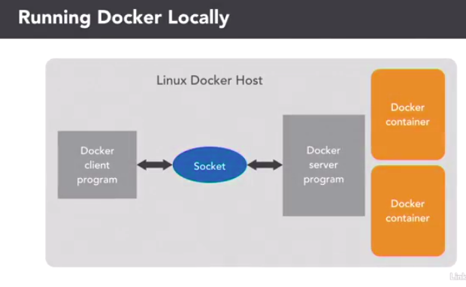

Slide 3
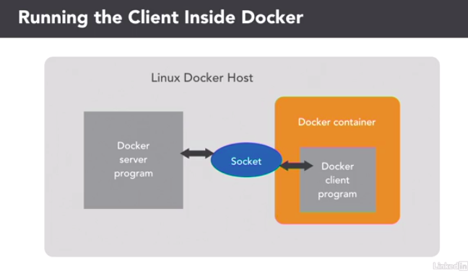

Slide 4
Communication in Containers
Creating Links
Creating Private Networks

Slide 5
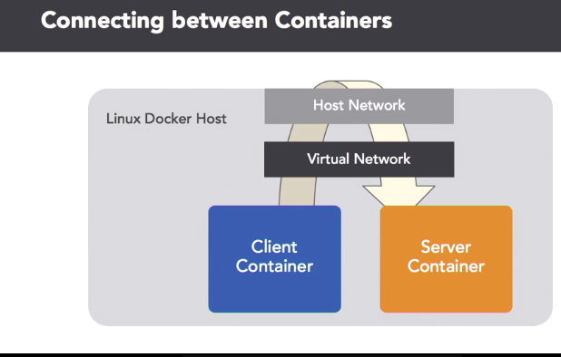

Slide 6
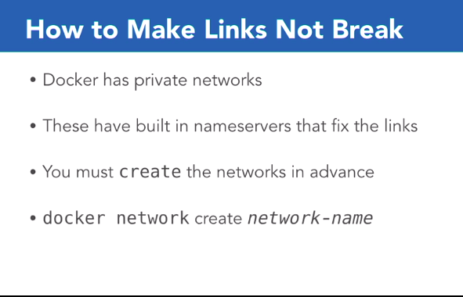

Slide 7
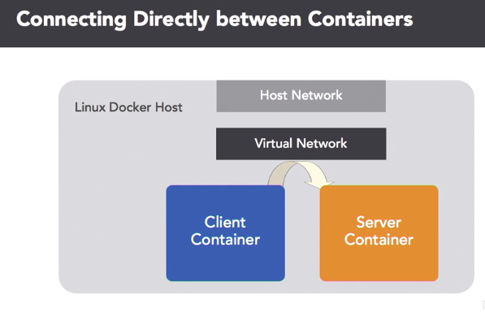

Slide 8
