Slide 1
Introduction to containers and docker
What are Containers?
A container is a standard unit of software that packages up code and all its dependencies so the application runs quickly and reliably from one computing environment to another.

Slide 2
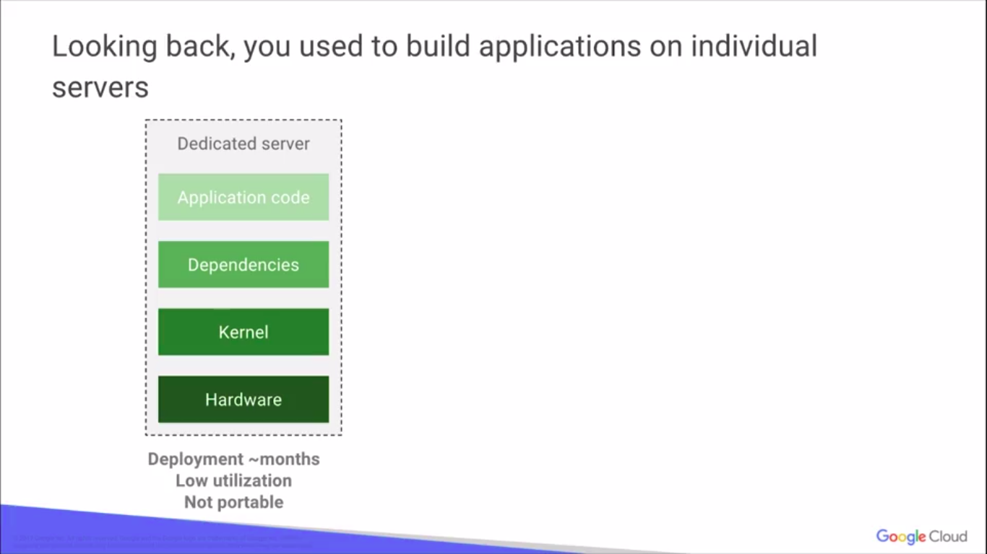

Slide 3
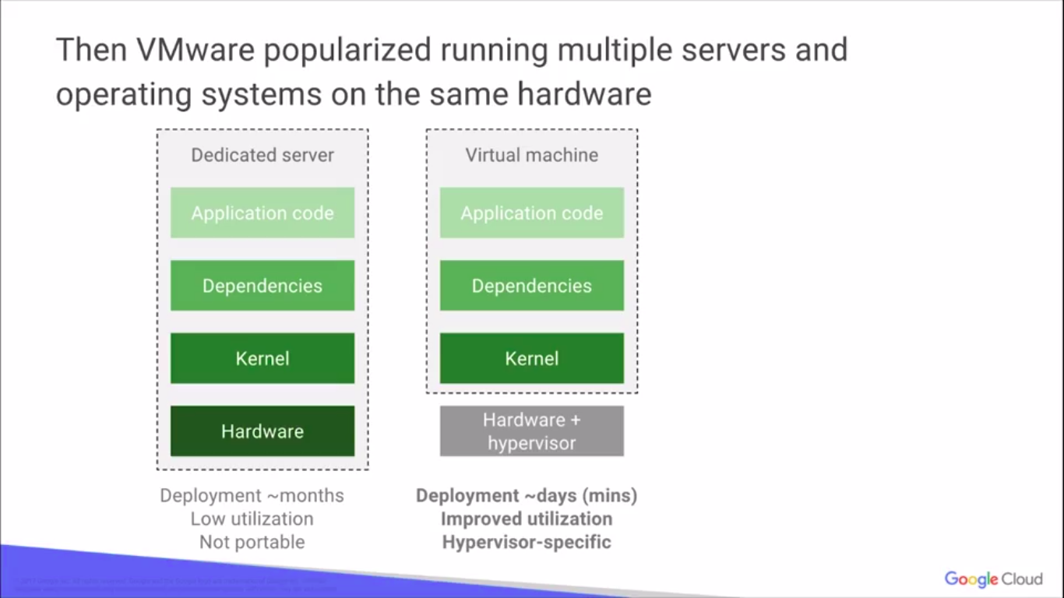

Slide 4
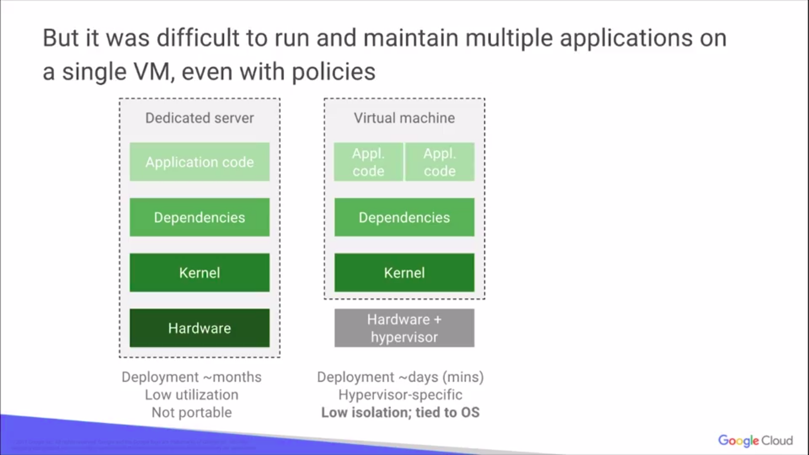

Slide 5
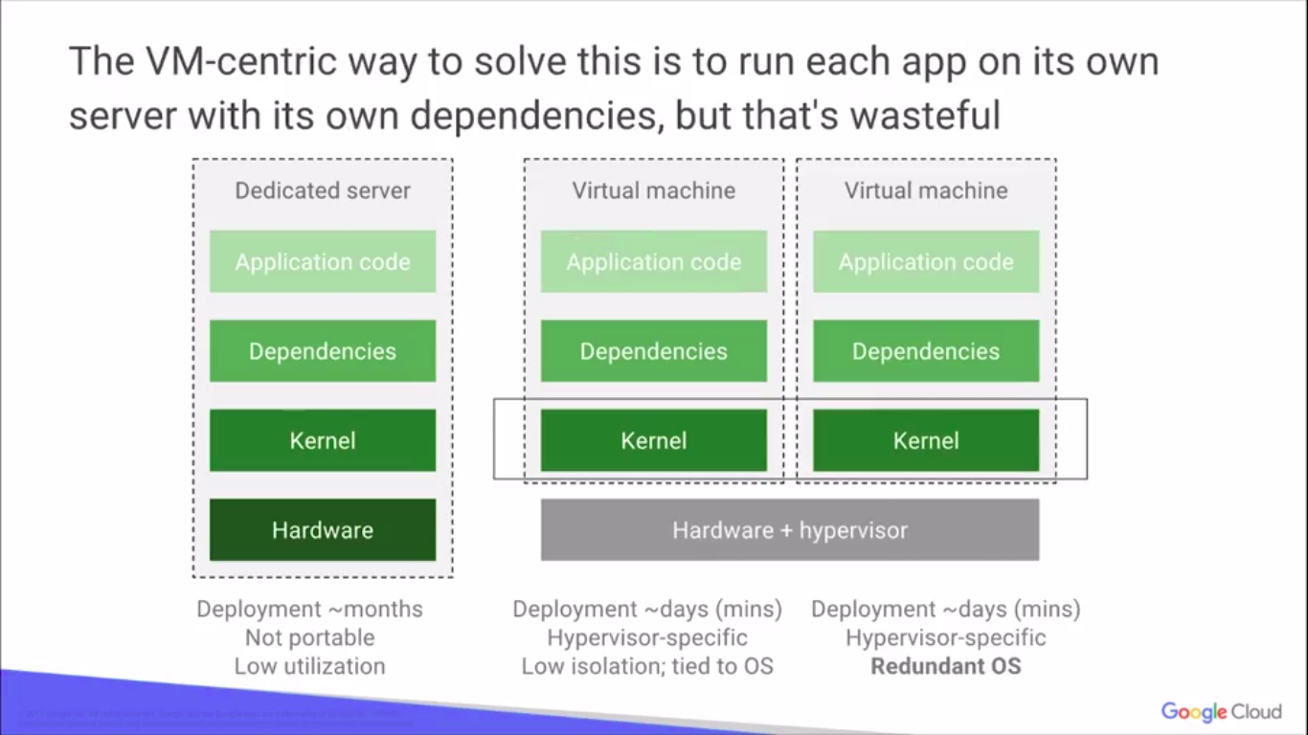

Slide 6
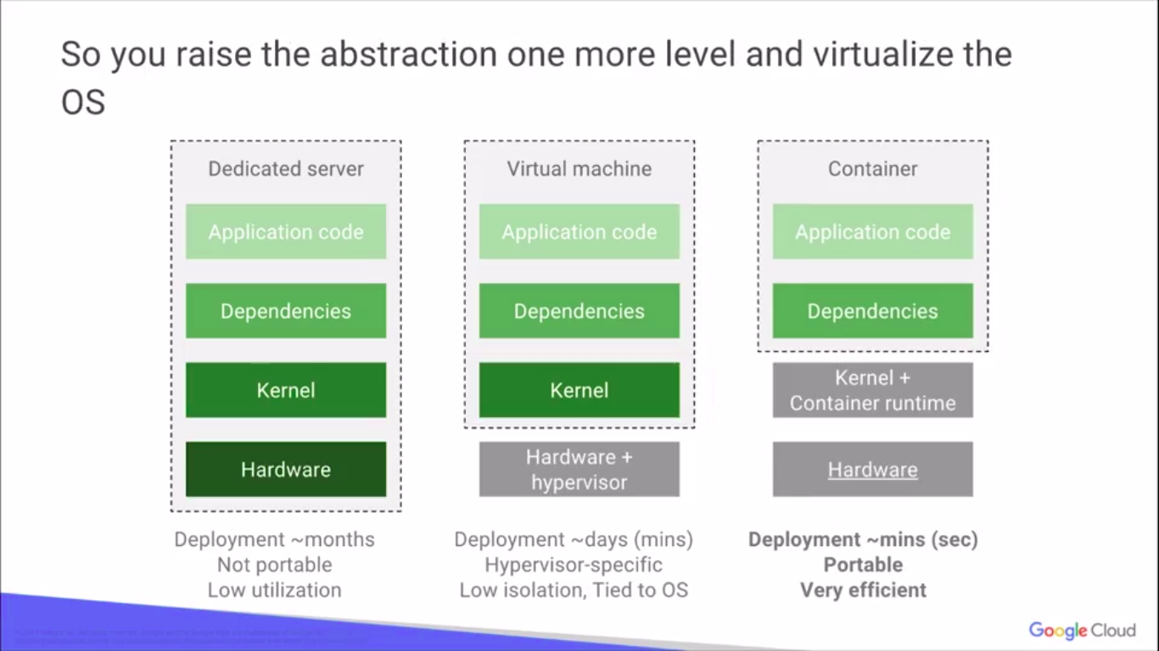

Slide 7
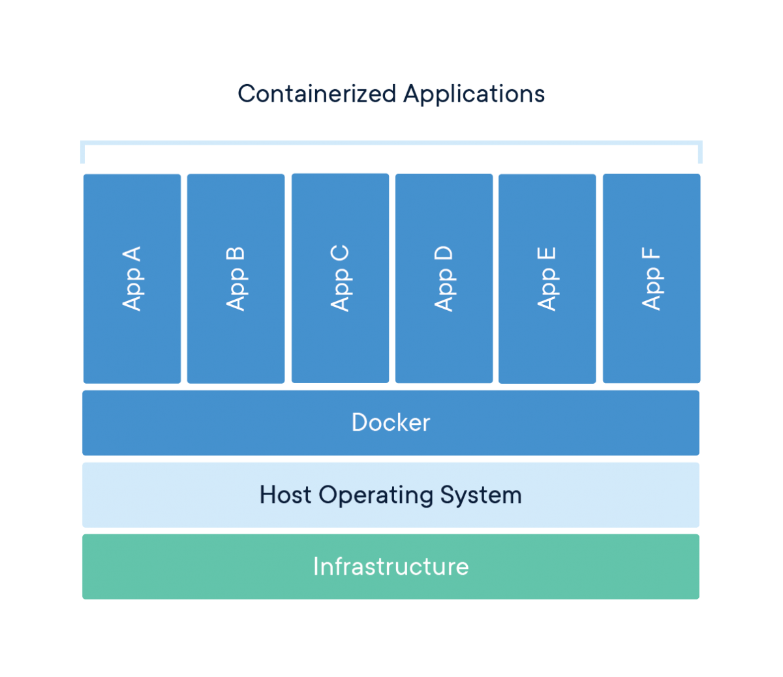
What is Docker?
A Docker container image is a lightweight, standalone, executable package of software that includes everything needed to run an application: code, runtime, system tools, system libraries and settings.

Slide 8
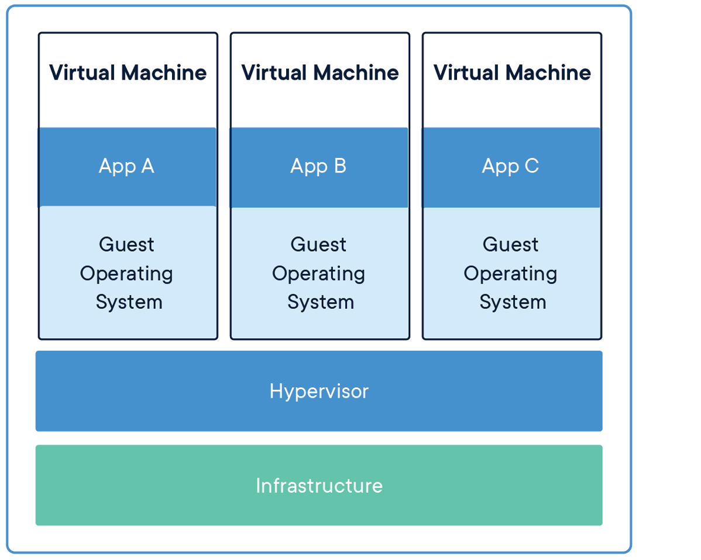
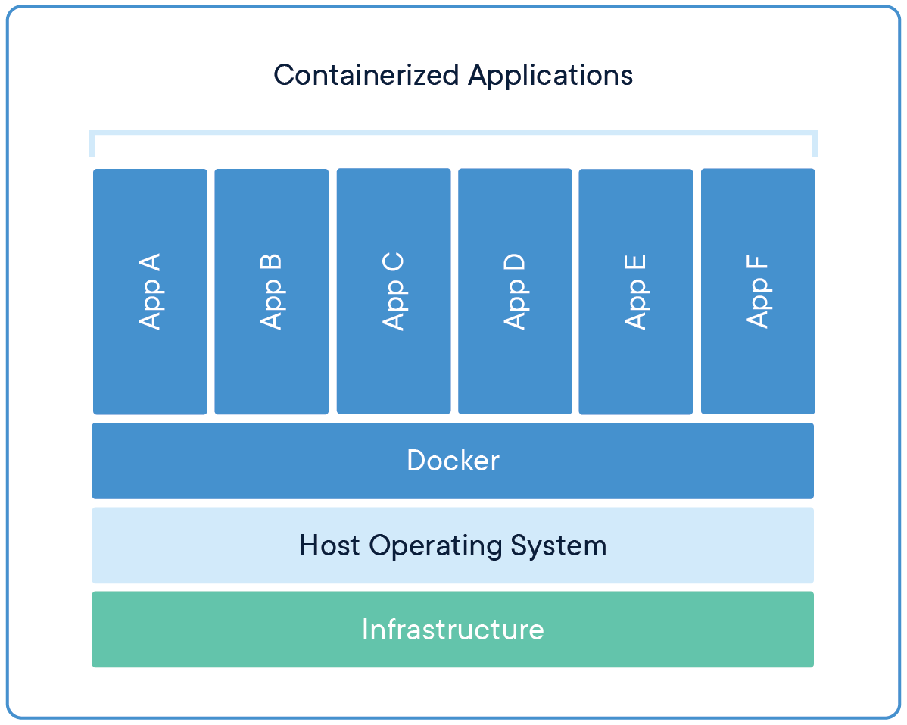
Comparing Containers and Virtual Machines
Containers and virtual machines have similar resource isolation and allocation benefits, but function differently because containers virtualize the operating system instead of hardware. Containers are more portable and efficient.

Slide 9
Docker is a platform for developers and sysadmins to develop, deploy, and run applications with containers. The use of Linux containers to deploy applications is called containerization. Containers are not new, but their use for easily deploying applications is.
Containerization is increasingly popular because containers are:
Flexible: Even the most complex applications can be containerized.
Lightweight: Containers leverage and share the host kernel.
Interchangeable: You can deploy updates and upgrades on-the-fly.
Portable: You can build locally, deploy to the cloud, and run anywhere.
Scalable: You can increase and automatically distribute container replicas.
Stackable: You can stack services vertically and on-the-fly.

Slide 10
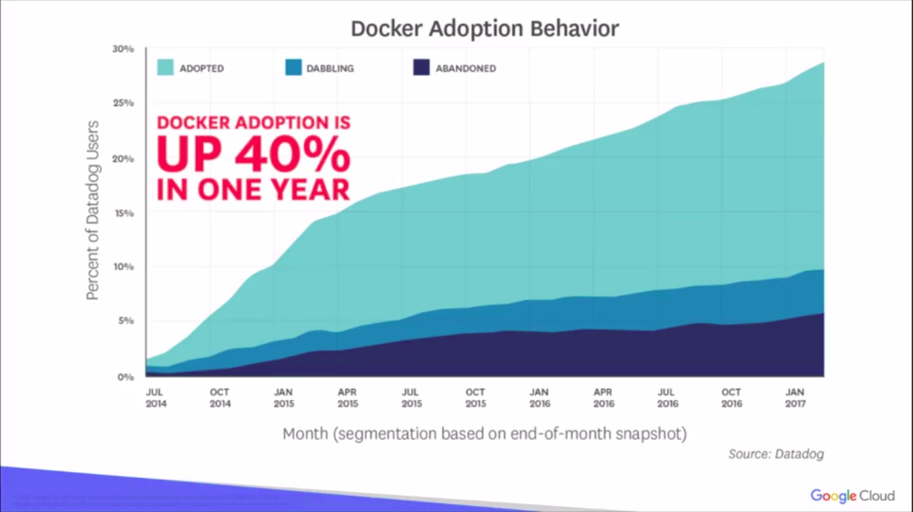
Docker History
Released in around 2013.It's a massive adoption in the market today.
It's up to about 40% in one year Docked adoption itself. Written in: Go
Developed by: Docker, Inc.

Slide 11
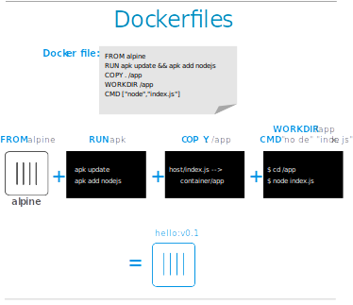
Images and containers
A container is launched by running an image. An image is an executable package that includes everything needed to run an application--the code, a runtime, libraries, environment variables, and configuration files.
These portable images are defined by something called a Dockerfile

Slide 12
Docker Engine+Docker hub = Docker Platform
Docker Engine
Docker Daemon
Docker CLI
Docker Daemon
Builds Images
Runs and Manages Containers
Docker CLI
• docker build # Build an image from a Dockerfile
• docker images # List all images on a Docker host
• docker run # Run an image
• docker ps # List all running and stopped instances
• docker stop # Stop a running instances
• docker rm # Remove an instance
• docker rmi # Remove an imageDocker

Slide 13
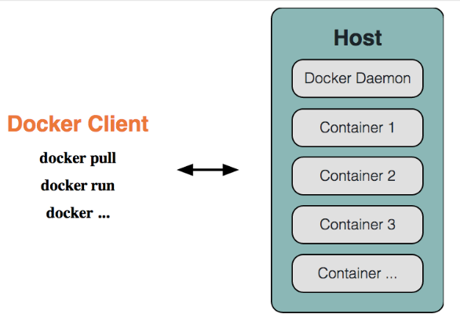
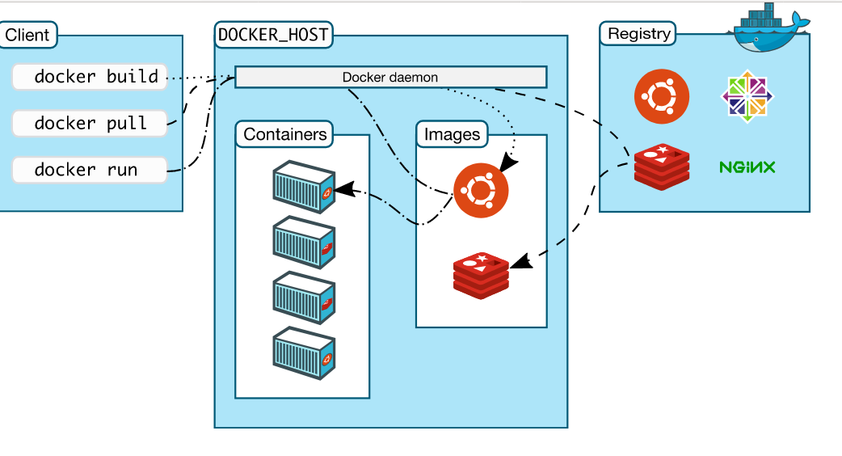
Docker Architecture

Slide 14
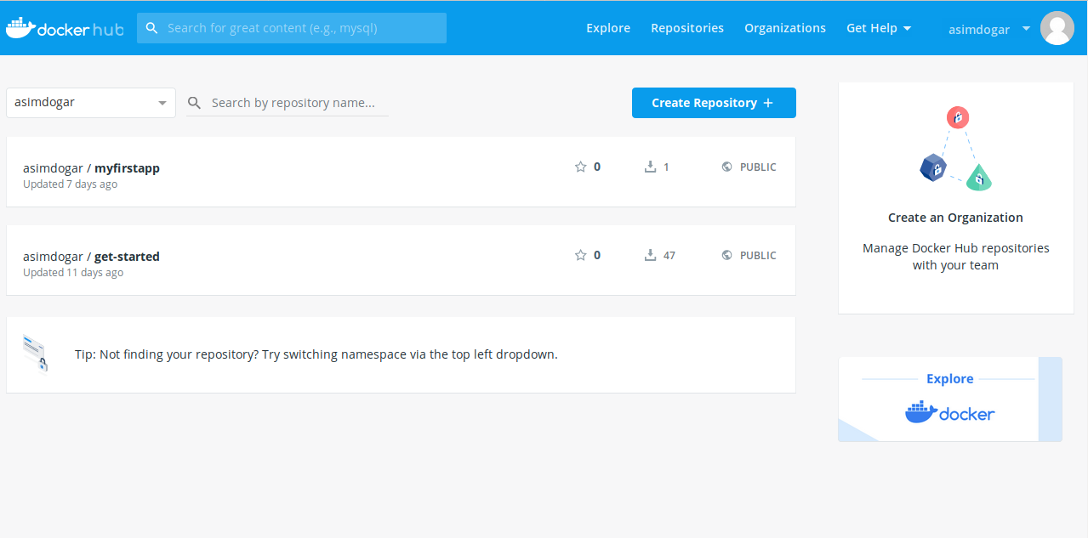
Docker Hub
• Provides Docker Services
• Library of public images
• Storage for your images
• free for public images
• cost for private images
•Automated builds(link github/bitbucket repo; trigger
build on commit)Docker Hub

Slide 15
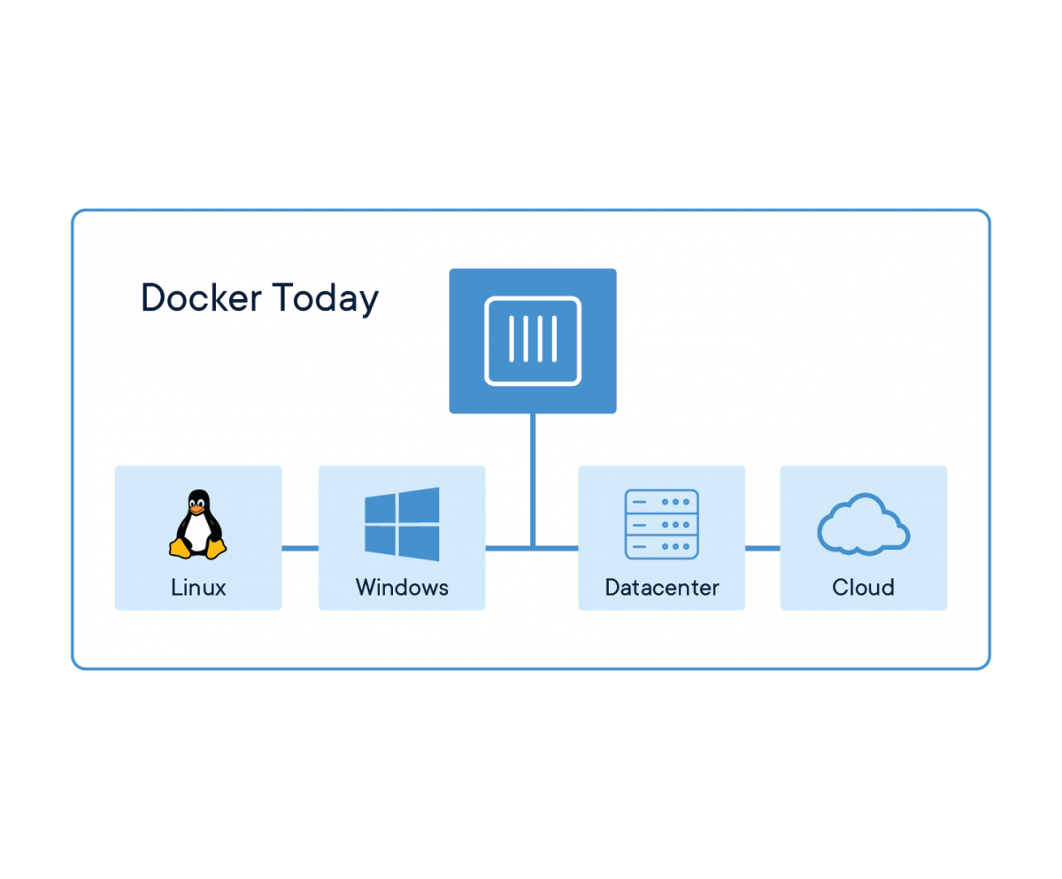
Docker Containers Are Everywhere: Linux, Windows, Data center, Cloud, Serverless, etc.

Slide 16
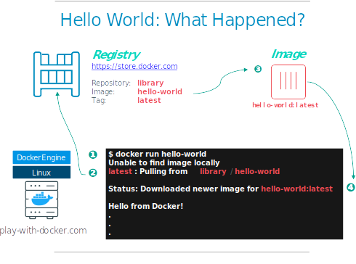
Running Image in Docker
## Execute Docker image
docker run hello-world

Slide 17
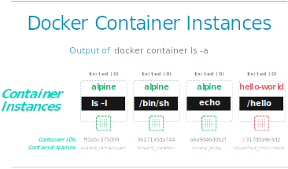

Slide 18
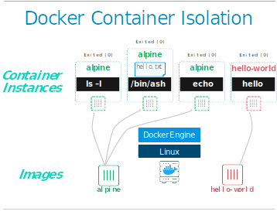
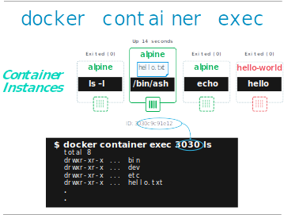
Container Isolation

Slide 19
Play with Docker
A simple, interactive and fun playground to learn Docker
https://labs.play-with-docker.com/

Slide 20
References
https://www.coursera.org/learn/google-kubernetes-engine
https://www.docker.com/get-started

