Slide 1
Kubernetes Basics
Before managing complete applications with Kubernetes and Container Engine,you'll want to know how containers work and what advantages they provide.

Slide 2
Introduction to containers and docker
What are Containers?
A container is a standard unit of software that packages up code and all its dependencies so the application runs quickly and reliably from one computing environment to another.

Slide 3
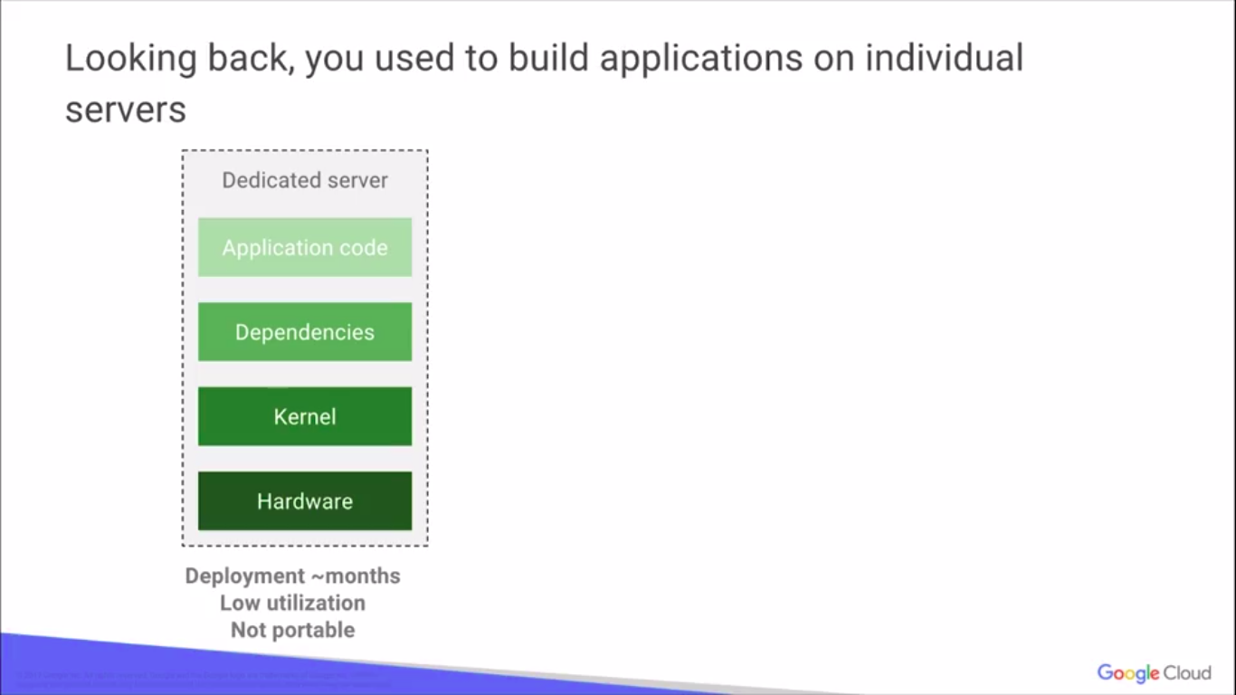

Slide 4
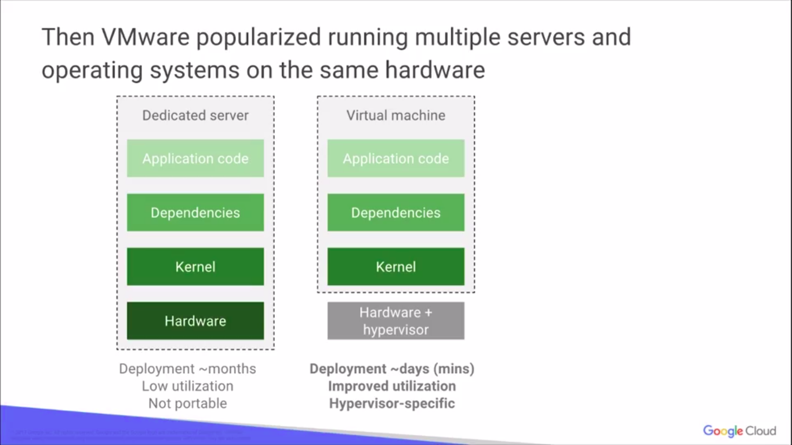

Slide 5
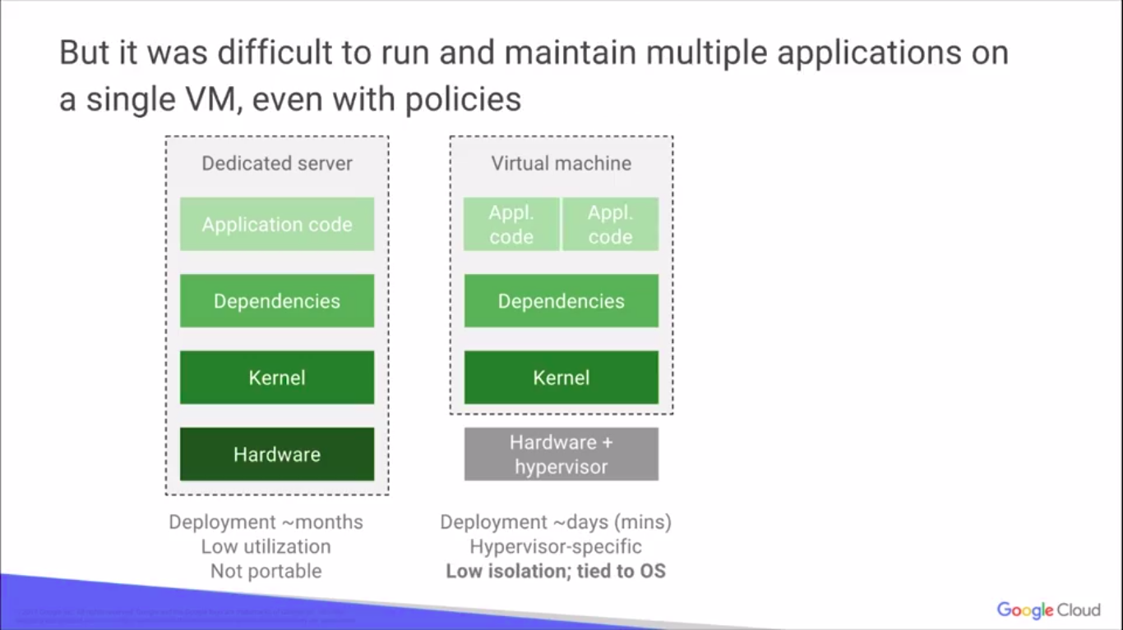

Slide 6
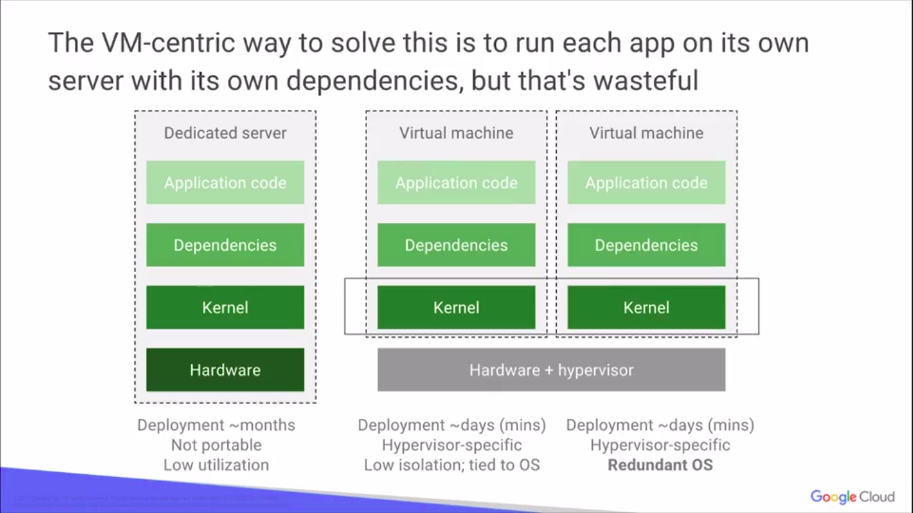

Slide 7
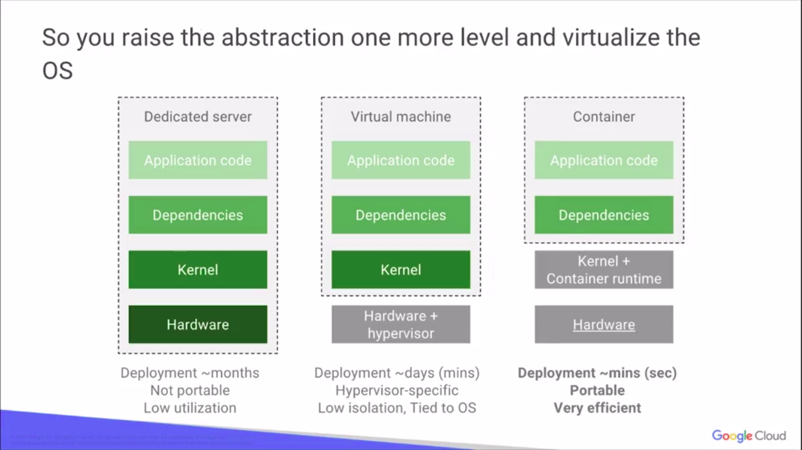

Slide 8
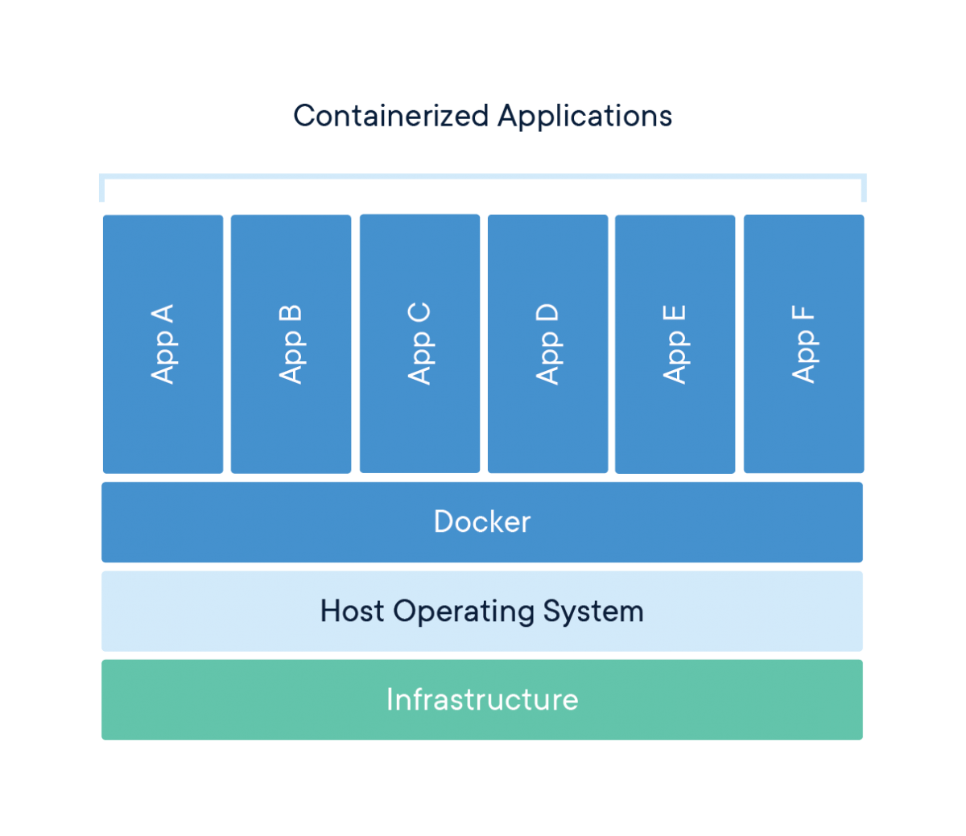
What is Docker?
A Docker container image is a lightweight, standalone, executable package of software that includes everything needed to run an application: code, runtime, system tools, system libraries and settings.

Slide 9
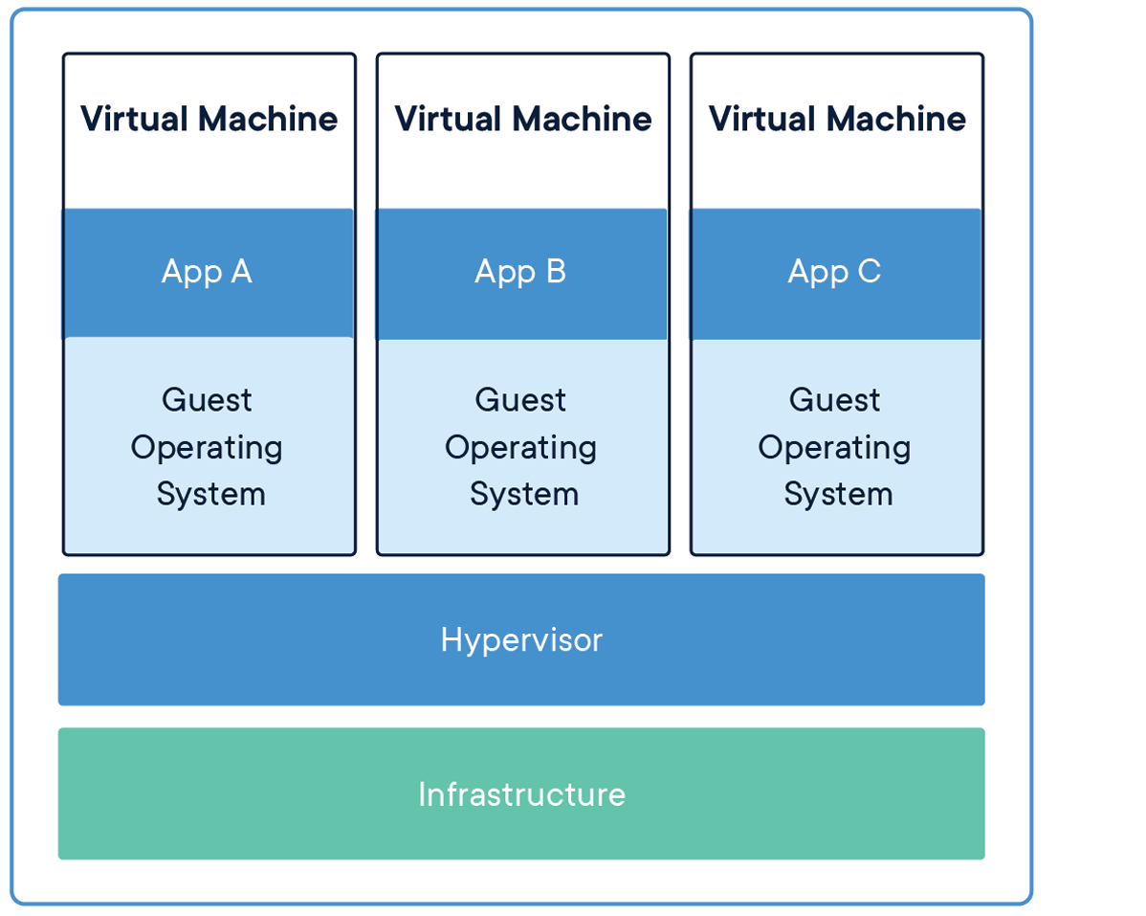
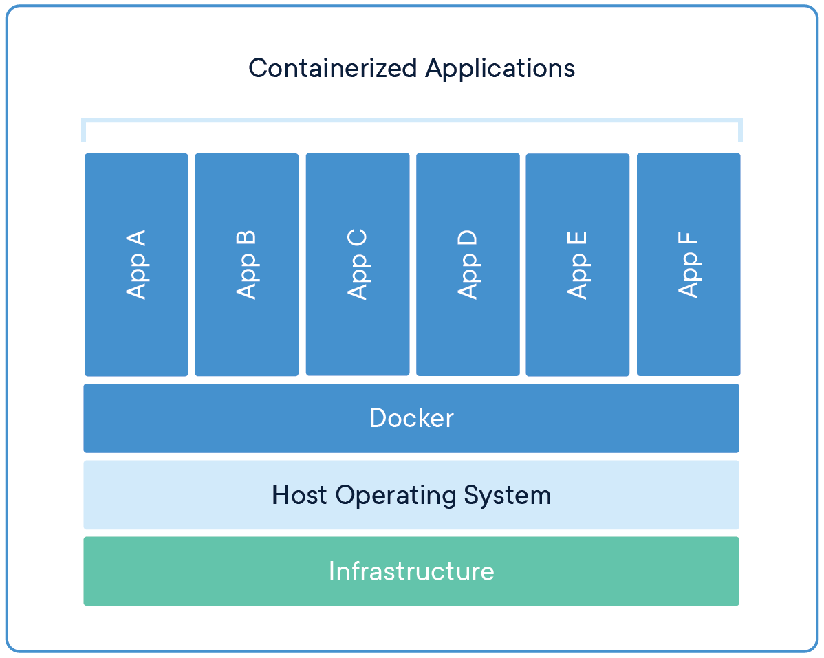
Comparing Containers and Virtual Machines
Containers and virtual machines have similar resource isolation and allocation benefits, but function differently because containers virtualize the operating system instead of hardware. Containers are more portable and efficient.

Slide 10
Docker is a platform for developers and sysadmins to develop, deploy, and run applications with containers. The use of Linux containers to deploy applications is called containerization. Containers are not new, but their use for easily deploying applications is.
Containerization is increasingly popular because containers are:
Flexible: Even the most complex applications can be containerized.
Lightweight: Containers leverage and share the host kernel.
Interchangeable: You can deploy updates and upgrades on-the-fly.
Portable: You can build locally, deploy to the cloud, and run anywhere.
Scalable: You can increase and automatically distribute container replicas.
Stackable: You can stack services vertically and on-the-fly.

Slide 11
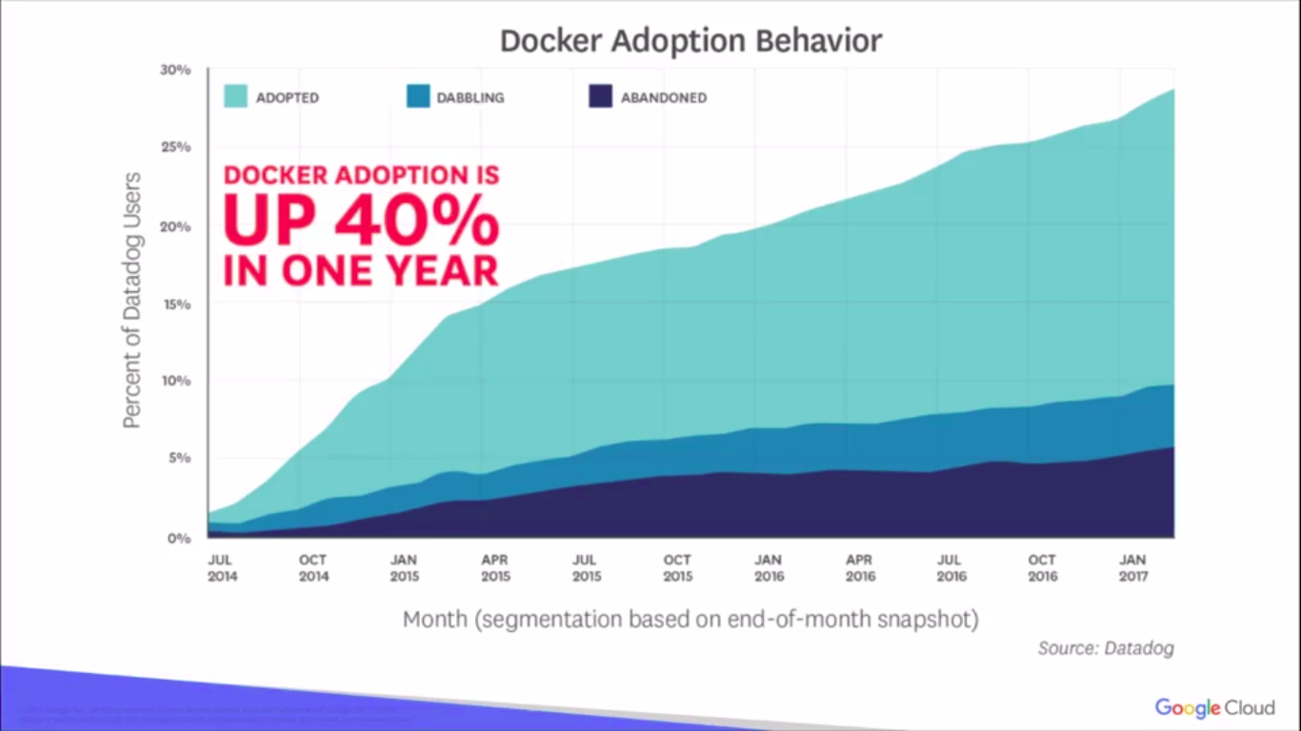
Docker History
Released in around 2013.It's a massive adoption in the market today.
It's up to about 40% in one year Docked adoption itself. Written in: Go
Developed by: Docker, Inc.

Slide 12
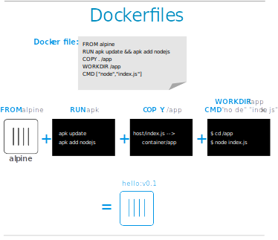
Images and containers
A container is launched by running an image. An image is an executable package that includes everything needed to run an application--the code, a runtime, libraries, environment variables, and configuration files.
These portable images are defined by something called a Dockerfile

Slide 13
Docker Engine+Docker hub = Docker Platform
Docker Engine
Docker Daemon
Docker CLI
Docker Daemon
Builds Images
Runs and Manages Containers
Docker CLI
• docker build # Build an image from a Dockerfile
• docker images # List all images on a Docker host
• docker run # Run an image
• docker ps # List all running and stopped instances
• docker stop # Stop a running instances
• docker rm # Remove an instance
• docker rmi # Remove an imageDocker

Slide 14
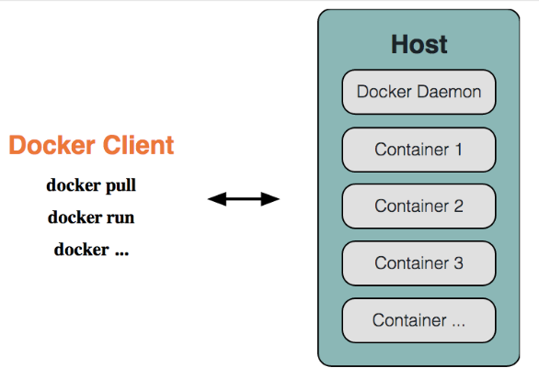
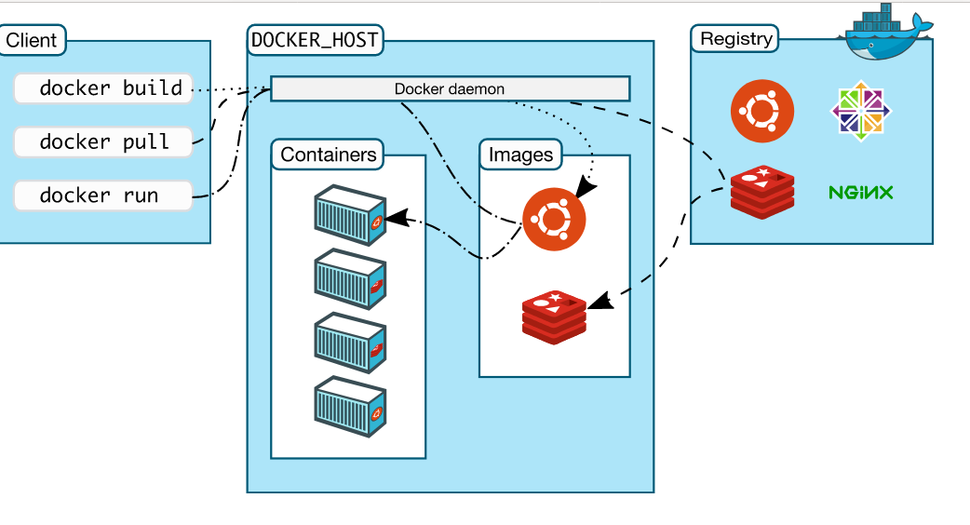
Docker Architecture

Slide 15
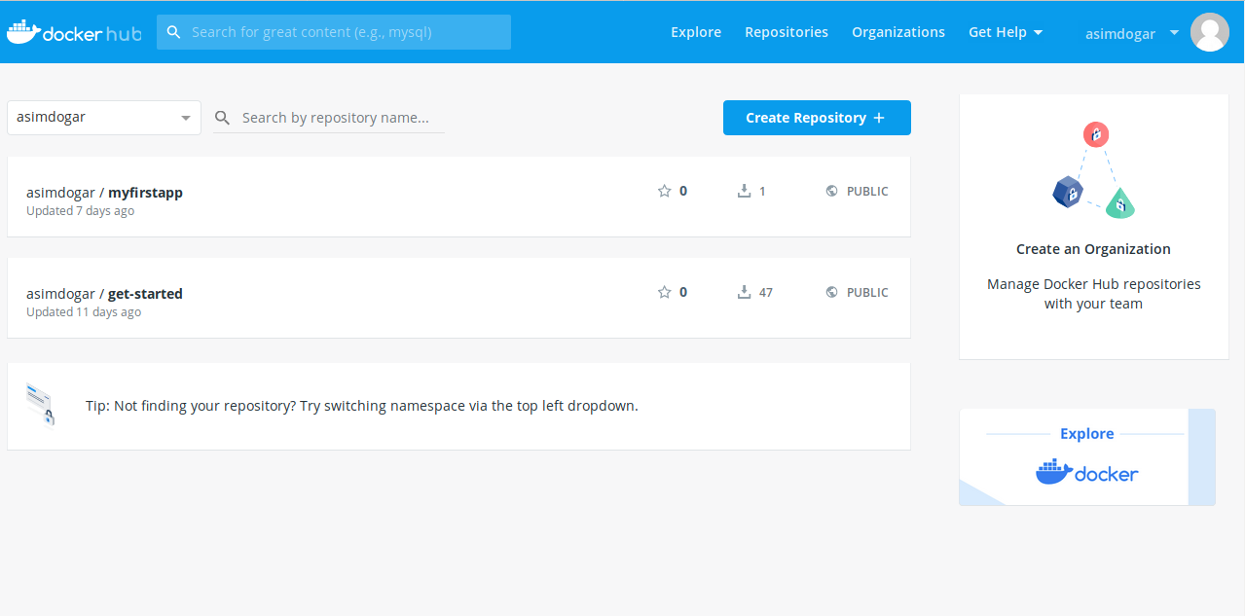
Docker Hub
• Provides Docker Services
• Library of public images
• Storage for your images
• free for public images
• cost for private images
•Automated builds(link github/bitbucket repo; trigger
build on commit)Docker Hub

Slide 16
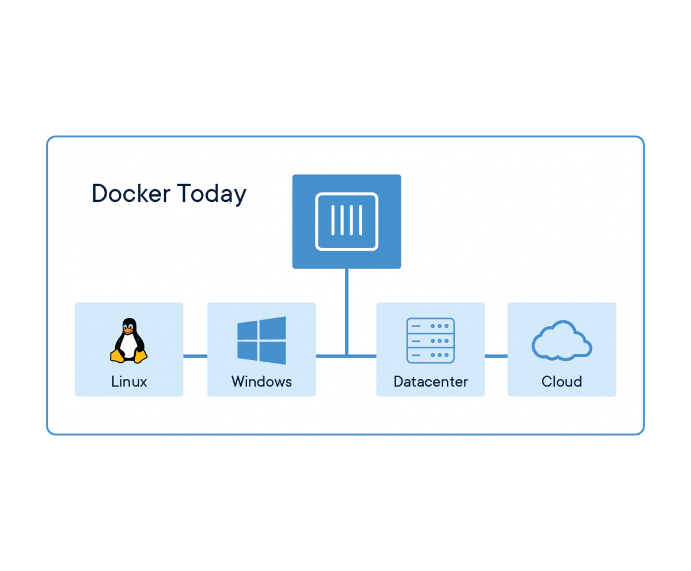
Docker Containers Are Everywhere: Linux, Windows, Data center, Cloud, Serverless, etc.

Slide 17
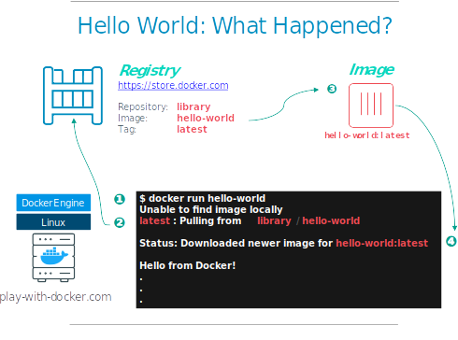
Running Image in Docker
## Execute Docker image
docker run hello-world

Slide 18
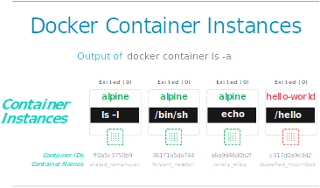

Slide 19
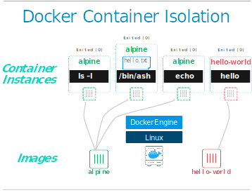
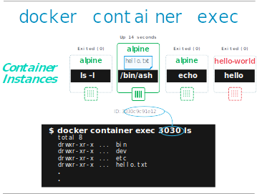
Container Isolation

Slide 20
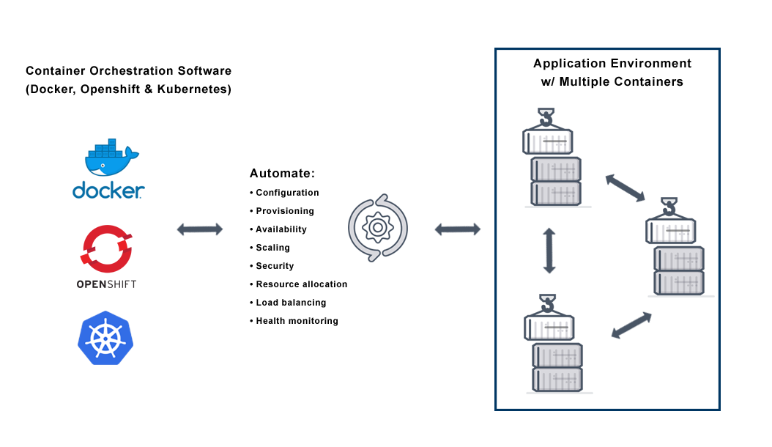
Container Orchestration

Slide 21
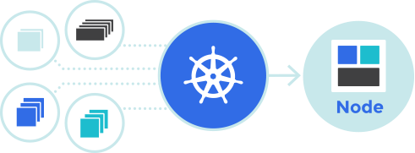
Kubernetes (K8s)
Kubernetes (K8s) is an open-source system for automating deployment, scaling, and management of containerized applications.
It was originally designed by Google, and is now maintained by the Cloud Native Computing Foundation.Initial release: 7 June 2014; Written in: Go

Slide 22
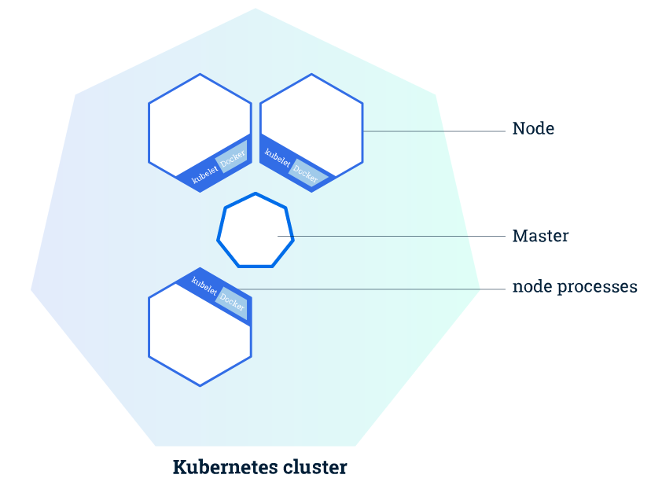
Kubernetes Clusters
A Kubernetes cluster consists of two types of resources:
The Master coordinates the cluster
Nodes are the workers that run applications
The nodes communicate with the master using the Kubernetes API, which the master exposes. End users can also use the Kubernetes API directly to interact with the cluster.

Slide 23
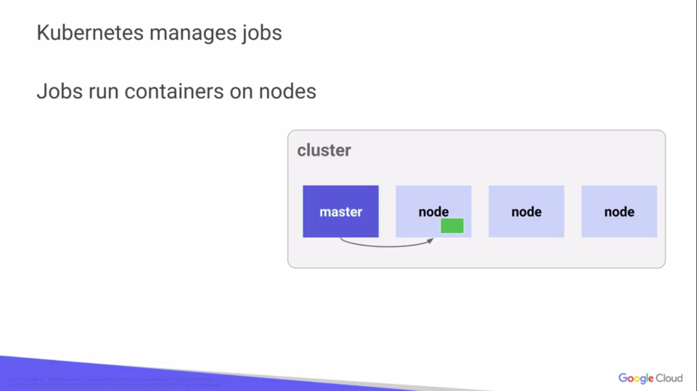

Slide 24
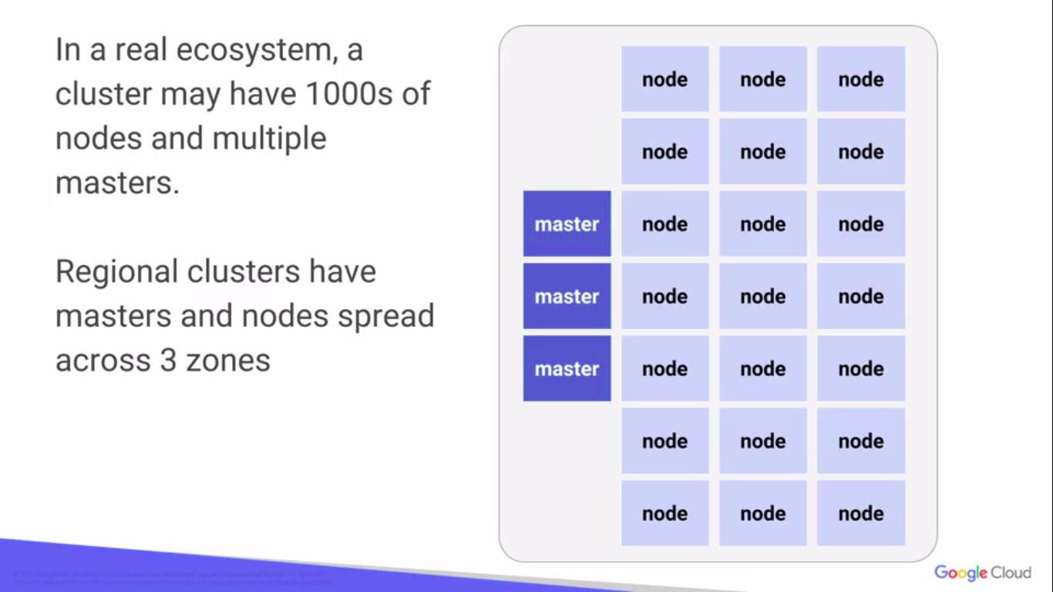

Slide 25
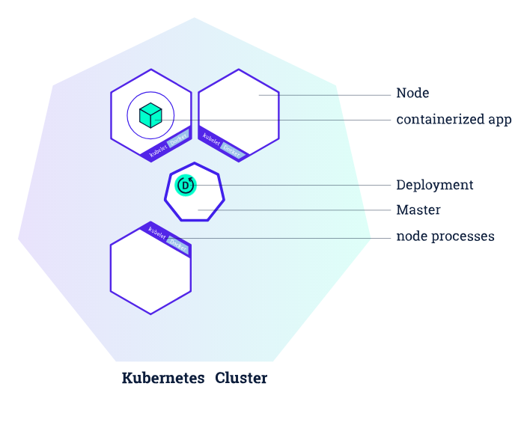
Deploying your first app on Kubernetes
You can create and manage a Deployment by using the Kubernetes command line interface,Kubectl. Kubectl uses the Kubernetes API to interact with the cluster.

Slide 26
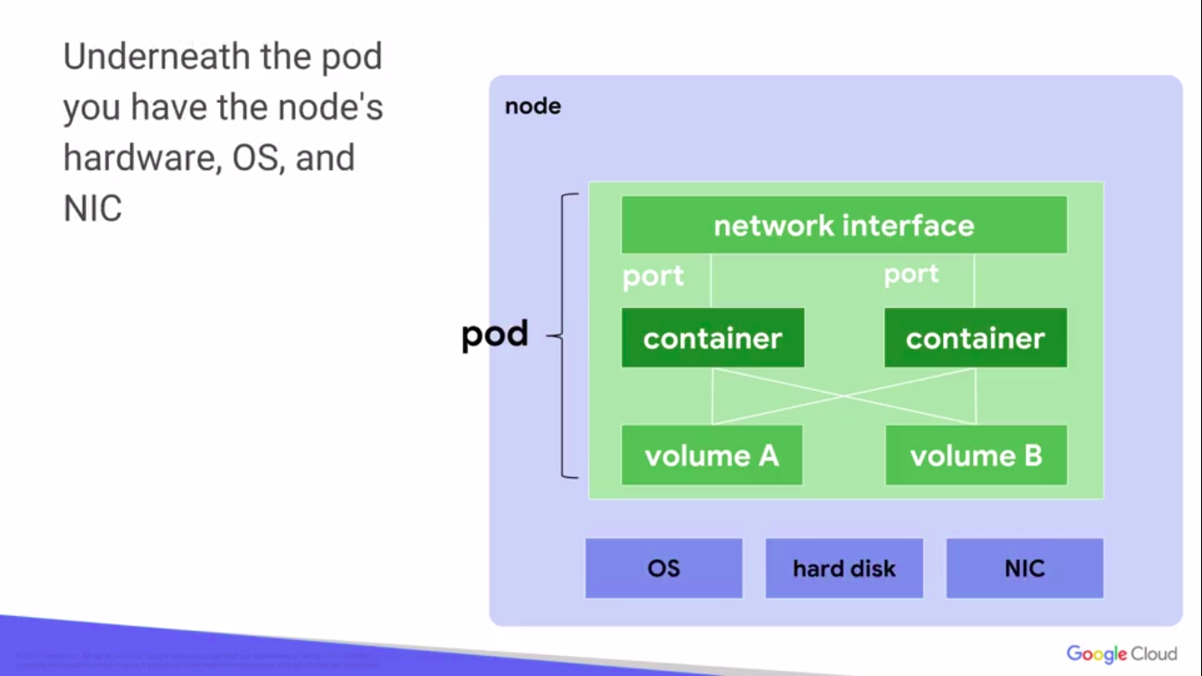
Kubernetes Pods
Shared storage, as Volumes
Networking, as a unique cluster IP address
Information about how to run each container, such as the container image version or specific ports to use

Slide 27
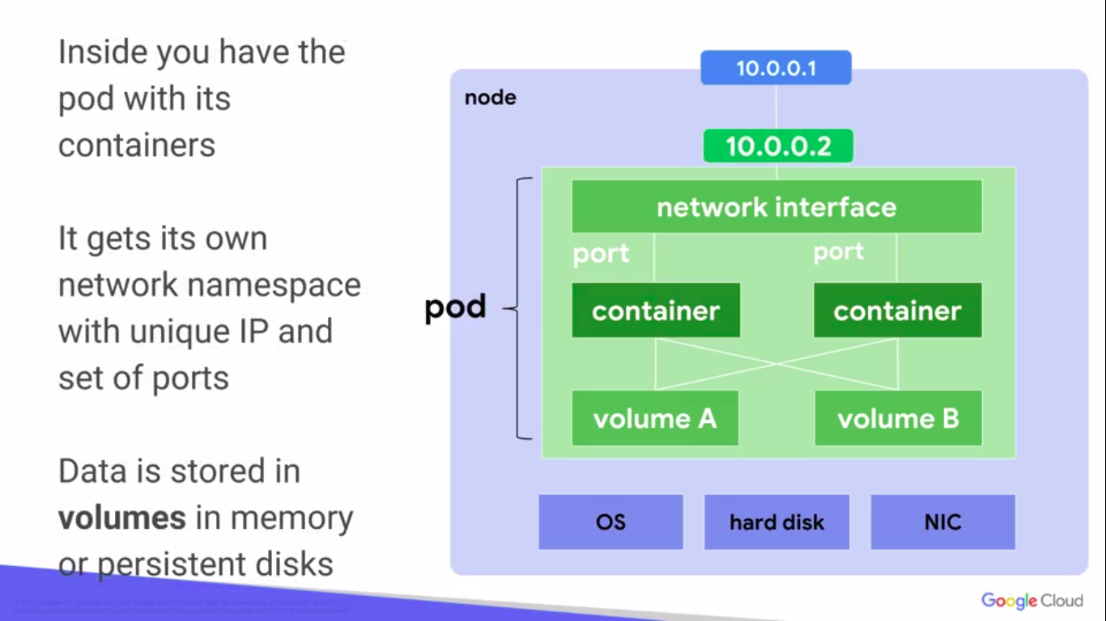

Slide 28
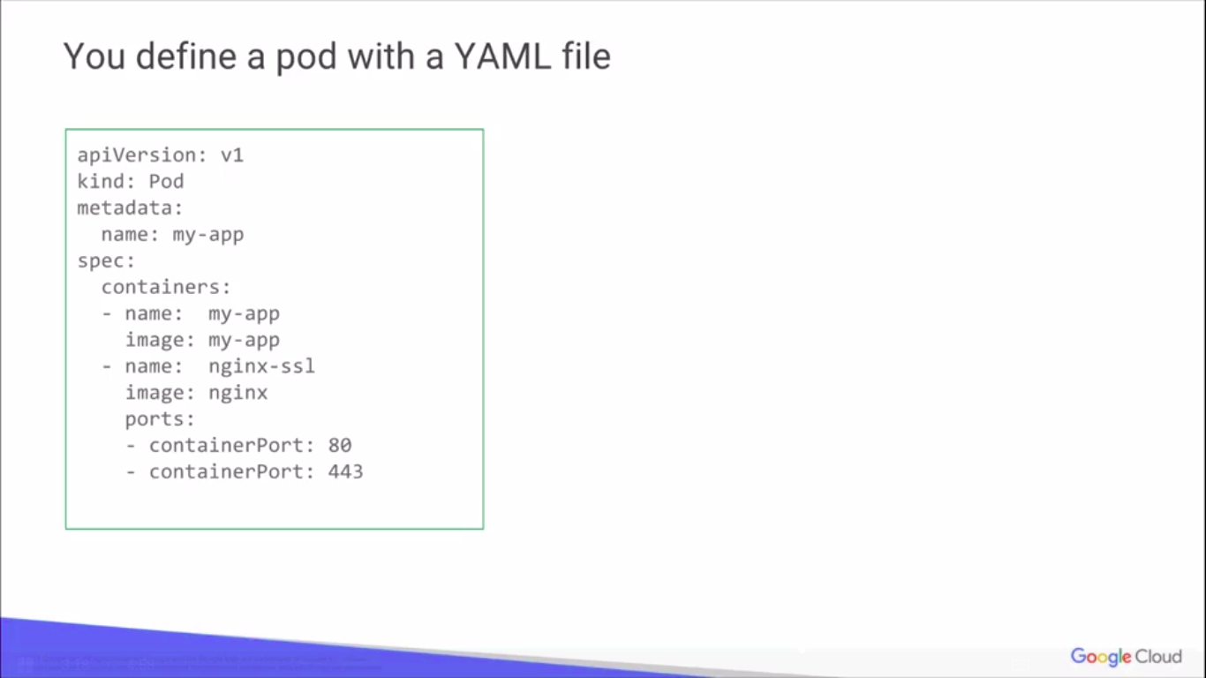
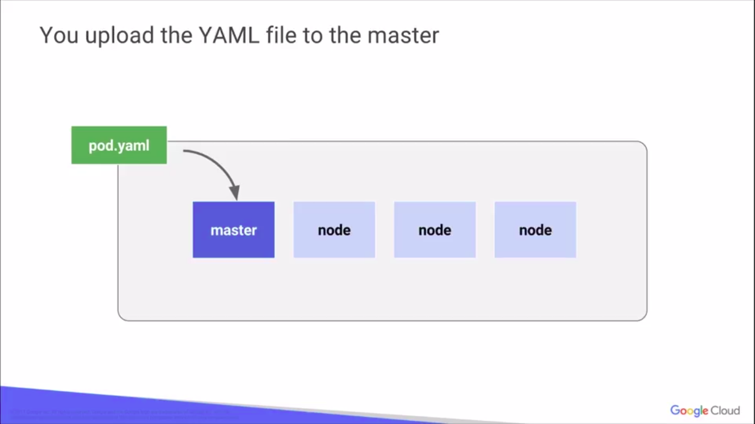

Slide 29
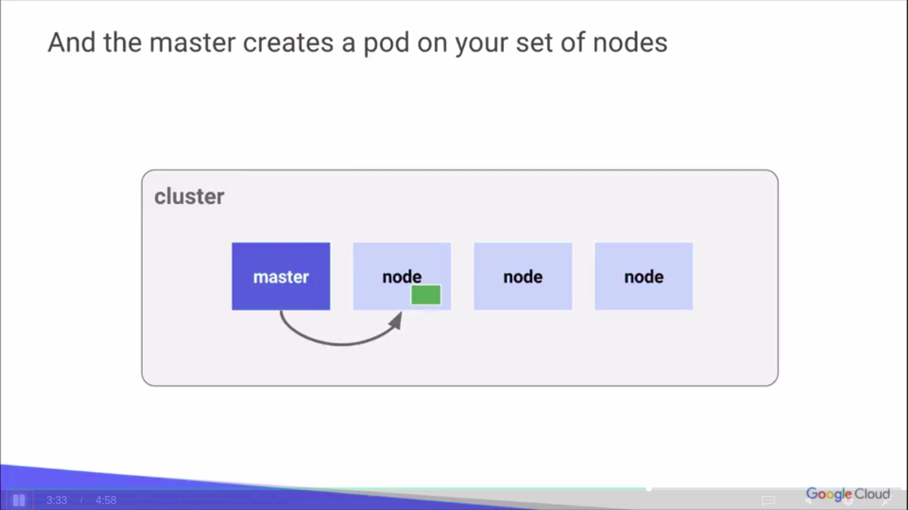
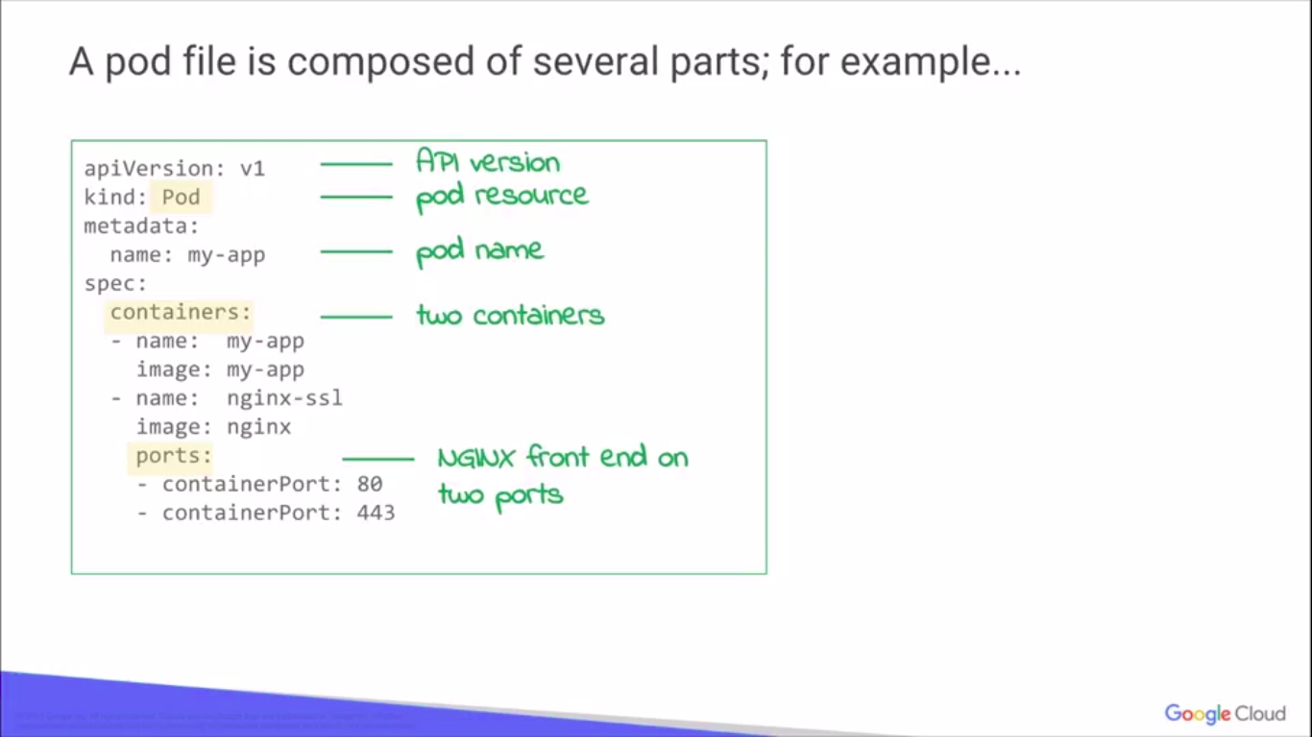

Slide 30
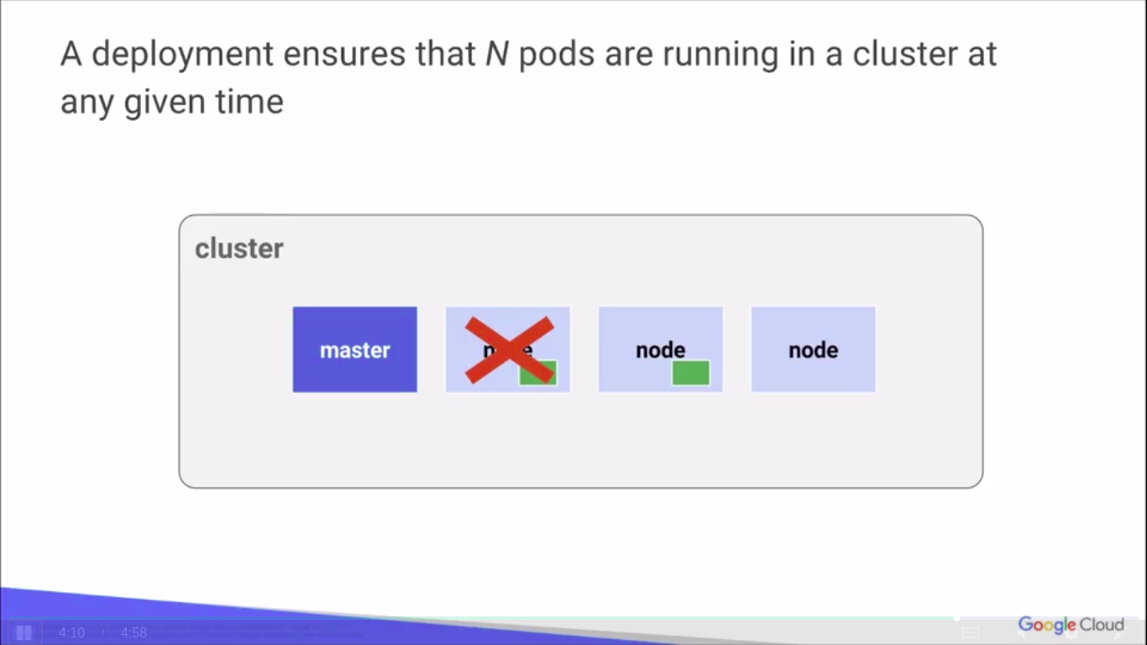
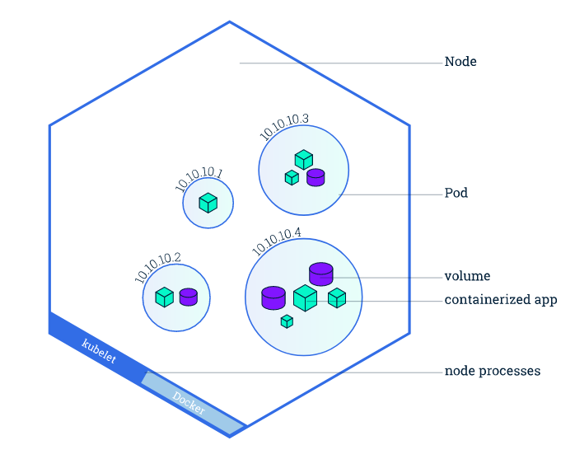

Slide 31
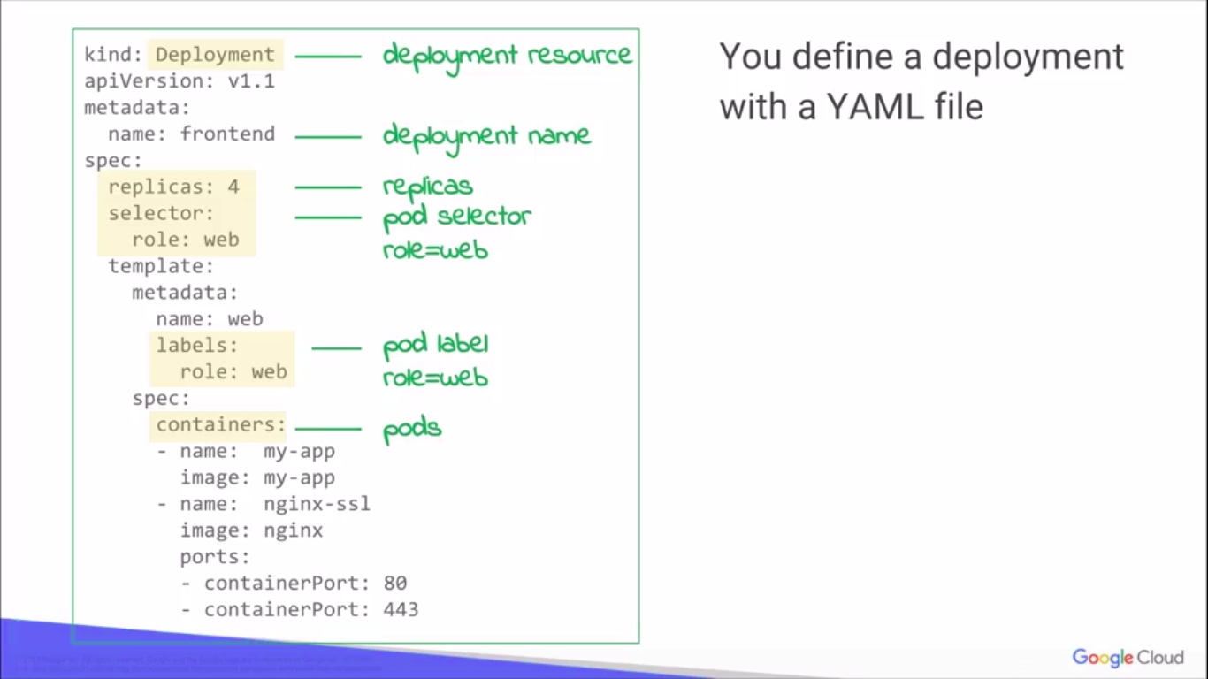
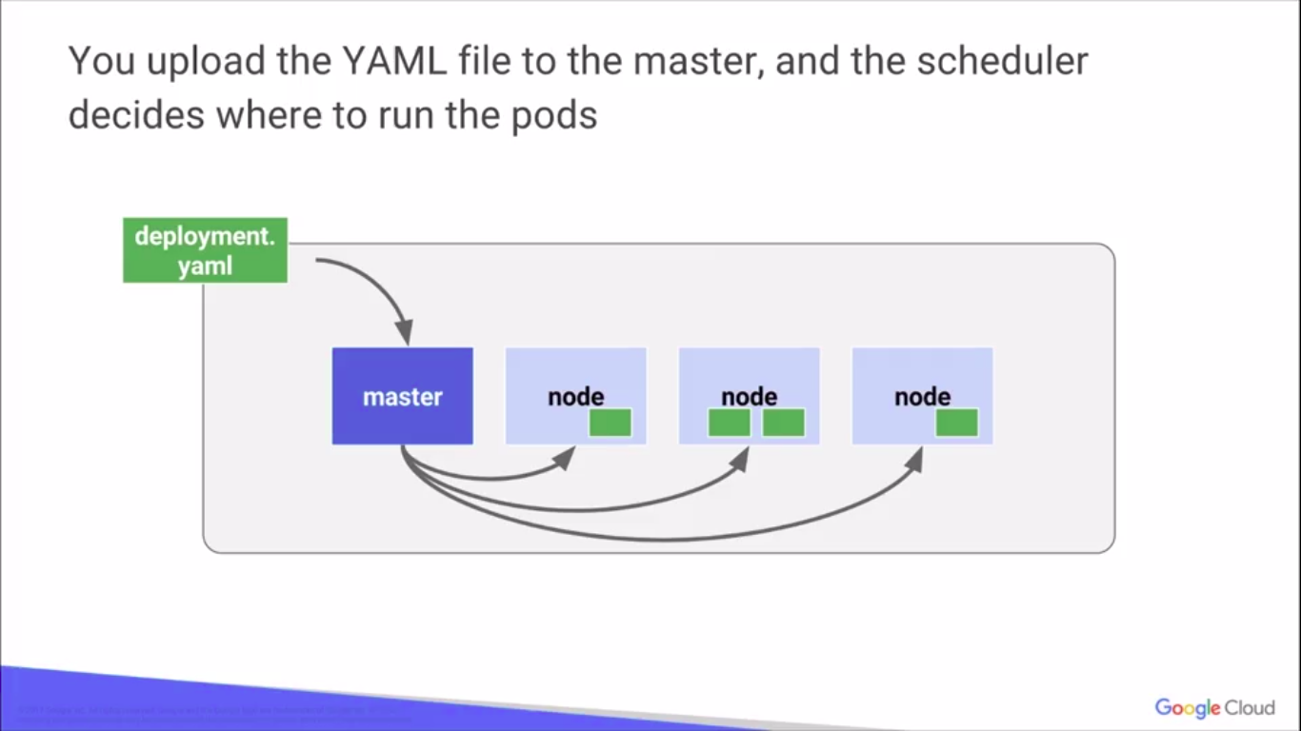

Slide 32
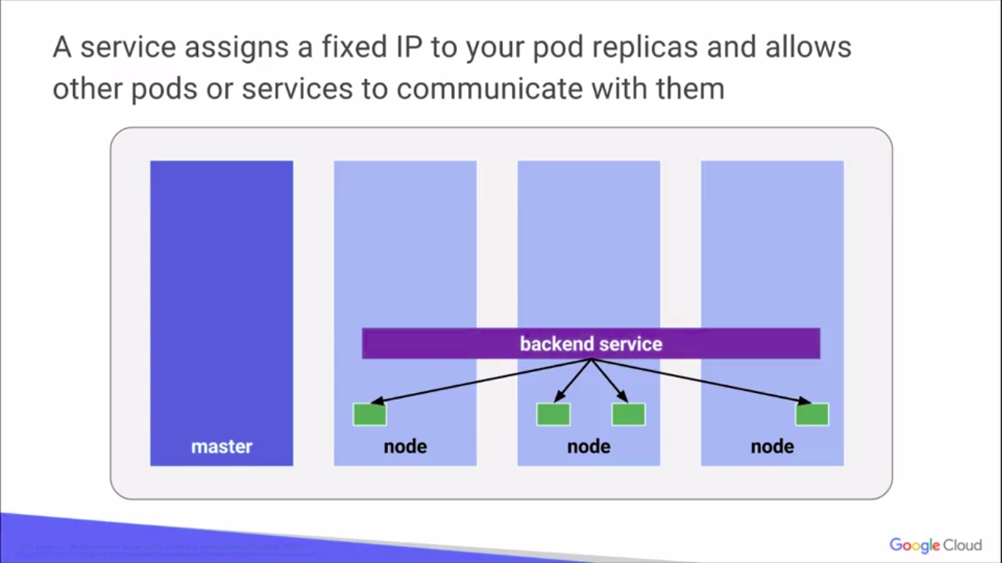

Slide 33
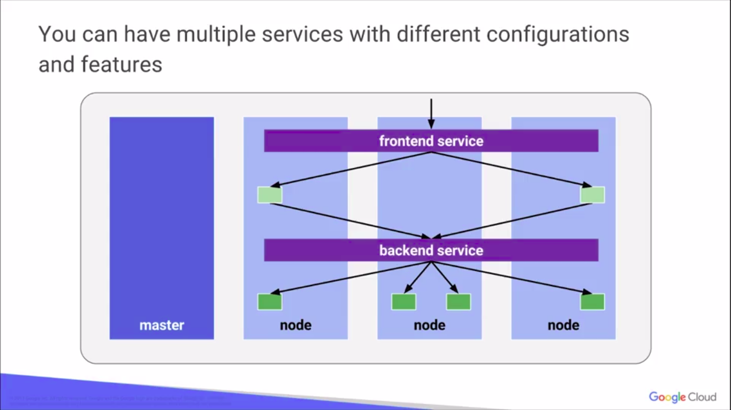

Slide 34
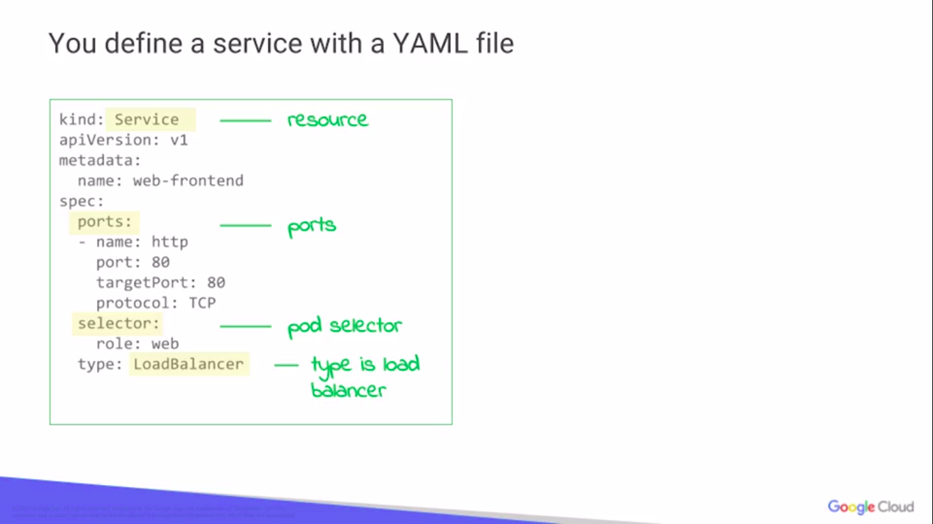

Slide 35
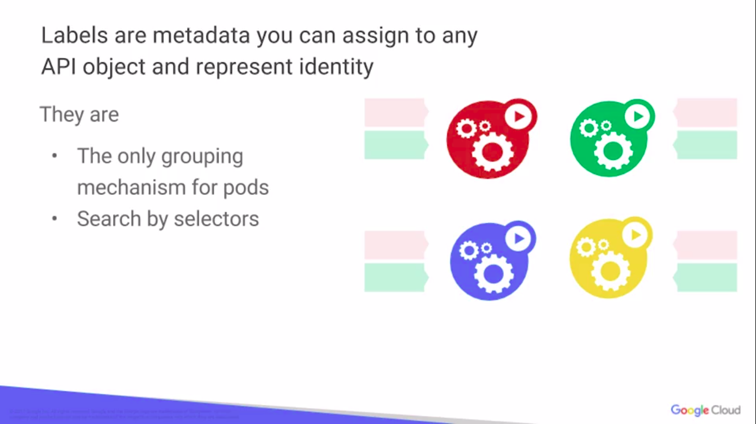
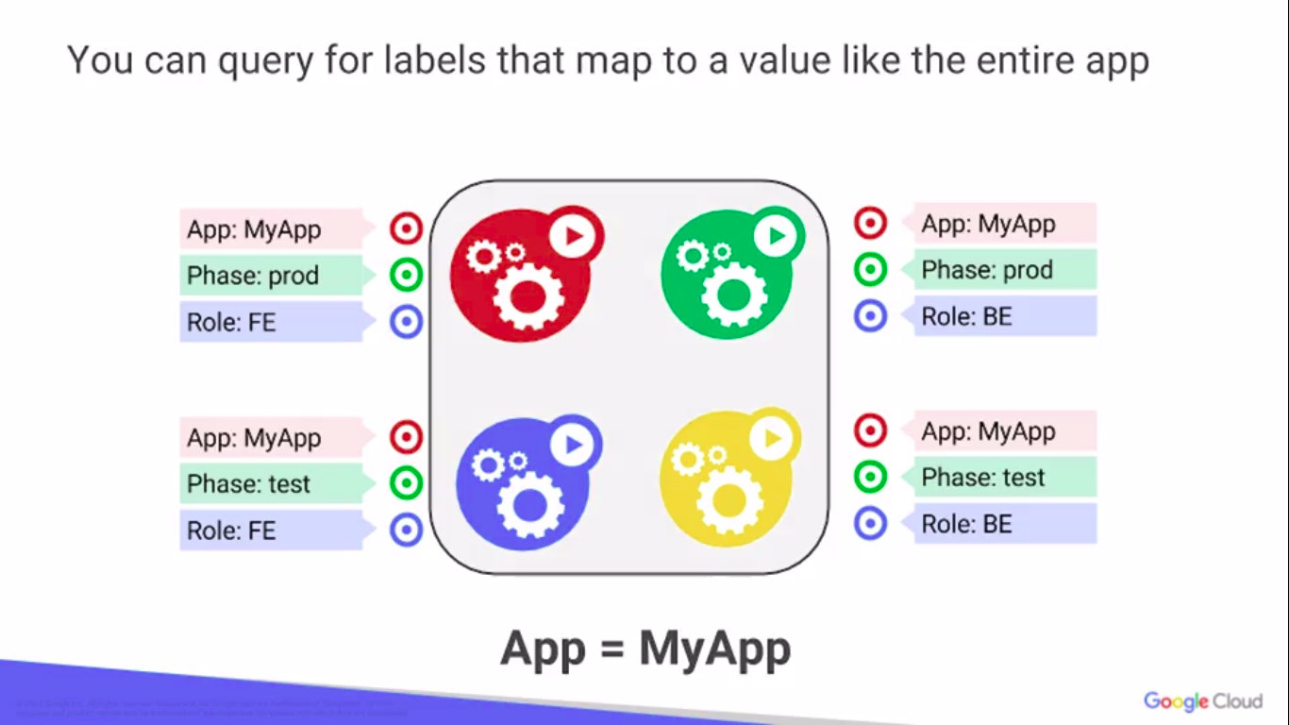

Slide 36
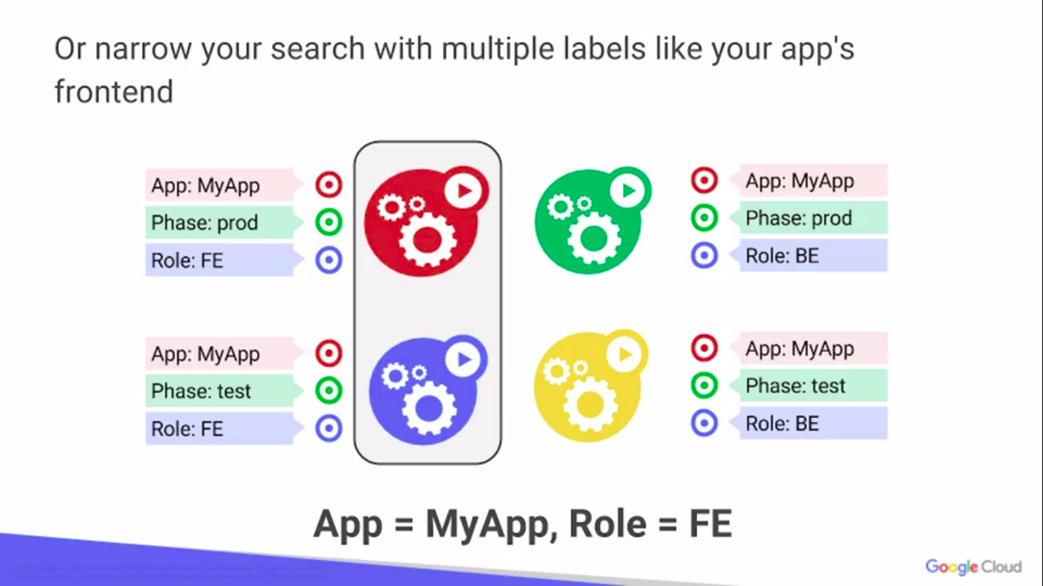
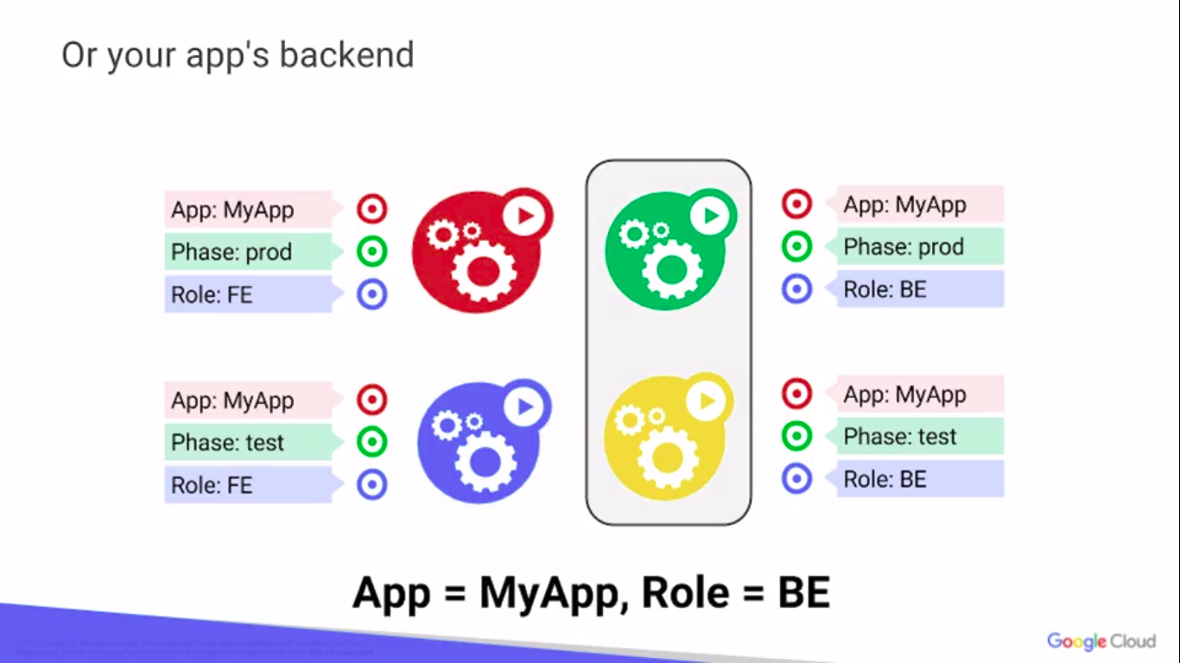

Slide 37
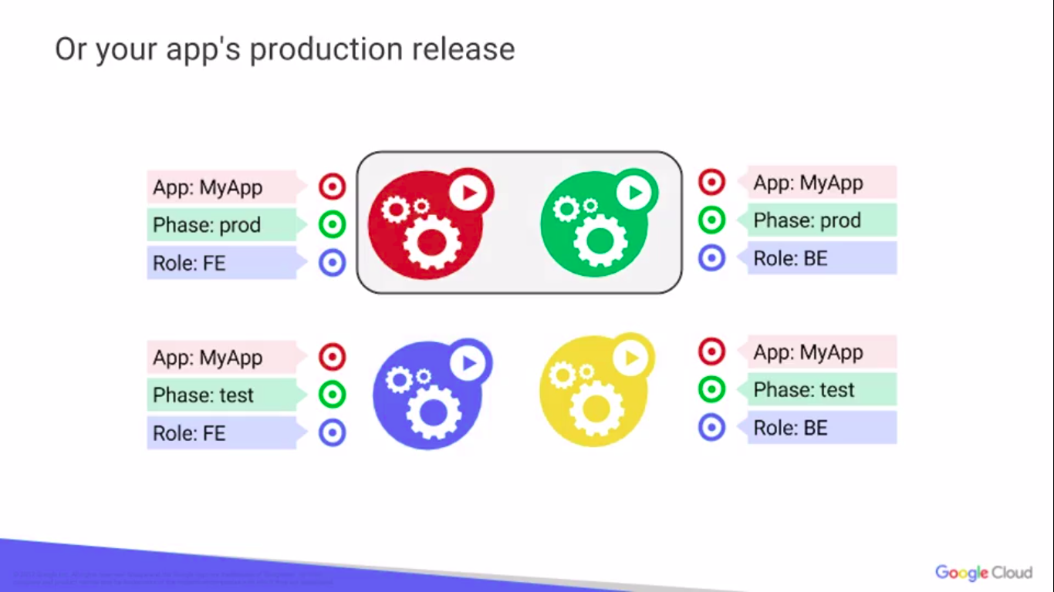
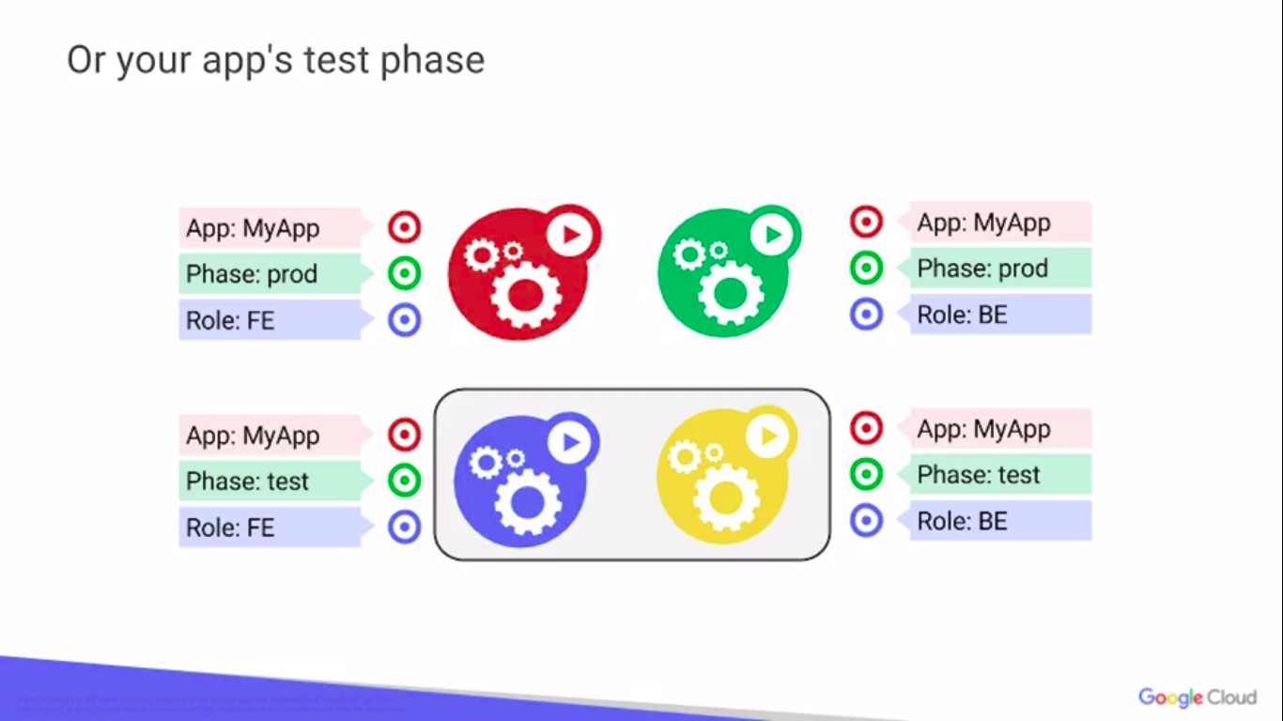

Slide 38
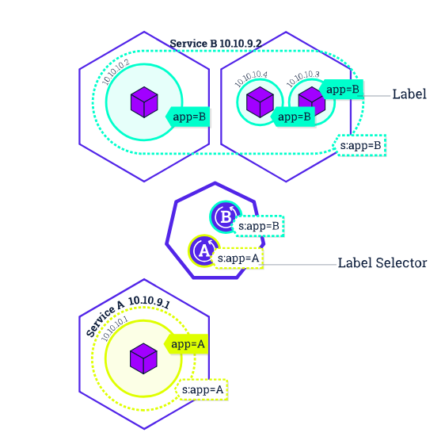

Slide 39
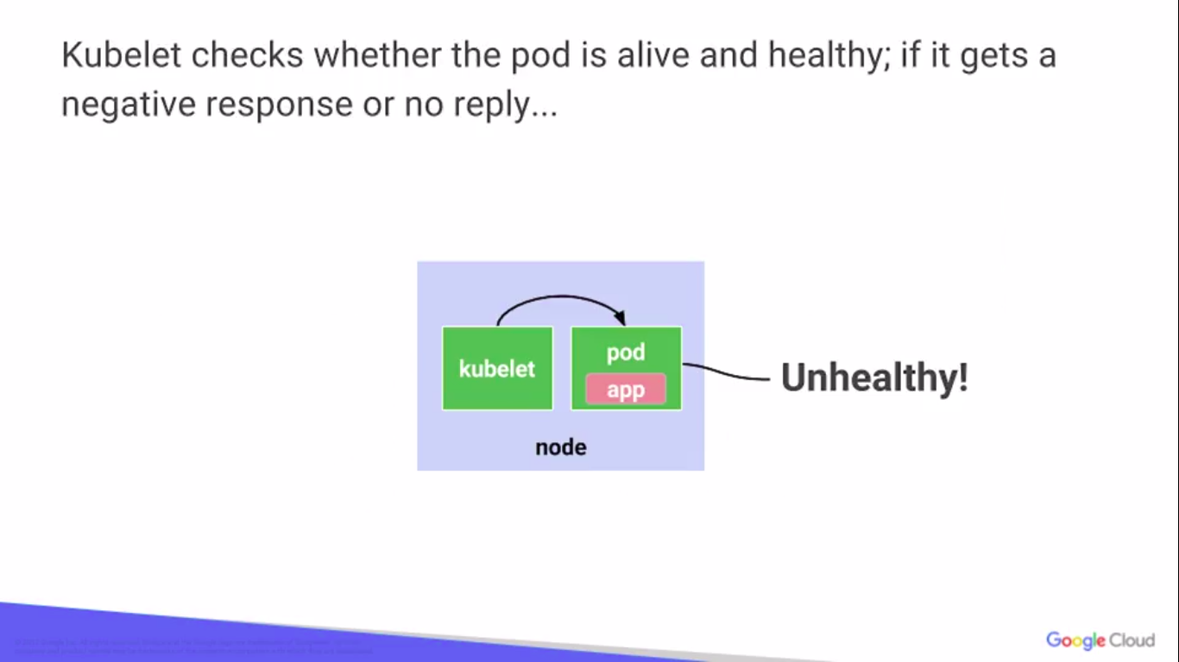
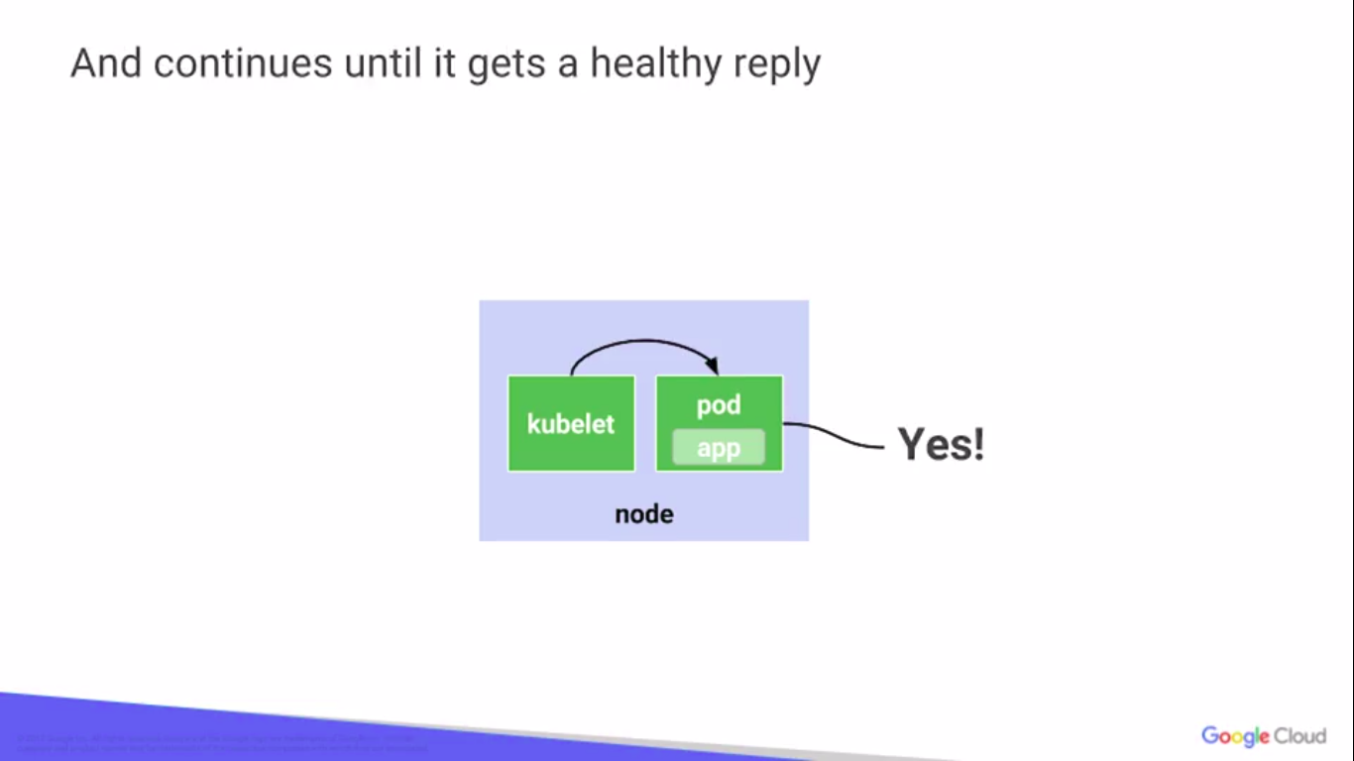
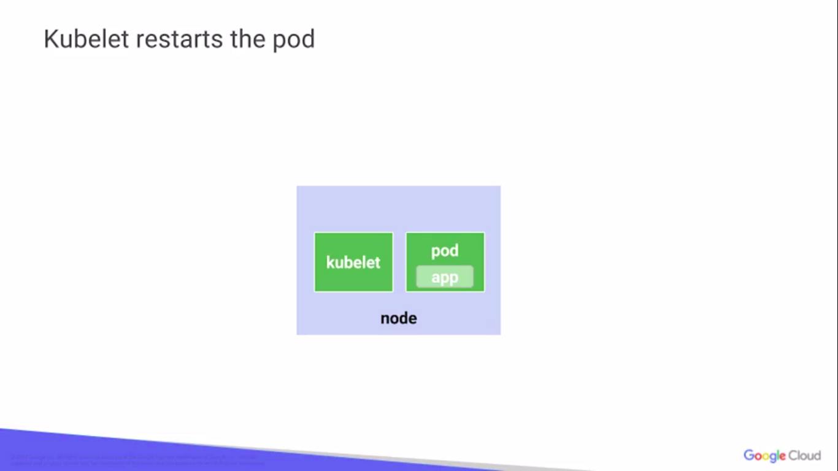

Slide 40
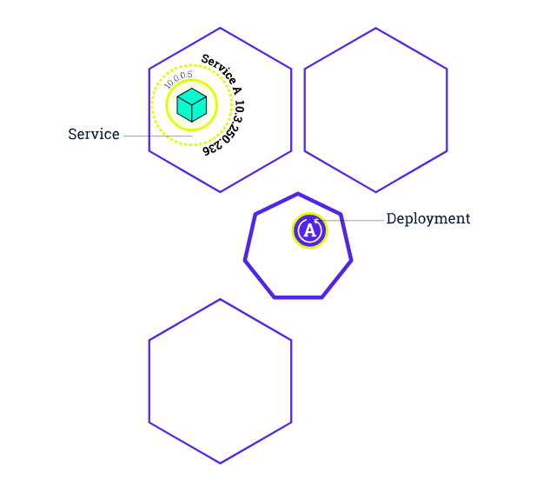
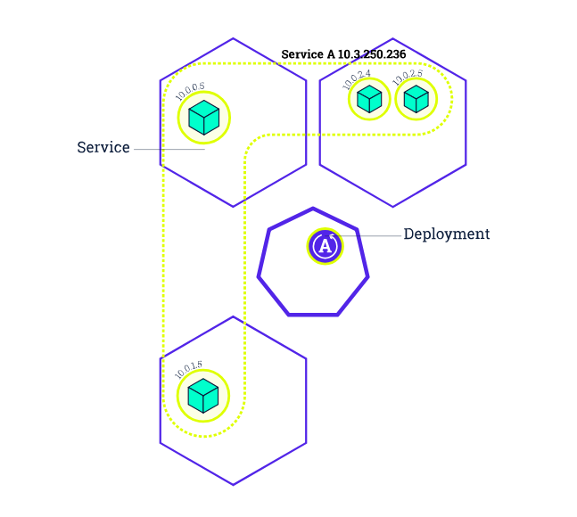
Scaling overview

Slide 41
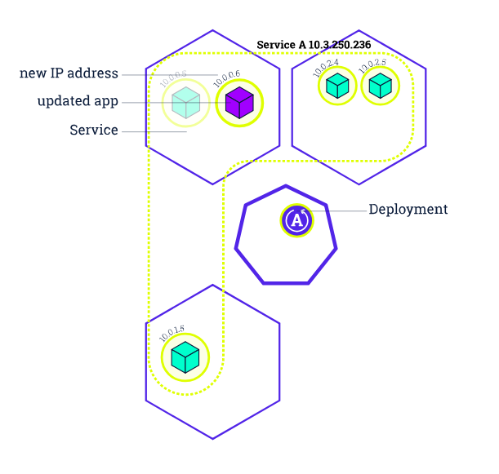



Rolling updates overview

Slide 42


Slide 43






Kubernetes Basics Modules
1. Create Cluster
2. Deploy App
3. Explore App
4. Expose App publicly
5. Scale up App
6. update App

Slide 44
Tutorials
https://kubernetes.io/docs/tutorials/kubernetes-basics

Slide 45
References
https://www.coursera.org/learn/google-kubernetes-engine
https://kubernetes.io/docs/tutorials/kubernetes-basics/
https://www.docker.com/get-started

