Slide 1
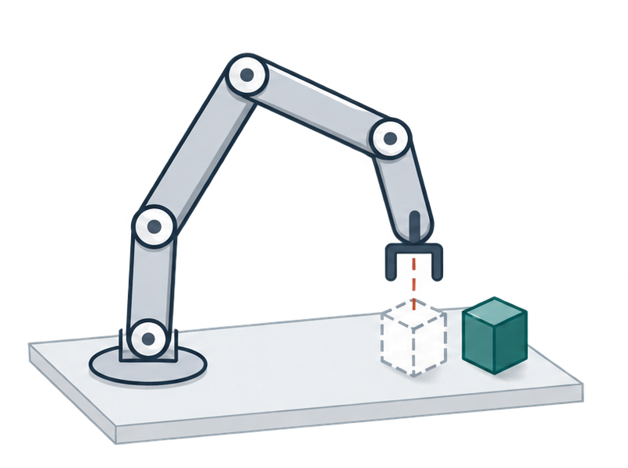



(a) Local mismatch
(b) Adapt the proposals
(c) Act, then observe
Consequence feedback
Object displaced
Short prefix
ASBS
Native
Adapted
Same frozen VLA
Native proposal
Re-observe
Conceptual schematic

Slide 2



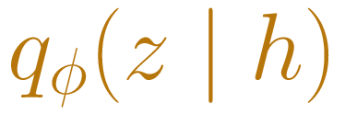


(a) Gather feedback
(b) Transport proposals
(c) Execute a prefix
Native noise
H
H
ASBS
Observation
+ task
Feedback-conditioned sampler
Frozen VLA
Same frozen VLA
Native prior
Adapted proposal
Action chunk
Candidate chunks
Short prefix
Noise changes; VLA stays frozen
Validate & execute
Consequence evaluator
Scored evidence
Same
observation
Fixed
continuation
Re-observe
Next context
H
H: refreshed context for the next call
Online variant · conceptual schematic

