Slide 1
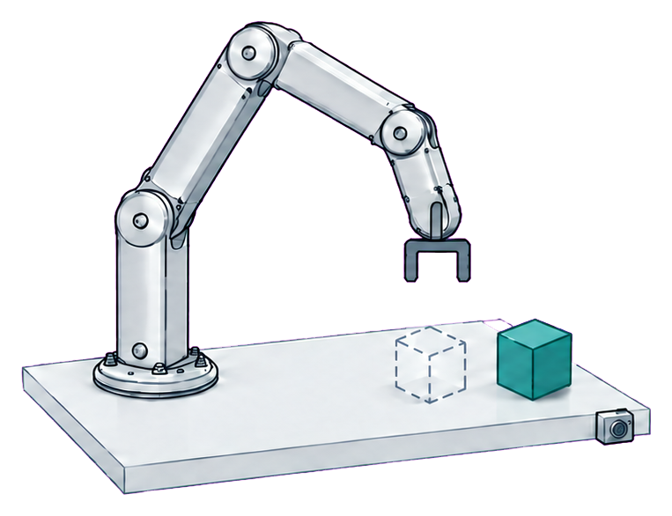
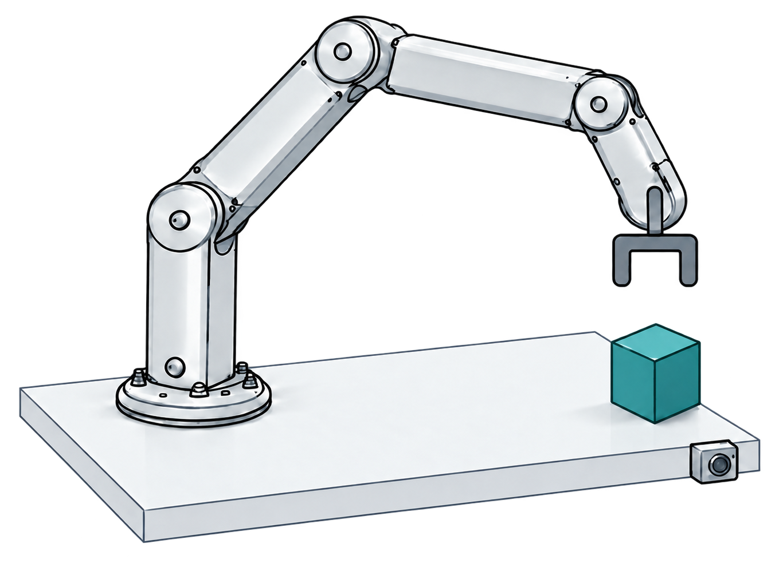

(a) Local mismatch
(b) Adapt the proposals
(c) Act, then observe
Object displaced
Consequence feedback
Short prefix
ASBS
Adapted
Native
Same frozen VLA
Native proposal
Re-observe
Conceptual illustration

Slide 2



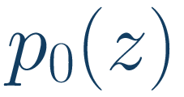
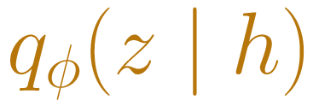


(a) Gather feedback
(b) Transport proposals
(c) Execute a prefix
History
Native noise
Observation + task
Observation
+ task
ASBS
Feedback-conditioned sampler
Frozen VLA
Same frozen VLA
Native prior
Adapted proposal
Action chunk
Short prefix
Candidate chunks
Proposal noise changes;
VLA stays frozen
Consequence
evaluator
Validate & execute
Scored evidence
Same observation
Re-observe
Fixed continuation
Refresh observation and history
Online variant · conceptual schematic

