Slide 1
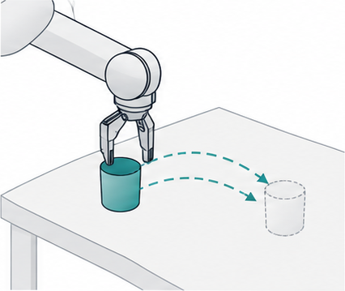



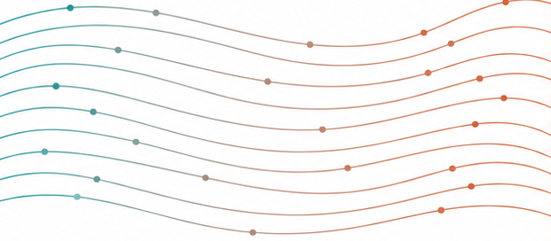
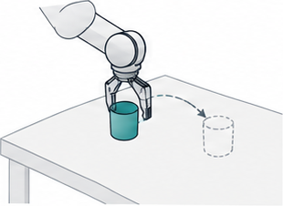
(a) Existing skill, new context
(b) ASBS: adapt the proposal law
(c) Decode, execute, observe
Consequence
feedback
Same frozen VLA
Same observation · fixed continuation
Feedback-conditioned transport
Action chunk
Adapted noise
Execute prefix
Frozen VLA + current observation
Native noise
Adapted noise
Native action candidates
Change the sampler, not the backbone
Re-observe
Re-observe and update feedback
Notes:
Mechanism schematic, not measured results. All labels, action tokens, decoder and wires are native editable objects. Six text-free illustration crops retain robot and smooth transport artwork. No guarantee of safety or skill preservation. Candidate scores share observation and fixed continuation.

