Slide 1


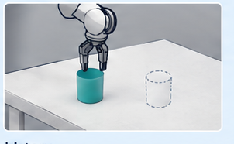
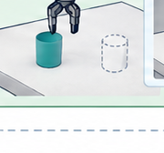
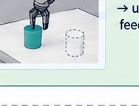
ASBS
Consequence feedback
same observation · fixed continuation
Feedback-conditioned proposal transport for frozen VLAs
progress
failure
unknown
Deployment context
Feedback-conditioned adapter
Trusted execution loop
instruction
adapted z
new target / changed contact
Frozen VLA proposal service
ASBS transport
same frozen
VLA decoder
checkpoint fixed
p0(z)
q(z | feedback)
observation
native proposal z ~ p0
execute prefix
…
re-observe →
update feedback
history
changes proposal law; keeps decoder fixed
…
new observation
Closed-loop rollout
1
observe
2
sample candidates
3
score consequences
4
transport
5
execute prefix
6
re-observe
repeat with new feedback

