Slide 1
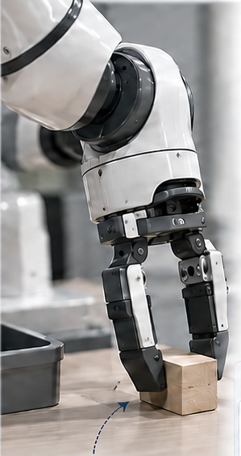
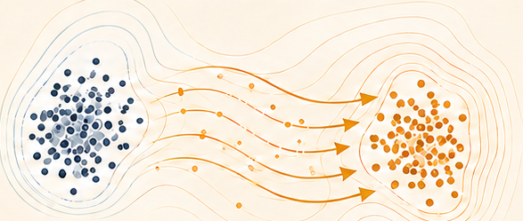

(a) Verified experience
(b) Offline ASBS consolidation
(c) Teacher-free execution
Recover after a missed grasp
Value under student continuation
New observations
Frozen VLA proposals
Prefix
Fixed student
Outcome
Learned proposer
···
···
···
···
Deploy
proposer
···
···
Candidate prefix
Student continuation
Future outcome
···
Energy
Re-observe
S2 selects
or abstains
ASBS
Frozen VLA
Adjoint matching
Corrector matching
Execute prefix
Observation tokens
Action tokens
···
···
···
Language tokens
···
Verified transitions
···
Execute prefix
Native
latent prior
Learned
proposer
(from ASBS)
Missed grasp
(e.g., slipped)
···
Successes and failures
No online S2 or critic.
Conceptual illustration; not measured transfer results.
Notes:
v20 source-faithful reconstruction. Text and simple geometry are editable. Complex artwork and marked formula assets remain independently movable images. Connectors have fixed endpoints. Generated robot illustrations are conceptual, not data.

Slide 2
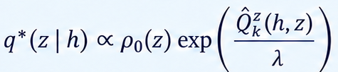

(a) Acquire verified experience
Record executed prefixes and outcomes.
Frozen VLA proposals
S2 selection / abstention
Execute prefix
Recovery capsules
A1
···
A1
···
(h, a, h′, success)
···
A2
···
A2
···
···
A3
···
A3
···
(h, a, h′, failure)
···
Verified experience (h, a, h′, outcome)
(b) Consolidate offline
Learn a conditional sampler that approximates the critic-defined target.
Continuation critic
Conditional ASBS
Fixed student thereafter
Adjoint matching
Corrector matching
∇z E
Energy-defined target
μ = ρ₀
qη(z | h)
Native qη or distilled pψ
Learned actor (qdep)
(c) Deploy without teacher or critic
ht
Use the learned proposer with the frozen VLA; re-observe and iterate.
History ht
Learned proposer
zt
Frozen VLA Gθ₀
Execute prefix
(past observations and actions)
qdep
(no weight updates)
···
tokens → actions
Re-observe
Proposed architecture; integration and distillation costs remain.
Notes:
v20 source-faithful reconstruction. Text and simple geometry are editable. Complex artwork and marked formula assets remain independently movable images. Connectors have fixed endpoints. Generated robot illustrations are conceptual, not data.

Slide 3






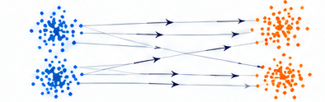



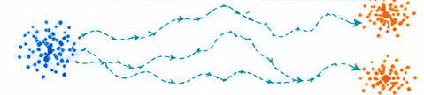







Why ASBS fits an energy-defined feedback target
Standard sample-trained formulations
Energy-defined target
(a) Diffusion
(b) Flow matching
(c) ASBS
Target samples
Source + target samples
Source samples + ∇E
Perturb samples
Interpolate sample pairs
Source
Energy, E(x)
No precomputed
target samples
Fit a denoiser / score
Fit a velocity field
Adjoint
matching
Corrector
matching
Denoiser
(sθ)
Fit a stochastic bridge
Generate from learned dynamics
Generate from learned dynamics
Sample the learned proposer
Noise (prior)
Samples
Source (prior)
Samples
Source (prior)
Proposer samples
Application: consequence-to-proposal learning
Q
Verified transitions
Student-continuation value
Latent energy
ASBS proposer
Energy supervision without precomputed target samples.
ASBS is itself a diffusion sampler; energy-based diffusion and flow alternatives exist.
Gradients and sampler rollouts have costs. VLA gains require matched experiments.
Notes:
v20 source-faithful reconstruction. Text and simple geometry are editable. Complex artwork and marked formula assets remain independently movable images. Connectors have fixed endpoints. Generated robot illustrations are conceptual, not data.

