Slide 1
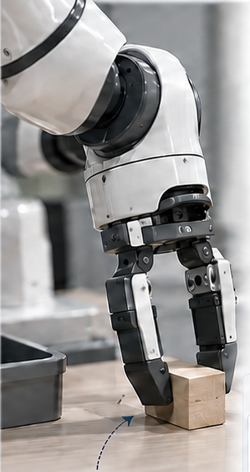
01 / CENTRAL IDEA
Turn expensive feedback into a reusable proposal
Score the frozen VLA’s own candidates, then learn where to sample next.
A changed scene
1 Evaluate consequences
2 Learn a proposer
3 Reuse at deployment
Own noise candidates
Fit continuation value;
train the ASBS drift.
ASBS proposer
Same frozen VLA
Same state and continuation
Simulated rollouts
No teacher actions
Execute 5 actions
Z₀ = 0
Learned noise
Re-observe and repeat
Point-source ASBS instance
A recovery may exist
in the native proposals.
Store context, noise, outcome
Reference endpoint: native prior
No rollout scorer or critic
Design objective, not an observed recovery result. Illustration is synthetic; feedback quality remains under validation.
Notes:
Experimental-alignment revision of v20, 2026-09-24. Conceptual architecture, not a claim of robot improvement. Current implemented sampler: Dirac-source adjoint matching; no separate corrector or distilled actor. S2-sim v1.1 used prefix 5 + native continuation 100, M=3; all-zero pilot scores require repair. Supervisor round16 queues full-episode scoring v1.2 with M=2 (or versioned M=3); this is not a validated result. Gaussian prior is the uncontrolled endpoint law, not the sampler starting law. Robot is generated illustration, not data. Fonts are not embedded; connectors have fixed endpoints.

Slide 2
02 / IMPLEMENTED INTERFACES
A consequence model trains the sampler—not the VLA
Separate feedback acquisition, offline learning, and closed-loop deployment.
ACQUIRE
Native candidates
Candidate prefix
Native continuation
Scored records
K noise draws per context
Decode; execute 5 actions
Roll out to budget H
M repeats per candidate
z ∼ N(0, I)
A = G₀(h, z)
Same frozen student
(h, z, score)
LEARN OFFLINE
Value under native continuation
Value gradient
Point-source adjoint matching
q* ∝ ρ₀ · exp(Q̂ / λ)
dZ = uη ds + dW; Z₀ = 0
Frozen decoder; feedback reshapes its latent input.
Zero drift → N(0,I) endpoint; learned drift → proposal.
DEPLOY
Context h
ASBS proposer
Frozen VLA
Execute prefix
Vision + proprioception
100 drift steps
+ Images and instruction
5 actions; re-observe
H and M are versioned acquisition settings. Native-continuation value does not guarantee repeated-use improvement.
Notes:
Experimental-alignment revision of v20, 2026-09-24. Conceptual architecture, not a claim of robot improvement. Current implemented sampler: Dirac-source adjoint matching; no separate corrector or distilled actor. S2-sim v1.1 used prefix 5 + native continuation 100, M=3; all-zero pilot scores require repair. Supervisor round16 queues full-episode scoring v1.2 with M=2 (or versioned M=3); this is not a validated result. Gaussian prior is the uncontrolled endpoint law, not the sampler starting law. Robot is generated illustration, not data. Fonts are not embedded; connectors have fixed endpoints.

Slide 3
03 / WHY THIS SUPERVISION INTERFACE
Learn from consequences, without a target action dataset
The distinction is the training signal—not a claim that ASBS beats every diffusion or flow method.
Sample-trained diffusion
Sample-trained flow matching
Our ASBS instance
Target samples
Source–target samples
A learned value gradient
Perturb target samples
Interpolate sample pairs
Start a controlled diffusion at 0
Fit a score / denoiser
Fit a velocity field
Fit a drift by adjoint matching
Sample with learned dynamics
Sample with learned dynamics
Sample with learned dynamics
What would establish the ASBS contribution?
Same feedback data
Strong no-rollout baselines
Matched deployment and cost
Match state coverage and continuation.
Value rerank · weighted fit · latent search
Reranking noise needs only one VLA decode.
ASBS is itself a diffusion sampler. Energy-based diffusion/flow alternatives exist; robot gains are not yet established.
Notes:
Experimental-alignment revision of v20, 2026-09-24. Conceptual architecture, not a claim of robot improvement. Current implemented sampler: Dirac-source adjoint matching; no separate corrector or distilled actor. S2-sim v1.1 used prefix 5 + native continuation 100, M=3; all-zero pilot scores require repair. Supervisor round16 queues full-episode scoring v1.2 with M=2 (or versioned M=3); this is not a validated result. Gaussian prior is the uncontrolled endpoint law, not the sampler starting law. Robot is generated illustration, not data. Fonts are not embedded; connectors have fixed endpoints.

