Slide 1
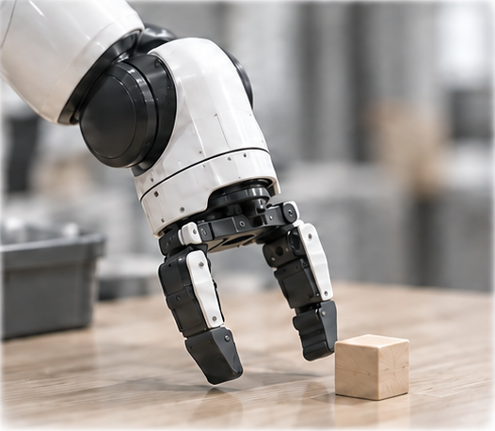
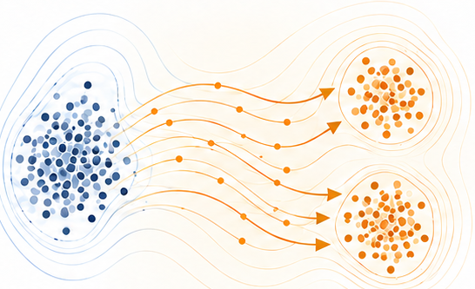
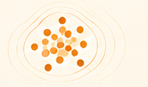

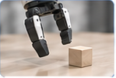
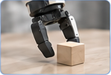
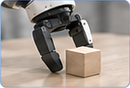
(a) Score student continuation
(b) Learn what to propose
(c) Reuse without online scoring
ASBS
After 10 chunks, resample next segment
Scores → value surrogate → sampler training
10 chunks
Learned proposer
···
One segment draw
At segment boundary
Fresh observation
Execute prefix
Frozen VLA
Native noise
Learned proposals
Re-observe each chunk
Candidate
segment
Native
continuation
Outcome
score
Store feedback in the proposer, not the VLA weights
Score-only supervision
No online simulator or surrogate
Simulator feedback
Proposed mechanism · conceptual scenes, not measured recovery results
Notes:
v22 source-faithful editable reconstruction. Conceptual scenes, not measured results. Current ten-chunk protocol is proposed. Text and simple geometry editable; robot art, particle routes and marked mathematical regions are movable rasters. Fixed connector endpoints. No simulator or surrogate queries at deployment; sampler/decoder costs remain.

Slide 2
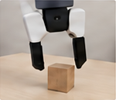






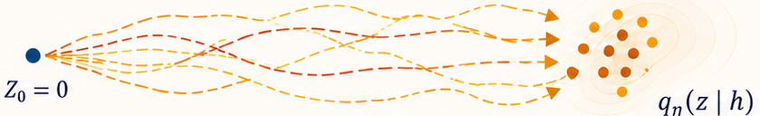








(a) Acquire continuation scores
Shared snapshot h
Candidate segment z
Native continuation
Outcome score
shared snapshot
···
···
(h, z¹, score)
10 chunks · re-observe each chunk
···
(h, z², score)
Simulator
supervision
(h, z³, score)
Frozen VLA
···
h
Native student thereafter
(b) Fit a reusable proposal sampler
Value surrogate
Conditional adjoint sampling
Training
gradients
(h, z, score)
Q̂(h, z)
KL-regularized target
Uncontrolled endpoint: ρ₀ = N(0, I)
Learn the drift offline
Reuse learned sampler
(c) Deploy the same frozen VLA
Current observation
Context h
Segment
boundary
ASBS proposer
Segment stream z₁:₁₀
Frozen VLA
Execute prefix
z⁽ʲ⁾
current state
task info
···
qη(z | h)
···
···
Resample after 10 chunks
(no weight updates)
5 actions per chunk
h
Fresh observation at every chunk
Proposed segment protocol; robot gains unverified.
Sampler integration and VLA decoding remain.
Notes:
v22 source-faithful editable reconstruction. Conceptual scenes, not measured results. Current ten-chunk protocol is proposed. Text and simple geometry editable; robot art, particle routes and marked mathematical regions are movable rasters. Fixed connector endpoints. No simulator or surrogate queries at deployment; sampler/decoder costs remain.

Slide 3
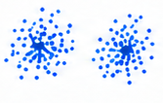
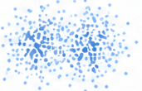
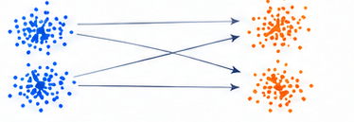
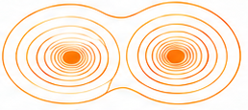


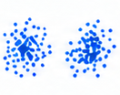
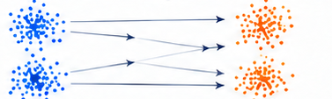



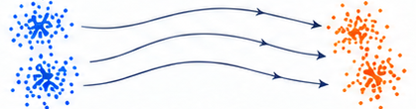





Different training signals, reusable samplers
(a) Sample-trained diffusion
(b) Standard flow matching
(c) Our adjoint-sampling route
Target samples
Perturb samples
Source + target samples
Value-defined target
Scores
Supervision
No precomputed target samples
Fit velocity field
Adjoint matching
Learning
Fit
denoiser
Fit conditional drift
Generate with learned dynamics
Generate with learned dynamics
Sample without online scoring
Sampling
Noise (prior)
Application:
Continuation scores
Value surrogate
ASBS proposer
Frozen VLA
ASBS is a diffusion sampler; energy-based diffusion and flow alternatives also exist.
Supervision comparison, not a measured performance ranking.
Notes:
v22 source-faithful editable reconstruction. Conceptual scenes, not measured results. Current ten-chunk protocol is proposed. Text and simple geometry editable; robot art, particle routes and marked mathematical regions are movable rasters. Fixed connector endpoints. No simulator or surrogate queries at deployment; sampler/decoder costs remain.

