Slide 1

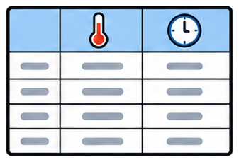
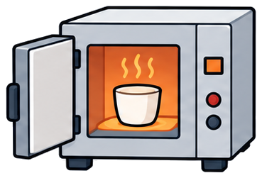

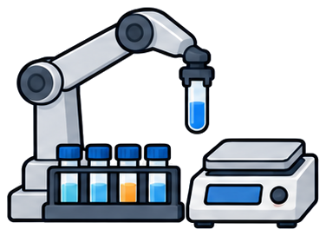



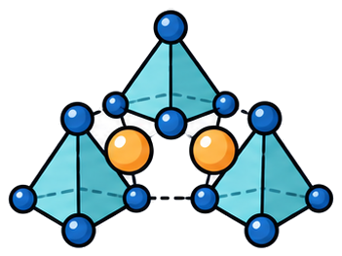
文献数据库
实验流程 Step 1–3
文献中的合成描述
结构化的合成知识
合成方案与实验装置
88,343,822
Could AI
繁琐细致的实验步骤
篇文献 · 全文 80.5 TB
① 称量后在玛瑙研钵中充分研磨混合
化学学科论文占比
Dream of Science
~20%
② 转移至刚玉坩埚
合成条件散落在正文段落中
尚未结构化
③ 分段热处理：350 / 1000 / 1300 °C
大模型读懂文献里的合成经验，生成可执行的研究方案，交给自动化实验室执行与仿真
Experimental Guidance · 文献原文
一段话里的四类信息
“
The phosphors of Sr4.75-5x-5yCa5xBa5y(PO4)2(SiO4):Eu0.252+ (0.01 ≤ x ≤ 1; 0.01 ≤ y ≤ 0.5) were prepared: I)
Sr4.75-5xCa5x((PO4)(SiO4)0.5)2:Eu0.252+ (0.01 ≤ x ≤ 0.95); and II) Sr4.75-5yBa5y(PO4) 2(SiO4):Eu0.252+ (y = 0.01, 0.05,
0.1, 0.2, 0.5). The starting materials were CaCO3 (99.99%), SrCO3 (99.99%), BaCO3 (99.99%), NH4H2PO4 (99.99%),
SiO2 (99.99%), Eu2O3 (99.99%). The stoichiometric chemicals were weighed and thoroughly mixed in an agate
mortar, then transferred to a corundum crucible and heated at 350 (in air), 1000 (in air) and 1300 °C (in reducing
(h2) atmosphere) for 15 h, respectively. In the experiments no signals from Eu3+ were detected on the emission spectra,
indicating the Eu3+ ions were successfully reduced to Eu2+ ions in the present experimental conditions.
组成与掺杂
起始原料
”
操作：称量 · 研磨 · 装料
热处理程序与气氛
简短且复杂的高密度知识信息 → 由大模型抽取为结构化合成方案（组成 · 原料 · 操作 · 条件）
Notes:
整体方案页：文献数据库 → 结构化知识 → 合成方案 → OpenLab 实验步骤；Experimental Guidance 引文四类信息着色（round 4, deck theme） [deck style; slide 16:9; pt_per_px=0.625]

