Slide 1
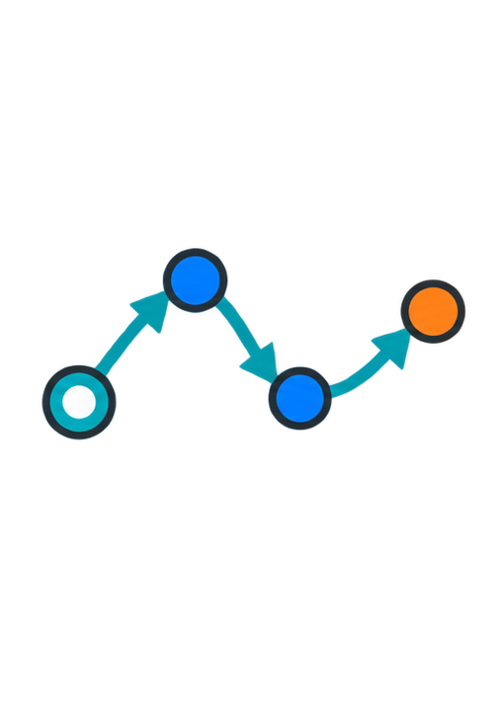
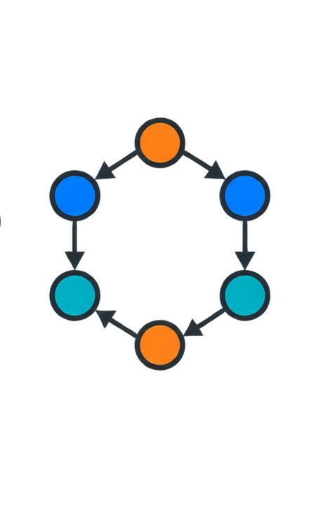




1
Rollout
2
Flow inputs
3
Constraints
4
Flow projection
5
Priced PPO
Rollout graph
λ = λ̄★ + β
F★ = projε(F̂; b, H)
···
λ = λ̄★ + β
F̂ → F★ | λ★
···
flow
cost
target F★
priced advantage
F̂ · A · Cₖ
Ã = Aᵣ − λ · A𝑐
PPO / TRPO
πₜ₊₁
Collect transitions
(sₜ, aₜ, rₜ, cₖ,ₜ, sₜ₊₁)
target flow is not executed
soft: bₖ = Bₖ/L
hard: F_H = 0
safety prices λ★

