Slide 1
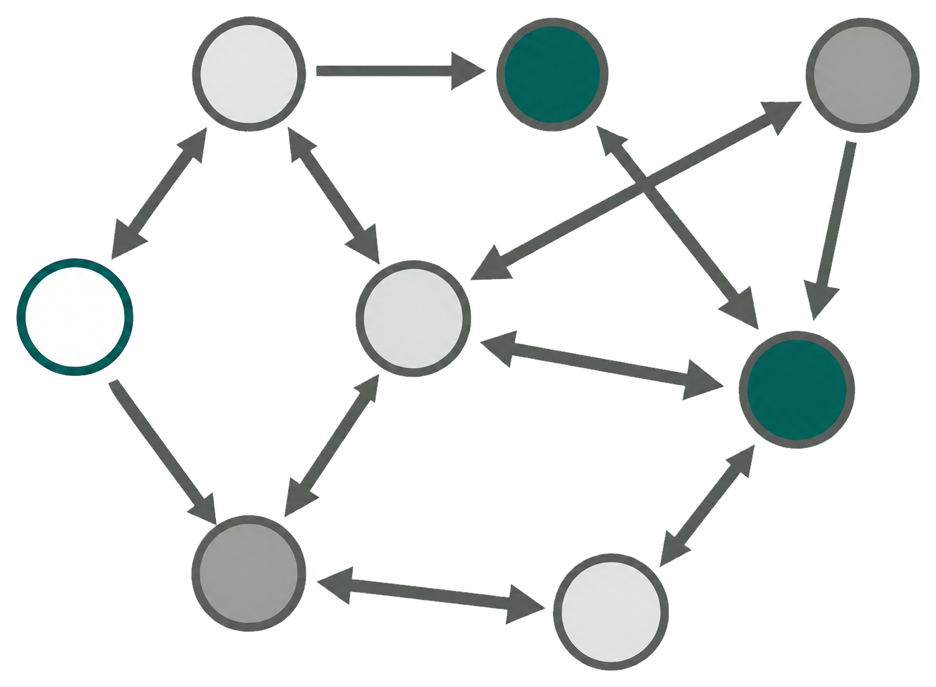
FLOW SPACE
budgets b_{k}
b_{k}, k = 1…K
2
Flow graph
3
Capacity compile
4
Compose
5
γ-Flow Sinkhorn
discretise
S
min ⟨D, F⟩ − ε H(F)
ε
D
S⁽¹⁾
hard min
(capacity
ω^{(k)}, c̄_{k}
S^{(1…K)}
(certificate)
ceiling)
F∗
F̂_{roll}
S⁽²⁾
⋮
softmin T_{c}
μ̂₀
S^{(K)}
row scaling
column scaling
S^{(k)} = b_{k} ω^{(k)} / c̄_{k}
0 ≤ F ≤ S
F 1 − γ F^{T} 1 = (1 − γ) μ₀
D, μ̂₀
transitions, rewards,
K costs
gates
F∗
POLICY SPACE
F̂_{roll}
1
Policy rollout
6
Flow-weighted PPO
7
Deployed-policy audit
π_{θ}
s₀
s₁
…
s_{T}
F∗
π_{θ}⁺
π_{θ}⁺
J_{ck} ≤ b_{k}
w_{t}
PPO clipped
budget b_{k}
clip
…
surrogate
π_{θ}⁺
F̂_{roll}
…
transfer Δ̂_{F}
gate
costs
…
F̂_{θ}, J_{ck}
α̂_{k} > 3 → (s,a)-flow
c₁
…
deployed
sampling (n, δ)
…
policy
persistent gap → recovery
c_{K}
w_{t} = clip(F∗ / F̂_{roll})
next rollout

