Slide 1
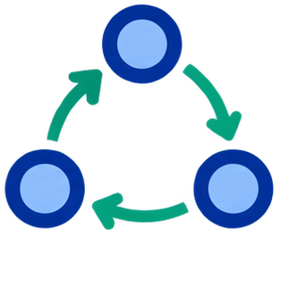
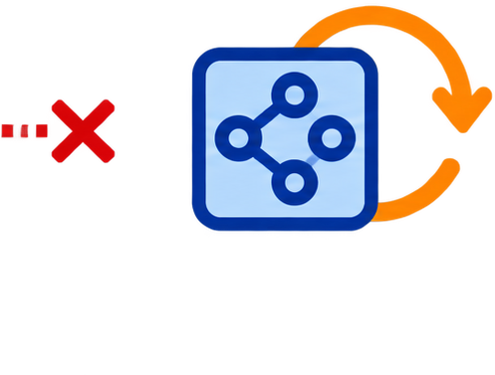
1
Build the graph
2
Project + price
3
Priced actor
rollout π_t
same transition graph, constrained once
GAE from rollout
observed F̂
target F★
reward Aᵣ · cost A_c
k-means · N nodes
target only · never executed
observed graph F̂
PPO / TRPO → πₜ₊₁
budget occupancy
+
F̂
A
C_k
k=1
λ̄★₁ > 0
J̄_k
k=2
λ̄★₂ = 0
clip + smooth
J̄_k − B_k → β_k
next rollout

