Slide 1

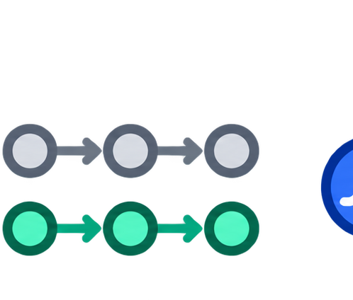
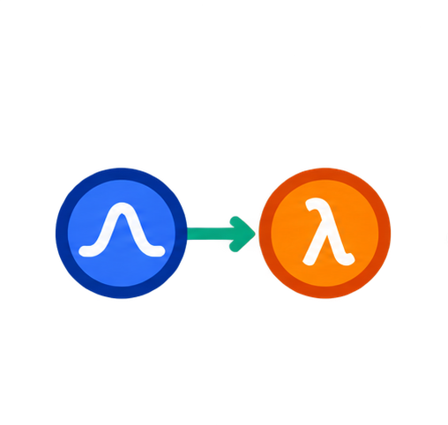
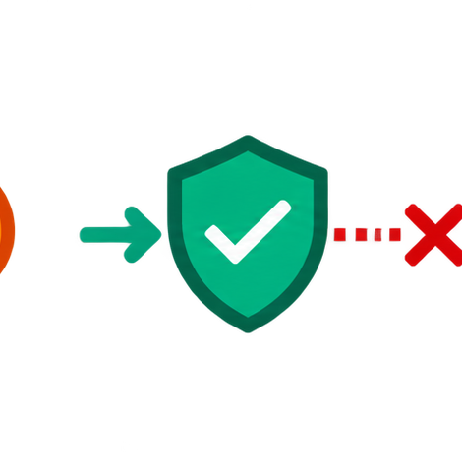




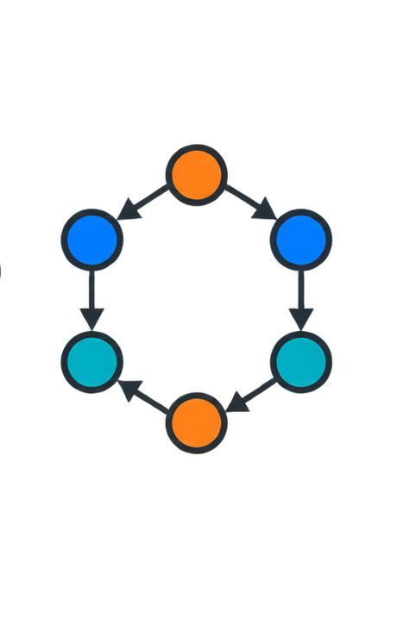
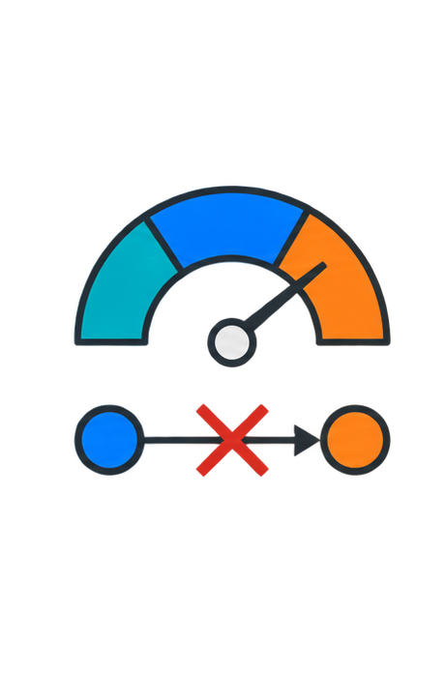
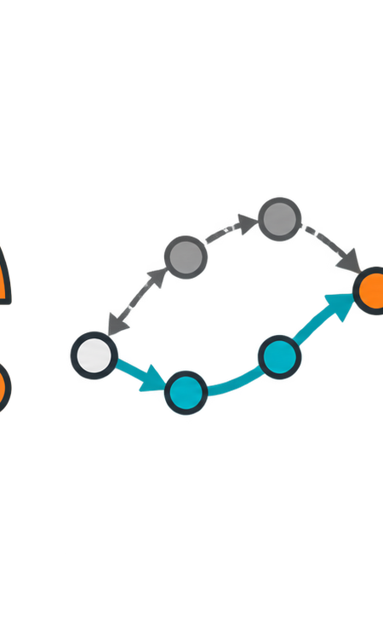

Penalty view
SafeOT
Constraint
one flow · all budgets
costs → objective
1. Constraints
2. One flow
3. Actor
(entropic)
C₁
C₁ · b₁
one flow
λ★ + β
→ actor
C₂
C₂ · b₂
leakage
λ₁
λ₂
λ₃
C₃
C₃ · b₃
b₁
b₂
b₃
⋮
F★
β
λ
episodes
H
F_H = 0
episodes
F★ → λ★
safety prices
weakness: fixed-price leakage
weakness: late / oscillation
fixed
Lagrangian
SafeOT
LP ε→0 / active
one price rule
penalty
constraints

