Slide 1
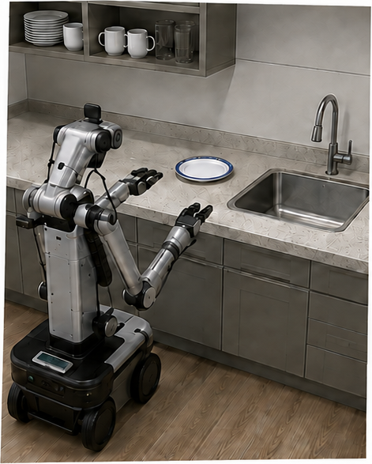
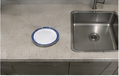
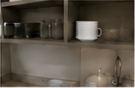


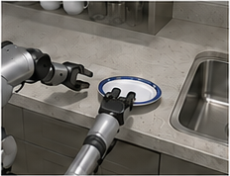
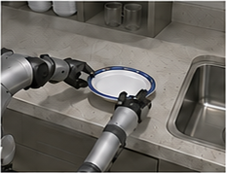
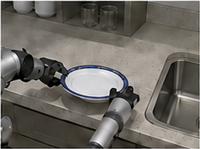
pi0.5 | From a task to continuous action
Task (language tokens)
Put away the dishes
Put
away
the
dishes
<eos>
...
(Task)
Observation
o
Images +
robot state
t
Predicted subtask
Camera views
VLA: subtask prediction
Pick up the plate
Same trained
model, two
inference modes
Context
VLA + action expert
Images (oₜ)
Flow matching
Action
trajectories
Continuous
action chunk
Noise
...
Robot state (qₜ)
a
⋯
a
t
t+H
Predicted subtask
(Pick up the plate)
Noise
Robot state
q
t
(joint positions)
1. Approach
2. Close (grasp rim)
3. Lift (clear of surface)
Inference schematic; independently illustrated scenes; training omitted.
Execution schematic
Notes:
Input is super_teaser-generated explanatory schematic, not an original paper figure. Exact photos, unsupported braces, joint glyph diagram and trajectory strokes remain raster. Text, primary boxes, arrows and convex encoder/decoder are editable. Source font identity unknown; Arial requested.

