Slide 1
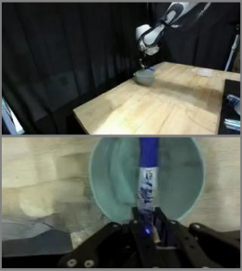
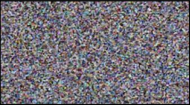
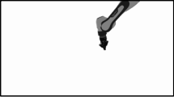
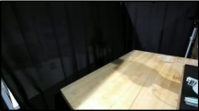
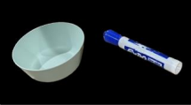
Trajectory
projector
Text
encoder
Put the marker
in the bowl
Robot trajectory
Cross attention
Task instruction
Rendering
Noisy frames
Concat &
MLP
Decoder
Diffusion
Transformer
Generated demonstration
Rendered motion
Encode
Scene prior
n views
MLP
Object prior
Notes:
Adapted from Junjie Ye et al., RoboDream: Compositional World Models for Scalable Robot Data Synthesis, arXiv:2606.02577v1, Figure 2 (2026-06-01). CC BY 4.0 https://creativecommons.org/licenses/by/4.0/. Changes: editable reconstruction from raster pixels/local OCR; Arial and Courier New approximate source typography; five independent artwork crops remain raster, token gradients approximate diagonal source blends.

