Slide 1
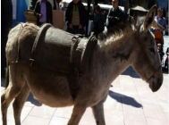
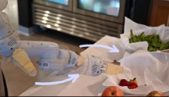
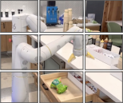
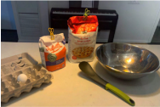
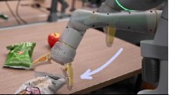
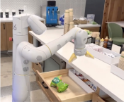
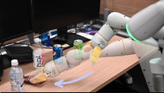
Internet-Scale VQA + Robot Action Data
Vision-Language-Action Models for Robot Control
Closed-Loop
Robot Control
Q: What is happening
in the image?
Q: What should the robot
RT-2
do to <task>? A: …
Large Language Model
A: 311 423 170 55 244
A grey donkey walks
down the street.
Put the strawberry
into the correct bowl
Q: Que puis-je faire avec
ces objets?
ViT
A: 3455 1144 189 25673
Faire cuire un gâteau.
T = [0.1, -0.2, 0]
A: 132 114 128 5 25 156
R = [10°, 25°, -7°]
Pick the nearly falling bag
Q: What should the robot
De-Tokenize
do to <task>?
Robot Action
A: 132 114 128 5 25 156
Translation = [0.1, -0.2, 0]
Rotation = [10°, 25°, -7°]
Co-Fine-Tune
Deploy
Pick object that is different
Notes:
Reconstructed from Zitkovich et al., RT-2, CoRL 2023, Figure 1, published PMLR PDF page 2. Seven local raster photo assets (including source motion annotations); all readable diagram labels and captions native.

