Slide 1
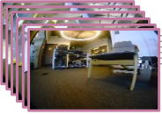
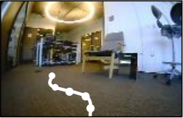
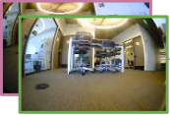
Observations
Past 5 timesteps
Positional Encoding
85x64x3 RGB
5M Parameters
x6
Temporal Distance
EfficientNet-B0
1-D, Continuous
ψ
Self-Attention
Self-Attention
512-D
5M Parameters
EfficientNet-B0
Transformer
ϕ
Normalized Actions
512-D
4 Layers, 4 Heads
Actions
Goal + Observation
7 Tokens
3x5-D, Continuous
21M Parameters
Early Fusion
x512-D
Notes:
Reconstructed from ViNT Figure 2, Shah et al., CoRL 2023, PMLR 229:711–733. Source pixels only. Three separate text-free photographic montage crops remain raster; all labels are editable. Positional-encoding internal curve is segmented native geometry. Stopwatch native primitives. Source font not uniquely identifiable; Arial substitute.

