Slide 1



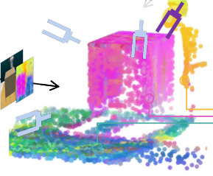
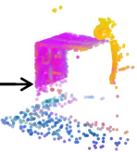

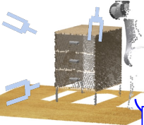
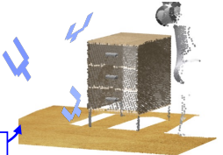
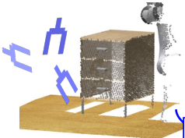
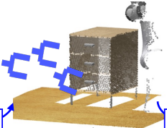
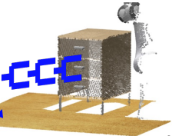
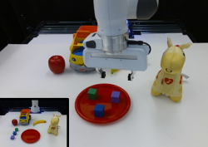
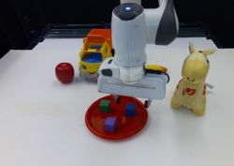
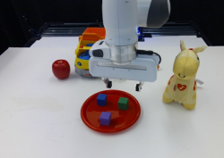
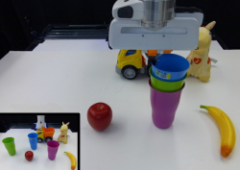
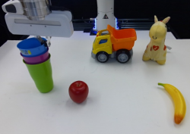
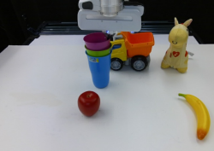


MLP
Proprioception
token
c
Denoising step
i
MLP
Noised trajectory
tokens
Denoising
Transformer
ϵ
loc
(
o
,
l
,
c
,
τ
i
,
i
)
MLP
θ
i
ϵ
rot
(
o
,
l
,
c
,
τ
i
,
i
)
Depth map
MLP
τ
θ
Image
Encoder
3D
scene
tokens
...
Language tokens
o
l
Image
Language
Encoder
2D to 3D unprojection
Multi-view aggregation
“Open the drawer”
(a) 3D Diffuser Actor model architecture
...
ϵ
loc
,
ϵ
rot
ϵ
loc
,
ϵ
rot
ϵ
loc
,
ϵ
rot
τ
N
∼
N
(
0
,
1
)
θ
θ
τ
N−1
τ
2
θ
θ
τ
1
θ
θ
Trajectory prediction
τ
0
(b) Denoising process
“Put the blocks in a triangle on the plate”
“Stack the cups”
(c) Real-world multi-task manipulation tasks
Notes:
Figure 1, complete panels a–c. Ke, Gkanatsios & Fragkiadaki, 3D Diffuser Actor, CoRL 2024 / PMLR 270 (2025). Image-only reconstruction from official PDF page4 rendered at 4x. Native labels, modules, tokens and connectors; local text-free photographs and point-cloud artwork retained as movable raster crops. Main multiview pointcloud crop contains three short colored arrow tails fused into its artwork. Source typography approximated with locally available Arial, Times New Roman and Courier New. All three panels preserved. Raster artwork comprises 19 local text-free crops; small camera rays, pointcloud gripper poses and three multiview arrow tails remain fused in those crops. Long denoising arrow uses a solid color instead of the source gradient; source module shadows are omitted. Copyright remains with Ke, Gkanatsios and Fragkiadaki; explicit reuse license was not located on the inspected PDF/article.

