Slide 1

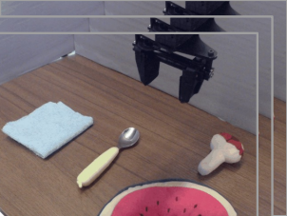

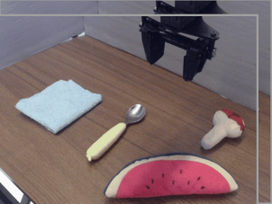
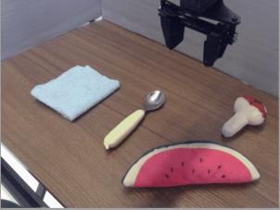
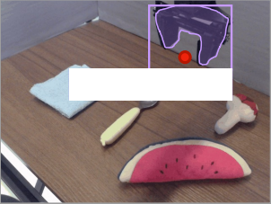
Robot Trajectory from Dataset
1. Describe scene
3. Compute motion primitives
5. Generate plans + subtasks
Task Instruction
Prismatic-VLM
Proprio → Primitives
Gemini LLM
Put the watermelon on the towel
Please describe the scene.
Explain the plan, subtask, and
movement for each step, given:
Proprio 1: [Δx, Δθ, ΔGrip]
State Info
Task
Desc.
Moves
This scene has a watermelon,
spoon, towel, and mushroom.
{right, down, down, ...}
Proprio 1: [Δx, Δθ, ΔGrip]
Plan: Go to watermelon, grasp, go
to towel, release
2. Extract bounding boxes
4. Compute gripper position
Subtasks:
Observations
1. The robot needs to grasp the
Grounding DINO
OWL + SAM
watermelon, so first must move to it
2. The robot is at the watermelon, so
it can now grasp it
3. ...
Moves:
black robotic arm
1. The watermelon is right of the
robot, so it must move <right>
2. The watermelon is below the
robot, so it must move <down>
3. ...
Notes:
Adapted from Zawalski et al. (2025), PMLR 270:3157–3181, Figure 4. https://proceedings.mlr.press/v270/zawalski25a.html CC BY 4.0. Raster-based native reconstruction; photos and logos retained as local raster assets.

