Slide 1
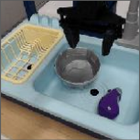
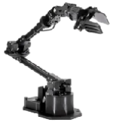
OpenVLA
Action De-Tokenizer
Δ
x
Δ
θ
3
Llama 2 7B
Δ
Grip
7D Robot
Input Image
Action
2
MLP Projector
Llama Tokenizer
“Put eggplant
DinoV2
SigLIP
in bowl”
1
Language Instruction
“What should the robot do to {task}? A:”
Notes:
Reconstruction of Figure 2, OpenVLA, PMLR270 (2025). Full architecture figure; two photo-only crops; all diagram labels editable. See ATTRIBUTION.md.

