Slide 1
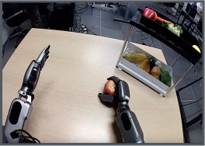

Vision
Encoder
Embodiment-Specific Module
Eagle-2
VLM
Pre-trained and Frozen
“Pick up the apple
and place it into
the bottom shelf”
Text
Tokenizer
Robot State
q
State
Encoder
t
a
t
a
a
t
+1
t
Cross-Attention
Action
Decoder
Self-Attention
Cross-Attention
a
t
+1
Self-Attention
Action
Encoder
⋮
Noised Action
⋮
a
t
+
H
−1
Motor
Action
a
t
+
H
−1
x N
DiT Blocks
K iterations
Notes:
Adapted from GR00T N1, NVIDIA et al., arXiv:2503.14734v2, Figure 3 page 4, 27 March 2025. Paper CC BY 4.0 https://creativecommons.org/licenses/by/4.0/. Native reconstruction from raster; two photographic/robot-art crops remain raster. No endorsement implied.

