Slide 1
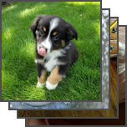
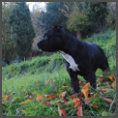
(1) Contrastive pre-training
(2) Create dataset classifier from label text
plane
car
Pepper the
aussie pup
Text
A photo of
Text
Encoder
dog
a
{object}
.
Encoder
T
1
T
2
T
3
T
N
bird
I
1
I
1
T
1
I
1
T
2
I
1
T
3
I
1
T
N
(3) Use for zero-shot prediction
I
2
I
2
T
1
I
2
T
2
I
2
T
3
I
2
T
N
T
1
T
2
T
3
T
N
Image
I
I
T
I
T
I
T
I
T
Encoder
3
3
1
3
2
3
3
3
N
Image
I
I
T
I
T
I
T
I
T
Encoder
1
1
1
1
2
1
3
1
N
I
I
T
I
T
I
T
I
T
A photo of
N
N
1
N
2
N
3
N
N
a
dog
.

