Slide 1
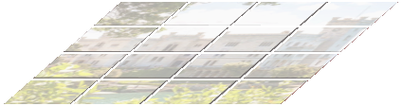
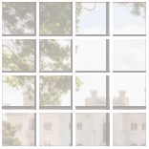
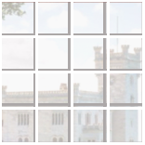






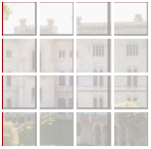



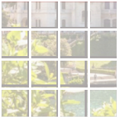




segmentation
z
l
z
l+1
classification
detection …
Layer l
Layer l+1
MLP
MLP
16×
LN
LN
A local window to
z
l
z
l+1
8×
perform self-attention
W-MSA
SW-MSA
A patch
LN
LN
4×
z
l−1
z
l
(a) Swin Transformer
(b) Shifted Window
(c) Two Successive Swin Transformer Blocks
H
×
W
×
48
H
×
W
×
C
H
×
W
×
2
C
H
×
W
×
8
C
4
4
4
4
8
8
32
32
Stage 1
Stage 2
Stage 3
Stage 4
H×W×3
Swin
Swin
Swin
Swin
Linear Embedding
Patch Merging
Patch Merging
Patch Merging
Images
Patch Partition
Transformer
Transformer
Transformer
Transformer
Block
Block
Block
Block
×2
×2
×6
×2
(d) Architecture

