Slide 1

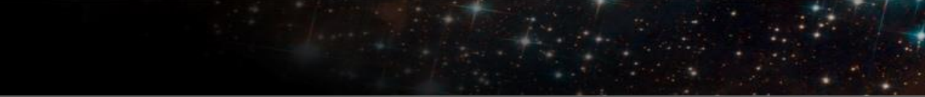
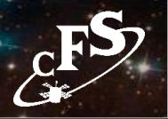
Project Centric Reuse
“Clone & Own” - Used similar heritage missions as starting
point
Changes made to the heritage software for the new mission
were not systematically managed
-
New flight hardware and/or operating system required changes
throughout FSW
-
Small FSW requirement changes could have significant testing
impacts
-
FSW changes were made at the discretion of developer
FSW test procedure changes were made at the discretion of the
tester
Extensive documentation changes were made for style
-
Not all artifacts from heritage missions were available
Inconsistent and minimal flight software (FSW) reuse cost
savings
6
Notes:
Source: David McComas / NASA GSFC, NTRS 20180007319. Reconstructed from the rendered page image and OCR; source speaker notes were not supplied. Logos remain independent raster images.

