Slide 1

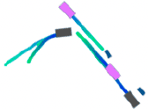
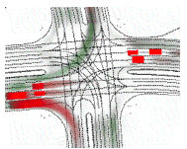
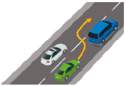




Ego-vehicle Query
B
BEV Feature
Agent-level
K, V
Feature
Track Q
B
K, V
Motion
Former
B
OccFormer
Planner
K, V
Map Q
Multi-view
Vision-only Input
Bird’s eye view
Feature
K, V
Occ Q
Scene-level
Feature
Motion Q
B
B
Backbone
Perception
Prediction
Planning

